Slide 1
Sequential Data &
Multi data-type Embedding
Email : sisung.kim1@gmail.com
GitHub : https://github.com/crimson206

Slide 2
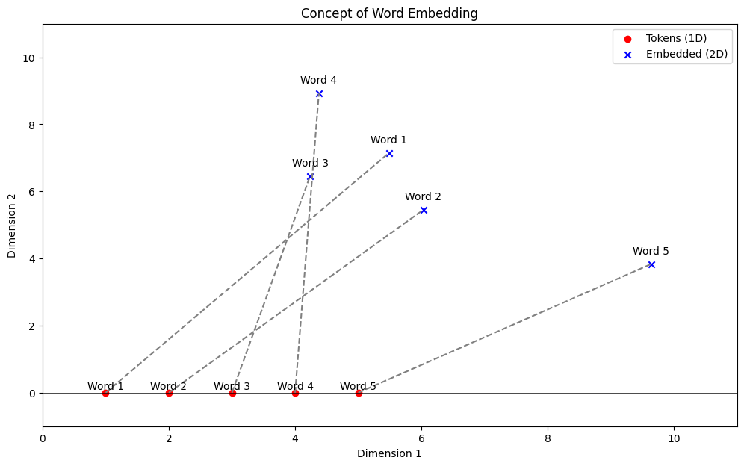
Embedding Background
Embeddings typically convert categorical data into vectors.
While raw data could be discrete numbers or categories, embeddings allow these discrete values to be represented in a continuous vector space.
In a one-dimensional space, each point is linearly separable; however, when embedded, these points can acquire a position in a multidimensional space.

Slide 3
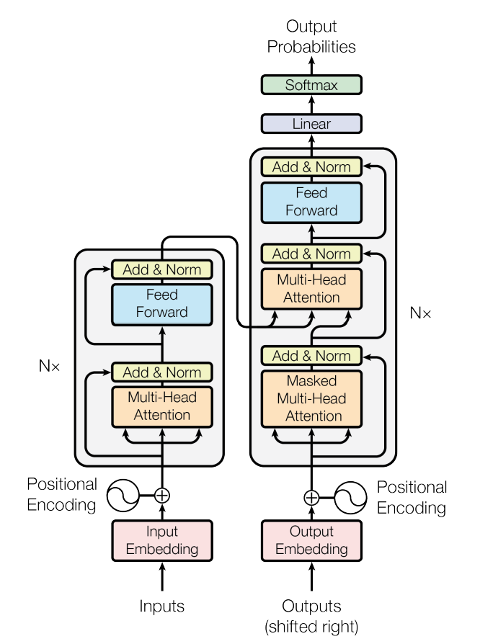
Sequential data & Transformer
In conversation, the meaning of each word is significantly influenced by its order within the sentence.
Such sequence-dependent data is often handled by one of the deep learning models, known as Transformers.
Transformers convert categorical words into expanded numerical sequences and interpret them.
The data we interpret doesn't necessarily have to be textual.
We will extend this issue into various dimensions.
"This image illustrates the Transformer architecture, as originally presented in the 'Attention is All You Need' paper”

Slide 4
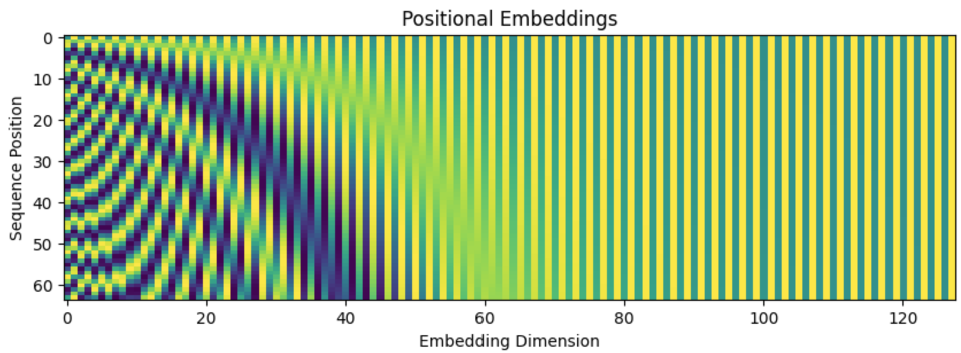
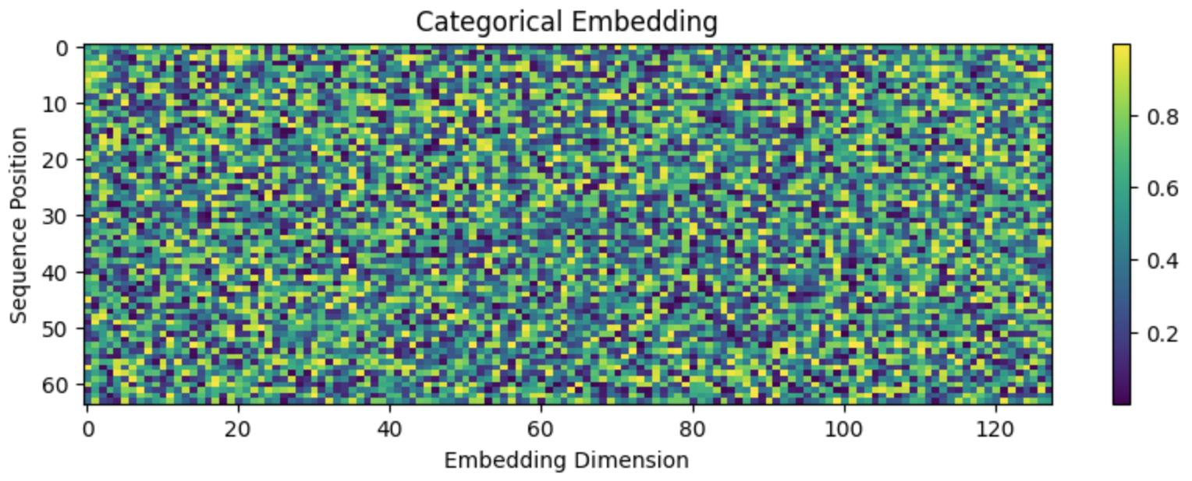
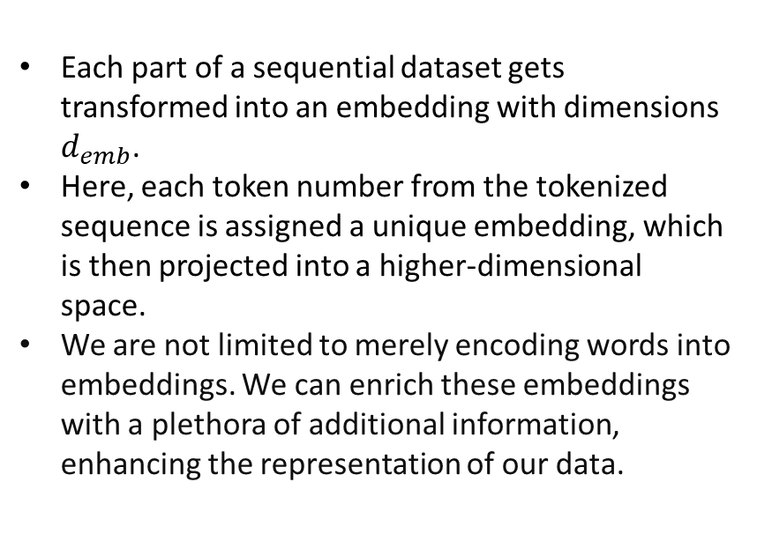
Embedding Dimension
Each part of a sequential dataset gets transformed into an embedding with dimensions $d_{emb}$​.
Here, each token number from the tokenized sequence is assigned a unique embedding, which is then projected into a higher-dimensional space.
We are not limited to merely encoding words into embeddings. We can enrich these embeddings with a plethora of additional information, enhancing the representation of our data.
The combined visualization highlights the rich structure that embeddings can provide to machine learning models, especially in handling sequential data.

Slide 5
Multi Data Embedding
Various types of data can be embedded into a higher dimensional space for more complex representations.
Even float type data can be embedded, allowing for a more nuanced interpretation of the data.
For instance, temperature readings can be embedded into a sinusoidal pattern.
In this way, embeddings can encompass not just textual data but various patterns and numerical data.
Multi-dimensional embeddings can significantly enrich the data representation.
Position1 | Position1
+
Category1 | Category2 | Continuous1 | Pattern1
=
Multi Embedding

Slide 6
Multi Embedding Example
The importance of predicting failures in the production line in advance based on large amounts of data collected.
We can predict the occurrence of future problems by analyzing various data obtained daily from the production line.
Categorical data: factory_id, product_id, production machine
Continuous: defect rate, temperature, humidity Position: time in a sequence, time after last maintenance
The link for the code example is in the next page.
future
make plan
defect rate
day
category1
+
category2
position1
position2
continuous1
n_data
d_emb

Slide 7
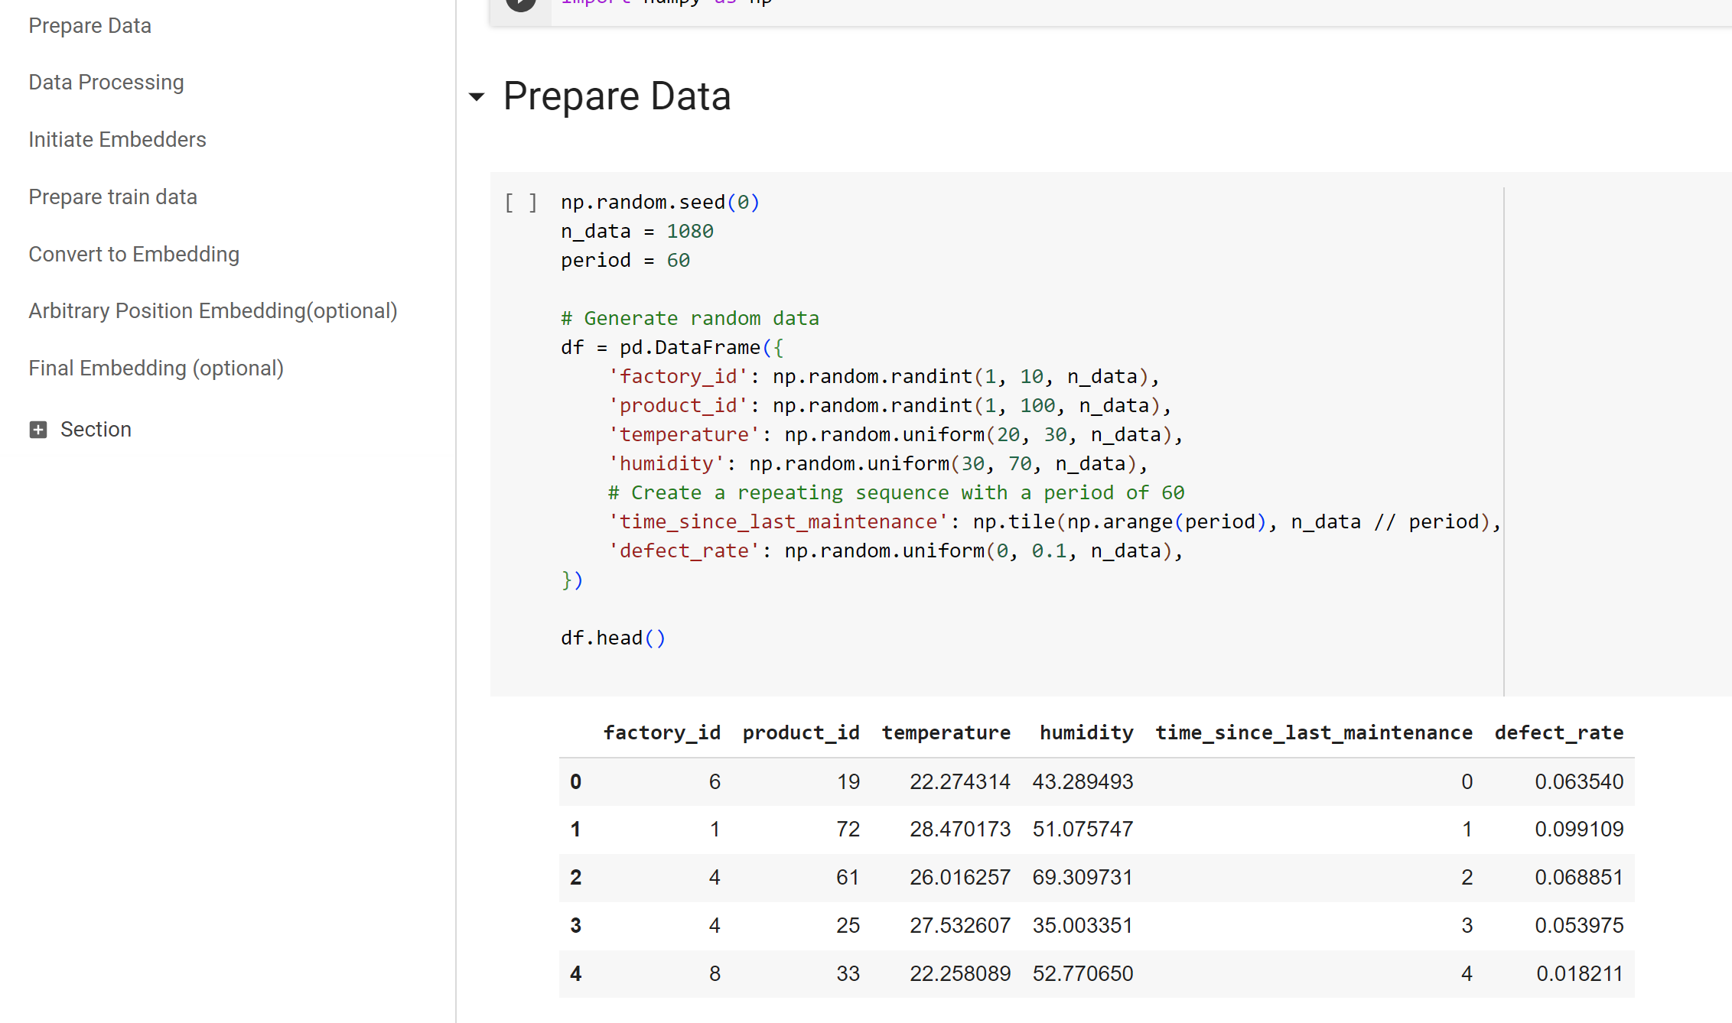
Example
Example Code :
https://colab.research.google.com/drive/13xU-P4F9-k7v_ILXtvfQ0vAPBvspFpDU?usp=sharing
The code includes only the multi embedding part, but not training model.

Slide 8
Thank you
For technical and collaboration inquiries: sisung.kim1@gmail.com More codes: https://github.com/crimson206

