Slide 1
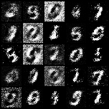
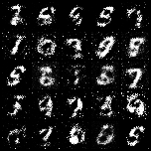
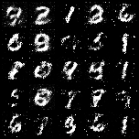
Experiment1
[128, 256, 512]
[784, 256]
[128, 256, 512, 1024]
[784, 512, 256]
[128, 256, 512, 1024, 2048]
[784, 1024, 512, 256]
Generator Hidden Features
Discriminator Hidden Features

Slide 2
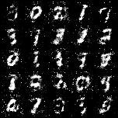
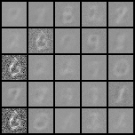
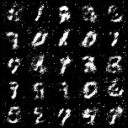
Experiment2
Tanh
for Image output
No Activation
for Image output
BCELoss
for classification
CrossEntropyLoss
for classification

Slide 3
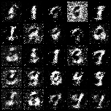
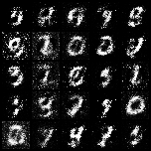
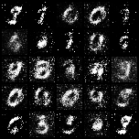
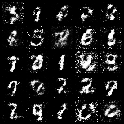
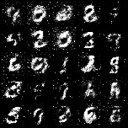
Experiment3
Latent dimension:
64
128
256
Epoch 0.5
Epoch 1.5

