Slide 1
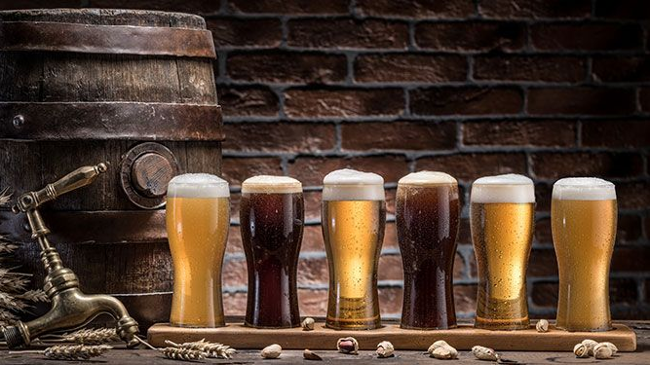
Capstone Project - The Battle of Neighborhoods
Where to open a brew-pub with craft beer in Milan?

Slide 2
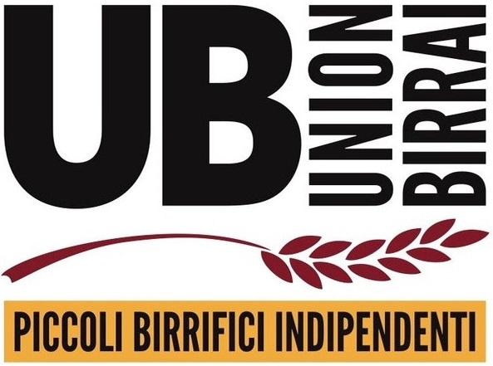
Capstone Project - The Battle of Neighborhoods
Craft beer is an industry that is growing incredibly fast in Italy, especially with the group ‘UnionBirrai’ (‘UnionBrewers’)

Slide 3

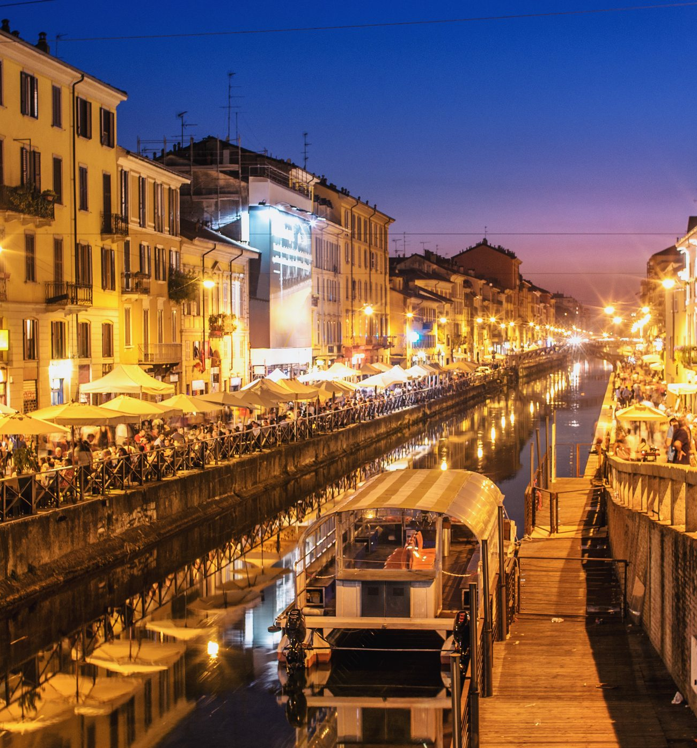
Capstone Project - The Battle of Neighborhoods
What about a city like Milan?
Can be the craft beer imported in a city this big exceeding the industrial beers market?

Slide 4
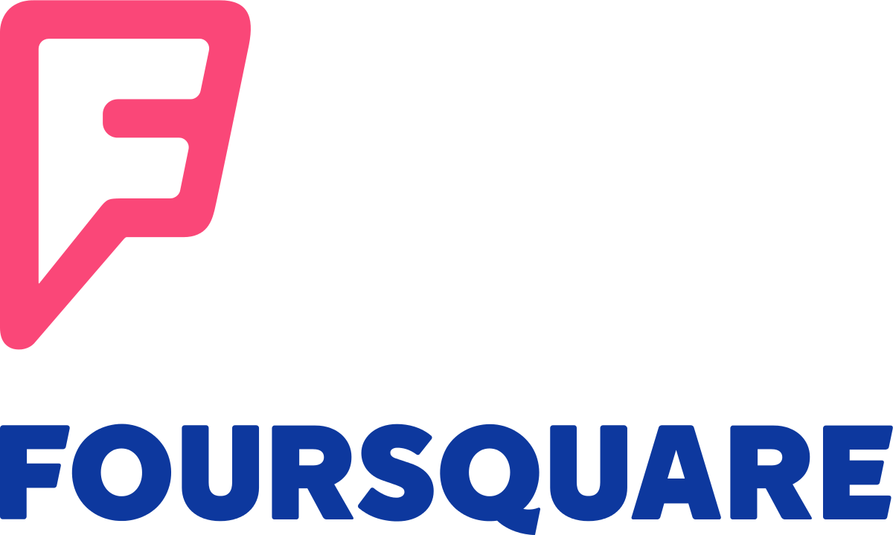
Capstone Project - The Battle of Neighborhoods
Data:
Data were obtained with the function ‘search’ on Foursquare. This function was applicated 3 times to find:
Pubs
Bars
Theatres, cinemas ecc…

Slide 5
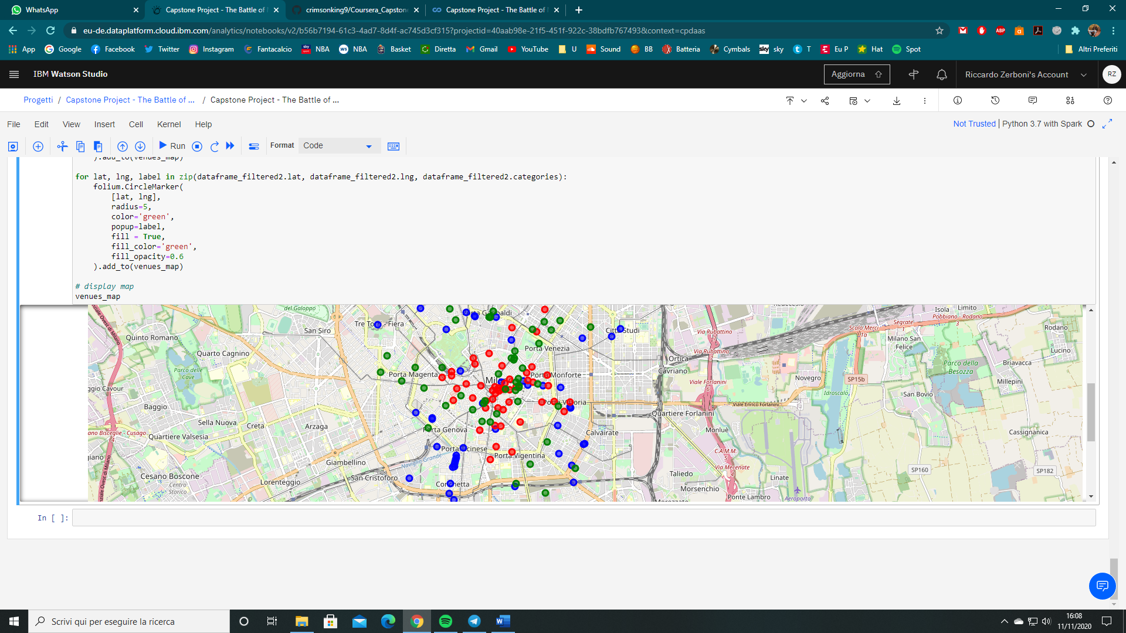
Capstone Project - The Battle of Neighborhoods
Blue = Pubs
Red = Bars
Green = Theatres, cinemas ecc…
Here’s the rappresentation with folium on Python after the data elaboration

Slide 6
Capstone Project - The Battle of Neighborhoods
Where to open?
Porta Magenta, Porta Venezia or Porta Vigentina districts
But also:
Porta Garibaldi, Città Studi and the South-West part of the city centre
And:
Tre torri

