Slide 1
Smart Map
The Future of Parking
Presented by Synergistic Parking Solutions

Slide 2
Introduction to Synergistic Parking Solutions
Oliver Hanna
Tristan Wagar
Connor Fitzgerald
Three ordinary CS students who came together with a shared passion for parking.

Slide 3
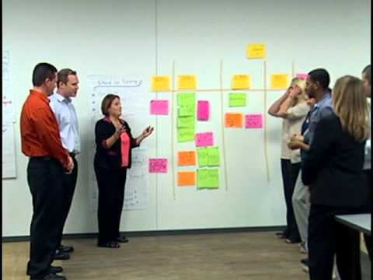

Methodologies
Agile
High Energy
Fast Paced
Simple
Pair Programming
Peer Code Review

Slide 5










Tools Used
jQuery 5/5 would use again
Bootstrap 4.5 / 5
PostgreSQL 2/5
GitHub 3/5
Trello 2.5/5
Google Maps API 5/5
AWS (Briefly) 3/5
Heroku 1/5
NodeJS 5/5
Express 4.5/5
Supervisor 5/5

Slide 6
Challenges
Small team size
Learning the tools
SuperMerge Conflict
This was no ordinary merge conflict, one of magnitude we have never experienced prior
Deployment to Heroku
AWS Customer Support
Getting the Parking Data

Slide 7
Demo

