Slide 1

Auditing the Effectiveness of Merchant Services
Data Analyst : Christian Rios-Chambi

Slide 2
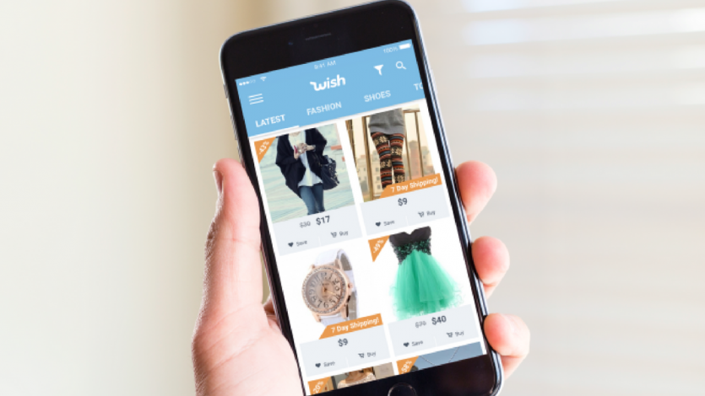
Company Background
Wish is a mobile e-commerce platform that connects hundreds of millions of consumers with the widest selection of products delivered directly to their doors. Our mission is to provide everyone access to the most affordable and convenient shopping experience on the planet.

Slide 3
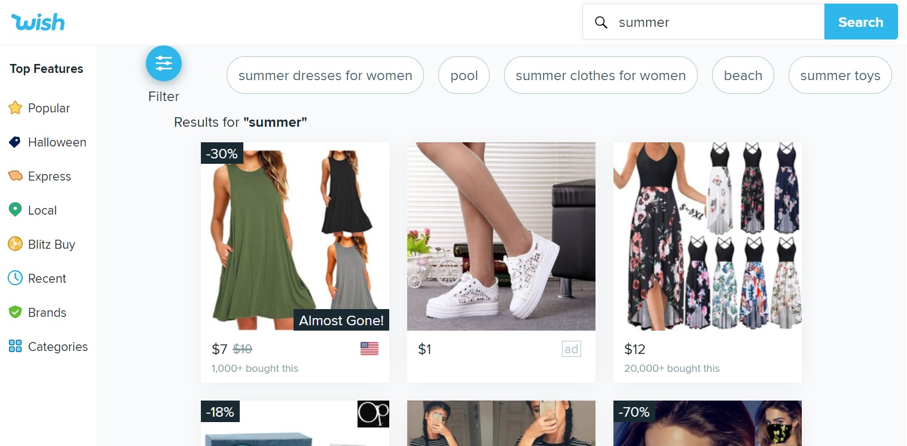
The Dataset
The data comes from the Wish platform (French localization)
Basically, the products listed in the dataset are those that would appear if you type "summer" in the search field of the platform.

Slide 4
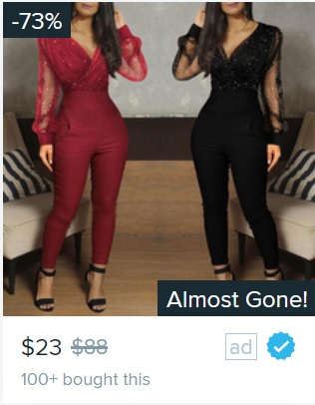
Defining the Problem
Discount %
Is Wish providing merchants with effective product services to increase revenue ?
Ad Boosts, Product badges,
Urgency text, Tag count.
Urgency Text
Price
Product Quality Badge
Units Sold

Slide 5
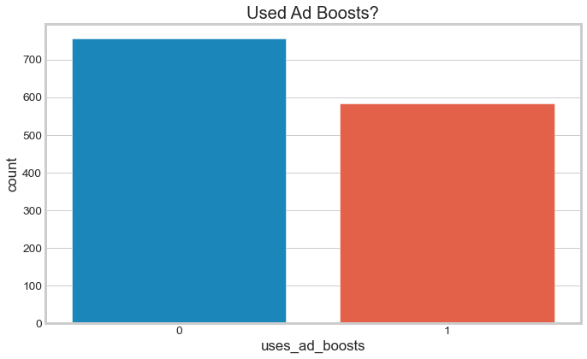
Ad Boosts
Ad Boost is Wish's native advertising tool for merchants.
Boosted products move higher up within the product rankings for the keywords associated with them. The products will show up on the Wish app and website, in search results, the related tab, and more.

Slide 6
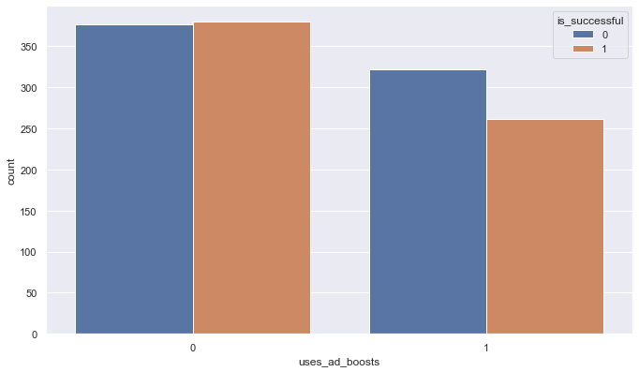

Slide 7
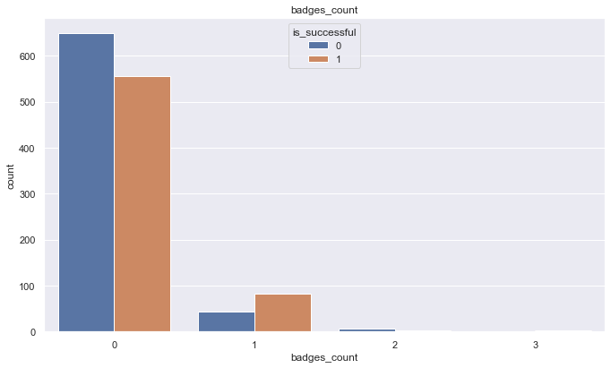
Badges

Slide 8
