Slide 1
Chapter 2 – Assessing individual factors determining drought vulnerability
Cristopher Fernández de Blas – 03/09/2025 IB-ForRes Project

Slide 2
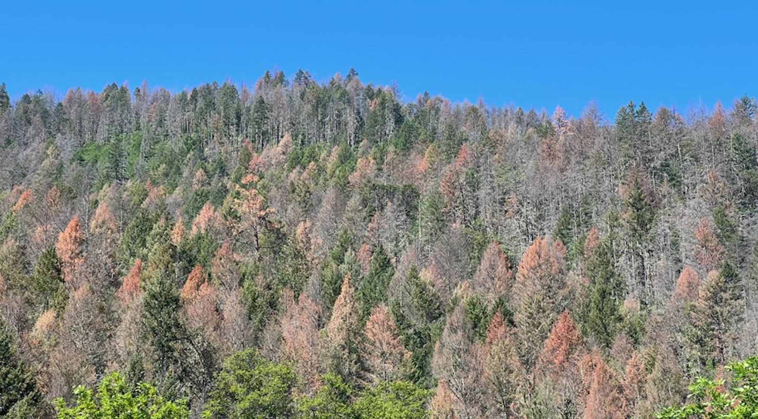
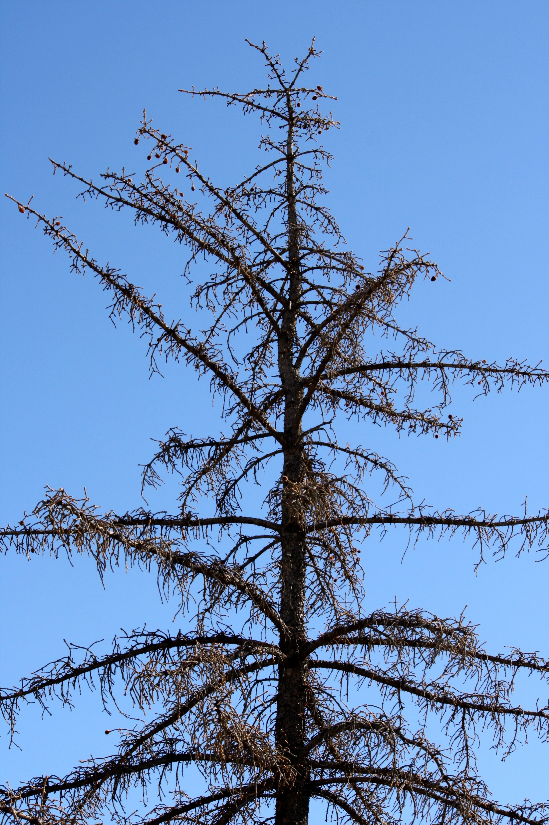
Drought-induced tree mortality
Introduction.
It is hard to forecast drought-induced die-back events
Individual level
Early-warning signals?

Slide 3





Responses to drought
Introduction.
Morphological
Tree size
SLA
Leaf C, N, C:N
Physiological
Pigments (photosynthesis)
Isotopes
Water status (LWC)
Tree decline
Whole-tree
Growth
Resilience

Slide 4
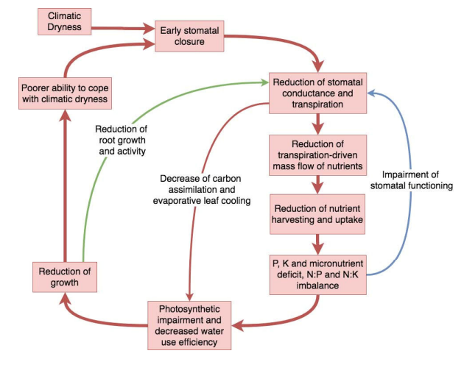
Responses to drought
Introduction.
Morphological
Bigger trees more vulnerable
↓SLA
↑Leaf C, C:N
↓ Leaf N
Physiological
↓ Water
↑ d13C, d18O
↓Pigments
↓LWC
Whole-tree
↓ BAI
Rt and Rs species dependent
Salazar-Tortosa et al., 2018

Slide 5
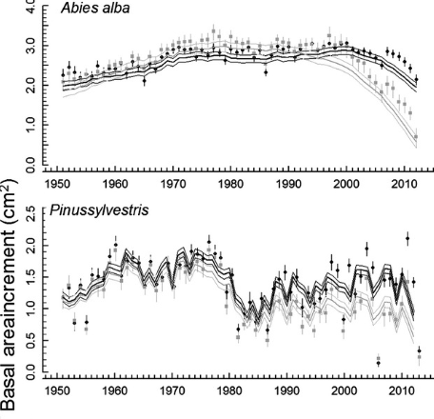
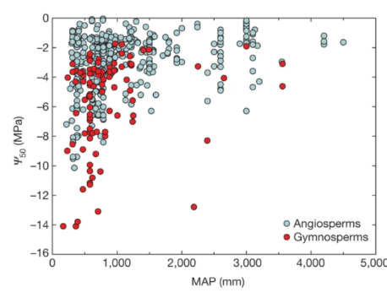
Responses to drought
Introduction.
Single-response trait approaches
Strategies to drought?
Choat et al., 2012
Camarero et al., 2015

Slide 6
Resource-use strategies
Introduction.
Multi-traits approaches
Leaf Economics Spectrum
Conservative
Acquisitive
↓ N content
↓ Photosynthesis
↓ Growth rates
↓ SLA
↑ N content
↑ Photosynthesis
↑ Growth rates
↑ SLA
Wright et al., 2004

Slide 7
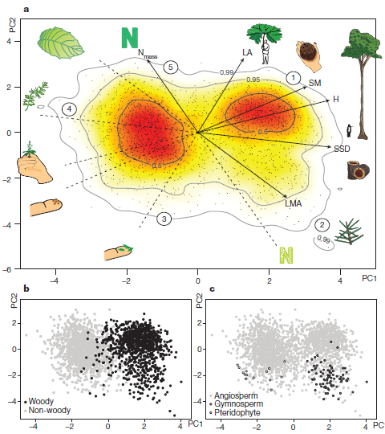
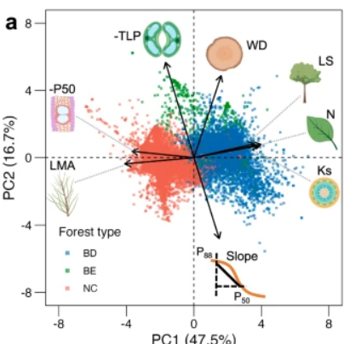
Resource-use strategies
Introduction.
Multi-traits approaches
Díaz et al., 2015
Liu et al., 2024
Notes:
Aquí la idea sería resaltar que existen otros ejes de variabilidad de traits que no queda recogida por el Leaf Economics Spectrum

Slide 8
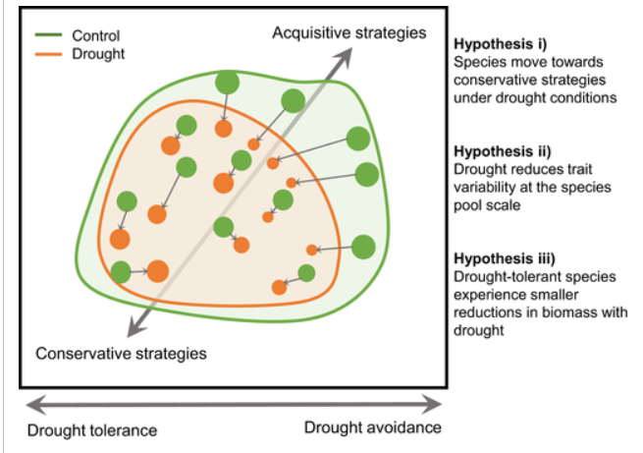
Resource-use strategies
Introduction.
Towards a more conservative strategy?
Rodríguez-Alarcón et al., 2022

Slide 9
Gap in knowledge
Introduction.
Single traits are unable to disentangle plant strategies to drought
Species-specific responses → forecast?
Lack of multi-traits studies
Lack of comparisons declining vs. Non-declining trees

Slide 10
Objectives
Introduction.
Main objective: to assess the morphological, physiological and whole-tree responses to drought-induced die-off.
To characterise tree morphological, physiological and whole-plant responses to drought at plot and individual level
To assess what responses are more sensitive to drought
To assess the effect of drought over trait coordination

Slide 11
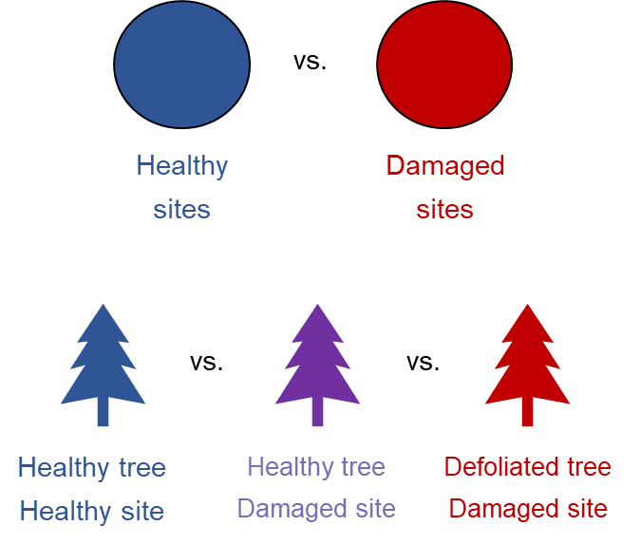






Objectives & Hypotheses
.
Obj. 1.- To characterise tree morphological, physiological and whole-plant responses to drought at plot and individual level
H1.- We expect higher height values, d13C, and lower SLA, N content, pigments concentration, growth rates and resilience in drought-affected sites and individuals
vs.
vs.
vs.
vs.
Non-declining
Declining
Abies alba Temperate
Pinus sylvestris Temperate
Pinus pinea Mediterranean
Healthy tree
Non-declining site
Healthy tree
Declining site
Damaged tree
Declining site
Boxplots + significant differences

Slide 12
Objectives & Hypotheses
.
Obj. 2.- To assess what responses are more sensitive to drought
H2.- We expect a higher change in physiological and whole-tree response traits than morphological traits
vs.
vs.
vs.
vs.
Non-declining
Declining
Abies alba Temperate
Pinus sylvestris Temperate
Pinus pinea Mediterranean
Healthy tree
Non-declining site
Healthy tree
Declining site
Damaged tree
Declining site
Response Ratios

Slide 13
Objectives & Hypotheses
.
Obj. 3.- To assess the effect of drought over trait coordination
H3.- We expect a shift towards more conservative strategies in drought-affected sites and individuals.
vs.
vs.
vs.
vs.
Non-declining
Declining
Abies alba Temperate
Pinus sylvestris Temperate
Pinus pinea Mediterranean
Healthy tree
Non-declining site
Healthy tree
Declining site
Damaged tree
Declining site
PCA

Slide 14
Study area
M&M .
Fig. 1.: Study sites in Iberia. Coloured areas represent the distribution area of each species.
Field data sampling:
02/2023 – 09/2023
14 sites, 91 plots
462 target trees
Fig. 1

Slide 15
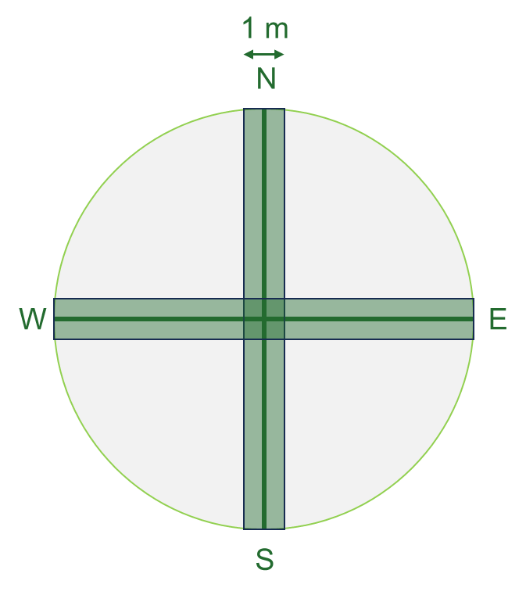

Sampling design
M&M .
34 m
1.- Mature trees inventory
Species identity, defoliation & d.b.h.
2.- Regeneration inventory
Species identity & height
3.- Shrub inventory
Species identity, height & cover
4.- Target trees
Height
LWC
SLA
Photosynthetic pigments
Isotopes (C, N, O)
5.- Soil data
Non-declining
Declining
vs.
vs.
Healthy tree
Non-declining site
Healthy tree
Declining site
Damaged tree
Declining site

Slide 16
Sampling design
M&M .
Defoliation threshold: 25%
Gottardini et al., 2020
Declining
vs.
Healthy tree
Declining site
Damaged tree
Declining site

Slide 17
Sampling design
M&M .
Morphological
Tree size → height, dbh
Leaf traits → leaf area
Physiological
Photosynthesis → Chl, carotenoids, chl a/b, chl / xc
Water relations → water content
Leaf nutrients → C & N content
Leaf isotopes → isotopes (C, O, N)
Whole-tree
Tree growth → BAI since 1980 and of the last 5 years
Resistance → 2012, 2017, 2022
Resilience → 2012, 2017
23 plots
51 plots
17 plots
5 targets x 91 plots
Abies alba
Pinus sylvestris
Pinus pinea
462 target trees

Slide 18
Preliminary results
Obj. 1.- To characterise tree morphological, physiological and whole-plant responses to drought at plot and individual level
Non-declining
Declining
Tall trees less affected by drought
Higher C content in declining sites for Pinus sylvestris
Age → Older trees were more susceptible
Higher competition in declining sites

Slide 19
Preliminary results
Obj. 1.- To characterise tree morphological, physiological and whole-plant responses to drought at plot and individual level
Non-declining
Declining
Lower LWC in declining tha non-declining sites
Lowe pigments content in declining sites
Increased d13C in declining sites
More intense responses in temperate (Abies alba > Pinus sylvestris than Mediterranean (P. pinea) species

Slide 20
Preliminary results
Obj. 1.- To characterise tree morphological, physiological and whole-plant responses to drought at plot and individual level
Non-declining
Declining
Lower growth rates in declining tan non-declining sites
Only significant differences in Rt 2012 in P. sylvestris
Growth decreased with increasing defoliation

Slide 21
Preliminary results
Obj. 1.- To characterise tree morphological, physiological and whole-plant responses to drought at plot and individual level
vs.
Healthy tree
Declining site
Damaged tree
Declining site
Tall trees less affected by drought
Age → Older trees were more susceptible
Higher competition in declining sites, but not significant

Slide 22
Preliminary results
Obj. 1.- To characterise tree morphological, physiological and whole-plant responses to drought at plot and individual level
vs.
Healthy tree
Declining site
Damaged tree
Declining site
Lower LWC in declining tha non-declining sites
Lowe pigments content in declining sites
Increased d13C in declining sites
More intense responses in temperate (Abies alba > Pinus sylvestris than Mediterranean (P. pinea) species

Slide 23
Preliminary results
Obj. 1.- To characterise tree morphological, physiological and whole-plant responses to drought at plot and individual level
vs.
Healthy tree
Declining site
Damaged tree
Declining site
Lower growth rates in declining tan non-declining sites
Lower Rs12
Growth decreased with increasing defoliation

Slide 24
Preliminary results
Obj. 2.- To assess what responses are more sensitive to drought
Non-declining
Declining
LogRR = log(X_{coldspot} / X_{hotspot})
Morphological: tree size > leaf traits
Physiological: low inter and intraspecific variability, pigments > isotopes
Whole-tree: highest variability, growth reductions prominent in temperate species
Temperate species had higher RR than Mediterranean species, particularly Pinus sylvestris

Slide 25
Preliminary results
Obj. 2.- To assess what responses are more sensitive to drought
vs.
Healthy tree
Declining site
Damaged tree
Declining site
LogRR = log(X_{damaged} / X_{healthy})
Morphological: leaf traits > tree size
Physiological: low inter and intraspecific variability, pigments > isotopes
Whole-tree: highest variability, growth reductions prominent in Pinus sylvestris
Lower interspecific differences

Slide 26
Preliminary results
Obj. 3.- To assess the effect of drought over trait coordination
Very high orthogonality

Slide 27
Preliminary results
Variable selection based on bibliography
Obj. 3.- To assess the effect of drought over trait coordination
Conservative
Stomatal closure, low growth
High growth & photosynthesis
Acquistive
Acquistive
Axis 1: trade-off growth & chl. – d13C → growth vs. Stomatal conductance
Axis 2: conservative – acquisitive axis

Slide 28
Preliminary results
Obj. 3.- To assess the effect of drought over trait coordination
Supplementary: A. Only coldspots, B-C. Only hotspots

Slide 29
Preliminary results
Obj. 3.- To assess the effect of drought over trait coordination
Supplementary: A. Only coldspots, B-C. Only hotspots

Slide 30
Conclussions
Declining sites had higher tree size, competition, d13C, and lower pigments concentration, growth rates and resilience
Species-specific responses → more intense in temperate species
Whole-tree responses showed the highest variability
Drought-induced conservative strategies → species-dependent

Slide 31
What is next…
January – May → data analysis
Since April → framework
Manuscript → mid October

Slide 32
What is next…
January – May → data analysis
Since April → framework
Manuscript → mid October
Finishing current framework→ late September
Finishing/correcting our analyses → early October
Manuscript → mid October
We want to show you our final results in October!
And please, feel free to participate in anything you want to

Slide 33
Thanks for your attention ☺

