Slide 1
Variable selection
Chapter 2

Slide 2



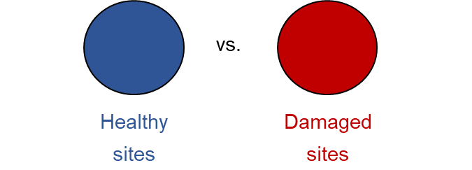



Objectives
Obj. 1 – To characterise tree morphological, physiological and whole-tree responses to drought
Obj. 2 – To assess trait coordination within species
Obj. 3 – To modelise tree responses to describe the underlying processes of tree decline
vs.
vs.
Abies alba Temperate
Pinus sylvestris Temperate
Pinus pinea Mediterranean
Non-declining
Declining
vs.
vs.
Healthy tree
Non-declining site
Healthy tree
Declining site
Damaged tree
Declining site

Slide 3
Objectives
Obj. 1 – To characterise tree morphological, physiological and whole-tree responses to drought
Obj. 2 – To assess trait coordination within species
Obj. 3 – To modelise tree responses to describe the underlying processes of tree decline
Significant differences
PCAs

Slide 4
Obj. 1 – To characterise tree morphological, physiological and whole-tree responses to drought
AIC
Wilcoxon → p-values
Models → p-values
Null model: Response ~ 1 + (1|site)
Full model: Response ~ status/damage + (1|site)

Slide 5
Obj. 1 – To characterise tree morphological, physiological and whole-tree responses to drought
Non-declining
Declining

Slide 6
Obj. 1 – To characterise tree morphological, physiological and whole-tree responses to drought
vs.
Healthy tree
Declining site
Damaged tree
Declining site

Slide 7
Obj. 1 – To characterise tree morphological, physiological and whole-tree responses to drought
vs.
Non-declining
Declining
Healthy tree
Declining site
Damaged tree
Declining site
Abies alba
Pinus sylvestris
Abies alba
Pinus sylvestris
↓ Height
↓ SLA
↑ δ¹³C
↓BAI
↓ Height
↓ BAI
↑ Height
↓ Chl.
↓ BAI
Pinus pinea
Pinus pinea
↓ Height
↓ SLA
↓ Chl.

Slide 8
Obj. 2 – To assess trait coordination within species
AIC
Wilcoxon → p-values
Models → p-values
Null model: Response ~ 1 + (1|site)
Full model: Response ~ status/damage + (1|site)
Variable selection based on expert knowledge

Slide 9
Obj. 2 – To assess trait coordination within species
Tree size
Leaf C use
Leaf nutrients
Height, d.b.h., age, Hegyi
C content, SLA, C:N
N content, δ15N
Photosynthetic pigments
Photoprotection pigments
Water use
Chl., chl. a/b, chl. A, chl. b
Carotenoids, Chl. / car.
LWC, δ13C, δ18O
Tree growth
BAI80, BAI05, Rt, Rs

Slide 10
Abies alba
P. sylvestris
P. pinea

Slide 11
Obj. 2 – To assess trait coordination within species
Tree size
Leaf C use
Leaf nutrients
Height, d.b.h., age, Hegyi
C content, SLA, C:N
N content, δ15N
Photosynthetic pigments
Photoprotection pigments
Water use
Chl., chl. a/b, chl. A, chl. b
Carotenoids, Chl. / car.
LWC, δ13C, δ18O
Tree growth
BAI80, BAI05, Rt, Rs
Var. selection

Slide 12
Obj. 2 – To assess trait coordination within species
Abies alba
P. sylvestris
PCAs
Existence of a global plant traits spectrum!
P. pinea
Temperate species: PC1 – resource acquisition / PC2 - photosynthesis
Taller trees ‘faster strategies’
Mediterranean species: PC1 – resource acquisition?
Taller trees ‘slower strategies’

Slide 13
Obj. 2 – To assess trait coordination within species
Abies alba
Drought-induced decline collapses trait coordination (Yu et al. 2022)
Growth determined by resource acquisition
Growth limited by stomatal regulation

Slide 14
Obj. 2 – To assess trait coordination within species
Pinus sylvestris
Defoliation → ‘slow’ strategy
LES preserved even in decline conditions
Growth limited by stomatal regulation

Slide 15
Obj. 2 – To assess trait coordination within species
Pinus pinea
Larger trees ‘slower’ strategies
Trade-off growth-PS

Slide 16
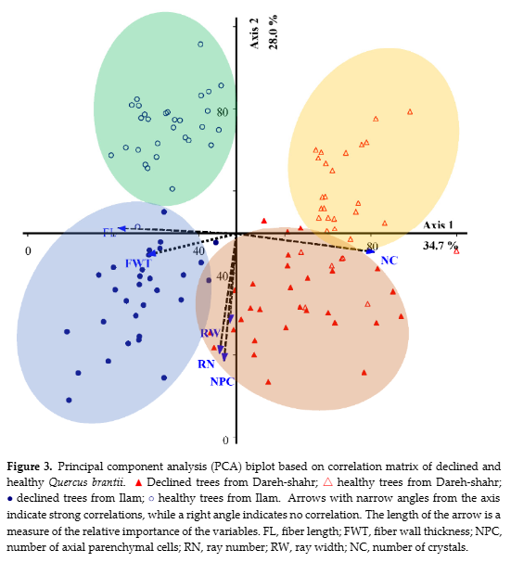
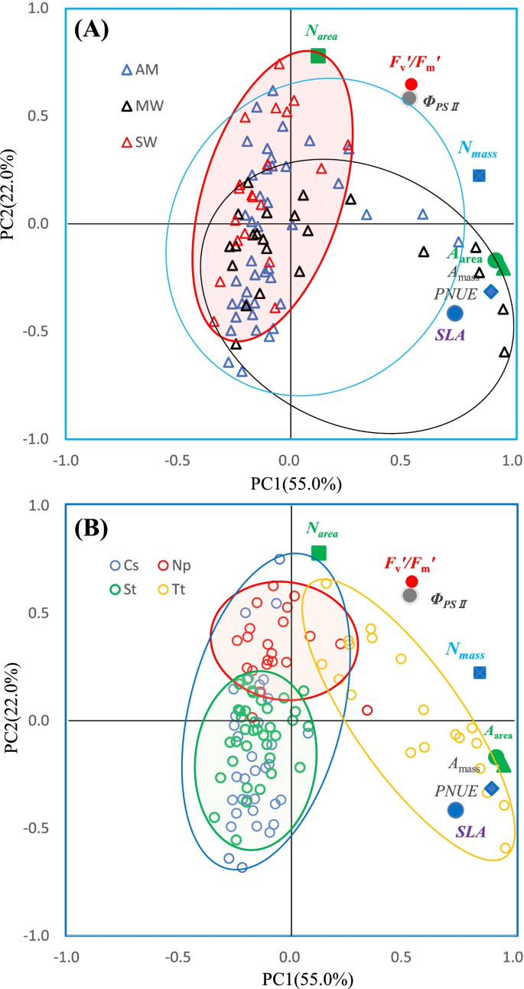
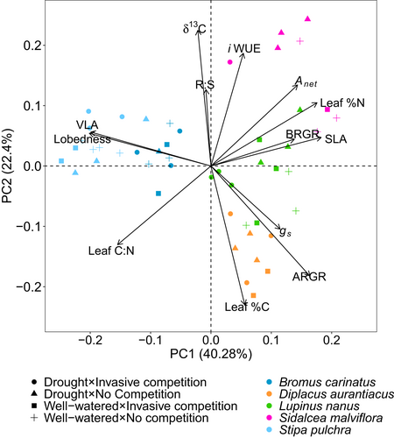
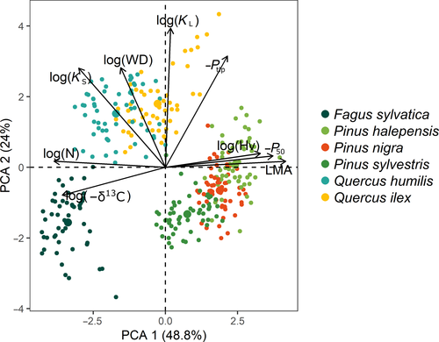
Soheili et al. 2023
Healthy (hollow) vs. Declining (full) oaks. Coordination of parenchyma anatomy
Yu et al. 2023
Control (AM) vs. Moderate (MW) vs. Severe warming (SW)
Luong & Loik 2022
Different stress treatments in C3 and C4 Californian grasses
Rosas et al. 2021
Trait coordination of Mediterranean species

Slide 17
Obj. 2 – To assess trait coordination within species

Slide 18
Obj. 2 – To assess trait coordination within species
Abies alba
Similar trait variability (functional space)
Non-declining: more acquisitive (↑ growth and SLA)
Declining: more conservative (↑δ¹³C)

Slide 19
Obj. 2 – To assess trait coordination within species
Pinus sylvestris
Reduced variability in declining sites!
Non-declining: more acquisitive (↑ growth, N and SLA)
Declining: more conservative (↑δ¹³C)

Slide 20
Obj. 2 – To assess trait coordination within species
Pinus pinea
More trait variability in declining sites
No LES?
Non-declining: ↑ growth and ↑δ¹³C → ↑iWUE?
Declining: ↑N → PS?

Slide 21
Obj. 2 – To assess trait coordination within species
Existence of within-species trait coordination
LES + height // PS
Declining trees shift towards more conservative strategies (LES)

Slide 22
Obj. 3 – Model structure
Precipitation / drought
Temperature
δ¹³C only trait effectively correlated with growth
(Rosas et al. 2021)
WUE
(d13C)
Growth
(BAI80)
Tree size
(h)
iWUE conditions C uptake (Galiano et al. 2011)
Leaf N content (=PS capacity) determines iWUE (=d13C) (Benavides et al. 2023; Querejeta et al. 2025)
Defoliation is a consequence of reduced growth (Camarero et al. 2015)
LES
(N, SLA)
Pigments
Defoliation
Most N in leaves in form of RuBisCo and other phosotynthetic enzymes → N content already summarizes it
(Field & Mooney 1986; Galiano et al. 2011; Benavides et al. 2023)
Nm and SLA very correlated regardless of stress (Yu et al. 2022)

