Slide 1
Preliminar analyses - Figures
Chapter 2: assessing individual factors determining drought vulnerability

Slide 2
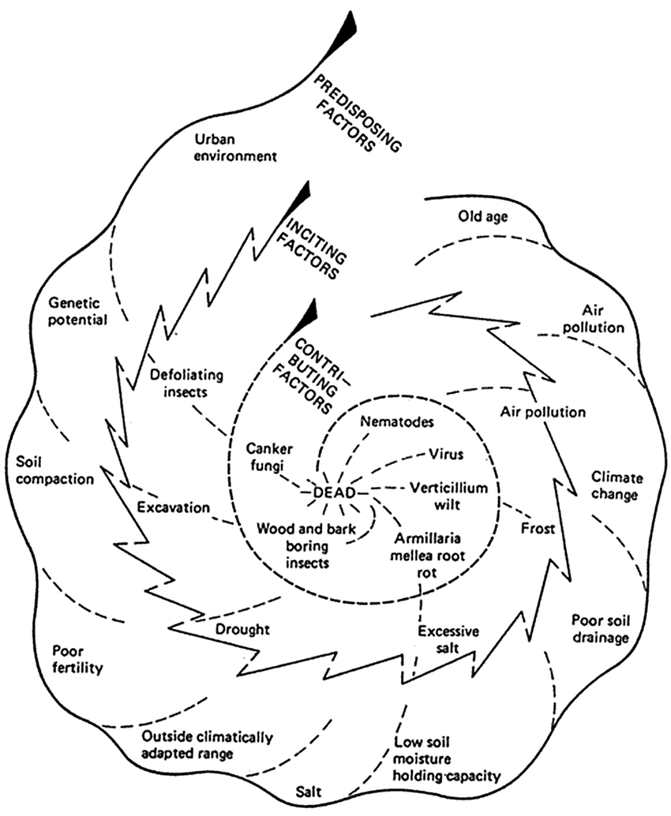
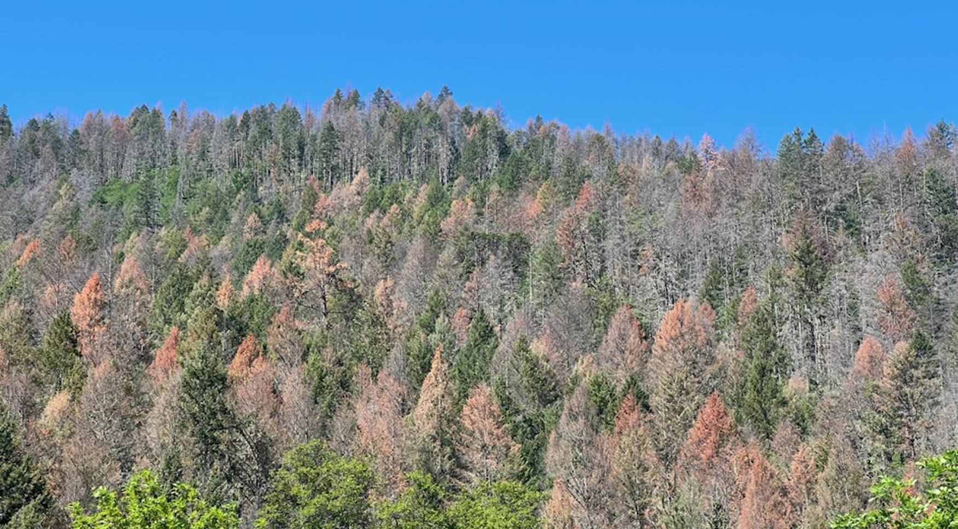
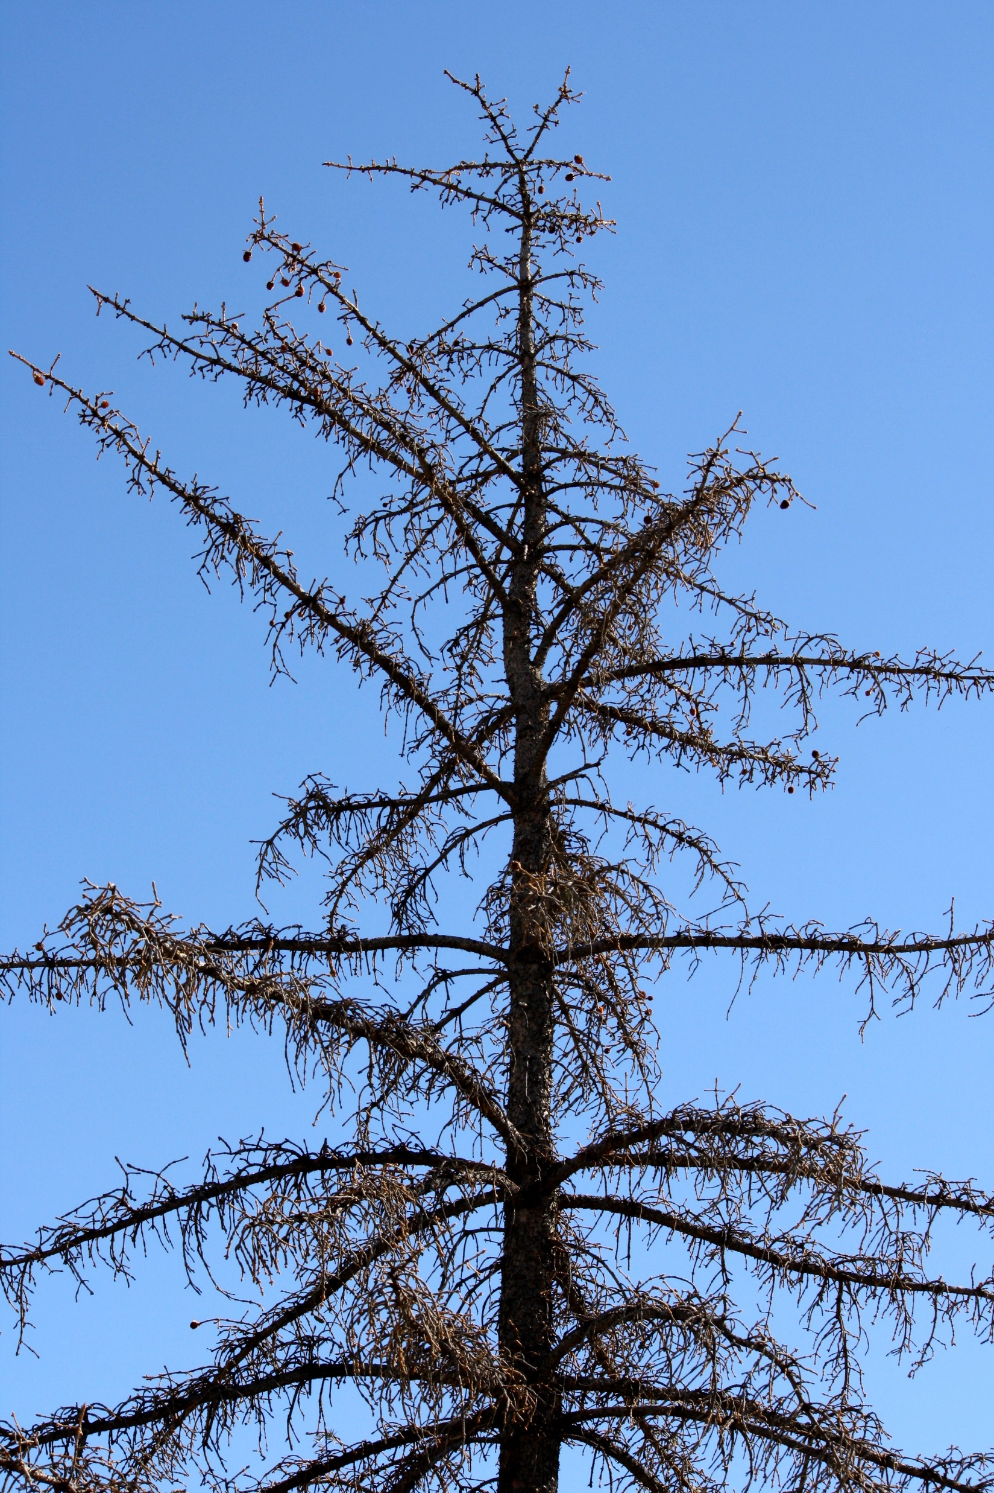
Drought-induced tree mortality
Introduction.
It is hard to forecast drought-induced die-back events
Individual level
Early-warning signals?

Slide 3
Complementary strategies to cope with drought
Introduction.
Mortality is a slow process
Dieoff is triggered by inciting factors
Tree size (dbh, altura)
Competition (Hegyi index)
iWUE (SLA, EWT)
Growth
Resistance & Resilience (Lloret’s indices)
Defoliation
Pigments (Chl, carotenoids)
Leaf isotopes (δ¹³C, δ¹⁵n, δ¹⁸O)
Wood isotopes (δ¹³C, δ¹⁵n, δ¹⁸O)
=/=

Slide 4
Complementary strategies to cope with drought
Introduction.
Mortality is a slow process
Dieoff is triggered by inciting factors
Tree size (dbh, altura)
Competition (Hegyi index)
iWUE (SLA, EWT)
Growth
Resistance & Resilience (Lloret’s indices)
Defoliation
Pigments (Chl, carotenoids)
Leaf isotopes (δ¹³C, δ¹⁵n, δ¹⁸O)
Wood isotopes (δ¹³C, δ¹⁵n, δ¹⁸O)
=/=

Slide 5
Complementary strategies to cope with drought
Introduction.
Leaf Economics Spectrum
Isohydric
"Conservative"
Anisohydric
"Acquisitive"
↑iWUE
Stomatal closure
↓ Growth
↓ Photosynthetic rates
↓ SLA
↓ iWUE
Leaf ↓Ψ
↑ Growth
↑ Photosynthetic rates
↑ SLA

Slide 6
Complementary strategies to cope with drought
Introduction.
Declining sites
Non-declining sites
Isohydric
"Conservative"
Anisohydric
"Acquisitive"
C starvation
Hydraulic failure

Slide 7
Complementary strategies to cope with drought
G.I.K..
We are still unable to forecast die-off!
Most studies focus on single species
Lack of regional-scale studies
Relative importance of hydraulic failure vs. carbon starvation?
Overlooked interactions between processes
Do vulnerability factors & responses remain constant across species?
Do we observe the same at regional scale than in previous local studies?

Slide 8
Complementary strategies to cope with drought
G.I.K..
We are still unable to forecast die-off!
Obj. 1.: To characterise vulnerability factors determining drought vulnerability
Most studies focus on single species
Lack of regional-scale studies
Relative importance of hydraulic failure vs. carbon starvation?
Overlooked interactions between processes
Do vulnerability factors & responses remain constant across species?
Do we observe the same at regional scale than in previous local studies?
Obj. 2.- To assess morphological and physiological responses to drought

Slide 9
Complementary strategies to cope with drought
G.I.K..
We are still unable to forecast die-off!
Obj. 1.: To characterise vulnerability factors determining drought vulnerability
Most studies focus on single species
Lack of regional-scale studies
Relative importance of hydraulic failure vs. carbon starvation?
Overlooked interactions between processes
Do vulnerability factors & responses remain constant across species?
Do we observe the same at regional scale than in previous local studies?
Obj. 2.- To assess morphological and physiological responses to drought
Obj. 3.- To assess how underlying mechanisms behind drought vulnerability vary due to long-term adaptations along a moisture gradient

Slide 10
Study area
M&M .
Fig. 1.: Study sites in Iberia. Coloured areas represent the distribution area of each species.
Field data sampling:
02/2023 – 09/2023
14 sites, 91 plots
462 target trees
Fig. 1

Slide 11
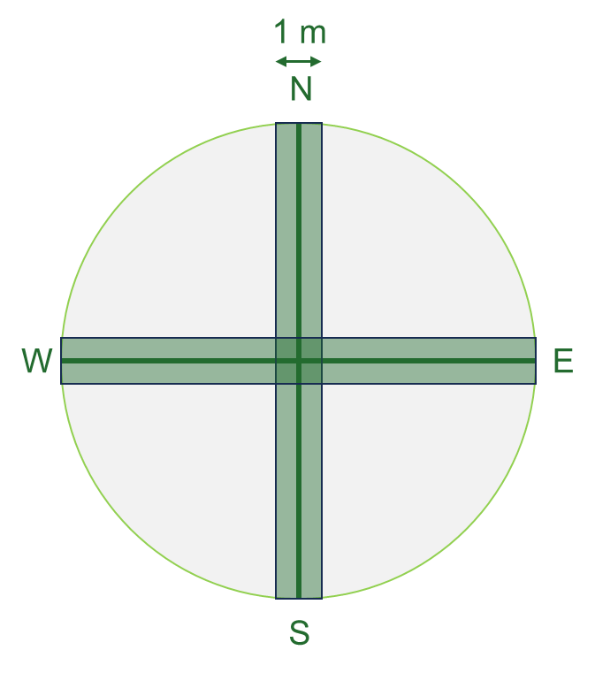

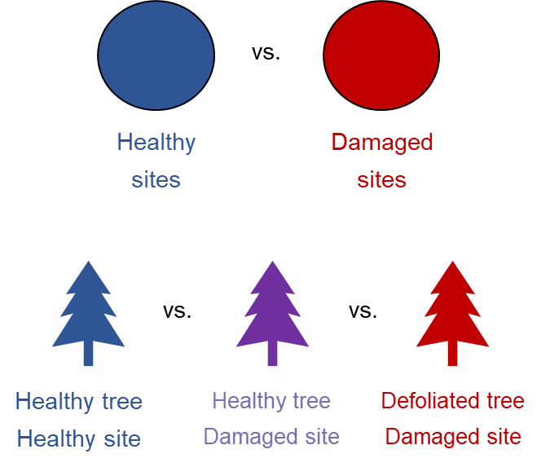
Sampling design
M&M .
34 m
1.- Mature trees inventory
Species identity, defoliation & d.b.h.
2.- Regeneration inventory
Species identity & height
3.- Shrub inventory
Species identity, height & cover
4.- Target trees
Height
LWC
SLA
Photosynthetic pigments
Isotopes (C, N, O)
5.- Soil data
Non-declining
Declining
Non-declining site
Non-declining site
Declining site

Slide 12
Sampling design
M&M .
Morphological
Tree growth → dendro
Leaf traits → leaf area & defoliation
Physiological
Photosynthesis → spectrophotometry
Water relations → water content
Leaf nutrients → C & N content
Leaf isotopes → isotopes
23 plots
51 plots
17 plots
5 targets x 91 plots
Abies alba
Pinus sylvestris
Pinus pinea
462 target trees

Slide 13
Objectives & Hypotheses
.
Obj. 1.- To characterise vulnerability factors determining drought vulnerability through assessment of morphological and physiological traits responses in drought-induced damaged vs. healthy areas
H1.- We expect tree size, past tree growth, competition and leaves traits to determine tree vulnerability to drought:
Non-declining
Declining
Non-declining site
Non-declining site
Declining site

Slide 14
Objectives & Hypotheses
.
Obj. 1.- To characterise vulnerability factors determining drought vulnerability through assessment of morphological and physiological traits responses in drought-induced damaged vs. healthy areas
H1.- We expect tree size, past tree growth and resilience, competition and leaves traits to determine tree vulnerability to drought:
Size: bigger trees will be more vulnerable due to hydraulic limitations (increased hydraulic resistance) → ↑ height, age & dbh in declining sites
Growth: we expect a reduced growth trend, and resilience → ↓ BAI, Rt & Rs in declining sites
Leaves traits: a higher SLA leads to faster water loss → ↑ SLA in declining sites
Competition: competition reduces water availability per tree and increases water interception → ↑ Hegyi index in declining sites

Slide 15
Objectives & Hypotheses
.
Obj. 2.- To assess morphological and physiological responses to drought, and what traits are more affected
H2.- We expect drought-induced reduced photosynthetic pigments concentrations, increased iWUE and leaves nutrients allocation
Pigments: water stress-induced increased ABA and ROS trigger upregulation of senescence-associated genes (SAG), and to damages to photosynthetic apparatus → ↓ Pigments concentration
iWUE: we an isohydric behaviour leading to stomatal closure → ↑ δ¹³C and δ¹⁸O in leaves and wood tissue
Nutrients: we nutrient allocation in leaves due to drought-induced reduced nutrients uptake → ↓N concentration and ↑ C:N ratio in declining sites
Non-declining
Declining
Non-declining site
Non-declining site
Declining site

Slide 16



Objectives & Hypotheses
.
Obj. 3.- To assess how underlying mechanisms behind drought vulnerability vary due to long-term adaptations along a moisture gradient
H3.- We expect higher vulnerability to increased aridity in temperate species than Mediterranean species
Abies alba
Temperate
Pinus sylvestris
Temperate
Pinus pinea
Mediterranean
Non-declining
Declining

Slide 17
Objectives & Hypotheses
.
Obj. 1.- To characterise vulnerability factors determining drought vulnerability through assessment of morphological and physiological traits responses in drought-induced damaged vs. healthy areas
Variable selection → Fig. 2.: boxplot
Obj. 2.- To assess morphological and physiological responses to drought, and what traits are more affected
Variable selection → Fig. 3.: boxplot
Obj. 3.- To assess how underlying mechanisms behind drought vulnerability vary due to long-term adaptations along a moisture gradient
PCA → Fig. 4.: Model (SEM)

Slide 18
Data analysis
.
Morphological
Tree growth → dendro
Leaf traits → leaf area & defoliation
Physiological
Photosynthesis → spectrophotometry
Water relations → water content
Leaf nutrients → C & N content
Leaf isotopes → isotopes
We have way too many variables!
Variable selection:
Bibliographic revision → to only keep traits that determine vulnerability
Correlogram → to see what variables are redundant
Wilcoxon test → to select the variables that might best forecast vulnerability

Slide 19
Data analysis
.
1.- Bibliographic revision
Vulnerability =/= response
Tree size (dbh, altura)
Competition (Hegyi index)
iWUE (SLA, EWT)
Growth
Resistance & Resilience (Lloret’s indices)
Defoliation
Pigments (Chl, carotenoids)
Leaf isotopes (δ¹³C, δ¹⁵n, δ¹⁸O)
Wood isotopes (δ¹³C, δ¹⁵n, δ¹⁸O)
=/=

Slide 20
Data analysis
.
2.- Correlogram
Redundant variables:
All average BAI values at different time scales are highly correlated → we should just pick one
Height and d.b.h. are highly correlated
Age is not that correlated to tree size (surprisingly)
What variables should we choose?
P-values

Slide 21
Data analysis
.
3.- P-values
Wilcoxon test + Bonferroni correction
To discard variables with no significant differences
This is the final selection!

Slide 22
Data analysis
.
3.- P-values
Wilcoxon test + Bonferroni correction
No significant differences between Declining vs. Non-declining for any species:
SLA
Leaves N content
Leaves C:N ratio
Leaves δ¹⁸O
Resistance 2017
Resistance 2022
Hegyi Index
Total chl. content
Chl. a content
Chl. b content
Carotenoids content

Slide 23
Preliminary results
M&M .
Vulnerability factors
Differences between Declining vs. Non-declining for any species:
Variable | A. alba | P. sylvestris | P. pinea | All
Height | ** | *** | - | ****
d.b.h. | ** | - | - | **
Age | - | **** | - | ****
Defoliation | **** | **** | - | ****
LWC | - | **** | - | ****
Chl. a/b | - | ** | - | ***
Chl. / xc | *** | - | - | *
C content | - | *** | - | -
δ¹³C | * | - | - | **
δ¹⁵N | - | **** | - | -

Slide 24
Preliminary results
M&M .
Responses
Differences between Declining vs. Non-declining for any species:
Variable | A. alba | P. sylvestris | P. pinea | All
BAI | **** | **** | - | ****
BAI 1980 | **** | **** | - | ****
BAI 20 | ** | **** | - | ****
BAI 15 | ** | **** | - | ****
BAI 10 | - | **** | - | ****
BAI 05 | - | **** | - | ****
Rt12 | - | **** | - | ****
Rs12 | - | **** | - | -
Rs17 | - | **** | - | -

Slide 25
Preliminary results
M&M .
Obj. 1.- To characterise vulnerability factors determining drought vulnerability through assessment of morphological and physiological traits responses in drought-induced damaged vs. healthy areas
Fig. 2

Slide 26
Preliminary results
M&M .
Obj. 1.- To characterise vulnerability factors determining drought vulnerability through assessment of morphological and physiological traits responses in drought-induced damaged vs. healthy areas
Tree height is higher in non-declining sites in all species → Bigger trees less vulnerable due to better access to deeper water sources.
Age is higher in declining sites (for P. sylvestris) → Older trees are more vulnerable due to hydraulic limitations and reduced photosynthetic efficiency.
Growth rates are higher in declining sites → Trees with declining growth rates are more vulnerable to drought.
Resistance and Resilience values are different according to the year and the species.

Slide 27
Preliminary results
M&M .
Obj. 2.- To assess morphological and physiological responses to drought, and what traits are more affected
Fig. 3

Slide 28
Preliminary results
M&M .
Obj. 2.- To assess morphological and physiological responses to drought, and what traits are more affected
Defoliation is higher and LWC lower in non-declining sites → Drought-induced leaf senescence and loss of leaf water turgor.
Chl. / carotenoids ratio is lower in declining sites (for P. sylvestris) → upregulated ROS synthesis leading to oxidative damage.
δ¹³C content is higher in declining sites → tight stomatal control in declining sites & increased iWUE
Leaves δ¹⁵N content is lower in declining sites → N allocation and impaired N uptake.

Slide 29
Preliminary results
M&M .
Obj. 3.- To assess how underlying mechanisms behind drought vulnerability vary due to long-term adaptations along a moisture gradient
Is it worth it grouping the variables in two components?
Linear Mixed Model or Structural Equations Model?
Defoliation = SPEI + PCA1 + PCA2 + (1 | site / plot id / tree id) ¿?

Slide 30
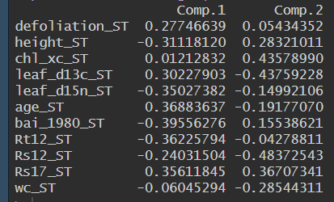
Preliminary results
M&M .
Obj. 3.- To assess how underlying mechanisms behind drought vulnerability vary due to long-term adaptations along a moisture gradient
Very high orthogonality
Comp. 1: height, δ¹⁵N, BAI, Rt12; defoliation, age
Comp. 2: δ¹³C, Rs12, LWC; Chl. / carotenoids, Rs17

Slide 31
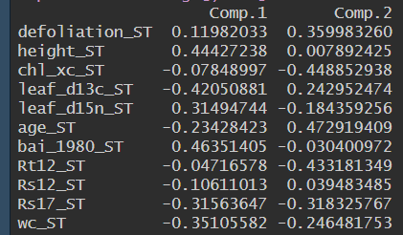

Preliminary results
M&M .
Obj. 3.- To assess how underlying mechanisms behind drought vulnerability vary due to long-term adaptations along a moisture gradient

Slide 32
Preliminary results
M&M .
Obj. 3.- To assess how underlying mechanisms behind drought vulnerability vary due to long-term adaptations along a moisture gradient
Higher orthogonality in non-declining than in declining sites
Non-declining more concentrated around PC2 negative values, declining around positive PC1
BAI / δ¹³C, Rt12

Slide 33
Preliminary results
M&M .
Obj. 3.- To assess how underlying mechanisms behind drought vulnerability vary due to long-term adaptations along a moisture gradient

Slide 34
Preliminary results
M&M .
Obj. 3.- To assess how underlying mechanisms behind drought vulnerability vary due to long-term adaptations along a moisture gradient
GLM?
SEM?
Changes in SEM pathways → different physiological processes in D vs. ND
Variables relationships
Non-declining
Declining

Slide 35
Preliminary results
M&M .
Obj. 3.- To assess how underlying mechanisms behind drought vulnerability vary due to long-term adaptations along a moisture gradient
SPEI, TEMP.
Turgor loss
Stomatal closure
Limitted uptake
RWC
Transpiration
δ¹³C
Transpiration
δ¹⁵N
Height
Age
Chl/xc
Leaf senescence
BAI80
Rt, Rs
Defoliation

Slide 36
Data analysis – Physiological responses
M&M .
3.- Response ratios
LogRR = log(X_{declining} / X_{non-declining})

