Slide 1
Preliminar analyses - Figures
Chapter 2: assessing individual factors determining drought vulnerability

Slide 2
Complementary strategies to cope with drought
Introduction.
Morphological traits
Tree growth
BAI, height, dbh
Photosynthesis, root system, reserves
↓
↑
Cell turgor, photosynthesis
↓
SLA
↑
↑
defoliation
↓
ABA, ROS
Damaged
sites
Healthy
sites

Slide 3
Complementary strategies to cope with drought
Introduction.
Physiological traits
↓
Chlorophylls
↑
Synthesis downregulation, ROS
↑
Carotenoids
↓
Photoprotection
↓
LWC
↑
Osmoregulation, permeability
↑
δ¹³C, δ¹⁸O
↓
Photosynthesis, transpiration
↓
N content
↑
N uptake
Damaged
sites
Healthy
sites

Slide 4
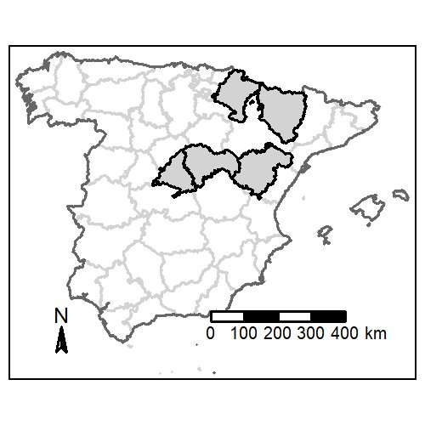
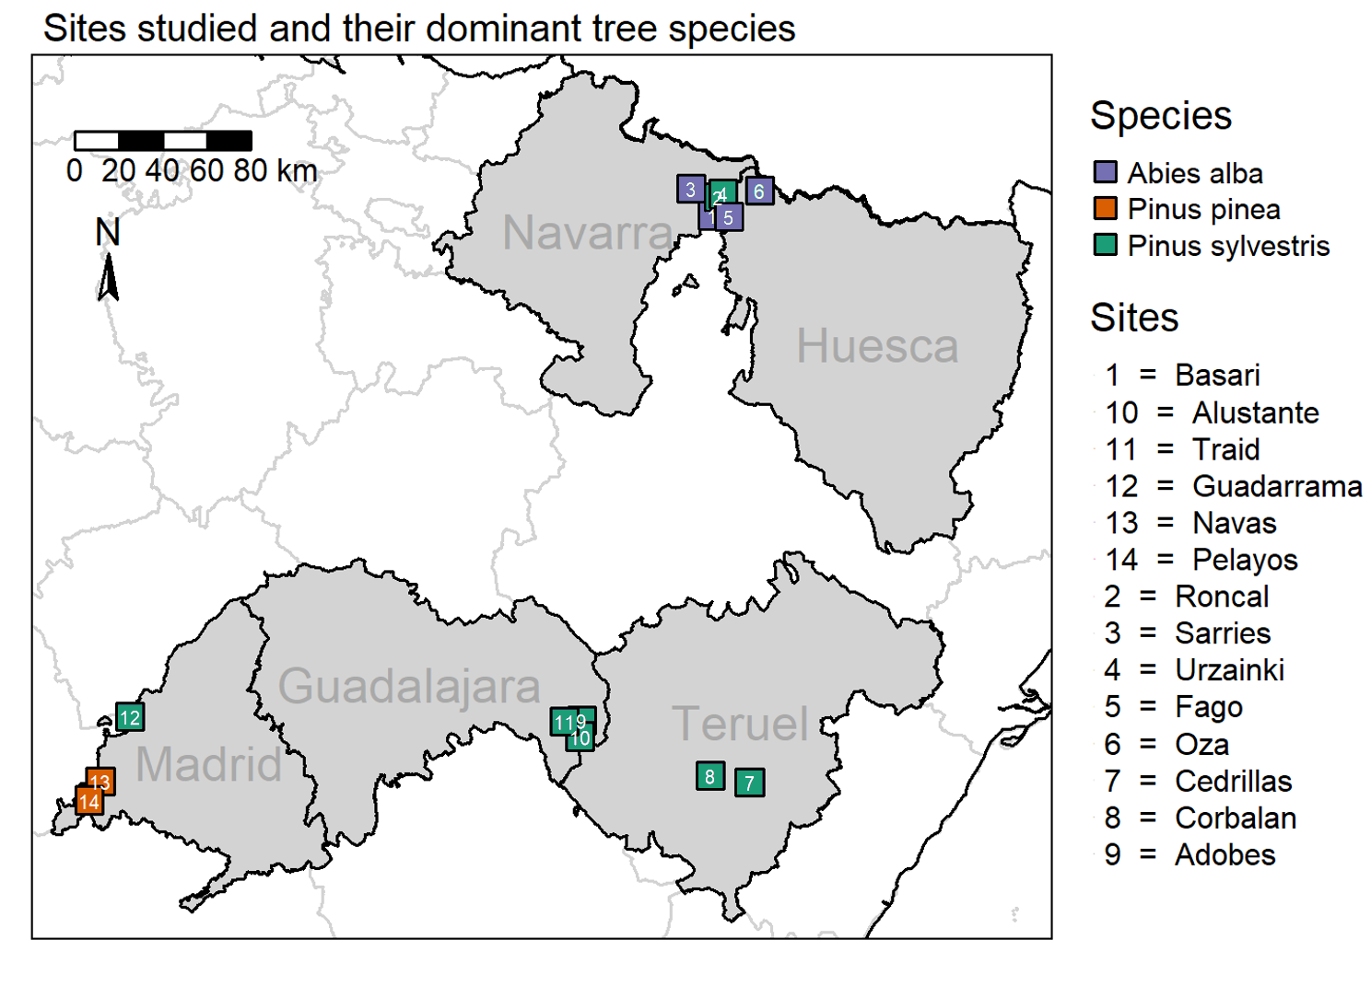
Study area
M&M .
Field data sampling:
02/2023 – 09/2023
14 sites, 91 plots
462 target trees

Slide 5



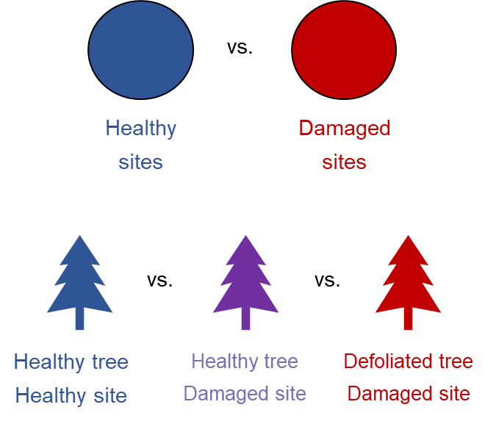
Objectives
Introduction.
3 species in damaged vs. healthy sites to:
Abies alba
Temperate
Pinus sylvestris
Temperate
Pinus pinea
Mediterranean
1) To characterise underlying mechanisms behind die-off responses though assessment of morphological and physiological traits responses in drought-induced damaged vs. healthy areas
2) To assess which morphological and physiological traits best determine drought-induced vulnerability

Slide 6
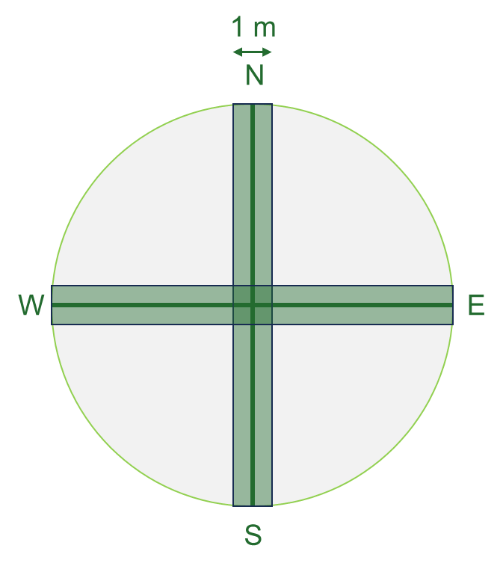

Sampling design
M&M .
34 m
1.- Mature trees inventory
Species identity, defoliation & d.b.h.
2.- Regeneration inventory
Species identity & height
3.- Shrub inventory
Species identity, height & cover
4.- Target trees
Height
LWC
SLA
Photosynthetic pigments
Isotopes (C, N, O)
5.- Soil data

Slide 7
Sampling design
M&M .
Morphological
Tree growth → dendro
Leaf traits → leaf area & defoliation
Physiological
Photosynthesis → spectrophotometry
Water relations → water content
Leaf nutrients → C & N content
Leaf isotopes → isotopes
23 plots
51 plots
17 plots
5 targets x 91 plots
Abies alba
Pinus sylvestris
Pinus pinea
462 target trees

Slide 8
Preliminary results
Figures
Standardized (BAI / d.b.h.) tree growth series of each site
Darker lines are healthy plots, and lighter lines, damaged plots. Gray bars represent mean annual precipitation (right y-axis).
Abies alba
Temperate
Pinus sylvestris
Temperate
Pinus pinea
Mediterranean

Slide 9
Preliminary results
Figures
Navarra (BAS/SAR) & Huesca (FAG/OZA): trees have always had significant differences in growth. However, convergence in recent years (which are more humid → maybe it’s temperatura’s fault?)
Navarra (RON/URZ) and Guadalajara (ADO/ALU/TRA): divergence over time.
Madrid (GUA): trees have always had significant differences in growth, although it seems more evidente in recent years?
Teruel (COR/CED): no clear pattern, but several interesting major decouplings in the last decades.
Madrid (PEL/NAV): no major differences in growth between healthy vs. defoliated sites.
Abies alba
Temperate
Pinus sylvestris
Temperate
Pinus pinea
Mediterranean

Slide 10
Preliminary results
Figures
Additive standardized (BAI / d.b.h.) tree growth series of each site per species.
Abies alba
Temperate
Pinus sylvestris
Temperate
Pinus pinea
Mediterranean

Slide 11
Preliminary results
Figures
When considering only Navarra for P. sylvestris, we observe a progressive divergence starting from c. 1968

Slide 12
Preliminary results
Figures
When considering only Navarra for P. sylvestris, we observe a progressive divergence starting from c. 1968

Slide 13
Preliminary results
Figures
When considering Navarra, Madrid, and Guadalajara, the divergence is still patent but both groups are a bit less differentiated.

Slide 14
Preliminary results
Figures
When considering Navarra, Madrid, Guadalajara, and Teruel, both groups are even less differentiated.

Slide 15
Preliminary results
Figures
When considering only Navarra for A. alba, we see that healthy and damaged trees have different baseline growth rates, but there is a downwards trend in recent decades

Slide 16
Preliminary results
Figures
When including Navarra and Huesca, the divergence between healthy and damaged tres starts c. 1965, and there is still a recent reduction in growth for both groups.

Slide 17
Preliminary results
Figures
Boxplots resulting from binning the scatterplots representing tree defoliation ~ leaf/morphological traits
Do you think it’d be better to invert the axis, binning the defoliation instead?

Slide 18
Preliminary results
Figures
Differences in defoliation between healthy vs. damaged sites are less evident in larger trees, perhaps because hydraulic limitations make them more vulnerable?
For P. sylv., defoliation values are higher for leaves with higher N content (%). I would expect the opposite, so maybe they are allocating N from senescent leaves?
Differences in defoliation between healthy vs. damaged sites are less evident in leaves with higher water content.

Slide 19
Preliminary results
Figures
Generally, we find higher defoliation values in leaves with lower δ¹³C. Lower δ¹³C values might be related to higher stomatal conductance, and thus water loss.
Generally, we find higher defoliation values in leaves with lower δ¹⁵N.
Generally, we find higher defoliation values in leaves with lower δ¹⁸O. Lower δ¹⁸C values might be related to higher iWUE?

Slide 20
Preliminary results
Figures
Scatterplots representing leaf/morphological traits ~ Mean Annual Precipitation (mean from last 10 years)

Slide 21
Preliminary results
Figures
Positive relationship between tree height and MAP only in healthy sites. Maybe defoliation is limiting tree size?
Opposite trends for C and N content. With increasing precipitation, C content is reduced, while N content increases. Probably because of higher chlorophyll content in leaves with higher precipitations?
Positive relationship between Chl. content and MAP specially in healthy sites. However, it’s not super strong…

Slide 22
Preliminary results
Figures
Both δ¹³C and δ¹⁸O are negatively correlated to MAP. The slope is slightly higher for damaged sights (lighter lines). This is related to higher stomatal conductance values in more humid places, thus allowing higher transpiration rates.
Positive relationship between tree height and MAP only in healthy sites. Maybe defoliation is limiting tree size?

