Slide 1
Preliminar analyses - Figures
Chapter 2: assessing individual factors determining drought vulnerability

Slide 2
Complementary strategies to cope with drought
Introduction.
Morphological traits
Tree growth
BAI, height, dbh
Photosynthesis, root system, reserves
↓
↑
Cell turgor, photosynthesis
↓
SLA
↑
↑
defoliation
↓
ABA, ROS
Declining
sites
Non-declining
sites

Slide 3
Complementary strategies to cope with drought
Introduction.
Physiological traits
↓
Chlorophylls
↑
Synthesis downregulation, ROS
↑
Carotenoids
↓
Photoprotection
↓
LWC
↑
Osmoregulation, permeability
↑
δ¹³C, δ¹⁸O
↓
Photosynthesis, transpiration
↓
N content
↑
N uptake
Declining
sites
Non-declining
sites

Slide 4
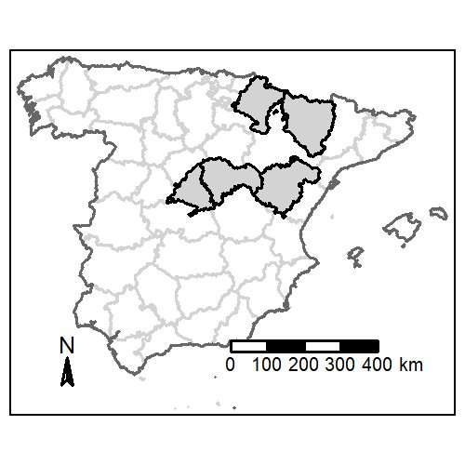
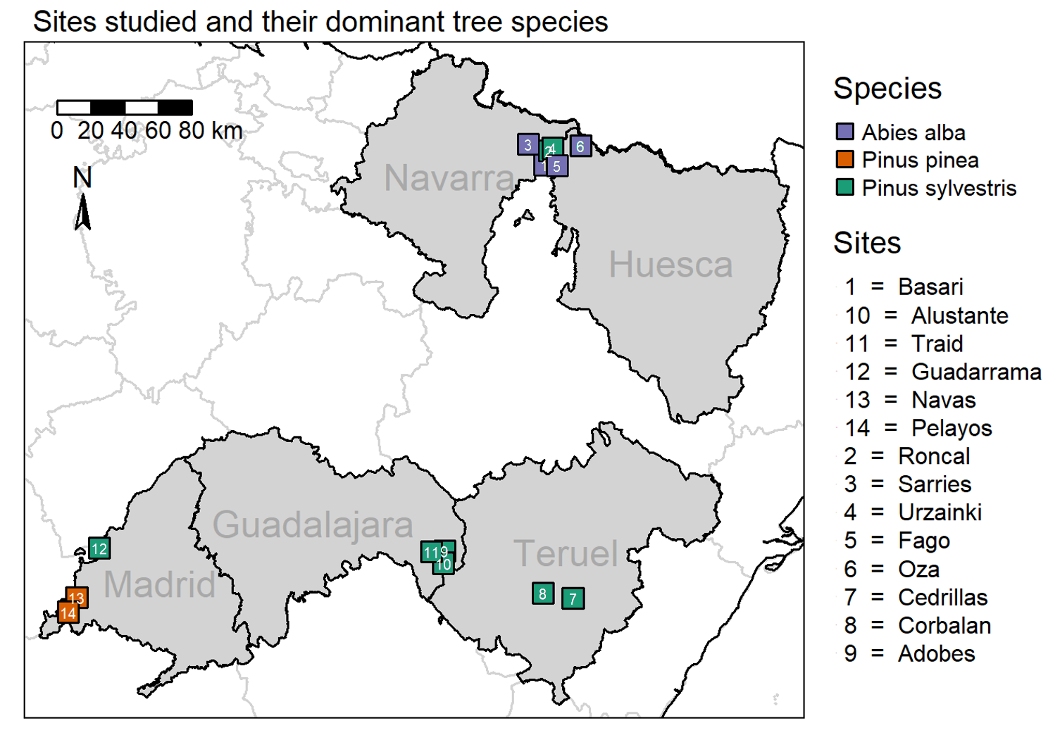
Study area
M&M .
Field data sampling:
02/2023 – 09/2023
14 sites, 91 plots
462 target trees

Slide 5
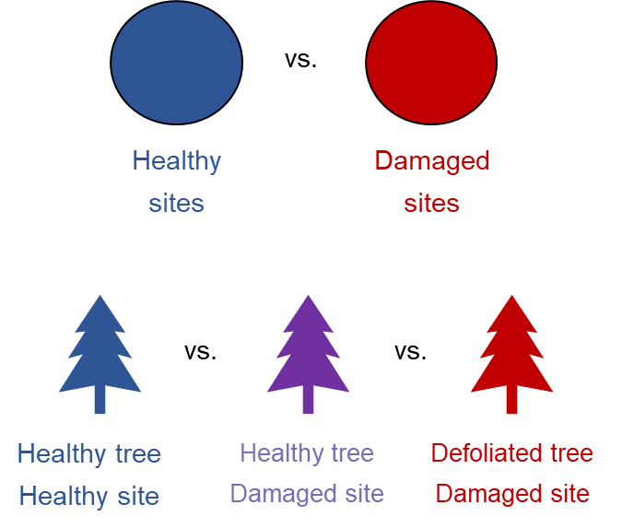
Objectives & Hypotheses
Introduction.
Obj. 1.- To characterise underlying mechanisms behind drought vulnerability through assessment of morphological and physiological traits responses in drought-induced damaged vs. healthy areas
H1.- We expect tree size, past tree growth, competition and leaves traits to determine tree vulnerability to drought:
Non-declining
Declining
Non-declining site
Non-declining site
Declining site

Slide 6
Objectives & Hypotheses
Introduction.
Obj. 1.- To characterise underlying mechanisms behind drought vulnerability through assessment of morphological and physiological traits responses in drought-induced damaged vs. healthy areas
H1.- We expect tree size, past tree growth, competition and leaves traits to determine tree vulnerability to drought:
Size: bigger trees will be more vulnerable due to hydraulic limitations (increased hydraulic resistance) → ↑ height, age & dbh in declining sites
Growth: we expect a reduced growth trend in → ↓ BAI in declining sites
Leaves traits: a higher SLA leads to faster water los → ↑ SLA in declining sites
Competition: competition reduces water availability per tree and increases water interception → ↑ Hegyi index in declining sites

Slide 7
Objectives & Hypotheses
Introduction.
Obj. 2.- To assess morphological and physiological responses to drought, and what traits are more affected
H2.- We expect drought-induced leaf senescence and reduced photosynthetic rates, leaves nutrients allocation and reduced transpiration in declining trees
Non-declining
Declining
Non-declining site
Non-declining site
Declining site
Obj. 3.- To determine how drought vulnerability changes along an aridity gradient in Iberian forests only in Pinus sylvestris
H3.- We expect higher vulnerability to increased aridity in temperate species than Mediterranean species

Slide 8
Objectives & Hypotheses
Introduction.
Obj. 2.- To assess morphological and physiological responses to drought, and what traits are more affected
H2.- We expect drought-induced leaf senescence, reduced photosynthetic rates and transpiration, and nutrient deficits in declining trees
Senescence: water stress-induced increased ABA and ROS trigger upregulation of senescence-associated genes (SAG), and to damages to photosynthetic apparatus → ↓ Pigments concentration and C:N ratio in declining sites
Transpiration and photosynthetic rates: we an isohydric behaviour leading to stomatal closure → ↑ δ¹³C and δ¹⁸O in leaves and wood tissue
Nutrients: we expected limited nutrient uptake due to reduced water availability → ↓N concentration in declining sites

Slide 9
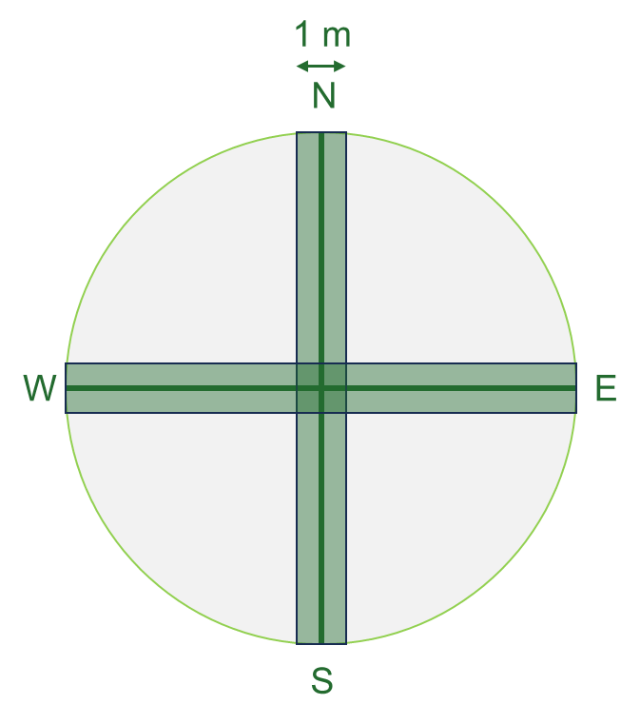

Sampling design
M&M .
34 m
1.- Mature trees inventory
Species identity, defoliation & d.b.h.
2.- Regeneration inventory
Species identity & height
3.- Shrub inventory
Species identity, height & cover
4.- Target trees
Height
LWC
SLA
Photosynthetic pigments
Isotopes (C, N, O)
5.- Soil data
Non-declining
Declining
Non-declining site
Non-declining site
Declining site

Slide 10
Sampling design
M&M .
Morphological
Tree growth → dendro
Leaf traits → leaf area & defoliation
Physiological
Photosynthesis → spectrophotometry
Water relations → water content
Leaf nutrients → C & N content
Leaf isotopes → isotopes
23 plots
51 plots
17 plots
5 targets x 91 plots
Abies alba
Pinus sylvestris
Pinus pinea
462 target trees

Slide 11



Preliminary results
Figures
Standardized (BAI / d.b.h.) tree growth series of each site per species. Gray bars represent M.A.P.
Abies alba
Temperate
Pinus sylvestris
Temperate
Pinus pinea
Mediterranean

Slide 12
Preliminary results
Figures
Standardized (BAI / d.b.h.) tree growth series of each site per species. Gray bars represent SPEI
Abies alba
Temperate
Pinus sylvestris
Temperate
Pinus pinea
Mediterranean

Slide 13
Preliminary results
Figures
Boxplots resulting from binning the scatterplots representing tree defoliation ~ leaf/morphological traits
(Now with inverted axis ☺ )

Slide 14
Preliminary results
Figures
In both species, but mainly in Abies alba, tree height increases vulnerability to drought, due increasing hydraulic limiations
Generally, δ¹³C increases with defoliation. δ¹³C is negatively correlated to higher stomatal conductance, thus implying that plants shut their stomata with increasing aridity (despite higher VPD).

Slide 15
Preliminary results
Figures
Chlorophylls concentration is lower in declining sites, but does not drop as defoliation levels increase
Abies alba seems more vulnerable
At intermidiate defoliation levels, SLA is higher in declining trees, but at higher defoliations the trend inverts
As defoliation increases, so do differences in growth between declining and non-declining sites

Slide 16
Preliminary results
Figures
Scatterplots representing leaf/morphological traits ~ Mean Annual Precipitation (mean from last 10 years)

Slide 17
Preliminary results
Figures
Positive relationship between tree height and MAP only in healthy sites. Maybe defoliation is limiting tree size?
Lower C:N ratios in humid sites. This could be related to higher chl. concentrations, increasing vulnerability as photosynthetic rates increase?
SLA is higher in more humid sites. Thus, trees in these sites exhibit a less water conservative behaviour

Slide 18
Preliminary results
Figures
Both δ¹³C and δ¹⁸O are negatively correlated to MAP. The slope is slightly higher for damaged sights (lighter lines). This is related to higher stomatal conductance values in more humid places, thus allowing higher transpiration (and water loss) rates.
The positive relation between MAP and 10 year- BAI is only observed in healthy sites

Slide 19
Preliminary results
Figures
Both δ¹³C and δ¹⁸O are negatively correlated to MAP. The slope is slightly higher for damaged sights (lighter lines). This is related to higher stomatal conductance values in more humid places, thus allowing higher transpiration rates.
Positive relationship between tree height and MAP only in healthy sites. Maybe defoliation is limiting tree size?

Slide 20
Preliminary results
Figures
Scatterplots representing leaf/morphological traits ~ 12 month SPEI

