Slide 1
Preliminar analyses - Figures
Chapter 2: assessing individual factors determining drought vulnerability

Slide 2
Complementary strategies to cope with drought
Introduction.
Morphological traits
Tree growth
BAI, height, dbh
Photosynthesis, root system, reserves
↓
↑
Cell turgor, photosynthesis
↓
SLA
↑
↑
defoliation
↓
ABA, ROS
Declining
sites
Non-declining
sites

Slide 3
Complementary strategies to cope with drought
Introduction.
Physiological traits
↓
Chlorophylls
↑
Synthesis downregulation, ROS
↑
Carotenoids
↓
Photoprotection
↓
LWC
↑
Osmoregulation, permeability
↑
δ¹³C, δ¹⁸O
↓
Photosynthesis, transpiration
↓
N content
↑
N uptake
Declining
sites
Non-declining
sites

Slide 4
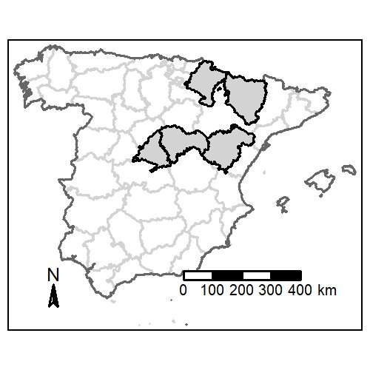
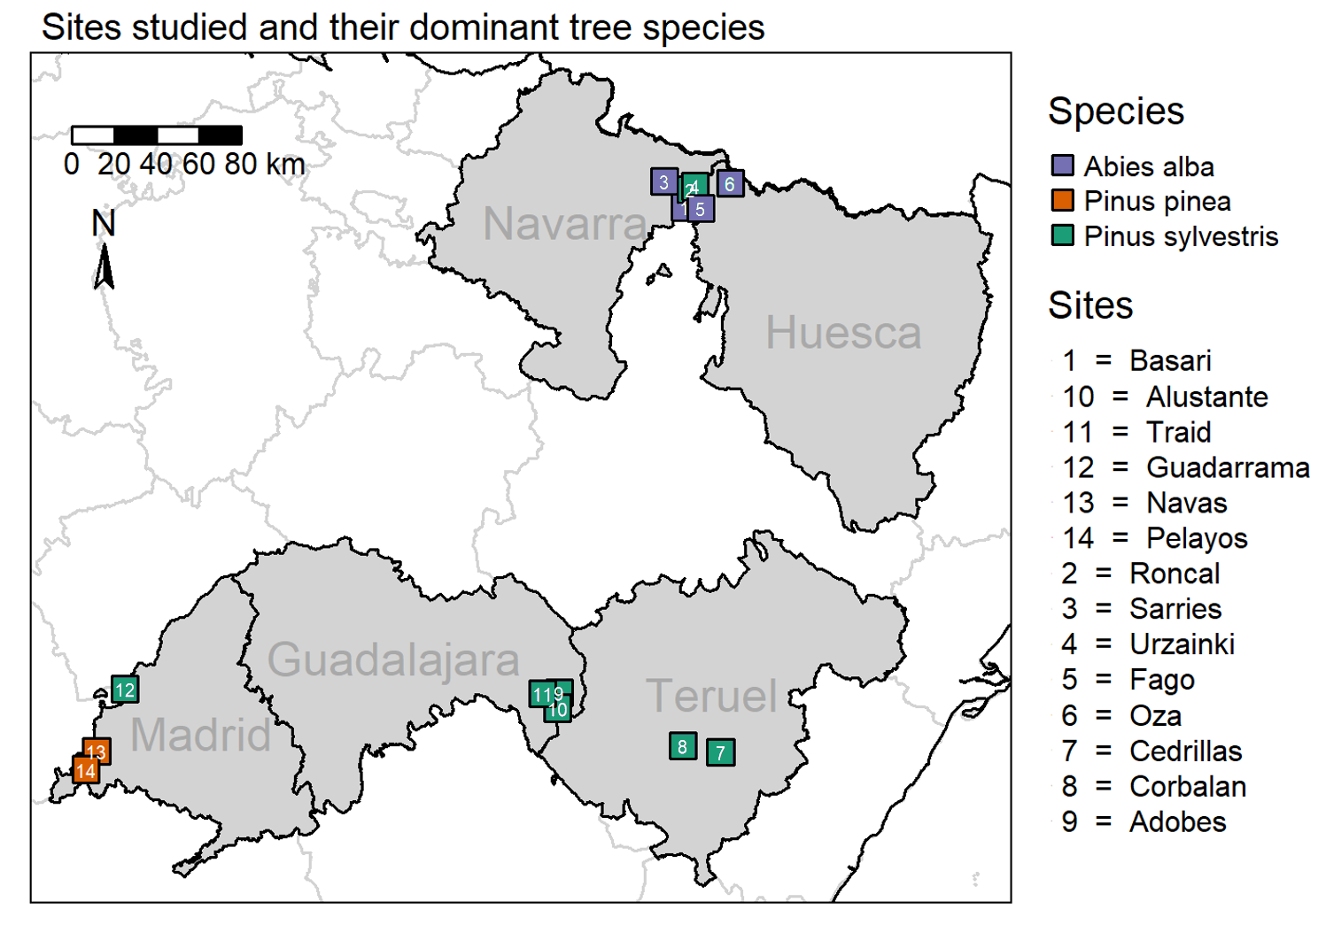
Study area
M&M .
Field data sampling:
02/2023 – 09/2023
14 sites, 91 plots
462 target trees

Slide 5
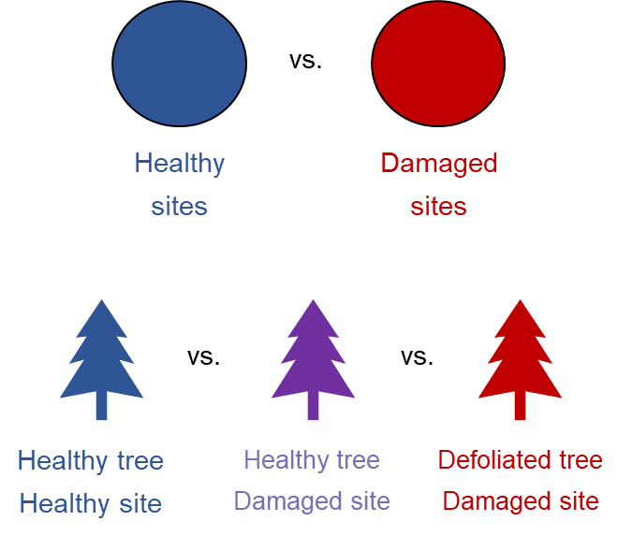
Objectives & Hypotheses
Introduction.
Obj. 1.- To characterise underlying mechanisms behind drought vulnerability through assessment of morphological and physiological traits responses in drought-induced damaged vs. healthy areas
H1.- We expect tree size, past tree growth, competition and leaves traits to determine tree vulnerability to drought:
Non-declining
Declining
Non-declining site
Non-declining site
Declining site

Slide 6
Objectives & Hypotheses
Introduction.
Obj. 1.- To characterise underlying mechanisms behind drought vulnerability through assessment of morphological and physiological traits responses in drought-induced damaged vs. healthy areas
H1.- We expect tree size, past tree growth, competition and leaves traits to determine tree vulnerability to drought:
Size: bigger trees will be more vulnerable due to hydraulic limitations (increased hydraulic resistance) → ↑ height, age & dbh in declining sites
Growth: we expect a reduced growth trend in → ↓ BAI in declining sites
Leaves traits: a higher SLA leads to faster water los → ↑ SLA in declining sites
Competition: competition reduces water availability per tree and increases water interception → ↑ Hegyi index in declining sites

Slide 7
Objectives & Hypotheses
Introduction.
Obj. 2.- To assess morphological and physiological responses to drought, and what traits are more affected
H2.- We expect drought-induced leaf senescence and reduced photosynthetic rates, leaves nutrients allocation and reduced transpiration in declining trees
Non-declining
Declining
Non-declining site
Non-declining site
Declining site
Obj. 3.- To determine how drought vulnerability changes along an aridity gradient in Iberian forests only in Pinus sylvestris
H3.- We expect higher vulnerability to increased aridity in temperate species than Mediterranean species

Slide 8
Objectives & Hypotheses
Introduction.
Obj. 2.- To assess morphological and physiological responses to drought, and what traits are more affected
H2.- We expect drought-induced leaf senescence, reduced photosynthetic rates and transpiration, and nutrient deficits in declining trees
Senescence: water stress-induced increased ABA and ROS trigger upregulation of senescence-associated genes (SAG), and to damages to photosynthetic apparatus → ↓ Pigments concentration and C:N ratio in declining sites
Transpiration and photosynthetic rates: we an isohydric behaviour leading to stomatal closure → ↑ δ¹³C and δ¹⁸O in leaves and wood tissue
Nutrients: we expected limited nutrient uptake due to reduced water availability → ↓N concentration in declining sites

Slide 9
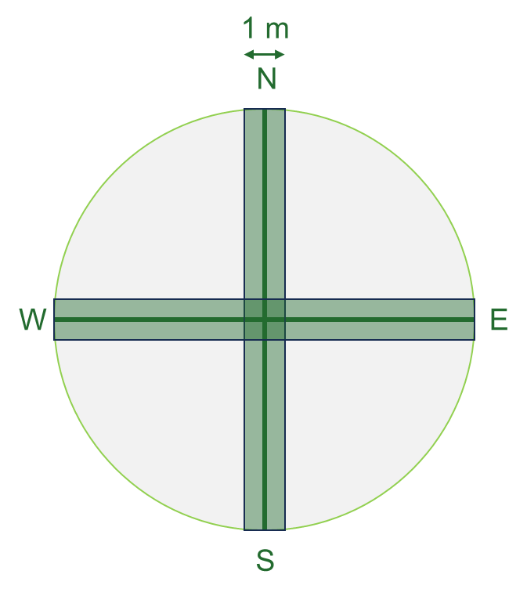

Sampling design
M&M .
34 m
1.- Mature trees inventory
Species identity, defoliation & d.b.h.
2.- Regeneration inventory
Species identity & height
3.- Shrub inventory
Species identity, height & cover
4.- Target trees
Height
LWC
SLA
Photosynthetic pigments
Isotopes (C, N, O)
5.- Soil data
Non-declining
Declining
Non-declining site
Non-declining site
Declining site

Slide 10
Sampling design
M&M .
Morphological
Tree growth → dendro
Leaf traits → leaf area & defoliation
Physiological
Photosynthesis → spectrophotometry
Water relations → water content
Leaf nutrients → C & N content
Leaf isotopes → isotopes
23 plots
51 plots
17 plots
5 targets x 91 plots
Abies alba
Pinus sylvestris
Pinus pinea
462 target trees

Slide 11
Data analysis
M&M .
Morphological
Tree growth → dendro
Leaf traits → leaf area & defoliation
Physiological
Photosynthesis → spectrophotometry
Water relations → water content
Leaf nutrients → C & N content
Leaf isotopes → isotopes
We have way too many variables!
Variable selection:
Bibliographic revision → to only keep traits that determine vulnerability
Correlogram → to see what variables are redundant
Response Ratio → to select the variables that might best forecast vulnerability
PCA → to group variables that behave similarly

Slide 12
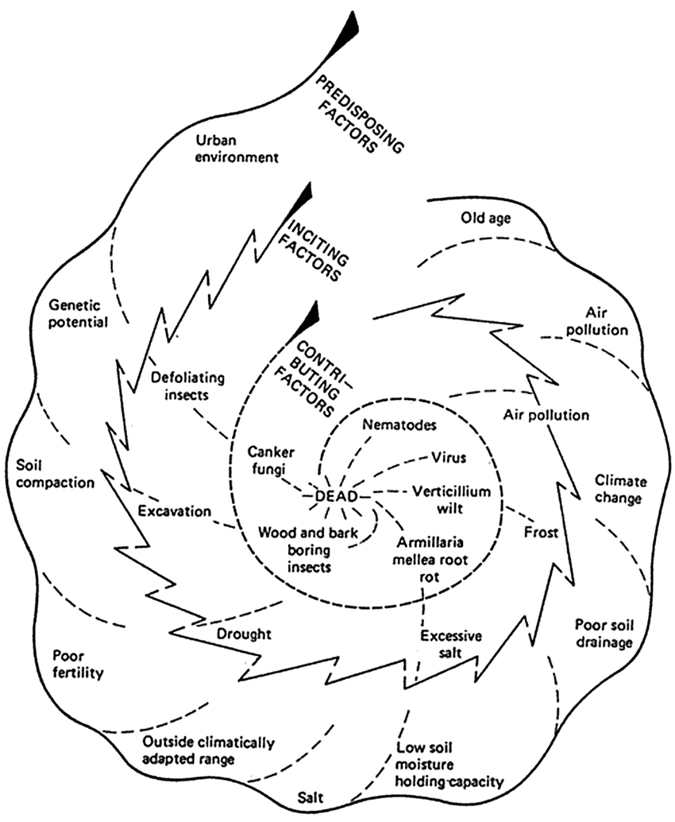
Data analysis
M&M .
1.- Bibliographic revision
Vulnerability =/= response
Tree size (dbh, altura)
Competition (Hegyi index)
iWUE (SLA, EWT)
Growth
Resistance & Resilience (Lloret’s indices)
Defoliation
Pigments (Chl, carotenoids)
Leaf isotopes (δ¹³C, δ¹⁵n, δ¹⁸O)
Wood isotopes (δ¹³C, δ¹⁵n, δ¹⁸O)
=/=

Slide 13
Data analysis
M&M .
2.- Correlogram
Redundant variables:
All average BAI values at different time scales are highly correlated → we should just pick one
Height and d.b.h. are highly correlated
Age is not that correlated to tree size (surprisingly)
What variables should we choose?
Response ratios

Slide 14
Data analysis
M&M .
3.- Response ratios
LogRR = log(X_{declining} / X_{non-declining})
To see how much do variables change between declining and non-declining sites
Variables with higher response ratios will be more useful to forecast vulnerability to drought
BAI since 1980 is the better predictor in general and among all the growth average values
Competition and age are great too
D.b.h. is worse predictor than height

Slide 15
Data analysis
M&M .
3.- Response ratios
LogRR = log(X_{declining} / X_{non-declining})
To see how much do variables change between declining and non-declining sites
This is the final selection!

Slide 16
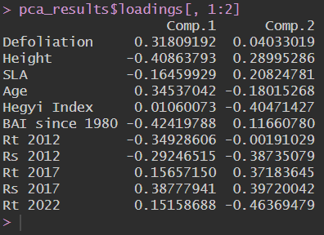
Data analysis
M&M .
4.- PCA
The first two axes explain a 67.07% of the variance
High orthogonality
Comp. 1: height, BAI, age, 2012 resistance,
Comp. 2: SLA, competition, resilience, 2017 & 2022 resistance

Slide 17
Preliminary results
M&M .
Tree height is higher in non-declining sites in all species.
Taller trees might be less vulnerable due to them having access to deeper water sources
Competition is more intense in declining sites. Denser stands are more vulnerable due limitting water and nutrients availability per individual
Age is higher in declining sites (for P. sylvestris).
Older trees are more vulnerable due to higher hydraulic limitations and reduced photosynthetic efficiency
Contrary to what we expected!

Slide 18
Preliminary results
M&M .
SLA is higher in non-declining sites.
With decreased water availability, trees can reduce SLA to prevent further water losses
Growth rates are more intense in higher in declining sites. Trees with declining growth rates are more vulnerable to drought
Contrary to what we expected!

Slide 19
Preliminary results
M&M .
Resistance and Resilience values are different according to the year and the species

