Slide 1
Preliminar analyses - Figures
Chapter 2: assessing individual factors determining drought vulnerability

Slide 2
Complementary strategies to cope with drought
Introduction.
Morphological traits
Tree growth
BAI, height, dbh
Photosynthesis, root system, reserves
↓
↑
Cell turgor, photosynthesis
↓
SLA
↑
↑
defoliation
↓
ABA, ROS
Declining
sites
Non-declining
sites

Slide 3
Complementary strategies to cope with drought
Introduction.
Physiological traits
↓
Chlorophylls
↑
Synthesis downregulation, ROS
↑
Carotenoids
↓
Photoprotection
↓
LWC
↑
Osmoregulation, permeability
↑
δ¹³C, δ¹⁸O
↓
Photosynthesis, transpiration
↓
N content
↑
N uptake
Declining
sites
Non-declining
sites

Slide 4
Study area
M&M .
Fig. 1.: Study sites in Iberia. Coloured areas represent the distribution area of each species.
Field data sampling:
02/2023 – 09/2023
14 sites, 91 plots
462 target trees
Fig. 1

Slide 5
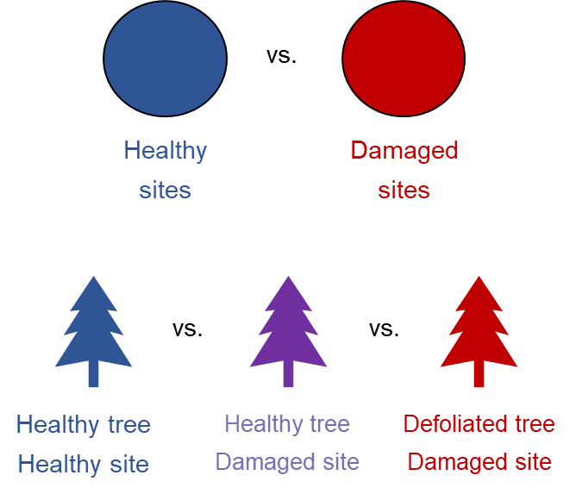
Objectives & Hypotheses
Introduction.
Obj. 1.- To characterise underlying mechanisms behind drought vulnerability through assessment of morphological and physiological traits responses in drought-induced damaged vs. healthy areas
H1.- We expect tree size, past tree growth, competition and leaves traits to determine tree vulnerability to drought:
Non-declining
Declining
Non-declining site
Non-declining site
Declining site

Slide 6
Objectives & Hypotheses
Introduction.
Obj. 1.- To characterise underlying mechanisms behind drought vulnerability through assessment of morphological and physiological traits responses in drought-induced damaged vs. healthy areas
H1.- We expect tree size, past tree growth and resilience, competition and leaves traits to determine tree vulnerability to drought:
Size: bigger trees will be more vulnerable due to hydraulic limitations (increased hydraulic resistance) → ↑ height, age & dbh in declining sites
Growth: we expect a reduced growth trend, and resilience → ↓ BAI, Rt & Rs in declining sites
Leaves traits: a higher SLA leads to faster water loss → ↑ SLA in declining sites
Competition: competition reduces water availability per tree and increases water interception → ↑ Hegyi index in declining sites

Slide 7
Objectives & Hypotheses
Introduction.
Obj. 2.- To assess morphological and physiological responses to drought, and what traits are more affected
H2.- We expect drought-induced reduced photosynthetic pigments concentrations, increased iWUE and leaves nutrients allocation
Pigments: water stress-induced increased ABA and ROS trigger upregulation of senescence-associated genes (SAG), and to damages to photosynthetic apparatus → ↓ Pigments concentration
iWUE: we an isohydric behaviour leading to stomatal closure → ↑ δ¹³C and δ¹⁸O in leaves and wood tissue
Nutrients: we nutrient allocation in leaves due to drought-induced reduced nutrients uptake → ↓N concentration and ↑ C:N ratio in declining sites
Non-declining
Declining
Non-declining site
Non-declining site
Declining site

Slide 8
Objectives & Hypotheses
Introduction.
Obj. 3.- To assess how underlying mechanisms behind drought vulnerability vary due to long-term adaptations along a moisture gradient
H3.- We expect higher vulnerability to increased aridity in temperate species than Mediterranean species

Slide 9
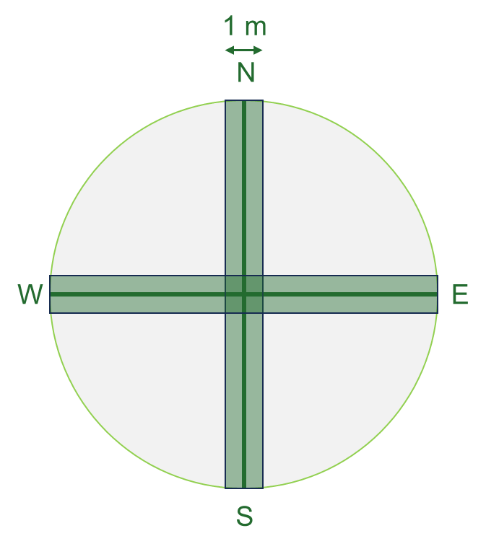

Sampling design
M&M .
34 m
1.- Mature trees inventory
Species identity, defoliation & d.b.h.
2.- Regeneration inventory
Species identity & height
3.- Shrub inventory
Species identity, height & cover
4.- Target trees
Height
LWC
SLA
Photosynthetic pigments
Isotopes (C, N, O)
5.- Soil data
Non-declining
Declining
Non-declining site
Non-declining site
Declining site

Slide 10
Sampling design
M&M .
Morphological
Tree growth → dendro
Leaf traits → leaf area & defoliation
Physiological
Photosynthesis → spectrophotometry
Water relations → water content
Leaf nutrients → C & N content
Leaf isotopes → isotopes
23 plots
51 plots
17 plots
5 targets x 91 plots
Abies alba
Pinus sylvestris
Pinus pinea
462 target trees

Slide 11
Data analysis
M&M .
Morphological
Tree growth → dendro
Leaf traits → leaf area & defoliation
Physiological
Photosynthesis → spectrophotometry
Water relations → water content
Leaf nutrients → C & N content
Leaf isotopes → isotopes
We have way too many variables!
Variable selection:
Bibliographic revision → to only keep traits that determine vulnerability
Correlogram → to see what variables are redundant
Response Ratio → to select the variables that might best forecast vulnerability
PCA → to group variables that behave similarly

Slide 12
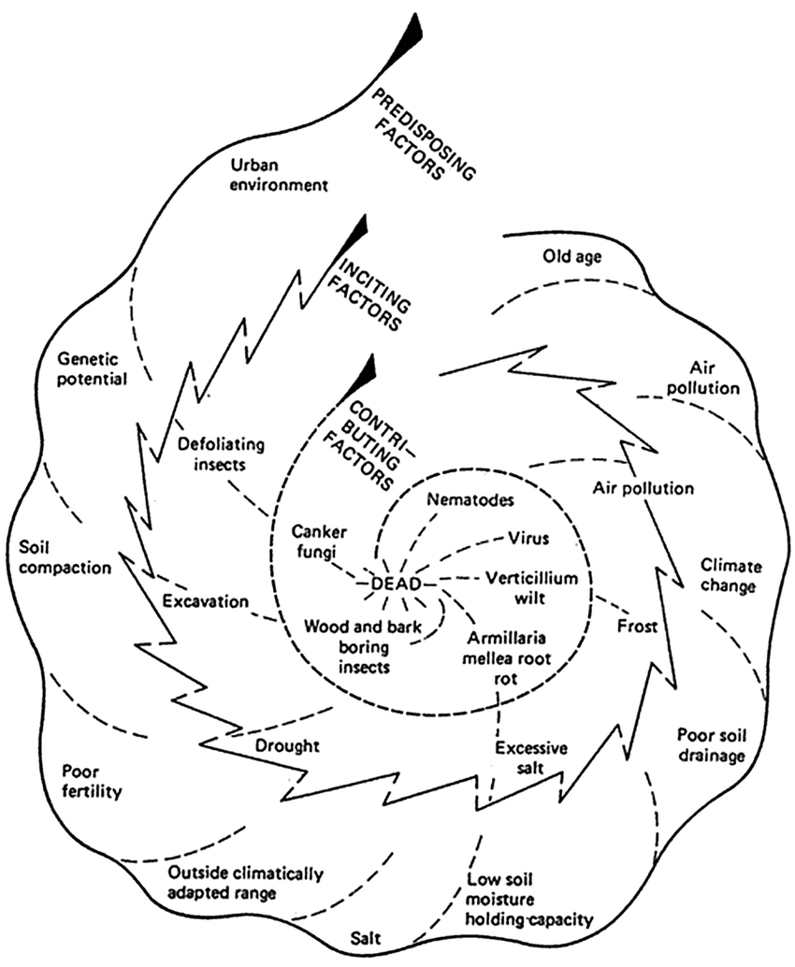
Data analysis
M&M .
1.- Bibliographic revision
Vulnerability =/= response
Tree size (dbh, altura)
Competition (Hegyi index)
iWUE (SLA, EWT)
Growth
Resistance & Resilience (Lloret’s indices)
Defoliation
Pigments (Chl, carotenoids)
Leaf isotopes (δ¹³C, δ¹⁵n, δ¹⁸O)
Wood isotopes (δ¹³C, δ¹⁵n, δ¹⁸O)
=/=

Slide 13
Data analysis
M&M .
2.- Correlogram
Redundant variables:
All average BAI values at different time scales are highly correlated → we should just pick one
Height and d.b.h. are highly correlated
Age is not that correlated to tree size (surprisingly)
What variables should we choose?
Response ratios

Slide 14
Data analysis
M&M .
3.- Response ratios
LogRR = log(X_{declining} / X_{non-declining})
To see how much do variables change between declining and non-declining sites
Variables with higher response ratios will be more useful to forecast vulnerability to drought
BAI since 1980 is the better predictor in general and among all the growth average values
Competition and age are great too
D.b.h. is worse predictor than height

Slide 15
Data analysis
M&M .
3.- Response ratios
LogRR = log(X_{declining} / X_{non-declining})
To see how much do variables change between declining and non-declining sites
This is the final selection!

Slide 16
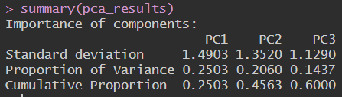
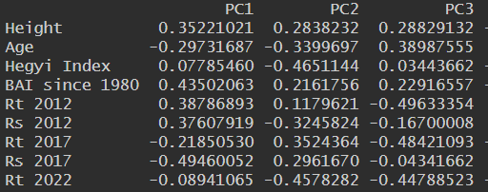
Data analysis
M&M .
4.- PCA
The first two axes explain a 45.60% of the variance (too little?); the first three a 60.00%
High orthogonality
Comp. 1: height, BAI, resilience
Comp. 2: competition, 2022 resistance
Comp. 3: age, 2012 6 2017 resistance

Slide 17
Preliminary results
M&M .
Tree height and d.b.h. are higher in non-declining sites in all species.
Bigger trees might be less vulnerable due to them having access to deeper water sources
Age is higher in declining sites (for P. sylvestris).
Older trees are more vulnerable due to higher hydraulic limitations and reduced photosynthetic efficiency
Contrary to what we expected!

Slide 18
Preliminary results
M&M .
Competition is more intense in declining sites. Denser stands are more vulnerable due limitting water and nutrients availability per individual
SLA is higher in non-declining sites.
With decreased water availability, trees can reduce SLA to prevent further water losses
SLA is a response instead of a vulnerability factor!
Contrary to what we expected!

Slide 19
Preliminary results
M&M .
Resistance and Resilience values are different according to the year and the species
Growth rates are more intense in higher in declining sites. Trees with declining growth rates are more vulnerable to drought

Slide 20
Preliminary results
M&M .
Fig. 2

Slide 21
Preliminary results
M&M .
Fig. 3

Slide 22
Data analysis
M&M .
5.- Model
Is it worth it grouping the variables in three components?
Linear Mixed Model or Structural Equations Model?
Defoliation = SPEI + PCA1 + PCA2 + PCA3 + (1 | site / plot id / tree id) ¿?
SPEI: we have no variability for A. alba and P. pinea → Model climatic niche first?
Should I try selecting variables with an AICc instead of grouping them by PCA’s components?

Slide 23
Data analysis
M&M .
5.- Model
SPEI: we have no variability for A. alba and P. pinea → Model climatic niche first?
We could start a LMM with just P. sylvestris first?

Slide 24
Data analysis – Physiological responses
M&M .
3.- Response ratios
LogRR = log(X_{declining} / X_{non-declining})
To see how much do variables change between declining and non-declining sites
Variables with higher response ratios will be more useful to characterise physiological responses to drought
Leaves isotopes are better predictors than wood isotopes
Chlorophyll is the best predictor regarding leaves pigments
N concentration is the best predictor regarding leaves nutrients

Slide 25
Data analysis – Physiological responses
M&M .
3.- Response ratios
LogRR = log(X_{declining} / X_{non-declining})
To see how much do variables change between declining and non-declining sites
This is the final selection!

Slide 26
Preliminary results
M&M .
Chlorophyll content is lower in declining than non-declining sites.
Water stress upregulates the expression of senescence-associated genes and the sythesis of ROS, damaging the photosynthetic apparatus.
This responses follow a temperate – Mediterranean gradient.

Slide 27
Preliminary results
M&M .
Leaves N content shows lower values in declining tan non-declining sites due to drought-induced N allocation and impaired N uptake . This pattern, however, is more clear at site-level.

Slide 28
Preliminary results
M&M .
Declining sites show lower SLA values, particularly in Abies alba, which reflects a shift towards a more water conservative strategies
Declining sites show a significantly lower leaves water content loss of cell turgor, particularly in temperate species
Isotopes show a tighter stomatal control in declining sites, particularly in temperate species → increased iWUE

Slide 29
Preliminary results
M&M .
Fig. 4

Slide 30
Preliminary results
M&M .
No significant differences between Declining vs. Non-declining for any species:
SLA
Leaves N content
Leaves C:N ratio
Leaves δ¹⁸O
Resistance 2017
Resistance 2022
Hegyi Index
Total chl. content
Chl. a content
Chl. b content
Carotenoids content

Slide 31
Preliminary results
M&M .
No significant differences between Declining vs. Non-declining for any species:
SLA
Leaves N content
Leaves C:N ratio
Leaves δ¹⁸O
Resistance 2017
Resistance 2022
Hegyi Index
Total chl. content
Chl. a content
Chl. b content
Carotenoids content

Slide 32
Preliminary results
M&M .
Differences between Declining vs. Non-declining for any species:
Variable | A. alba | P. sylvestris | P. pinea | All
Height | ** | *** | - | ****
d.b.h. | ** | - | - | **
Age | - | **** | - | ****
Defoliation | **** | **** | - | ****
LWC | - | **** | - | ****
Chl. a/b | - | ** | - | ***
Chl. / xc | *** | - | - | *
C content | - | *** | - | -
δ¹³C | * | - | - | **
δ¹⁵N | - | **** | - | -

Slide 33
Preliminary results
M&M .
Differences between Declining vs. Non-declining for any species:
Variable | A. alba | P. sylvestris | P. pinea | All
BAI | **** | **** | - | ****
BAI 1980 | **** | **** | - | ****
BAI 20 | ** | **** | - | ****
BAI 15 | ** | **** | - | ****
BAI 10 | - | **** | - | ****
BAI 05 | - | **** | - | ****
Rt12 | - | **** | - | ****
Rs12 | - | **** | - | -
Rs17 | - | **** | - | -

