Slide 1
SEM RESULTS OUTLINE
26/01/2026

Slide 2
SLA
BAI80
height
Evaporative water loss – gas exchange trade-off
Hydraulic constraints, limitted PS, access to water sources
Changes in PS rates and C balance
Hydraulic constraints
Tree decline preceded by lower growth rates
Higher growth promoting hydraulic filure, growth-resistance trade-off
Are LES and stomatal responses coordinated?
Hydraulic constraints, limited PS, vulnerability pests
δ13C
Reduced C gains (high demand, lower PS)
Does height increase vulnerability to drought?
C starvation
Is decline driven by resource use?
Is decline driven by C-water disbalance?
Defoliation

Slide 3
All together (no multigroup)
SLA
BAI80
0.628
height
-0.225
-0.105
-0.455
δ13C
CFI: 1.000
TLI: 1.000
-0.299
Defoliation

Slide 4
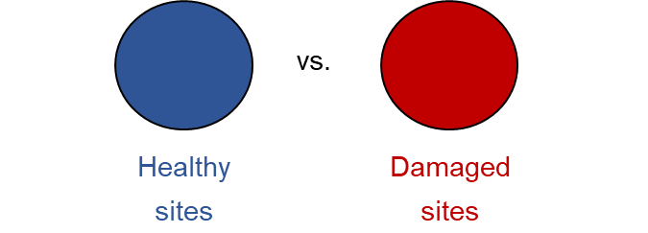
Conceptual models
SLA
BAI80
height
SLA
BAI80
height
δ13C
δ13C
Defoliation
Non-declining
Declining

Slide 5
Multigroup SEM
SLA
-0.191
BAI80
0.811
height
0.224
SLA
BAI80
height
-0.142
-0.394
-0.507
-0.467
δ13C
δ13C
CFI: 0.957
TLI: 0.743
-0. 398
Defoliation
Non-declining
Declining

Slide 6
SLA
-0.191
BAI80
0.811
height
0.224
SLA
BAI80
height
-0.142
-0.394
-0.507
-0.467
δ13C
δ13C
Non-declining
Declining
-0. 398
Defoliation
Taller tres grow more in D sites → Better access to water?
Height-driven hydraulic constraints → slightly more intense in declining sites
SLA decreases reduce transpiration → conservative response
Tree decline driven by decreased growth

Slide 7
Adding d18O?

Slide 8
All species
Replacing d13C by d18O makes the SEM WORSE
SLA
-0.196
BAI80
0.807
height
0.224
SLA
BAI80
height
-0.366
-0.380
δ18O
-0.398
δ18O
CFI: 0.852
TLI: 0.113
Defoliation
Non-declining
Declining

Slide 9
All species
Adding a covariance between isotopes?
SLA
-0.196
BAI80
0.807
height
0.224
SLA
BAI80
height
-0.406
-0.498
-0.137
-0.432
-0.398
δ13C
δ18O
0.234
δ13C
CFI: 0.873
TLI: 0.677
Non-declining
Declining
Defoliation
Within declining sites, d13C and d18O are coupled?

Slide 10
Adding d18O…
Non-declining
Declining
SLA
BAI80
height
SLA
BAI80
height
δ18O
δ13C
δ18O
δ13C
Need to try this, enough n (14 paths in declining, 9 in non-declining
Defoliation

Slide 11
Adding a covariance between C and O worsens the model → positive in declining??
All connected? Too complex
Replacing d13C by d18O worsens the model
How can we add it then?

Slide 12
Model per species

Slide 13
Abies alba
SLA
height
SLA
height
-0.643
0.488
-0.392
δ13C
δ13C
CFI: 0.843
TLI: 0.057
Defoliation
Non-declining
Declining

Slide 14
Abies alba
SLA
height
SLA
height
-0.643
0.488
-0.392
δ13C
δ13C
Trying with fixed.x did not help
Removing defoliation did not help
Defoliation
Height-driven hydraulic constraints only in declining sites

Slide 15
Abies alba (log)
Log(SLA)
Log (height)
Log (height)
-0.638
0.552
-0.317
δ13C
δ13C
CFI: 0.876
TLI: 0.256
0.319
Log(Defo)
Non-declining
Declining

Slide 16
Pinus sylvestris
BAI80
0.298
height
0.352
SLA
BAI80
height
-0. 561
-0.274
-0.330
δ13C
δ13C
0.380
CFI: 0.967
TLI: 0.801
Defoliation
Non-declining
Declining

Slide 17
Pinus sylvestris
BAI80
0.298
height
0.352
SLA
BAI80
height
-0. 561
-0.274
-0.330
δ13C
δ13C
0.380
Taller trees more defoliated in declining sites → but not due to d13C?
Strong coordination SLA-d13C → conservative strategies
Defoliation

Slide 18
Pinus pinea
Since SLA → d13C is non-significant, I exclude it from the SEM as we have very small n (23 for non-declining, 54 for declining)
SLA
BAI80
height
SLA
-0.267
BAI80
0.360
height
-0.357
0.465
δ13C
δ13C
-0.340
0302
Defoliation
Nothing is significant…
Non-declining
Declining

Slide 19
Pinus pinea
Since SLA → d13C is non-significant, I exclude it from the SEM as we have very small n (23 for non-declining, 54 for declining)
SLA
BAI80
height
SLA
-0.267
BAI80
0.360
height
-0.357
0.465
δ13C
δ13C
-0.340
0302
Height-driven hydraulic constraints in declining trees
Trees that grew more are less conservative and defoliated
Defoliation

