Slide 1
Variable selection Objectives 1 & 2 Results Model proposal
Chapter 2
19/11/2025

Slide 2
Theoretical framework How certain trees and stands are more vulnerable to drought?
Tree size
Resource use economic spectrum:
Size / leaf / N
Tree size
Leaf C use
Leaf nutrients
Height, d.b.h., age, Hegyi
C content, SLA, C:N
N content, δ15N
Water use
Photoprotection pigments
Photosynthetic pigments
C economy & WUE
LWC, δ13C, δ18O
Carotenoids, Chl. / car.
Chl., chl. a/b, chl. A, chl. b
Tree growth
BAI80, BAI05, Rt, Rs

Slide 3
Variable selection Theoretical knowledge
Tree size
Resource use economic spectrum:
Size / leaf / N
Tree size
Leaf C use
Leaf nutrients
Height, d.b.h., age, Hegyi
C content, SLA, C:N
N content, δ15N
Water use
Photoprotection pigments
Photosynthetic pigments
C economy & WUE
LWC, δ13C, δ18O
Carotenoids, Chl. / car.
Chl., chl. a/b, chl. A, chl. b
Tree growth
BAI80, BAI05, Rt, Rs

Slide 4
‘Slow’
‘Fast’
Leaf Economics Spectrum
↓ N content
↓ Photosynthetic rates
↓ SLA
↑ N content
↑ Photosynthetic rates
↑ SLA
Wright et al., 2004
Conservative
Acquisitive
Whole-plant economics spectrum
↓ N content
↓ Photosynthetic rates
↓ SLA
↓ Transpiration rates
↓ Growth rates
↑ N content
↑ Photosynthetic rates
↑ SLA
↑ Transpiration rates
↑ Growth rates
Reich, 2014
Height
Decoupled from LES (Díaz et al., 2016)
Conditions hydraulics and growth (Darcy’s Law)

Slide 5
Abies alba
P. sylvestris
P. pinea

Slide 6



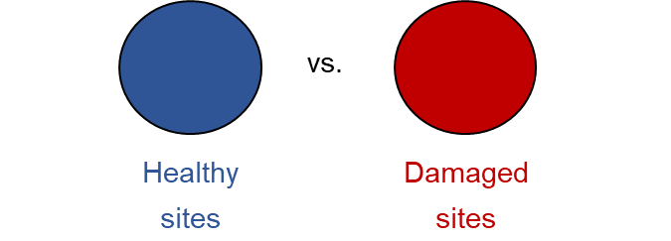



Objectives
Obj. 1 – To characterise tree morphological, physiological and whole-tree responses to drought
Obj. 2 – To assess trait coordination within species
Obj. 3 – To modelise tree responses to describe the underlying processes of tree decline
vs.
vs.
Abies alba Temperate
Pinus sylvestris Temperate
Pinus pinea Mediterranean
AIC comparison
Non-declining
Declining
PCA ordination
vs.
vs.
Healthy tree
Non-declining site
Healthy tree
Declining site
Damaged tree
Declining site
DECIDE WHAT TO MODEL

Slide 7
Obj. 1.
Non-declining
Declining
vs.
Healthy tree
Declining site
Damaged tree
Declining site
Abies alba
Abies alba
↓ Height (site productivity)
↓ SLA (conservative strategies)
↑ δ¹³C (increased WUE)
↓BAI (lower growth)
↑ Height
Pinus sylvestris
Pinus sylvestris
↓ Chl. & Car.
↓ BAI
↓ Height
↓ BAI
Pinus pinea
Pinus pinea
↓ Chl. & Car.
↓ Height
↓ SLA
Not strong correlations

Slide 9
Obj. 1.
vs.
Non-declining
Declining
Healthy tree
Declining site
Damaged tree
Declining site
Abies alba
Declining sites:
Shorter trees, more conservative strategies
Abies alba
↓ Height (site productivity)
↓ SLA (conservative strategies)
↑ δ¹³C (increased WUE)
↓BAI (lower growth)
↑ Height
Pinus sylvestris
Pinus sylvestris
↓ Chl. & Car.
↓ BAI
Declining trees:
Lower chlorophyll and growth
↓ Height
↓ BAI
Pinus pinea
Pinus pinea
↓ Chl. & Car.
↓ Height
↓ SLA

Slide 10
Obj. 2 – To assess trait coordination within species
PCAs
Existence of a global plant traits spectrum!
Temperate species: PC1 – resource acquisition / PC2 - photosynthesis
Taller trees ‘faster strategies’
Mediterranean species: PC1 – resource acquisition?
Taller trees ‘slower strategies’

Slide 11
Obj. 2 – To assess trait coordination within species
Two options:
Different PCAs to check how ordination changes.
PCA all together
We have done both! But nice results come from the first, because ordination changes.

Slide 12
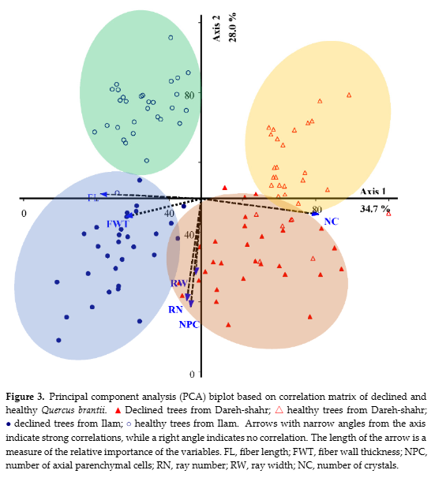
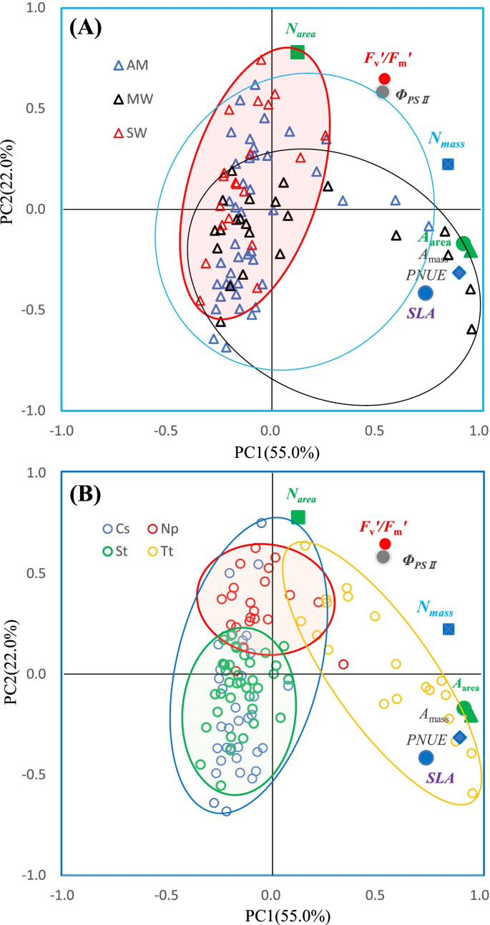
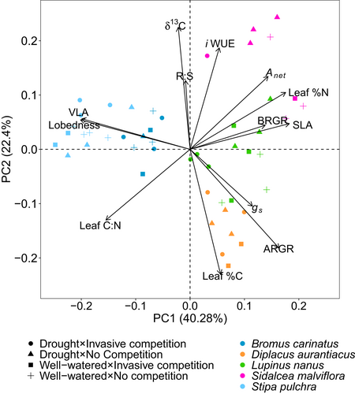
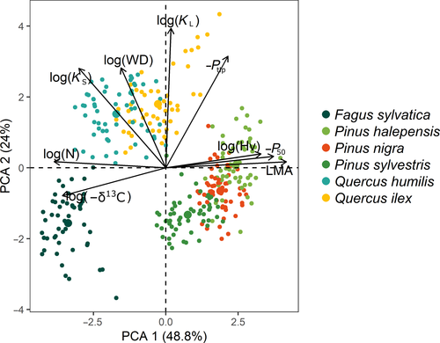
Soheili et al. 2023
Healthy (hollow) vs. Declining (full) oaks. Coordination of parenchyma anatomy
Yu et al. 2023
Control (AM) vs. Moderate (MW) vs. Severe warming (SW)
Luong & Loik 2022
Different stress treatments in C3 and C4 Californian grasses
Rosas et al. 2021
Trait coordination of Mediterranean species

Slide 13
Obj. 2 – Maybe to Supporting?
PERMANOVA:
Declining vs. Non-declining: significant divergence
Healthy vs. Damaged: no significant divergence

Slide 14
Obj. 2 – To assess trait coordination within species
Abies alba
Similar trait variability (functional space)
Non-declining: more acquisitive (↑ growth and SLA)
Declining: more conservative (↑δ¹³C)

Slide 15
Obj. 2 – To assess trait coordination within species
Pinus sylvestris
Reduced variability in declining sites!
Non-declining: more acquisitive (↑ growth, N and SLA)
Declining: more conservative (↑δ¹³C)

Slide 16
Obj. 2 – To assess trait coordination within species
Pinus pinea
More trait variability in declining sites
No LES?
Non-declining: ↑ growth and ↑δ¹³C → ↑iWUE?
Declining: ↑N → PS?

Slide 17
Obj. 2: Lower trait coordination in declining than non-declining sites (in non-decline three groups: LES + height, clorophyll, WUE)
Abies alba
Maybe to Supporting?
Drought-induced decline collapses trait coordination (Yu et al. 2022)
Growth determined by resource acquisition
Growth limited by stomatal regulation

Slide 18
Obj. 2: Lower trait coordination in declining than non-declining sites (in non-decline three groups: LES + height, clorophyll, WUE)
Pinus sylvestris
Maybe to Supporting?
Defoliation → ‘slow’ strategy
Growth limited by stomatal regulation
LES preserved even in decline conditions

Slide 19
Obj. 2: Lower trait coordination in Mediterranean species: height + growth, photosynthesis + WUE, but LES not coordinated
Pinus pinea
Maybe to Supporting?
Larger trees ‘slower’ strategies
Trade-off growth-PS
N-SLA?

Slide 20
Obj. 2 – To assess trait coordination within species
Existence of within-species trait coordination
LES + height // PS
Declining trees shift towards more conservative strategies (LES)

Slide 21
Obj. 3 – Model structure
Non-declining
Declining
SLA related to hydraulics
LES
(N, SLA)
Growth
(BAI80)
Tree size
(h)
Leaf N content (=PS capacity) determines iWUE (=d13C) (Benavides et al. 2023; Querejeta et al. 2025)
Defoliation is a consequence of reduced growth (Camarero et al. 2015)
Nm and SLA very correlated regardless of stress (Yu et al. 2022)
Pigments
Defoliation
Most N in leaves in form of RuBisCo and other phosotynthetic enzymes → N content already summarizes it
(Field & Mooney 1986; Galiano et al. 2011; Benavides et al. 2023)
WUE
(d13C, d18O)

Slide 22
Obj. 3 – Model structure
Non-declining
Declining
SLA related to hydraulics
LES
(N, SLA)
Growth
(BAI80)
Tree size
(h)
Leaf N content (=PS capacity) determines iWUE (=d13C) (Benavides et al. 2023; Querejeta et al. 2025)
Defoliation is a consequence of reduced growth (Camarero et al. 2015)
Nm and SLA very correlated regardless of stress (Yu et al. 2022)
Defoliation
WUE
(d13C, d18O)
Most N in leaves in form of RuBisCo and other phosotynthetic enzymes → N content already summarizes it
(Field & Mooney 1986; Galiano et al. 2011; Benavides et al. 2023)
Pigments
Pinus pinea Mediterranean

