Slide 1
Chapter 2 – Assessing individual factors determining drought vulnerability
Cristopher Fernández de Blas - 24/07/2025 IB-ForRes Project

Slide 2
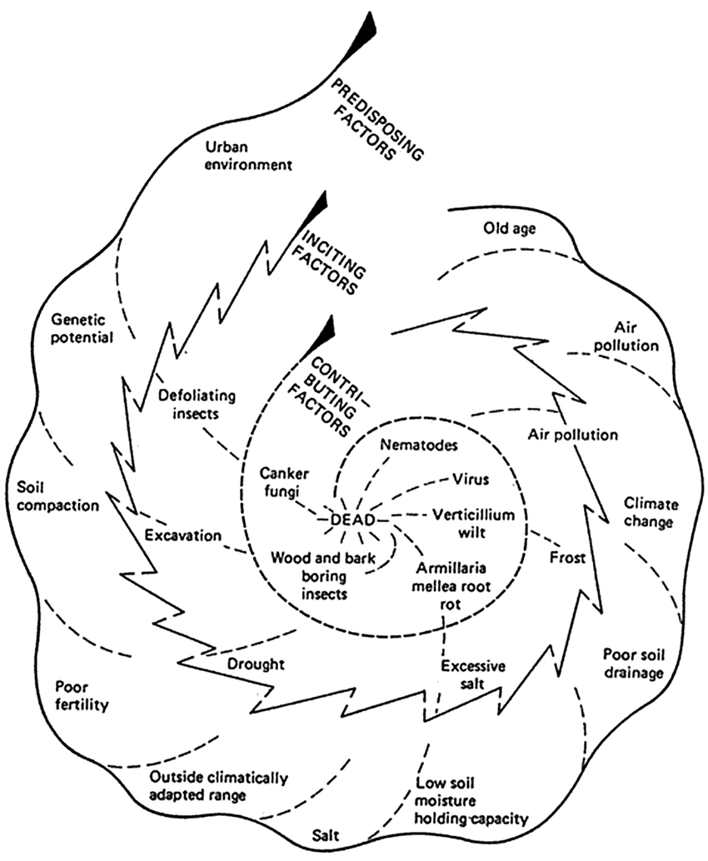
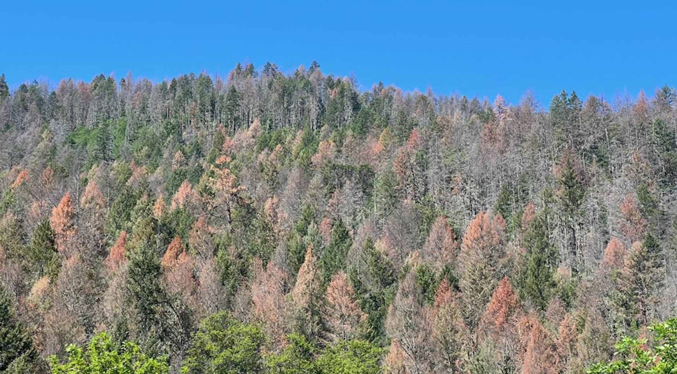
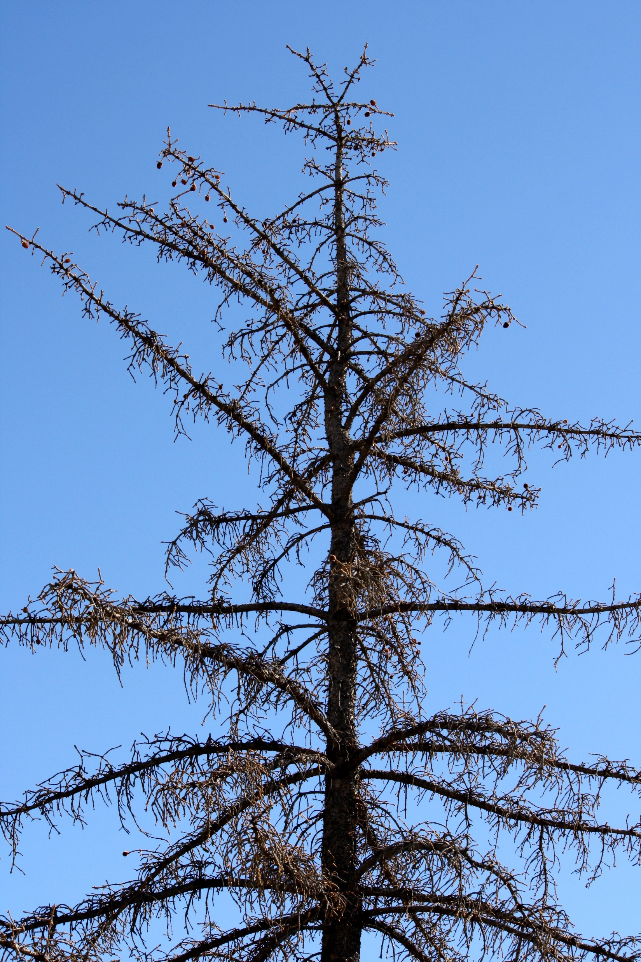
Drought-induced tree mortality
Introduction.
It is hard to forecast drought-induced die-back events
Individual level
Early-warning signals?

Slide 3
Complementary strategies to cope with drought
Introduction.
Mortality rates are highly variable
Dieoff is triggered by inciting factors:
Forecasting tool!
Predisposing factors: extrinsic conditions or intrinsic traits that increase the chances to undergo die-off (i.e. height, competition, climate)
Inciting factors: single events that trigger mortality (i.e. drought, outbreaks, etc.)
Contributing factors: non-lethal agents that further contribute to mortality (i.e. parasitic fungi).
Manion et al. 1991

Slide 4

Complementary strategies to cope with drought
Introduction.
Isohydric
Anisohydric
Conifers
Maintain leaf Ψ
Stomatal closure
↓ Transpiration
↓ Photosynthetic rates
Close to hydrulic safety margin → Leaf ↓Ψ
Embolism
↑ Transpiration
↑ Photosynthetic rates
Carbon starvation
Hydraulic failure

Slide 5
Complementary strategies to cope with drought
Introduction.
C starvation
Hydraulic failure
Drought
↑ Temp.
Drought
↑ Temp.
↓Ψ soil
↑ Evapotranspirative demand
↓Ψ soil
↑ Evapotranspirative demand
↓Transpiration
↓g_{s}
↑Tension
xylem
↑Transpiration
Not mutually exclusive!
↓Hydraulic conductance
↓Photosynthesis
C tradeoffs
Embolism
↓Growth
↓Defenses
↓Resilience
↓Growth
↓Photosynthesis
McDowell et al., 2008

Slide 6
Complementary strategies to cope with drought
Introduction.
Predisposing factors affect these mechanisms
Drought
↑ Temp.
Drought
↑ Temp.
Competition
Competition
↓Ψ soil
↑ Evapotranspirative demand
↓Ψ soil
↑ Evapotranspirative demand
Height
Height
Former growth
↑Tension
xylem
↓Transpiration
↓g_{s}
↑Transpiration
Age
Rs, Rt
↓Hydraulic conductance
↓Photosynthesis
C tradeoffs
Embolism
↓Growth
↓Defenses
↓Resilience
↓Growth
↓Photosynthesis

Slide 7
Complementary strategies to cope with drought
Introduction.
Mortality may be a fast or slow process /
Mortality rates are highly variable → look into predisposing
Dieoff is modulated by predisposing factors
Tree size (dbh, height)
Age
Competition (Hegyi index)
Growth (all, 1980)
Lloret’s Rt (2012, 2017, 2022)
Lloret’s Rs (2012, 2017)
Potential predictors for drought-induced die-off!

Slide 8
Resource-use strategies
Introduction.
Leaf Economics Spectrum
Conservative
Acquisitive
↓ N content
↓ Photosynthesis
↓ Growth rates
↓ SLA
↑ N content
↑ Photosynthesis
↑ Growth rates
↑ SLA
Wright et al., 2004

Slide 9
Responses to drought
Introduction.
Towards a more conservative strategy?
Drought
↑ Temp.
↓Cell turgor
↑ Evapotranspirative demand
↓Ψ plant
↑Oxidative damage
↓LWC
↓ SLA
↓Transpiration
↓Chl., ↑Carotenoids
N reabsorption
↓Photosynthesis
↑ δ¹³C, δ¹⁸O
Defoliation
↓C:N
↓Growth

Slide 10
Complementary strategies to cope with drought
Introduction.
Mortality may be a fast or slow process /
Mortality rates are highly variable → look into predisposing
Dieoff may induce several responses:
Defoliation
Pigments (Chl, carotenoids)
Nutrients (C, N, C:N)
SLA
LWC
Leaf isotopes (δ¹³C, δ¹⁵n, δ¹⁸O)
Wood isotopes (δ¹³C, δ¹⁵n, δ¹⁸O)
Growth (05, 10, 15, 20)
=/=

Slide 11
Complementary strategies to cope with drought
Introduction.
Predisposing factors
(Sánchez-Salguero et al. 2012, Allen et al. 2015)
(De Soto et al. 2020, Serra-Maluquer et al. 2021, Valeriano et al. 2021)
Responses
(Liu et al. 2017, Jaleel et al. 2018)
Extrinsic factors
Abiotic (climate, soil)
Biotic (competition)
Morphological responses
SLA
Leaves nutrients (C, N, C:N)
Physiological responses
Pigments (Chl., carotenoids)
LWC
Leaves isotopes (δ¹³C, δ¹⁵N, δ¹⁸O)
Wood isotopes
Whole-plant responses
Short-term growth
Defoliation
Intrinsic factors
Hydraulic traits
Tree size (height, dbh)
Tree age
Long-term growth

Slide 12
Complementary strategies to cope with drought
Introduction.
Main objective: to assess the predisposing factors and indivual responses to drought-induced die-off.
Extrinsic factors
Abiotic (climate, soil)
Biotic (competition)
Morphological responses
SLA
Leaves nutrients (C, N, C:N)
Physiological responses
Pigments (Chl., carotenoids)
LWC
Leaves isotopes (δ¹³C, δ¹⁵N, δ¹⁸O)
Wood isotopes
Whole-plant responses
Short-term growth
Defoliation
Intrinsic factors
Hydraulic traits
Tree size (height, dbh)
Tree age
Long-term growth

Slide 13
Complementary strategies to cope with drought
G.I.K..
We still do not know the relative importance of predisposing factors at regional scale and across species
Obj. 1.: To assess predisposing factors determining tree die-off
Lack of regional scale studies
Understudied species-specific responses
+
Extrinsic factors
Morphological responses
Whole-plant responses
Short-term growth
Defoliation
Intrinsic factors
Physiological responses
We are still unable to forecast die-off!

Slide 14
Complementary strategies to cope with drought
G.I.K..
We lack regional-scale studies integrating multiple drought-induced responses of trees and several species
Obj. 2.: To characterize tree morphological, physiological and whole-plant responses to drought at regional level and across species and assess what responses are more affected
Lack of regional scale studies
Understudied species-specific responses
+
Extrinsic factors
Morphological responses
Whole-plant responses
Short-term growth
Defoliation
Intrinsic factors
Physiological responses
We are still unable to forecast die-off!

Slide 15
Complementary strategies to cope with drought
G.I.K..
We still do not know how traits converge upon drought and how it varies across species
Underlooked interactions between responses
Obj. 3.: To assess the convergence of traits and the coordination between responses in healthy vs. damaged trees
Extrinsic factors
Morphological responses
Whole-plant responses
Short-term growth
Defoliation
Intrinsic factors
Physiological responses
We are still unable to forecast die-off!

Slide 16
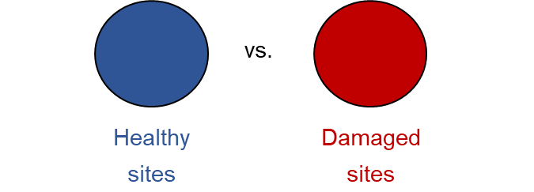






Objectives & Hypotheses
.
Obj. 1.- To assess the predisposing factors determining drought susceptibility and their relative importance across species
H1.- We expect tree size, past tree growth, competition and leaves traits to determine tree vulnerability to drought:
vs.
vs.
vs.
vs.
Non-declining
Declining
Abies alba Temperate
Pinus sylvestris Temperate
Pinus pinea Mediterranean
Healthy tree
Non-declining site
Healthy tree
Declining site
Damaged tree
Declining site

Slide 17
Objectives & Hypotheses
.
Obj. 1.- To assess the predisposing factors determining drought susceptibility and their relative importance across species
H1.- We expect tree size, past tree growth and resilience, competition and leaves traits to be main drivers for tree mortality:
Size: bigger trees will be more vulnerable due to hydraulic limitations (increased hydraulic resistance) → ↑ height, age & dbh in declining sites
Growth: we expect a reduced growth trend, and resilience → ↓ BAI, Rt & Rs in declining sites
Leaves traits: a higher SLA leads to faster water loss → ↑ SLA in declining sites
Competition: competition reduces water availability per tree and increases water interception → ↑ Hegyi index in declining sites
vs.
vs.
vs.
vs.
Figs. 2 & 3: boxplot
Abies alba Temperate
Pinus sylvestris Temperate
Pinus pinea Mediterranean
Healthy tree
Non-declining site
Healthy tree
Declining site
Damaged tree
Declining site

Slide 18
Objectives & Hypotheses
.
Obj. 2.- To characterize tree morphological, physiological and whole-plant responses to drought at regional level and across species and assess what responses are more affected.
H2.- We expect drought-induced reduced photosynthetic pigments concentrations, increased iWUE and leaves nutrients allocation
Pigments: water stress-induced increased ABA and ROS trigger upregulation of senescence-associated genes (SAG), and to damages to photosynthetic apparatus → ↓ Pigments concentration
iWUE: we an isohydric behaviour leading to stomatal closure → ↑ δ¹³C and δ¹⁸O in leaves and wood tissue
Nutrients: we nutrient allocation in leaves due to drought-induced reduced nutrients uptake → ↓N concentration and ↑ C:N ratio in declining sites
vs.
vs.
vs.
vs.
Figs. 4 & 5: boxplot + RR
Abies alba Temperate
Pinus sylvestris Temperate
Pinus pinea Mediterranean
Healthy tree
Non-declining site
Healthy tree
Declining site
Damaged tree
Declining site

Slide 19
Objectives & Hypotheses
.
Obj. 3.- To assess the convergence of traits and the coordination between responses in healthy vs. damaged trees.
H3.- We expect a coordination of conservative strategies induced by drought, and variations in each species path
vs.
vs.
Abies alba Temperate
Pinus sylvestris Temperate
Pinus pinea Mediterranean
vs.
vs.
Healthy tree
Non-declining site
Healthy tree
Declining site
Damaged tree
Declining site
Fig. 6.: PCAs

Slide 20
Study area
M&M .
Fig. 1.: Study sites in Iberia. Coloured areas represent the distribution area of each species.
Field data sampling:
02/2023 – 09/2023
14 sites, 91 plots
462 target trees
Fig. 1

Slide 21
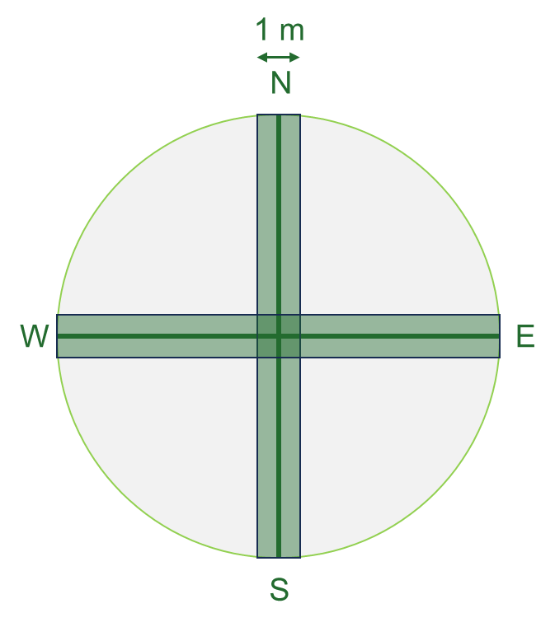

Sampling design
M&M .
34 m
1.- Mature trees inventory
Species identity, defoliation & d.b.h.
2.- Regeneration inventory
Species identity & height
3.- Shrub inventory
Species identity, height & cover
4.- Target trees
Height
LWC
SLA
Photosynthetic pigments
Isotopes (C, N, O)
5.- Soil data
Non-declining
Declining
vs.
vs.
Healthy tree
Non-declining site
Healthy tree
Declining site
Damaged tree
Declining site

Slide 22
Sampling design
M&M .
Morphological
Tree growth → growth
Leaf traits → leaf area & defoliation
Leaf nutrients → C & N content
Physiological
Photosynthesis → spectrophotometry
Water relations → water content
Leaf isotopes → isotopes
23 plots
51 plots
17 plots
5 targets x 91 plots
Abies alba
Pinus sylvestris
Pinus pinea
462 target trees

Slide 23
Data analysis
.
Morphological
Tree growth → dendro
Leaf traits → leaf area & defoliation
Physiological
Photosynthesis → spectrophotometry
Water relations → water content
Leaf nutrients → C & N content
Leaf isotopes → isotopes
We have way too many variables!
Variable selection:
Bibliographic revision → to differenciate between inciting factors and responses
Correlogram → to see what variables are redundant
Wilcoxon test → to select what variables show a significant difference

Slide 24
Data analysis
.
2.- Correlogram & p-values
Redundant variables:
What variables should we choose?
Wilcoxon test + Bonferroni correction
To discard variables with no significant differences
vs.
vs.
Healthy tree
Non-declining site
Healthy tree
Declining site
Damaged tree
Declining site

Slide 25
Data analysis
.
2.- Correlogram & p-values
Vulnerability =/= response
Tree size (dbh, height)
Age
Competition (Hegyi index)
Growth (all, 1980)
Lloret’s Rt (2012, 2017, 2022)
Lloret’s Rs (2012, 2017)
Defoliation
Pigments (Chl, carotenoids)
Nutrients (C, N, C:N)
SLA
LWC
Leaf isotopes (δ¹³C, δ¹⁵n, δ¹⁸O)
Wood isotopes (δ¹³C, δ¹⁵n, δ¹⁸O)
Growth (05, 10, 15, 20)
=/=

Slide 26
Preliminary results
Obj. 1.- To assess the predisposing factors determining drought susceptibility and their relative importance across species.
Competition was higher for declining trees in Pinus pinea → arid environments
Age → Older trees are more vulnerable
Trees with declining growth rates are more vulnerable to drought.
Resilience was lower for damaged trees than healthy tres in Pinus sylvestris.
vs.
vs.
Healthy tree
Non-declining site
Healthy tree
Declining site
Damaged tree
Declining site
Fig. 2

Slide 27
Preliminary results
Obj. 2.- To characterize tree morphological, physiological and whole-plant responses to drought at regional level and across species.
vs.
vs.
Fig. 4
Healthy tree
Non-declining site
Healthy tree
Declining site
Damaged tree
Declining site
Morphological
SLA → no differences
N content → lower in damaged Abies alba

Slide 28
Preliminary results
Obj. 2.- To characterize tree morphological, physiological and whole-plant responses to drought at regional level and across species.
Physiological
Lower LWC in Abies alba & P. sylvestris
Lower Chl in Pinus pinea
↑δ¹³C
Fig. 4

Slide 29
Preliminary results
Obj. 2.- To characterize tree morphological, physiological and whole-plant responses to drought at regional level and across species.
vs.
vs.
Fig. 4
Healthy tree
Non-declining site
Healthy tree
Declining site
Damaged tree
Declining site
Whole-plant
↓Growth
Defoliation

Slide 30
Preliminary results
Obj. 2.- To characterize tree morphological, physiological and whole-plant responses to drought at regional level and across species.
LogRR = log(X_{damaged} / X_{healthy})
Short-term growth reduction was the most prominent response in Pinus sylvestris
SLA, N had relatively high RR
RR were higher for Pinus sylvestris than for Abies alba and Pinus pinea
Fig. 5

Slide 31
Preliminary results
Obj. 3.- To assess the convergence of traits and the coordination between responses in healthy vs. damaged trees.
Damaged trees
↑ defoliation
↓ growth, Rs12, LWC

Slide 32
Preliminary results
Obj. 3.- To assess the convergence of traits and the coordination between responses in healthy vs. damaged trees.
Abies alba → ↑ Chl & N, ↓δ¹³C than Pinus → more acquisitive strategy
Pinus sylvestris → ↑ Defoliation higher δ¹³C than Abies alba, ↓ growth & resilience.
Pinus pinea → ↑ δ¹³C & competition, ↓Chl. & N → more conservative strategy

Slide 33
Preliminary results
M&M .
Obj. 3.- To assess the convergence of traits and the coordination between responses in healthy vs. damaged trees.
SPEI, TEMP.
Turgor loss
Stomatal closure
Limitted uptake
RWC
Transpiration
δ¹³C
Transpiration
δ¹⁵N
Height
Age
Chl/xc
Leaf senescence
BAI80
Rt, Rs
Defoliation

Slide 34
Conclussions
.
Predisposing factors like age, competition and long-term growth can modulate die-off responses at individual level
Responses to drought include decreased short-term growth, decreased Chl. And water content
Decaying trees coordinate their responses towards more resource-conservative strategies

Slide 35
Supplementary Material - Figures
Chapter 2: assessing individual factors determining drought vulnerability

Slide 36
Preliminary results
Obj. 1.- To assess the predisposing factors determining drought susceptibility and their relative importance across species
LogRR = log(X_{damaged} / X_{healthy})
BAI, competition and age were the most determining factors for Abies alba
BAI and competition were the most determining factors in Pinus sylvestris
Competition and SLA are the only significant RR for Pinus pinea
Fig. 3

Slide 37
Preliminary results
M&M .
Differences between Declining (healthy) vs. Declining (damaged) for any species:
 | All |  |  | A. alba |  |  | P. sylvestris |  |  | P. pinea
Variable
Height | *** | **** | - | *** | - | - | - | ** | - | - | - | -
d.b.h. | - | * | - | *** | - | - | - | - | - | - | - | -
Age | - | **** | ** | - | - | * | - | **** | - | - | - | -
Hegyi Index | **** | - | 0,0557 | - | - | - | - | - | - | - | - | -
BAI | **** | **** | * | **** | * | - | * | **** | - | - | - | -
BAI 1980 | *** | **** | *** | **** | ** | - | - | **** | - | - | - | -
Rt12 | - | **** | - | - | - | - | - | **** | - | - | - | -
Rt17 | - | - | - | - | - | - | - | - | - | - | - | -
Rt22 | - | - | - | - | - | - | - | - | - | - | - | -
Rs12 | - | **** | **** | - | - | - | * | **** | - | - | - | -
Rs17 | - | - | - | - | - | - | ** | - | - | - | - | -

Slide 38
Preliminary results
M&M .
Differences between Declining (healthy) vs. Declining (damaged) for any species:
 | All |  |  | A. alba |  |  | P. sylvestris |  |  | P. pinea
Variable
BAI 20 | - | **** | **** | * | - | - | - | **** | * | - | - | -
BAI 15 | - | **** | **** | - | - | - | - | **** | * | - | - | -
BAI 10 | - | **** | **** | - | - | - | - | **** | ** | - | - | -
BAI 05 | - | **** | **** | - | - | - | - | **** | ** | - | - | -
LWC | - | **** | 0,053 | - | - | - | *** | **** | - | - | - | -
SLA | - | - | - | - | - | - | - | - | - | - | - | -
Chl. | * | *** | - | - | - | - | - | - | * | - | - | -
Chl a | * | *** | - | - | - | - | - | * | * | - | - | -
Chl b | - | * | - | - | - | - | - | - | - | - | - | -
Chl a/b | * | ** | - | - | - | - | - | * | - | - | - | -
Carotenoids | - | * | - | - | - | - | - | - | - | - | - | -
Chl / carotenoids | - | - | - | ** | - | - | - | - | * | - | - | *
C | - | - | - | - | - | - | ** | * | - | - | - | -
N | - | - | * | - | - | - | - | - | - | - | - | -
C:N | - | - | - | - | - | - | - | - | - | - | - | -
D13c | ** | - | - | - | - | - | - | - | - | - | - | -
D15n | - | ** | **** | - | - | - | - | **** | - | - | - | -
d18o | - | - | - | - | - | - | - | - | - | - | - | -
Defoliation | **** | **** | **** | - | **** | **** | ** | **** | **** | - | **** | ****

