Slide 1
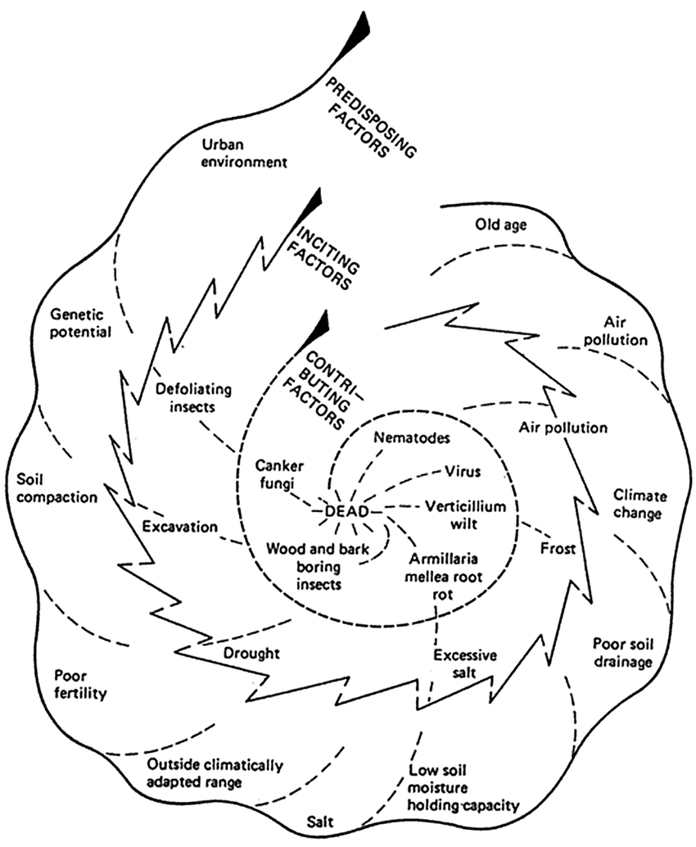
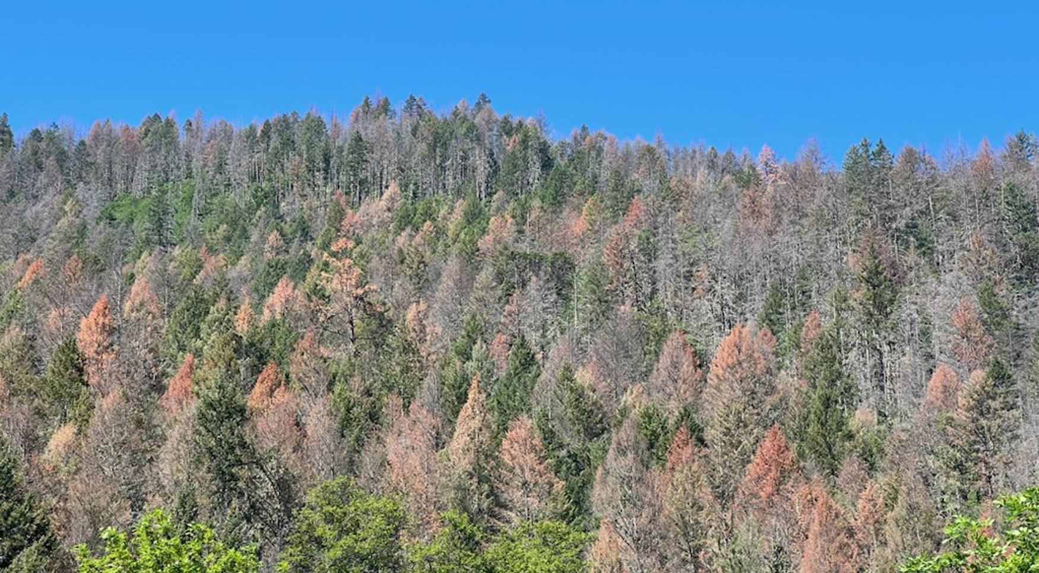
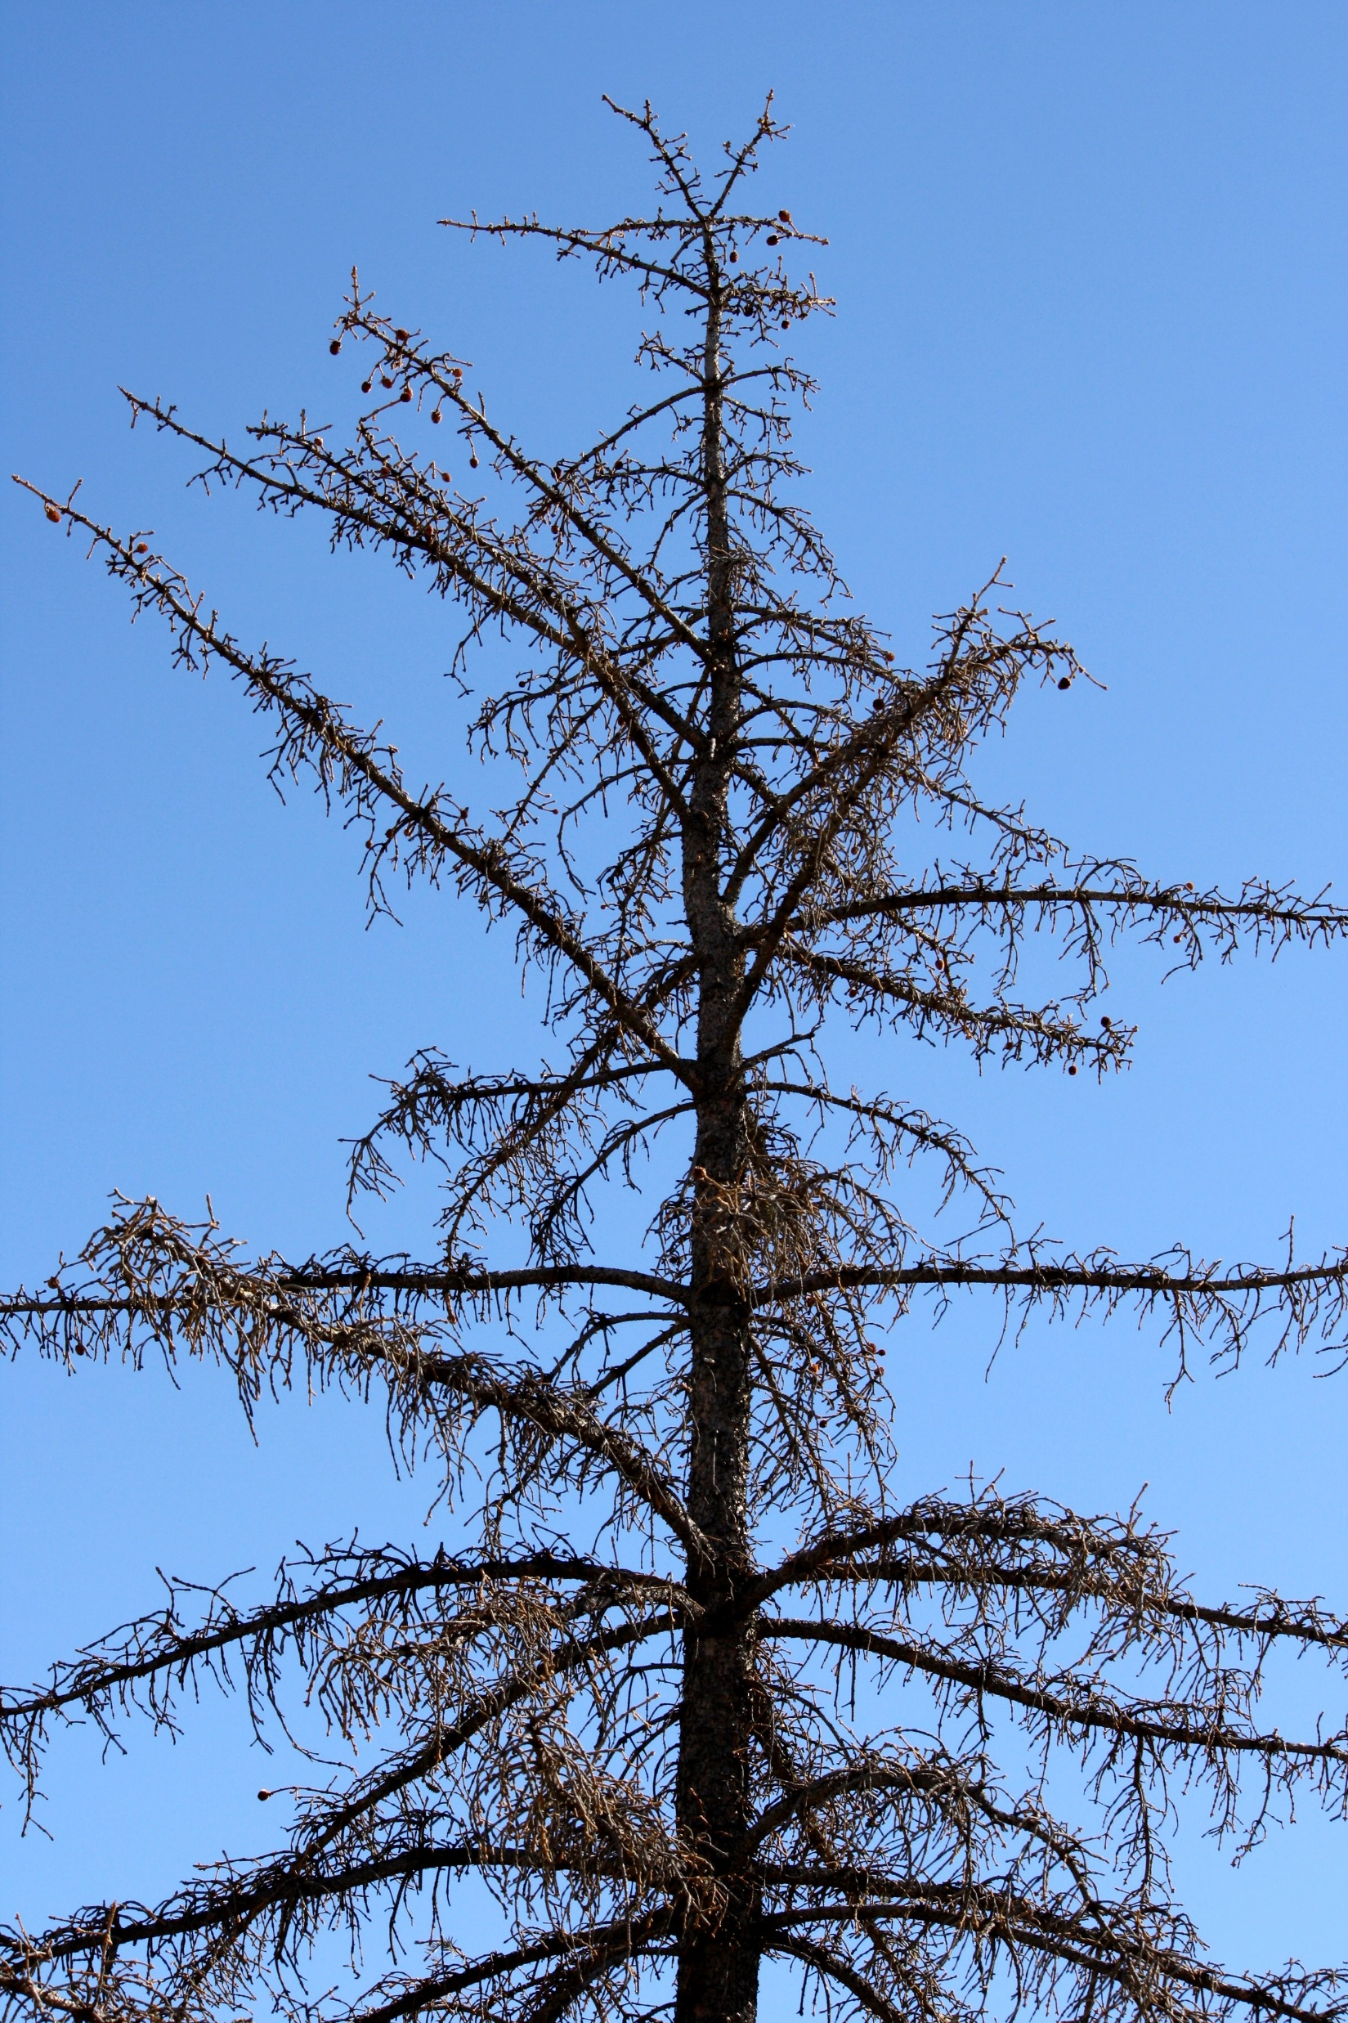
Drought-induced tree mortality
Introduction.
It is hard to forecast drought-induced die-back events
Individual level
Early-warning signals?

Slide 2
Complementary strategies to cope with drought
Introduction.
Mortality rates are highly variable
Dieoff is triggered by inciting factors:
Forecasting tool!
Predisposing factors: extrinsic conditions or intrinsic traits that increase the chances to undergo die-off (i.e. height, competition, climate)
Inciting factors: single events that trigger mortality (i.e. drought, outbreaks, etc.)
Contributing factors: non-lethal agents that further contribute to mortality (i.e. parasitic fungi).
Manion et al. 1991

Slide 3
Complementary strategies to cope with drought
Introduction.
Leaf Economics Spectrum
Isohydric
Anisohydric
↑iWUE
Stomatal closure
↓ Growth
↓ Photosynthetic rates
↓ SLA
↓ iWUE
Leaf ↓Ψ
↑ Growth
↑ Photosynthetic rates
↑ SLA

Slide 4
Complementary strategies to cope with drought
Introduction.
Declining trees
Non-declining trees
Isohydric
"Conservative"
Anisohydric
"Acquisitive"
C starvation
Hydraulic failure

Slide 5
Complementary strategies to cope with drought
Introduction.
C starvation
McDowell et al., 2008
Hydraulic failure
Drought
↑ Temp.
Drought
↑ Temp.
↓Ψ soil
↑ Evapotranspirative demand
↓Ψ soil
↑ Evapotranspirative demand
Not mutually exclusive!
↑Tension
xylem
↓Transpiration
↓g_{s}
↑Transpiration
↓Hydraulic conductance
↓Photosynthesis
C tradeoffs
Embolism
↓Growth
↓Defenses
↓Resilience
↓Growth
↓Photosynthesis

Slide 6
Complementary strategies to cope with drought
Introduction.
Predisposing factors affect these mechanisms
Drought
↑ Temp.
Drought
↑ Temp.
Competition
Competition
↓Ψ soil
↑ Evapotranspirative demand
↓Ψ soil
↑ Evapotranspirative demand
Height
Height
Former growth
↑Tension
xylem
↓Transpiration
↓g_{s}
↑Transpiration
Age
Rs, Rt
↓Hydraulic conductance
↓Photosynthesis
C tradeoffs
Embolism
↓Growth
↓Defenses
↓Resilience
↓Growth
↓Photosynthesis

Slide 7
Responses to drought
Introduction.
Drought
↑ Temp.
↓Cell turgor
↑ Evapotranspirative demand
↓Ψ plant
↑Oxidative damage
↓LWC
↓ SLA
↓Transpiration
↓Chl., ↑Carotenoids
N reabsorption
↓Photosynthesis
↑ δ¹³C, δ¹⁸O
Defoliation
↓C:N
↓Growth

Slide 8
Complementary strategies to cope with drought
Introduction.
Mortality may be a fast or slow process /
Mortality rates are highly variable → look into predisposing
Dieoff is triggered by predisposing factors
Tree size (dbh, altura)
Competition (Hegyi index)
Growth
Resistance & Resilience (Lloret’s indices)
Defoliation
Pigments (Chl, carotenoids)
SLA
RWC
Leaf isotopes (δ¹³C, δ¹⁵N, δ¹⁸O)
Wood isotopes (δ¹³C 2012-2017, δ¹³C 2017-2022)
=/=

Slide 9
Complementary strategies to cope with drought
Introduction.
Predisposing factors
(Sánchez-Salguero et al. 2012, Allen et al. 2015)
(De Soto et al. 2020, Serra-Maluquer et al. 2021, Valeriano et al. 2021)
Responses
(Liu et al. 2017, Jaleel et al. 2018)
Extrinsic factors
Abiotic (climate, soil)
Biotic (competition)
Morphological responses
SLA
Leaves nutrients (C, N, C:N)
Physiological responses
Pigments (Chl., carotenoids)
LWC
Leaves isotopes (δ¹³C, δ¹⁵N, δ¹⁸O)
Wood isotopes
Whole-plant responses
Short-term growth
Defoliation
Intrinsic factors
Hydraulic traits
Tree size (height, dbh)
Tree age
Long-term growth

Slide 10
Complementary strategies to cope with drought
Introduction.
Predisposing factors
(Sánchez-Salguero et al. 2012, Allen et al. 2015)
(De Soto et al. 2020, Serra-Maluquer et al. 2021, Valeriano et al. 2021)
Responses
(Liu et al. 2017, Jaleel et al. 2018)
Extrinsic factors
Abiotic (climate, soil)
Biotic (competition)
Morphological responses
SLA
Leaves nutrients (C, N, C:N)
Physiological responses
Pigments (Chl., carotenoids)
LWC
Leaves isotopes (δ¹³C, δ¹⁵N, δ¹⁸O)
Wood isotopes
Whole-plant responses
Short-term growth
Defoliation
Intrinsic factors
Hydraulic traits
Tree size (height, dbh)
Tree age
Long-term growth

Slide 11
Complementary strategies to cope with drought
G.I.K..
Difficult to generalize influence of predisposing factors and responses
Obj. 1.: To assess what predisposing factors determine tree die-off and what physiological responses they trigger
Lack of regional scale studies
Understudied species-specific responses
+
Extrinsic factors
Morphological responses
Whole-plant responses
Short-term growth
Defoliation
Intrinsic factors
Physiological responses
We are still unable to forecast die-off!

Slide 12
Complementary strategies to cope with drought
G.I.K..
We still do not know the relative importance of predisposing factors at regional scale and across species
Obj. 2.: To assess what predisposing factors have the highest influence on morphological and physiological responses
Extrinsic factors
Morphological responses
Whole-plant responses
Short-term growth
Defoliation
Intrinsic factors
Physiological responses
We are still unable to forecast die-off!

Slide 13
Complementary strategies to cope with drought
G.I.K..
The prevalence of carbon starvation vs. hydraulic failure remains obscure → still difficult to forecast how individuals will decay
Underlooked interactions between responses
Obj. 3.: To assess the convergence of traits and the coordination between responses in healthy vs. damaged trees
Extrinsic factors
Morphological responses
Whole-plant responses
Short-term growth
Defoliation
Intrinsic factors
Physiological responses
We are still unable to forecast die-off!

Slide 14
Study area
M&M .
Fig. 1.: Study sites in Iberia. Coloured areas represent the distribution area of each species.
Field data sampling:
02/2023 – 09/2023
14 sites, 91 plots
462 target trees
Fig. 1

Slide 15
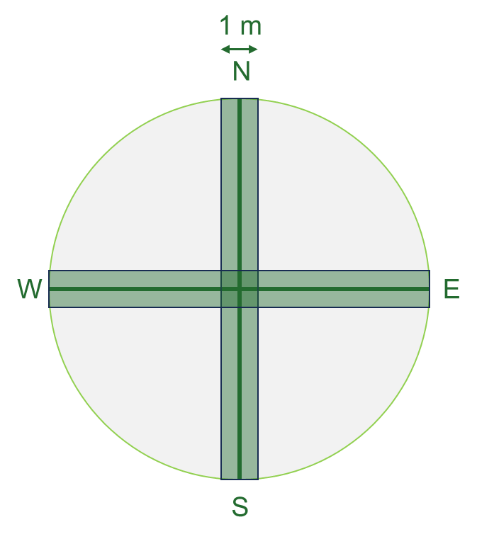

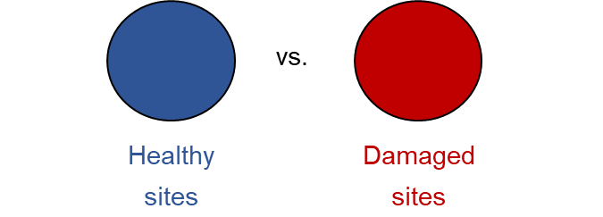



Sampling design
M&M .
34 m
1.- Mature trees inventory
Species identity, defoliation & d.b.h.
2.- Regeneration inventory
Species identity & height
3.- Shrub inventory
Species identity, height & cover
4.- Target trees
Height
LWC
SLA
Photosynthetic pigments
Isotopes (C, N, O)
5.- Soil data
Non-declining
Declining
vs.
vs.
Healthy tree
Non-declining site
Healthy tree
Declining site
Damaged tree
Declining site

Slide 16
Sampling design
M&M .
Morphological
Tree growth → growth
Leaf traits → leaf area & defoliation
Leaf nutrients → C & N content
Physiological
Photosynthesis → spectrophotometry
Water relations → water content
Leaf isotopes → isotopes
23 plots
51 plots
17 plots
5 targets x 91 plots
Abies alba
Pinus sylvestris
Pinus pinea
462 target trees

Slide 17



Objectives & Hypotheses
.
Obj. 1.- To assess the predisposing factors determining drought susceptibility vulnerability and the morphological and physiological responses induced by drought, and how these vary across species.
H1.- We expect tree size, past tree growth, competition and leaves traits to determine tree vulnerability to drought:
vs.
vs.
vs.
vs.
Non-declining
Declining
Abies alba Temperate
Pinus sylvestris Temperate
Pinus pinea Mediterranean
Healthy tree
Non-declining site
Healthy tree
Declining site
Damaged tree
Declining site

Slide 18
Objectives & Hypotheses
.
Obj. 1.- To assess the predisposing factors determining drought susceptibility vulnerability and the morphological and physiological responses induced by drought, and how these vary across species.
H1.1.- We expect tree size, past tree growth and resilience, competition and leaves traits to be main drivers for tree mortality:
Size: bigger trees will be more vulnerable due to hydraulic limitations (increased hydraulic resistance) → ↑ height, age & dbh in declining sites
Growth: we expect a reduced growth trend, and resilience → ↓ BAI, Rt & Rs in declining sites
Leaves traits: a higher SLA leads to faster water loss → ↑ SLA in declining sites
Competition: competition reduces water availability per tree and increases water interception → ↑ Hegyi index in declining sites
vs.
vs.
vs.
vs.
Figs. 2 & 3.: boxplots
Abies alba Temperate
Pinus sylvestris Temperate
Pinus pinea Mediterranean
Healthy tree
Non-declining site
Healthy tree
Declining site
Damaged tree
Declining site

Slide 19
Objectives & Hypotheses
.
Obj. 1.- To assess the predisposing factors determining drought susceptibility vulnerability and the morphological and physiological responses induced by drought, and how these vary across species.
H1.2.- We expect drought-induced reduced photosynthetic pigments concentrations, increased iWUE and leaves nutrients allocation
Pigments: water stress-induced increased ABA and ROS trigger upregulation of senescence-associated genes (SAG), and to damages to photosynthetic apparatus → ↓ Pigments concentration
iWUE: we an isohydric behaviour leading to stomatal closure → ↑ δ¹³C and δ¹⁸O in leaves and wood tissue
Nutrients: we nutrient allocation in leaves due to drought-induced reduced nutrients uptake → ↓N concentration and ↑ C:N ratio in declining sites
vs.
vs.
vs.
vs.
Figs. 2 & 3.: boxplots
Abies alba Temperate
Pinus sylvestris Temperate
Pinus pinea Mediterranean
Healthy tree
Non-declining site
Healthy tree
Declining site
Damaged tree
Declining site

Slide 20
Objectives & Hypotheses
.
Obj. 1.- To assess the predisposing factors determining drought susceptibility vulnerability and the morphological and physiological responses induced by drought, and how these vary across species.
H1.3.- We expect drought-induced reduced photosynthetic pigments concentrations, increased iWUE and leaves nutrients allocation
Pigments: water stress-induced increased ABA and ROS trigger upregulation of senescence-associated genes (SAG), and to damages to photosynthetic apparatus → ↓ Pigments concentration
iWUE: we an isohydric behaviour leading to stomatal closure → ↑ δ¹³C and δ¹⁸O in leaves and wood tissue
Nutrients: we nutrient allocation in leaves due to drought-induced reduced nutrients uptake → ↓N concentration and ↑ C:N ratio in declining sites
vs.
vs.
vs.
vs.
Figs. 2 & 3.: boxplots
Abies alba Temperate
Pinus sylvestris Temperate
Pinus pinea Mediterranean
Healthy tree
Non-declining site
Healthy tree
Declining site
Damaged tree
Declining site

Slide 21
Objectives & Hypotheses
.
Obj. 2.- To assess what predisposing factors have a larger effect, and what morphological and physiological responses to drought are more intense
vs.
vs.
Abies alba Temperate
Pinus sylvestris Temperate
Pinus pinea Mediterranean
vs.
vs.
Healthy tree
Non-declining site
Healthy tree
Declining site
Damaged tree
Declining site
Fig. 4.: Response Ratios

Slide 22
Objectives & Hypotheses
.
Obj. 3.- To assess how underlying mechanisms behind tree mortality vary along a moisture gradient and between species
H3.- We expect variations in each species path
vs.
vs.
Abies alba Temperate
Pinus sylvestris Temperate
Pinus pinea Mediterranean
vs.
vs.
Healthy tree
Non-declining site
Healthy tree
Declining site
Damaged tree
Declining site
Fig. 5.: pca

Slide 23
Data analysis
.
Morphological
Tree growth → dendro
Leaf traits → leaf area & defoliation
Physiological
Photosynthesis → spectrophotometry
Water relations → water content
Leaf nutrients → C & N content
Leaf isotopes → isotopes
We have way too many variables!
Variable selection:
Bibliographic revision → to differenciate between inciting factors and responses
Correlogram → to see what variables are redundant
Wilcoxon test → to select what variables show a significant difference

Slide 24
Data analysis
.
1.- Bibliographic revision
Predisposing factor =/= response
Tree size (dbh, altura)
Competition (Hegyi index)
iWUE (SLA, EWT)
Growth
Resistance & Resilience (Lloret’s indices)
Defoliation
Pigments (Chl, carotenoids)
SLA
RWC
Leaf isotopes (δ¹³C, δ¹⁵n, δ¹⁸O)
Wood isotopes (δ¹³C 2012-2017, δ¹³C 2017-2022)
=/=

Slide 25
Data analysis
.
2.- Correlogram
Redundant variables:
All average BAI values at different time scales are highly correlated → we should just pick one
Height and d.b.h. are highly correlated
Age is not that correlated to tree size (surprisingly)
What variables should we choose?
P-values

Slide 26
Data analysis
.
3.- P-values
Wilcoxon test + Bonferroni correction
To discard variables with no significant differences
vs.
vs.
Healthy tree
Non-declining site
Healthy tree
Declining site
Damaged tree
Declining site

Slide 27
Preliminary results
M&M .
Differences between Declining (healthy) vs. Declining (damaged) for any species:
 | All |  |  | A. alba |  |  | P. sylvestris |  |  | P. pinea
Variable
Height | *** | **** | - | *** | - | - | - | ** | - | - | - | -
d.b.h. | - | * | - | *** | - | - | - | - | - | - | - | -
Age | - | **** | - | - | - | * | - | **** | - | - | - | -
Hegyi Index | **** | - | - | - | - | - | - | - | - | - | - | -
BAI | **** | **** | - | **** | * | - | * | **** | - | - | - | -
BAI 1980 | *** | **** | *** | **** | ** | - | - | **** | - | - | - | -
BAI 20 | - | **** | **** | * | - | - | - | **** | * | - | - | -
BAI 15 | - | **** | **** | - | - | - | - | **** | * | - | - | -
BAI 10 | - | **** | **** | - | - | - | - | **** | ** | - | - | -
BAI 05 | - | **** | **** | - | - | - | - | **** | ** | - | - | -
Rt12 | - | **** | - | - | - | - | - | **** | - | - | - | -
Rt17 | - | - | - | - | - | - | - | - | - | - | - | -
Rt22 | - | - | - | - | - | - | - | - | - | - | - | -
Rs12 | - | **** | **** | - | - | - | * | **** | - | - | - | -
Rs17 | - | - | - | - | - | - | ** | - | - | - | - | -

Slide 28
Preliminary results
M&M .
Differences between Declining (healthy) vs. Declining (damaged) for any species:
 | All |  |  | A. alba |  |  | P. sylvestris |  |  | P. pinea
Variable
BAI 20 | - | **** | **** | * | - | - | - | **** | * | - | - | -
BAI 15 | - | **** | **** | - | - | - | - | **** | * | - | - | -
BAI 10 | - | **** | **** | - | - | - | - | **** | ** | - | - | -
BAI 05 | - | **** | **** | - | - | - | - | **** | ** | - | - | -
LWC | - | **** | - | - | - | - | *** | **** | - | - | - | -
SLA | - | - | - | - | - | - | - | - | - | - | - | -
Chl. | * | *** | - | - | - | - | - | - | * | - | - | -
Chl a | * | *** |  | - | - | - | - | * | * | - | - | -
Chl b | - | * | - | - | - | - | - | - | - | - | - | -
Chl a/b | * | ** | - | - | - | - | - | * | - | - | - | -
Carotenoids | - | * | - | - | - | - | - | - | - | - | - | -
Chl / carotenoids | - | - | - | ** | - | - | - | - | * | - | - | *
C | - | - | - | - | - | - | ** | * | - | - | - | -
N | - | - | - | - | - | - | - | - | - | - | - | -
C:N | - | - | - | - | - | - | - | - | - | - | - | -
D13c | ** | - | - | - | - | - | - | - | - | - | - | -
D15n | - | ** | **** | - | - | - | - | **** | - | - | - | -
d18o | - | - | - | - | - | - | - | - | - | - | - | -
Defoliation | **** | **** | **** | - | **** | **** | ** | **** | **** | - | **** | ****

Slide 29
Data analysis
.
3.- P-values
Vulnerability =/= response
Tree size (dbh, height)
Age
Competition (Hegyi index)
Growth (all, 1980, 20, 15, 10)
Lloret’s Rt (2012, 2017, 2022)
Lloret’s Rs (2012, 2017)
Defoliation
Pigments (Chl, carotenoids)
Nutrients (C, N, C:N)
SLA
RWC
Leaf isotopes (δ¹³C, δ¹⁵n, δ¹⁸O)
Wood isotopes (δ¹³C, δ¹⁵n, δ¹⁸O)
Growth (5)
=/=

Slide 30
Preliminary results
Obj. 1.- To assess the predisposing factors determining drought susceptibility vulnerability and the morphological and physiological responses induced by drought, and how these vary across species.
Age is higher in declining sites and more in damaged than healthy individuals → Older trees are more vulnerable due to hydraulic limitations and reduced photosynthetic efficiency.
Hegyi Index is only higher for damaged than healthy individuals in Pinus pinea → Competition gains importance in arid environments
Growth rates are lower in damaged individuals → Trees with declining growth rates are more vulnerable to drought.
Resilience was lower for damaged trees than healthy tres in Pinus sylvestris.
vs.
vs.
Healthy tree
Non-declining site
Healthy tree
Declining site
Damaged tree
Declining site
Fig. 2

Slide 31
Preliminary results
Obj. 1.- To assess the predisposing factors determining drought susceptibility vulnerability and the morphological and physiological responses induced by drought, and how these vary across species.
Defoliation is higher damaged than healthy trees → Drought-induced leaf senescence and loss of leaf water turgor.
LWC was only lower for damaged trees in temperate species.
N content was lower in damaged Abies alba
Chl. content is lower in damaged sites only in Pinus pinea → upregulated ROS synthesis leading to oxidative damage maybe due to high temperatures.
δ¹³C content is higher in damaged trees → tight stomatal control & increased iWUE
Recent growth is lower in damaged than healthy individuals
Fig. 3

Slide 32
Preliminary results
Obj. 2.- To assess what predisposing factors have a larger effect, and what morphological and physiological responses to drought are more intense
LogRR = log(X_{damaged} / X_{healthy})
BAI, Rs, Competition and Age were the variables with highest RR
C content, Height and Wood δ¹³C had non-significant RRs
Fig. 4

Slide 33
Preliminary results
Obj. 2.- To assess what predisposing factors have a larger effect, and what morphological and physiological responses to drought are more intense
LogRR = log(X_{damaged} / X_{healthy})
Pinus sylvestris shows higher RR than Abies alba and Pinus pinea
Fig. 4

Slide 34
Preliminary results
Obj. 3.- To assess the convergence and the coordination of traits between responses in healthy vs. damaged tres.
vs.
Fig. 4
Healthy tree
Declining site
Damaged tree
Declining site

Slide 35
Preliminary results
Obj. 3.- To assess the convergence and the coordination of traits between responses in healthy vs. damaged tres.
Higher collinearity in damaged trees → convergence in responses
Abies alba shows higher growth, and lower δ¹³C than Pinus → more acquisitive strategy
Damaged tree
Declining site
Pinus sylvestris shows higher δ¹³C than Abies alba and lower growth and resilience.
Pinus pinea shows the highest δ¹³C, and lower Chl., N and LWC → tighter stomatal control → more conservative strategy
Healthy tree
Declining site

Slide 36
Preliminary results
vs.
vs.
Healthy tree
Non-declining site
Healthy tree
Declining site
Damaged tree
Declining site

Slide 37
Preliminary results
vs.
vs.
Abies alba Temperate
Pinus sylvestris Temperate
Pinus pinea Mediterranean

Slide 38
Preliminary results
M&M .
Obj. 3.- To assess the convergence and the coordination of traits between responses in healthy vs. damaged tres.
GLM?
SEM?
Changes in SEM pathways → different physiological processes in D vs. ND
Variables relationships
Non-declining
Declining

Slide 39
Preliminary results
M&M .
Obj. 3.- To assess how underlying mechanisms behind drought vulnerability vary due to long-term adaptations along a moisture gradient
SPEI, TEMP.
Turgor loss
Stomatal closure
Limitted uptake
RWC
Transpiration
δ¹³C
Transpiration
δ¹⁵N
Height
Age
Chl/xc
Leaf senescence
BAI80
Rt, Rs
Defoliation

Slide 40
Preliminar analyses - Figures
Chapter 2: assessing individual factors determining drought vulnerability

Slide 41
Data analysis – Physiological responses
M&M .
3.- Response ratios

Slide 42
Preliminary results
M&M .
Differences between Declining (healthy) vs. Declining (damaged) for any species:
Variable | ND - DH | ND - DD | DH – DD
Height | **** | **** | -
d.b.h. | ** | **** | -
Age | ** | **** | ****
Hegyi Index | **** | **** | **
Defoliation | **** | **** | ****
LWC | **** | **** | **
SLA | **** | ** | -
Chl. Content | **** | **** | -
Chl. a | **** | **** | -
Chl. b | *** | **** | -
Carotenoids | *** | **** | -
Chl. a/b | **** | **** | -
Chl. / xc | *** | **** | -
C content | - | ** | -
N content | * | - | ***
C:N ratio | ** | - | **

Slide 43
Preliminary results
M&M .
Differences between Declining (healthy) vs. Declining (damaged) for any species:
Variable | ND - DH | ND - DD | DH – DD
δ¹³C | **** | *** | -
δ¹⁸O | - | ** | -
δ¹⁵N | * | **** | ****
Wood 17 | ** | * | -
Wood 22 | * | ** | -
BAI | **** | **** | ***
BAI 1980 | **** | **** | ****
BAI 20 | **** | **** | ****
BAI 15 | **** | **** | ****
BAI 10 | ** | **** | ****
BAI 05 | ** | ***** | *****
Rt12 | **** | **** | *
Rt17 | - | - | -
Rt22 | **** | - | -
Rs12 | - | **** | ****
Rs17 | - | **** | *

Slide 44
Preliminary results
M&M .
Obj. 3.- To assess the convergence and the coordination of traits between responses in healthy vs. damaged tres.
Is it worth it grouping the variables in two components?
Linear Mixed Model or Structural Equations Model?
Defoliation = SPEI + PCA1 + PCA2 + (1 | site / plot id / tree id) ¿?

Slide 45
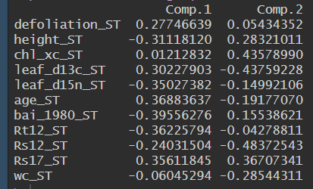
Preliminary results
M&M .
Obj. 3.- To assess the convergence and the coordination of traits between responses in healthy vs. damaged tres.
Very high orthogonality
Comp. 1: height, δ¹⁵N, BAI, Rt12; defoliation, age
Comp. 2: δ¹³C, Rs12, LWC; Chl. / carotenoids, Rs17

Slide 46
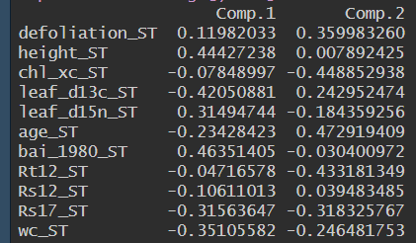

Preliminary results
M&M .
Obj. 3.- To assess the convergence and the coordination of traits between responses in healthy vs. damaged tres.

Slide 47
Preliminary results
M&M .
Obj. 3.- To assess the convergence and the coordination of traits between responses in healthy vs. damaged tres.
Higher orthogonality in non-declining than in declining sites
Non-declining more concentrated around PC2 negative values, declining around positive PC1
BAI / δ¹³C, Rt12

Slide 48
Preliminary results
M&M .
Obj. 3.- To assess the convergence and the coordination of traits between responses in healthy vs. damaged tres.

