Slide 1
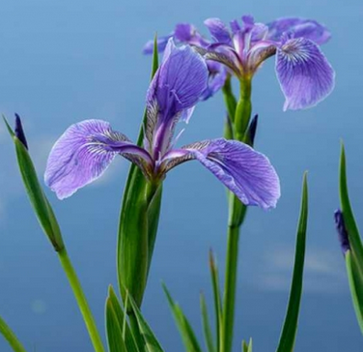
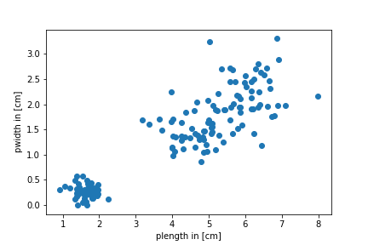
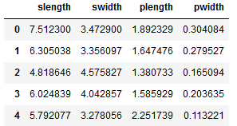
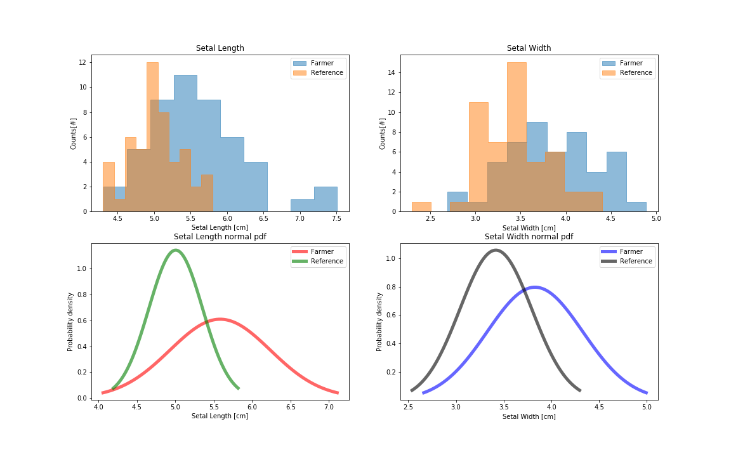
The Mutation of Iris Setosa
A Criminal Story
Iris Setosa
C. Cris *, M. Freunek *
* Swiss Federal Institute of Intellectual Property, 3013 Bern
Initial Situation and Summary
Company v4Setosa owns a patent claiming protection on gene sequence of Iris Setosa
Iris Setosa found on a farmers field, treated with a product rom Sonte Manto, show possibly larger setal leaves than normal, possibly indicating a gene mutation and therewith a patent infringement of the patent of v4Setosa
Two data sets available:
A reference data set of definitely non-mutated Iris Setosa
A mixed data-set of farmers Iris Setosa, Virginica and Versicolor
Hypothesis test (t-test) shown significant evidence of gene mutation of Iris Setosa setal leave
Task and H0-Hypothesis
By means of the reference data set of non-mutated Iris Setosa investigate, if there is a mutation of the farmer Iris Setosa setal size.
H0-Hypothesis: There is NO mutation of farmers Iris Setosa (increasing size of setal leaves) treated with Sonte Manto.
H1-Hypothesis: There is a mutation of farmers Iris Setosa (increasing size of setal leaves) treated with Sonte Manto.
Methods / Procedure / Test
1. Identifying Iris Setosa in farmers data set:
2. T-test of two samples, not paired, samples differ in standard deviation
(.ttest_ind(equal=False))
3. T-Test yields:
Scatterplot yields Iris Setosa
Filter for Setosa:
p_{l} < 2.5 cm
p_{w} < 0.7 cm
Remark: Farmer data through random generator:
np.random.normal(x,y, size = pts) * np.random.normal(1.1,0.1, size = pts)
 |  | Slenght [cm] | Sidth [cm]
Reference data | mean | 5.01 | 3.42
 | std | 0.35 | 0.38
 | p-test normal distribution | 0.91 | 0.39
Farmers data | mean | 5.59 | 3.82
 | std | 0.65 | 0.50
 | p-test normal distribution | 0.03 | 0.78
Conclusions
Normal distribution of reference and farmer data
reference and farmer data differ in SD
Iris Setosa in farmer data can be filtered via petal size
p-test with p << 0.05 clearly rejects the H0-hypothesis and support H1 hypothesis
 | P-value
setal length | 7.6·10⁻⁷
setal width | 1.7·10⁻⁵

