Slide 1

Pre-training of Deep RL Agents for Improved Learning under Domain Randomization
Reinforcement Learning 2024-2025
Vincenzo Crisà 2143080

Slide 2


1. Introduction
Learning from pixels
Domain Randomization
DeepMind control suite

Slide 3
Learning from pixels
1 Introduction
Common practice:
MDP problem by stacking several consecutive images into a state;
Encoder learns a latent representation of the images;
Latent vector as input for a RL policy network.
This approach is known to have issues related to
sample efficiency,
degenerated feature representations,
overfitting.
Image augmentation techniques improves performance by enhancing robustness and reducing overfitting without requiring any change to the RL algorithm.

Slide 4
Domain Randomization
1 Introduction
Bridge the visual gap between simulated training environmet and real world applications.
In visual domain randomization, the rendered observations from simulated environments are subjected to:
Random texturing
Image augmentation
This helps to learn a policy invariant to these shifts and is more likely to succeed on the transferring phase.

Slide 5
DeepMind control Suite 1 Introduction
Google DeepMind's software stack for physics-based simulation and Reinforcement Learning environments, using MuJoCo physics.
The environments are characterized by
To provide the agent with a temporal perception of the environment, the images are stacked into a sequence of length 3 using a Wrapper.
Domain with a specific Task
Observations are rgb 84x84 images
Continuous action space [-1,1]
Fixed episode length of 1000 steps
Reward for episode [0,1000]

Slide 6
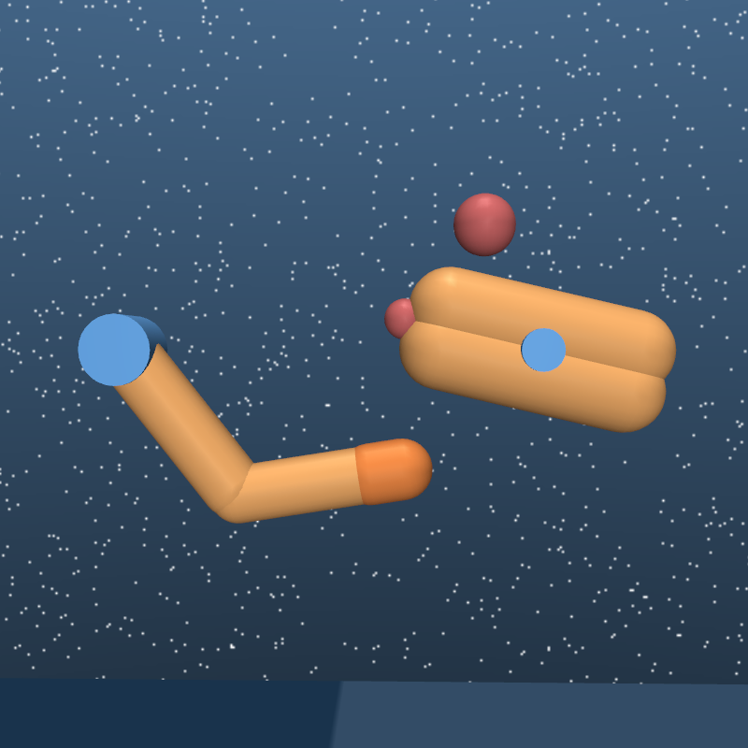
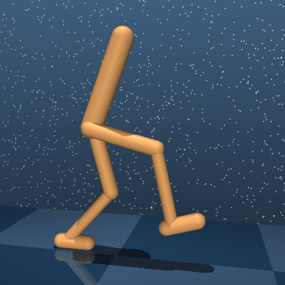
DeepMind control Suite 1 Introduction
Domain: Finger, Task: Spin
Domain: Walker, Task: Walk

Slide 7
2. Data-regularized Q (DrQ)
DrQ
Action decision process
Training parameters
Training statistics
Training results

Slide 8
DrQ
2 Data-regularized Q
DrQ enhance the Soft Actor-Critic training by introducing separate regularization mechanisms:
Image augmentation on the images sampled from the replay buffer:
Averaging the Q function for two different augmentation of the same state.
Padding each size by 4 pixels
Random crop back to the original resolution, shifted by ± 4 pixels

Slide 9
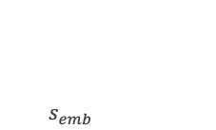
Action decision process
2 Data-regularized Q
Encoder
Actor
$s_{emb}$
Convolution
Linear
Convolution
Linear
Convolution
Convolution
Linear
Linear
Linear
$a_{t}=tanh⁡(μ_{θ}\left(s_{emb}\right)+σ_{θ}\left(s_{emb}\right)ε)$ where $ε\sim 𝒩(0,1)$

Slide 10
Action decision process
2 Data-regularized Q
Encoder
Actor
$s_{emb}$
Four convolution layers with 3x3 kernel size and 32 channels
Linear layer with output size set to 50
Convolution
Linear
Four fully connected layers of size 1024
Standard deviation range: [-10,2]
Convolution
Linear
Convolution
Convolution
Linear
Linear
Linear
$a_{t}=tanh⁡(μ_{θ}\left(s_{emb}\right)+σ_{θ}\left(s_{emb}\right)ε)$ where $ε\sim 𝒩(0,1)$

Slide 11
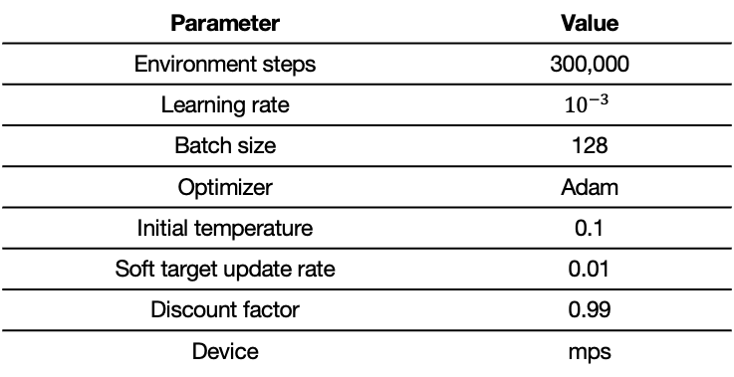
Training parameters
2 Data-regularized Q
Parameter | Value
Environment steps | 300,000
Learning rate | $${10}^{−3}$$
Batch size | 128
Optimizer | Adam
Initial temperature | 0.1
Soft target update rate | 0.01
Discount factor | 0.99
Device | mps
Notes:
The temperature parameter α determines the relative importance of the entropy term against the reward, and thus controls the stochasticity of the optimal policy.

Slide 12
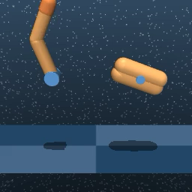
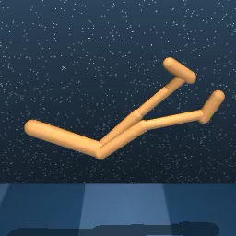
Training statistics
2 Data-regularized Q

Slide 13
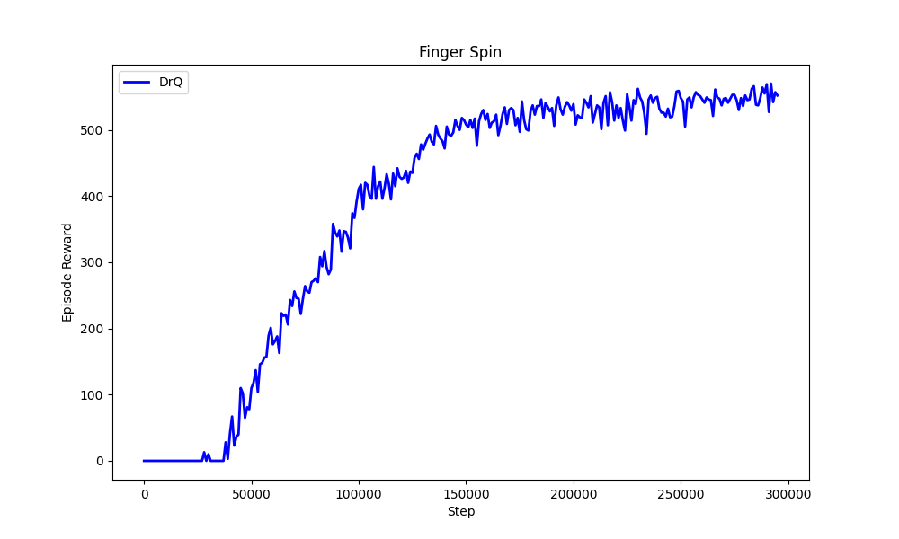
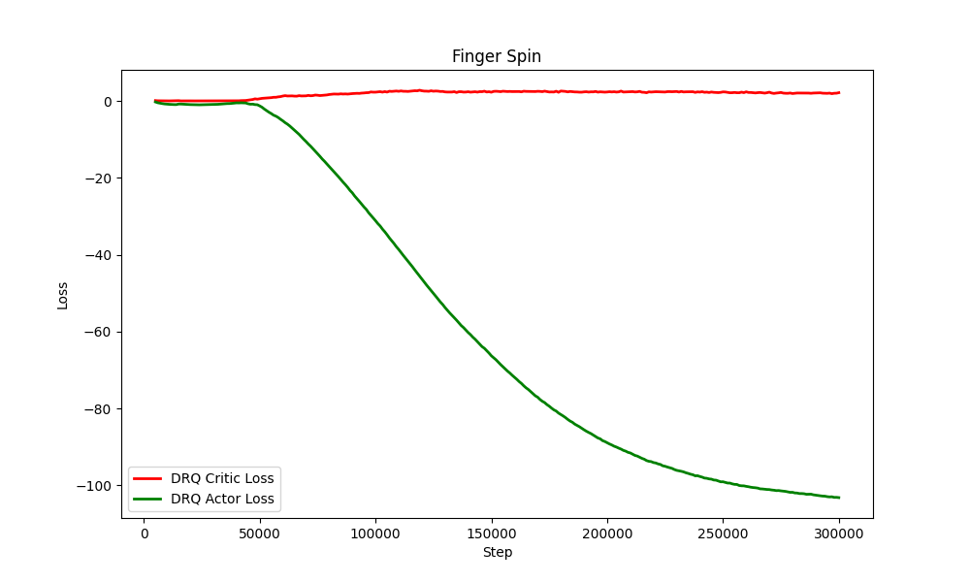
Training statistics
2 Data-regularized Q

Slide 14
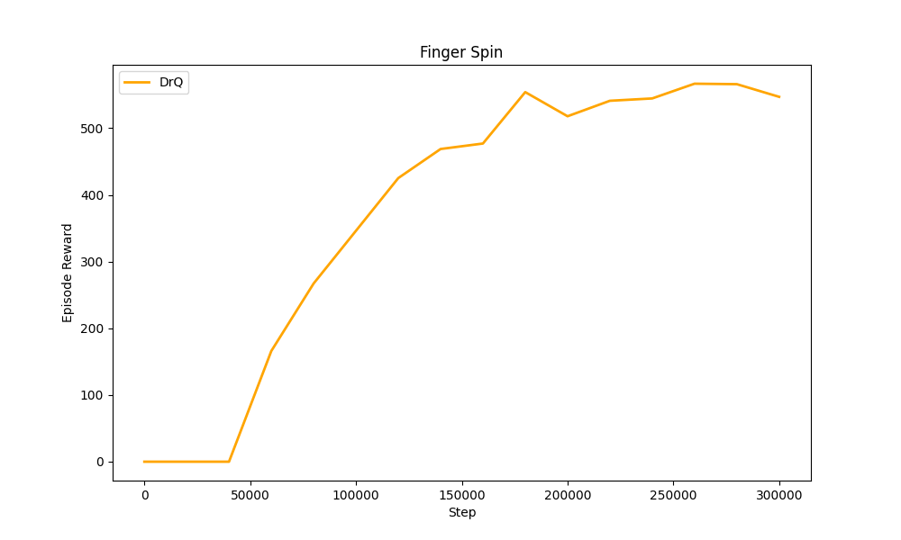
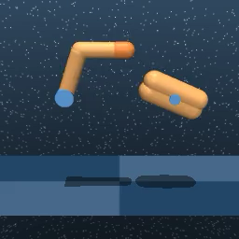
Training results
2 Data-regularized Q

Slide 15
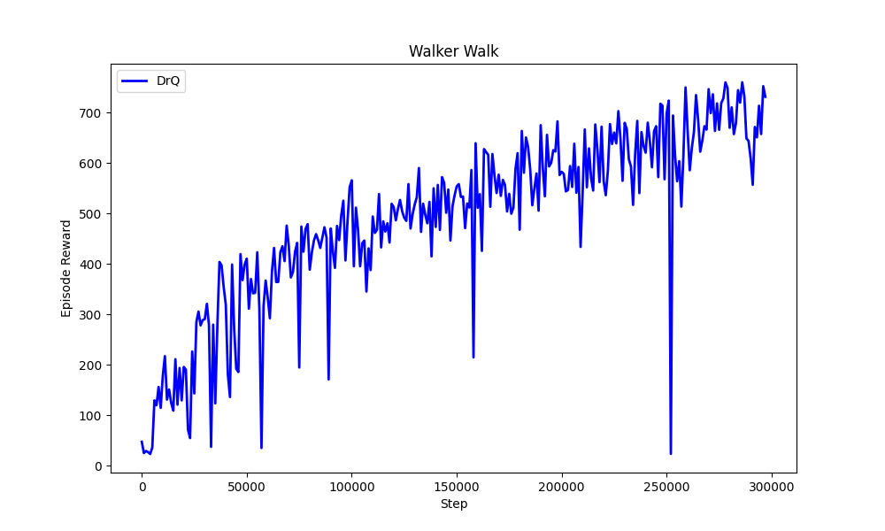
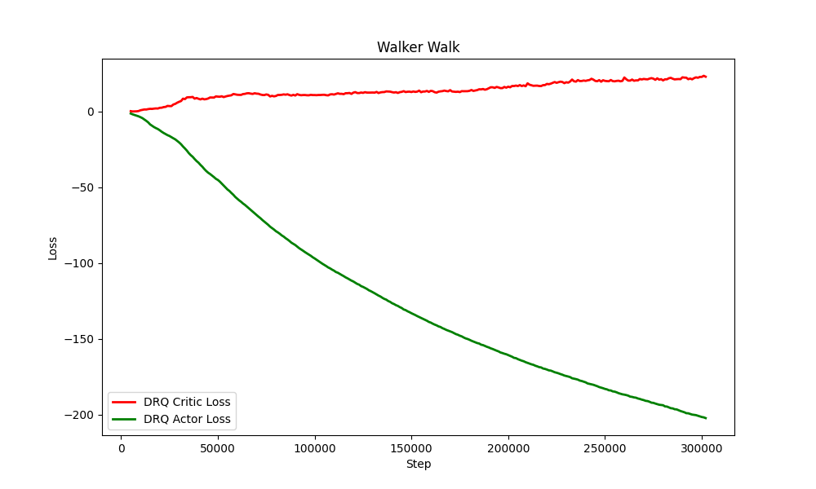
Training statistics
2 Data-regularized Q

Slide 16
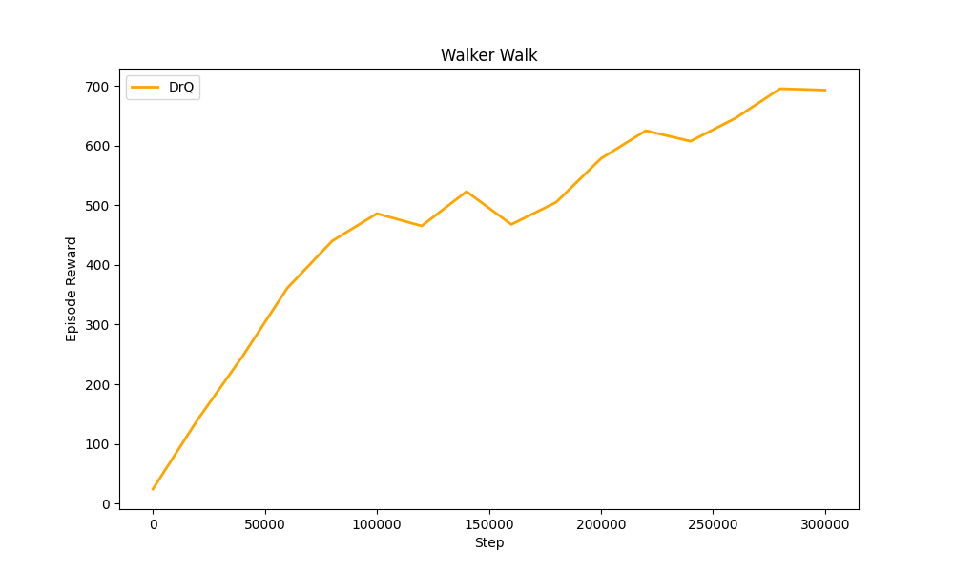
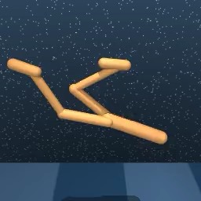
Training results
2 Data-regularized Q

Slide 17
3. Domain Randomization Adjusting Pre-training (DRAP)
DRAP
Domain Randomization Removal architecture
Sequence dataset creation
Pre-training parameters

Slide 18
DRAP
3 Domain Randomization Adjusting Pre-training
Domain Randomization Adjusting Pre-training (DRAP) adds additional variance from visual randomization separating visual pre-training to achieve visual invariance properties from RL training.
Use the simulation to construct paired images of randomized observations and canonical observations.
Train an Encoder-Decoder network to reconstruct the canonical observation and predict the future canonical observation from the randomized images.
Use the pre-trained perception encoder as initialization for the encoder in DrQ.
The encoder learns to focus on the core parts of the images.

Slide 19
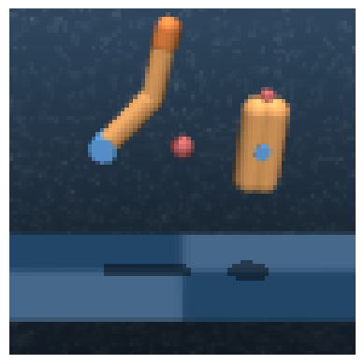
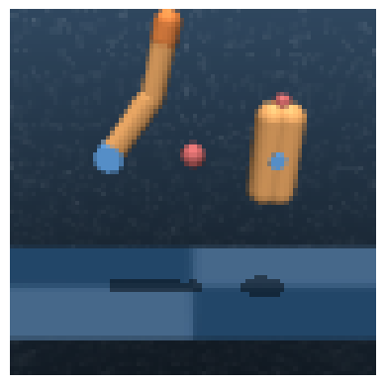
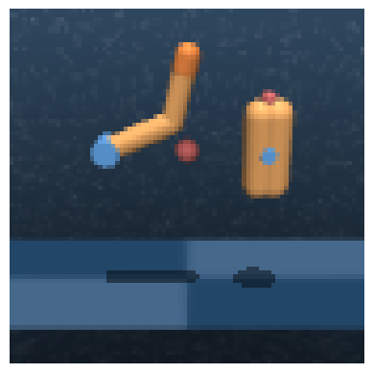
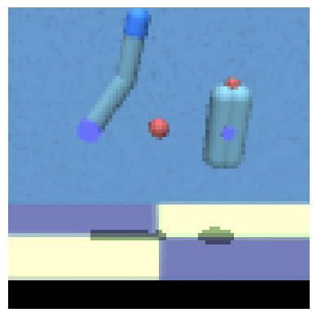
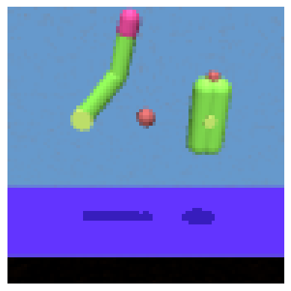
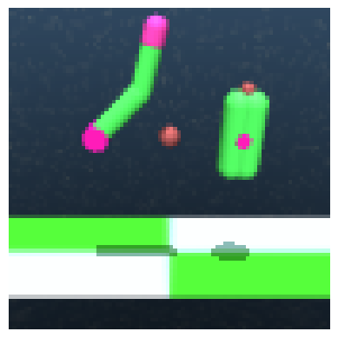











Domain Randomization Removal architecture
3 Domain Randomization Adjusting Pre-training
Decoder
$$t_{−1}$$
$$t_{0}$$
$$t_{+1}$$
$$a_{0}$$
MLP
Encoder
Decoder
$$t_{−2}$$
$$t_{−1}$$
$$t_{0}$$
$$t_{−2}$$
$$t_{−1}$$
$$t_{0}$$

Slide 20
Domain Randomization Removal architecture
3 Domain Randomization Adjusting Pre-training
Decoder
$$t_{−1}$$
$$t_{0}$$
$$t_{+1}$$
$$a_{0}$$
MLP
Two fully connected layers of size 1024
Encoder
Decoder
$$t_{−2}$$
$$t_{−1}$$
$$t_{0}$$
$$t_{−2}$$
$$t_{−1}$$
$$t_{0}$$
One upconvolution layer with 3x3 kernels and stride 2
Two convolutions with 3x3 kernel

Slide 21
Sequence dataset creation
3 Domain Randomization Adjusting Pre-training
The datased is characterized by sequences of observation sampled using the mujoco framework from the DeepMind control suite.
It allows to render the observation directly from the base XML file.
Each source file is characterized by two common XML files that defines
the sky,
material textures.
To create a more diverse and robust dataset, starting from the canonical XML file, three randomized versions are generated by modifying common simulation characteristics.

Slide 22
Sequence dataset creation
3 Domain Randomization Adjusting Pre-training
<mujoco>
<asset>
<texture name="skybox" type="skybox" builtin="gradient" rgb1=".4 .6 .8" rgb2="0 0 0"
width="800" height="800" mark="random" markrgb="1 1 1"/>
</asset>
</mujoco>
builtin field:
“gradient” with 70% of probability
”flat” with 30% of probability
markrgb value is randomly generated

Slide 23
Sequence dataset creation
3 Domain Randomization Adjusting Pre-training
<mujoco>
<asset>
<texture name="grid" type="2d" builtin="checker" rgb1=".1 .2 .3" rgb2=".2 .3 .4" width="300" height="300" mark="edge" markrgb=".2 .3 .4"/>
<material name="grid" texture="grid" texrepeat="1 1" texuniform="true" reflectance=".2"/>
<material name="self" rgba=".7 .5 .3 1"/>
<material name="self_default" rgba=".7 .5 .3 1"/>
<material name="self_highlight" rgba="0 .5 .3 1"/>
<material name="effector" rgba=".7 .4 .2 1"/>
<material name="effector_default" rgba=".7 .4 .2 1"/>
<material name="effector_highlight" rgba="0 .5 .3 1"/>
<material name="decoration" rgba=".3 .5 .7 1"/>
<material name="eye" rgba="0 .2 1 1"/>
<material name="target" rgba=".6 .3 .3 1"/>
<material name="target_default" rgba=".6 .3 .3 1"/>
<material name="target_highlight" rgba=".6 .3 .3 .4"/>
<material name="site" rgba=".5 .5 .5 .3"/>
</asset>
</mujoco>

Slide 24
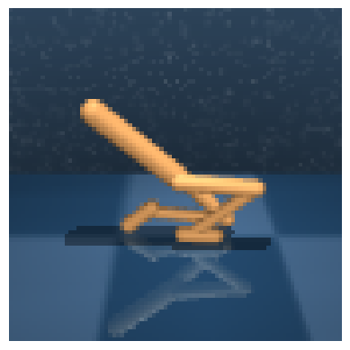


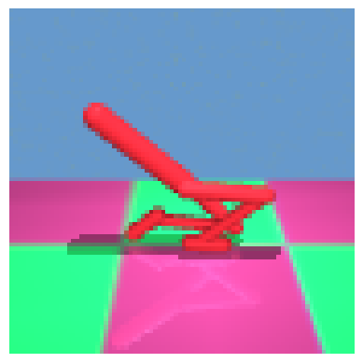
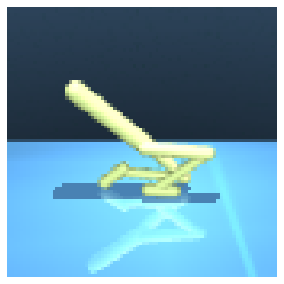
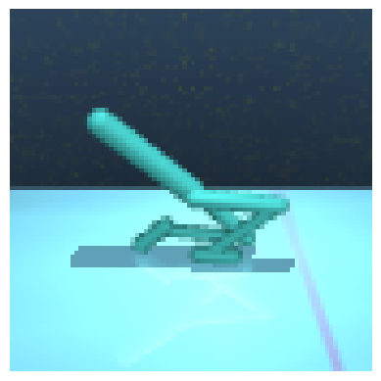
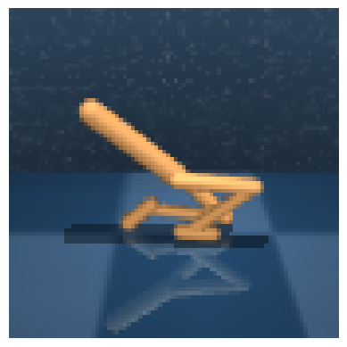
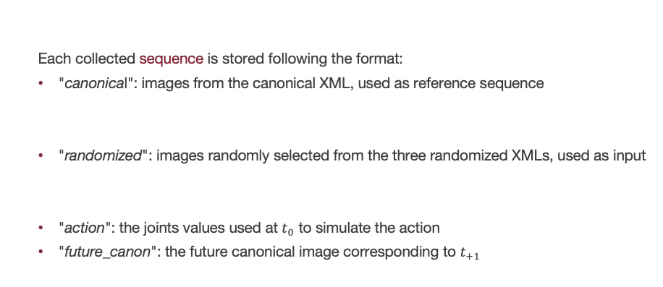
Sequence dataset creation
3 Domain Randomization Adjusting Pre-training
Each collected sequence is stored following the format:
"canonical": images from the canonical XML, used as reference sequence
"randomized": images randomly selected from the three randomized XMLs, used as input
"action": the joints values used at $t_{0}$ to simulate the action
"future_canon": the future canonical image corresponding to $t_{+1}$

Slide 25
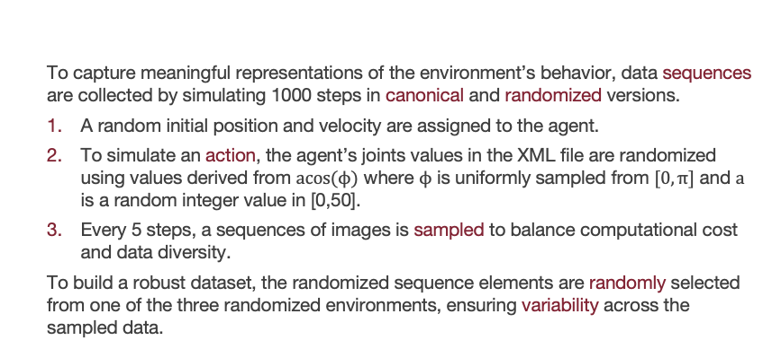
Sequence dataset creation
3 Domain Randomization Adjusting Pre-training
To capture meaningful representations of the environment’s behavior, data sequences are collected by simulating 1000 steps in canonical and randomized versions.
A random initial position and velocity are assigned to the agent.
To simulate an action, the agent’s joints values in the XML file are randomized using values derived from $\operatorname{acos}{(ϕ)}$ where $ϕ$ is uniformly sampled from $[0,π]$ and $a$ is a random integer value in [0,50].
Every 5 steps, a sequences of images is sampled to balance computational cost and data diversity.
To build a robust dataset, the randomized sequence elements are randomly selected from one of the three randomized environments, ensuring variability across the sampled data.

Slide 26
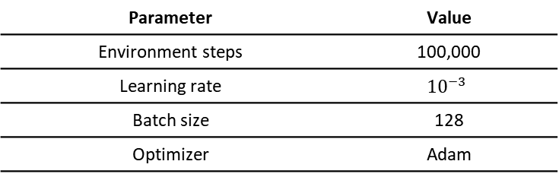
Pre-training Parameters
3 Domain Randomization Adjusting Pre-training
Parameter | Value
Environment steps | 100,000
Learning rate | $${10}^{−3}$$
Batch size | 128
Optimizer | Adam
The images from the dataset are subjected to the same augmentation used in DrQ.

Slide 27
4. DrQ + DRAP
Last part of the training
Training statistics
Training results
Conclusions

Slide 28
Last part of the training
4 Drq+DRAP
After the pre-training the decoder part is discarded, and the pre-trained encoder, is directly fine-tuned during DrQ training.
Since the previous training have been done on 300,000 environment steps, the pre-trained encoder’s weights are used to initialize DrQ encoder and use it for the remaining 200,000 environment interactions.

Slide 29
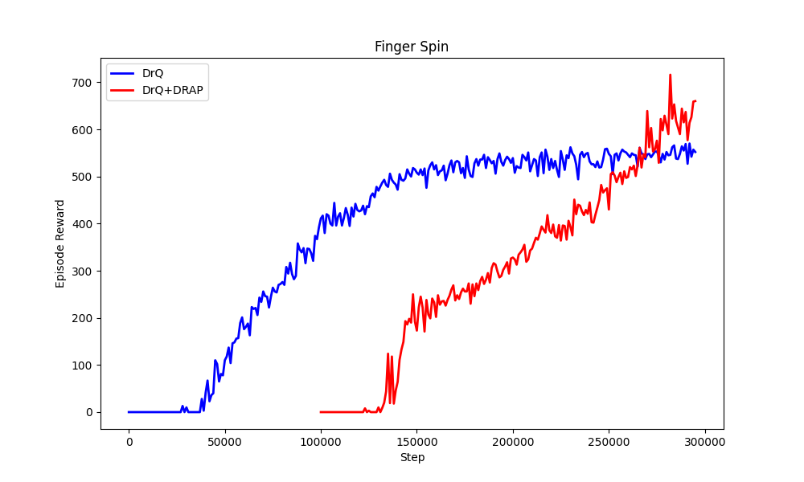
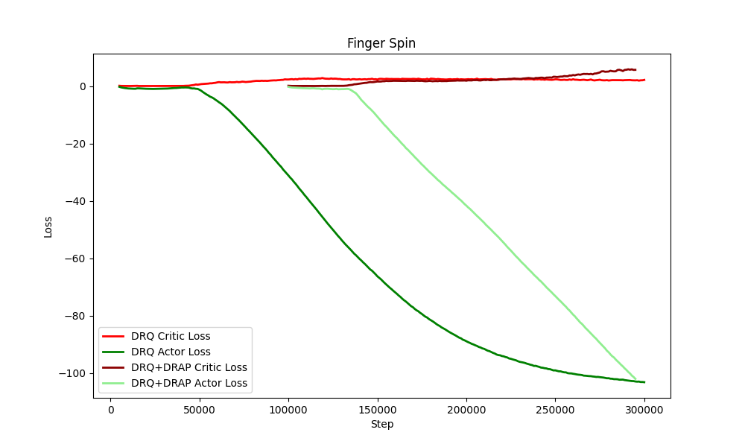
Training statistics
4 Drq+DRAP

Slide 30
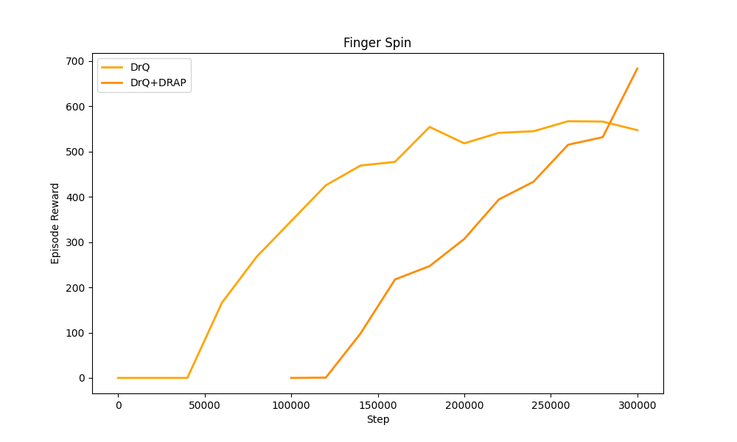
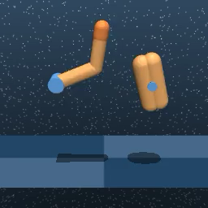
Training results
4 Drq+DRAP

Slide 31
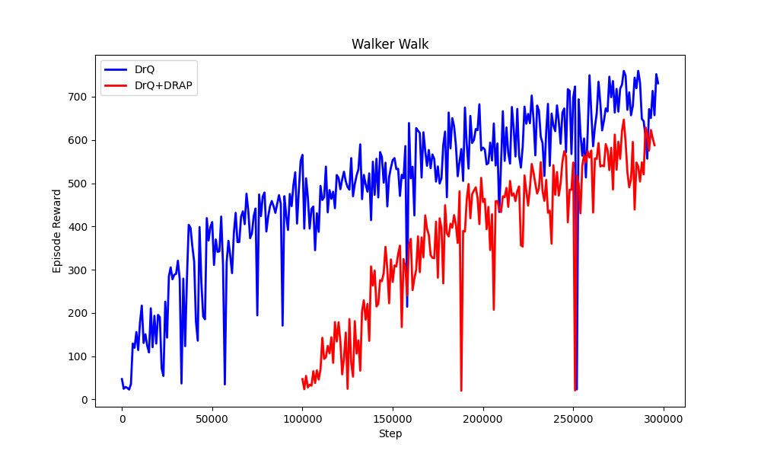
Training statistics
4 Drq+DRAP

Slide 32
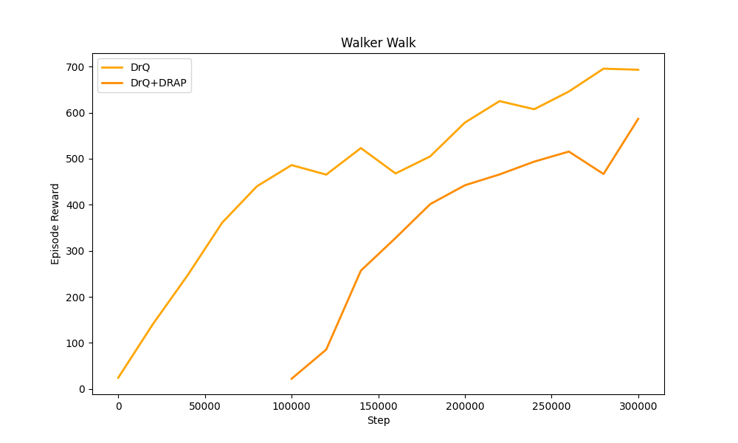
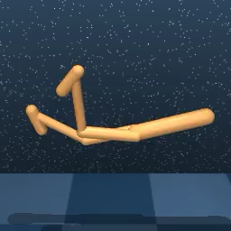
Training statistics
4 Drq+DRAP

Slide 33
Training results
4 Drq+DRAP
Finger domain
 | DrQ |  |  | DrQ + DRAP
 | Step | Reward | Duration | Step | Reward | Duration
Train | 300,000 | 552 | 93.2 s | 200,000 | 660 | 57.9 s
Evaluation | 300,000 | 547 |  | 200,000 | 683

Slide 34
Training results
4 Drq+DRAP
Walker domain
 | DrQ |  |  | DrQ + DRAP
 | Step | Reward | Duration | Step | Reward | Duration
Train | 300,000 | 657 | 77.9 s | 200,000 | 588 | 61.1s
Evaluation | 300,000 | 693 |  | 200,000 | 587

Slide 35
Conclusions
4 Drq+DRAP
The warm-start boosts the DrQ performace as the encoder has already learned to ignore visual variations, focusing on the agent and providing a much cleaner signal to the successive parts of the network.
The finger domain is simpler than the walker domain because it is more “static” and involves only two joints. This simplicity makes it easier for the network to learn a good policy, leading to more significant performance gains and improvements compared to the walker domain, which is more dynamic and requires additional training.
This results are obtained with random randomizations of the environments and so changing specific details of simulation, the results can be better or even worse.

Slide 36
Thank you for the attention.

