Slide 1



PiIrrigate
A smart irrigation system
Candidate: Crișan Virgil – Alexandru
Scientific coordinator: Assoc. Prof. Dr. Eng. Răzvan BOGDAN

Slide 2
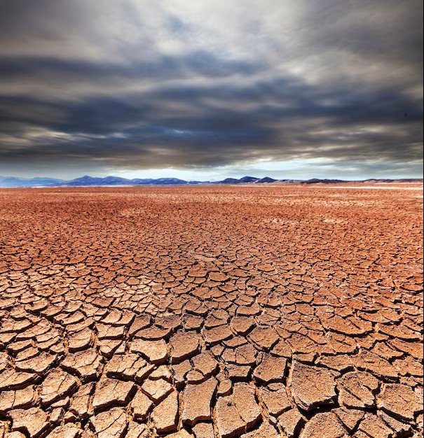
Motivation
Curiosity about IoT and LoRa
Similar monitoring project at IoT and Cloud, but with a different use-case
Global warming
Water scarcity and inefficient irrigation

Slide 3

State of the Art
CropX
Main differentiation: CropX is using a cellular-based communication system while PiIrrigate uses LoRa
Further development:
Native mobile App
Predictive irrigation using ML
Add solar panels for the ESP nodes
LoraWAN implementation

Slide 4
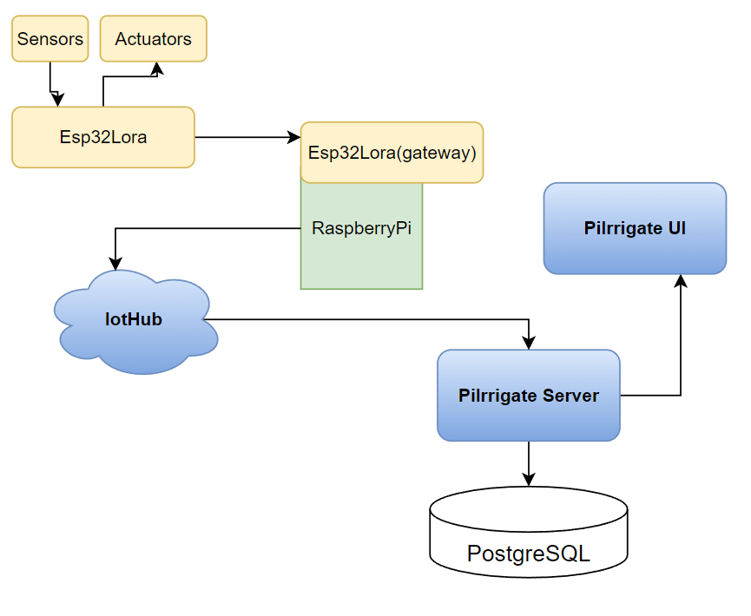
System Architecture

Slide 5


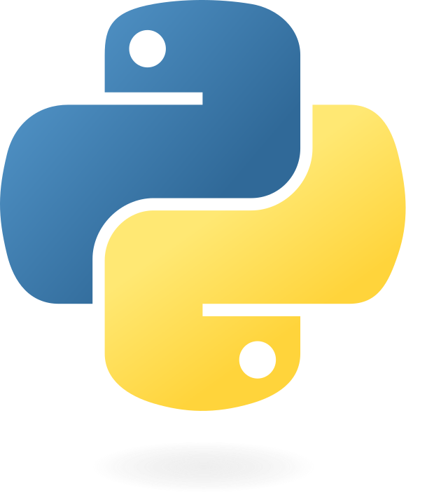

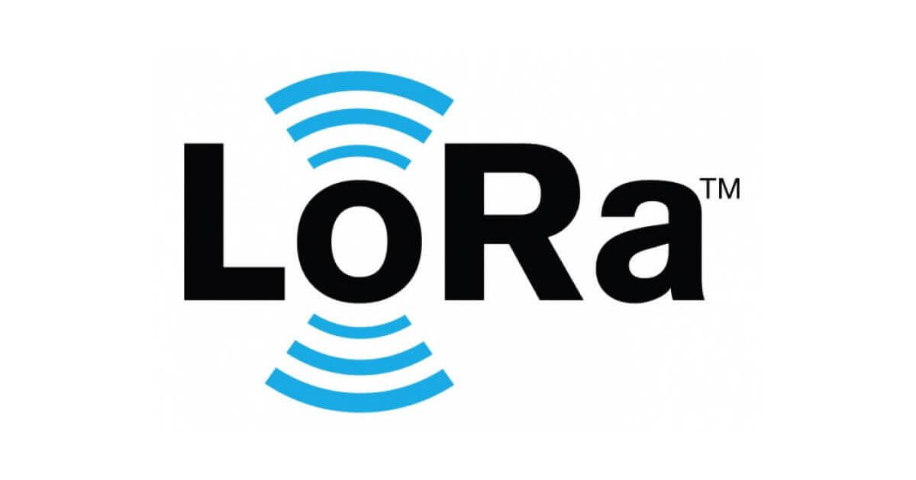


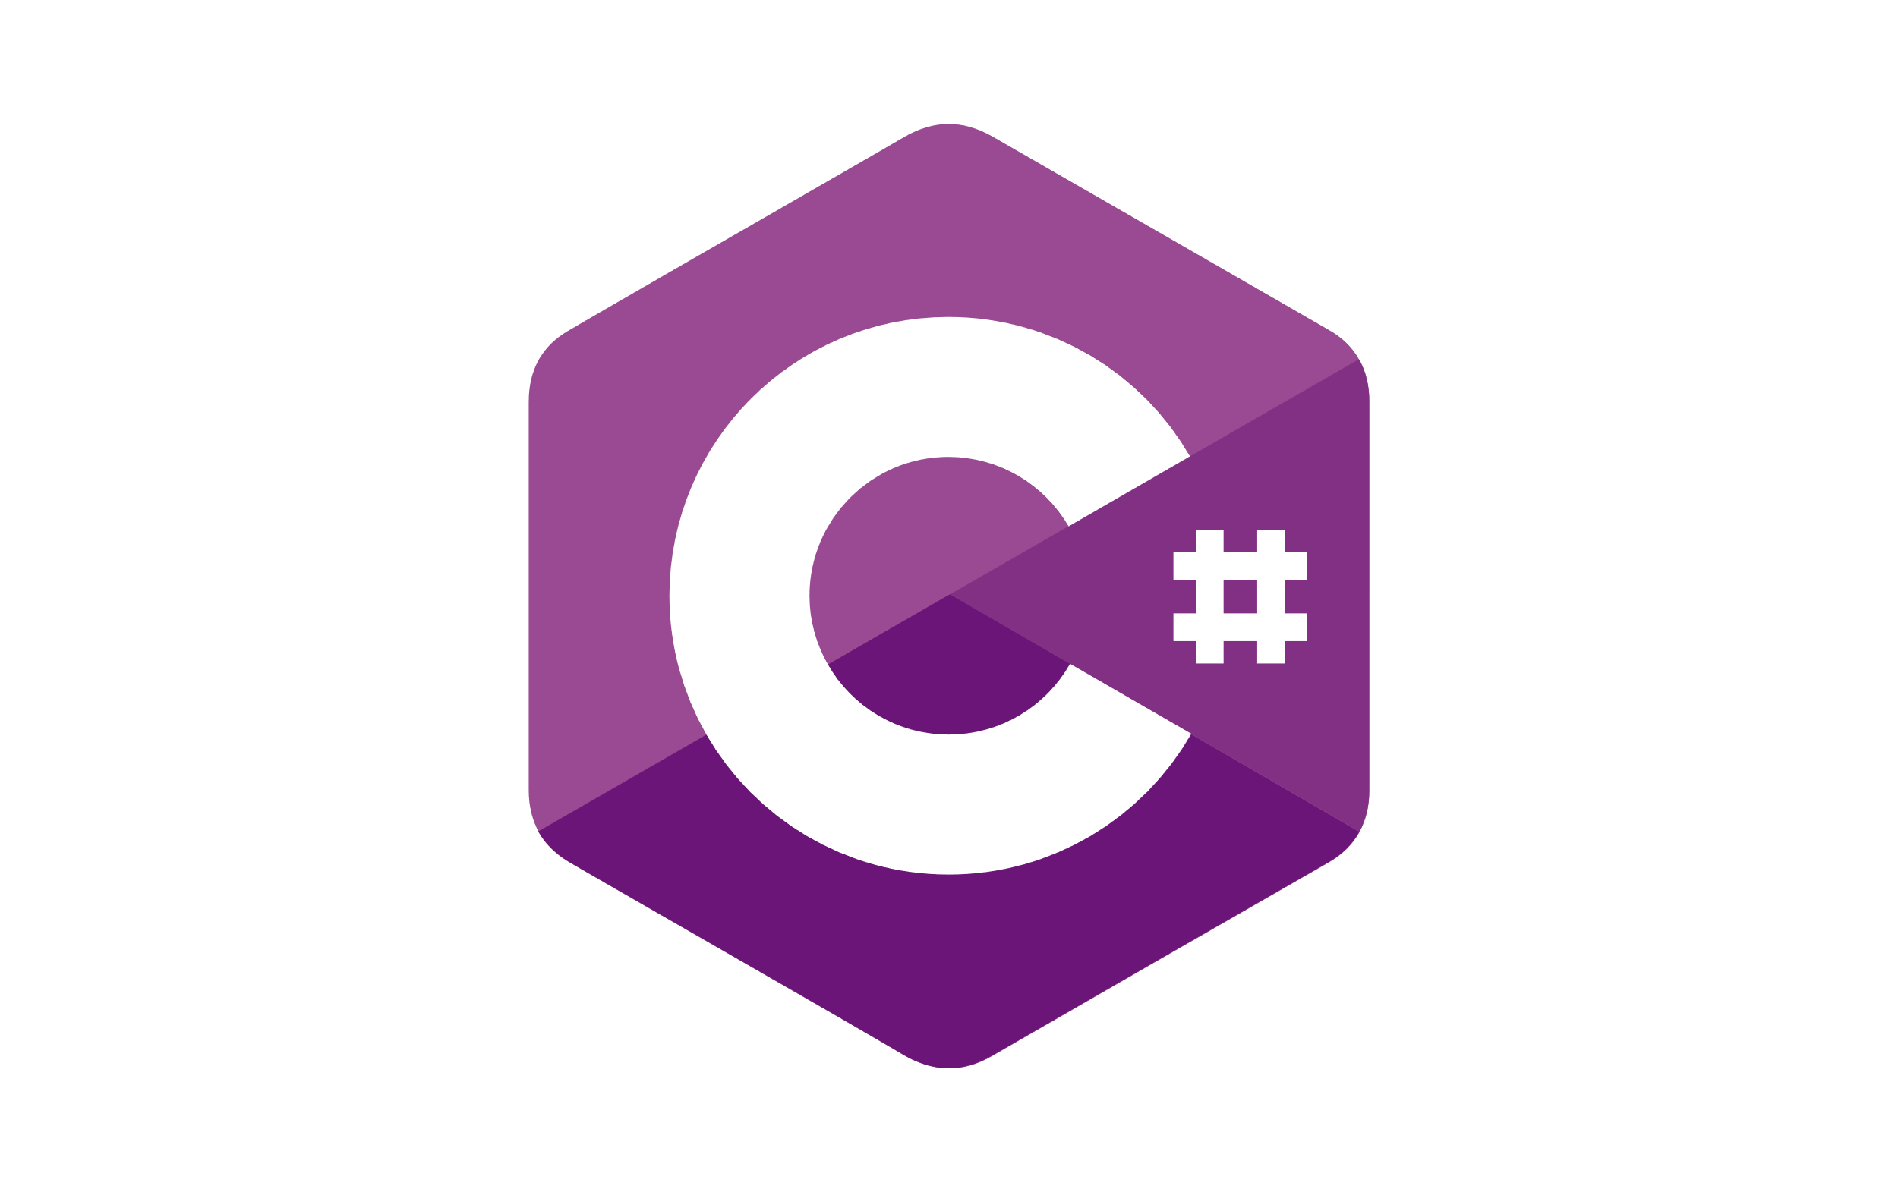




Used Technologies
Arduino
Framework

Slide 6
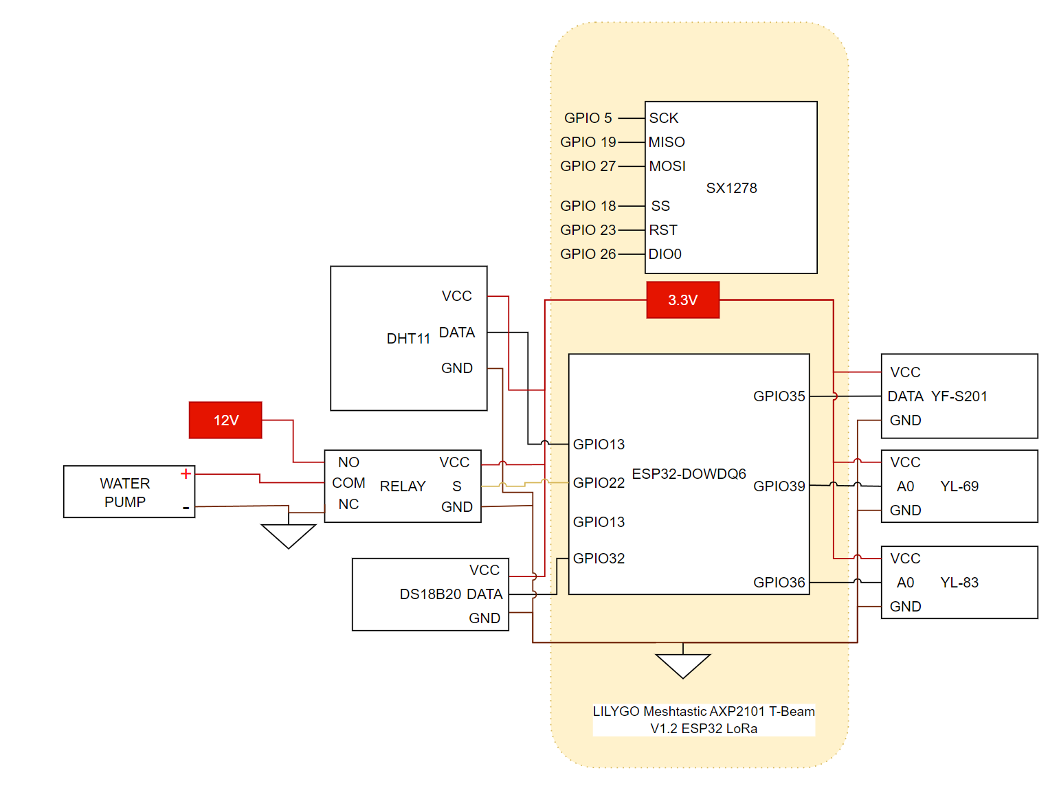
Hardware Architecture
Sender
LoRa

Slide 7
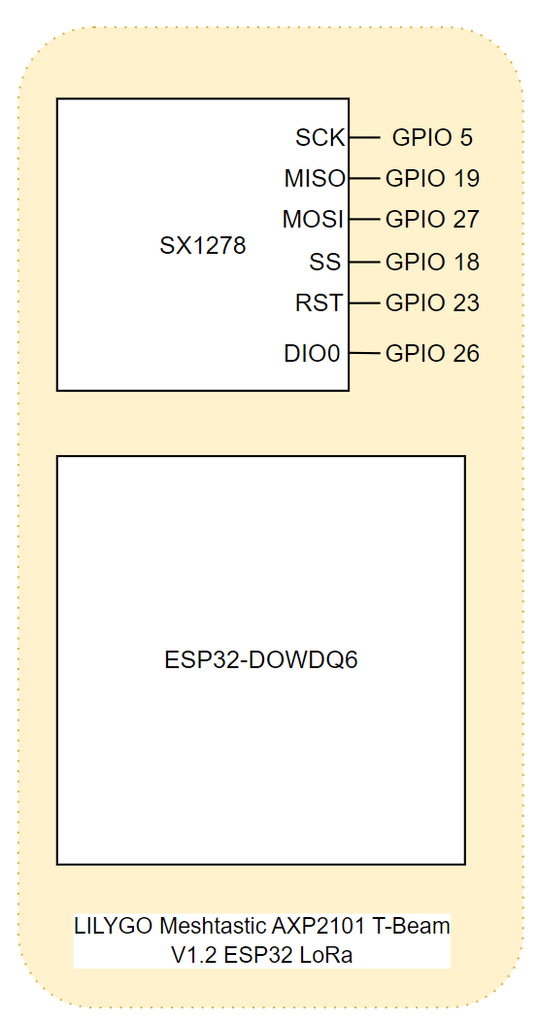
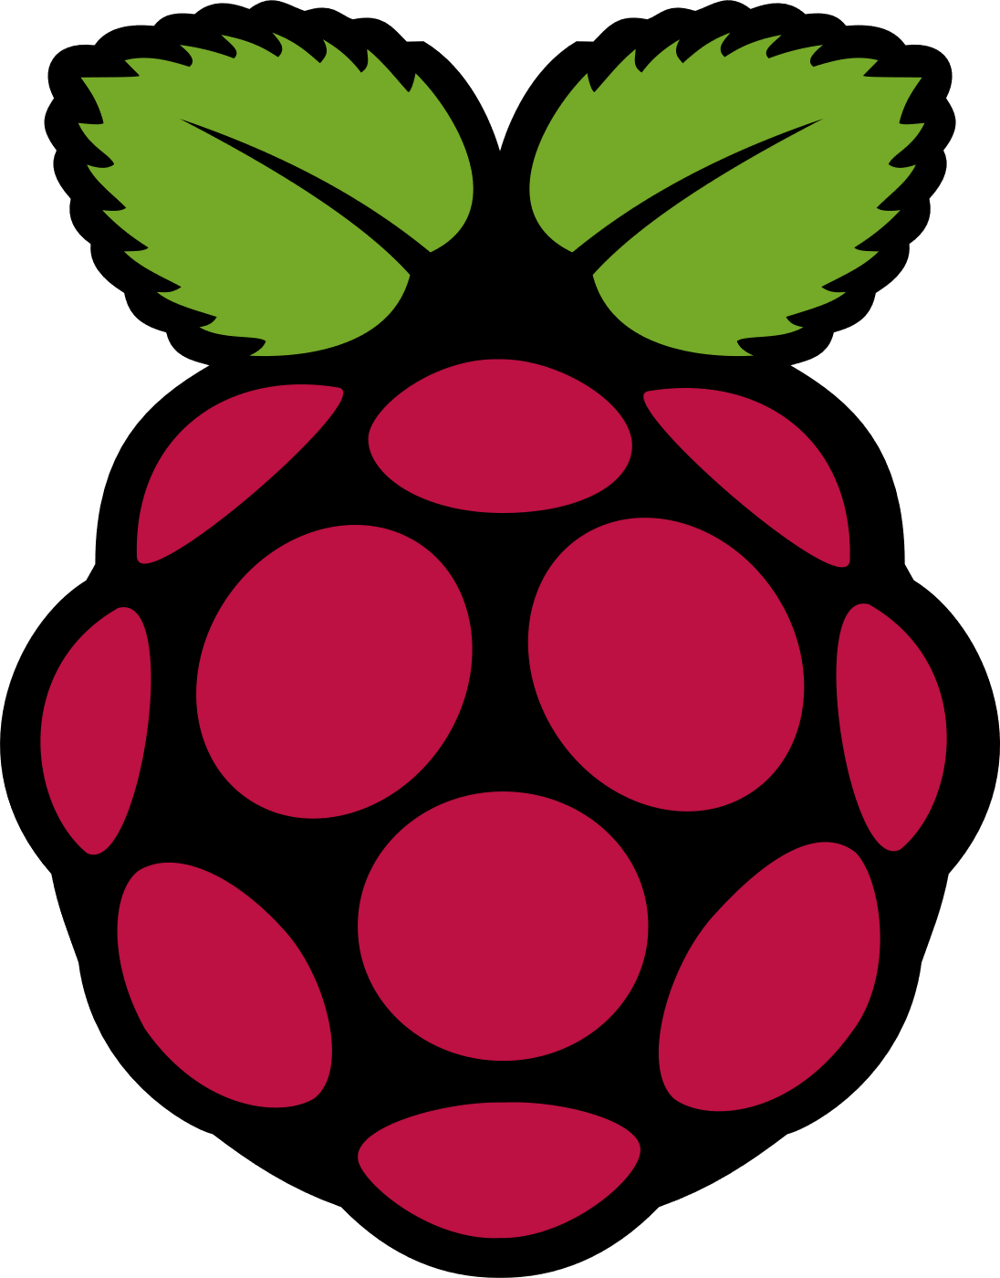
Hardware Architecture
Receiver
LoRa
Raspberry Pi
UART

Slide 8
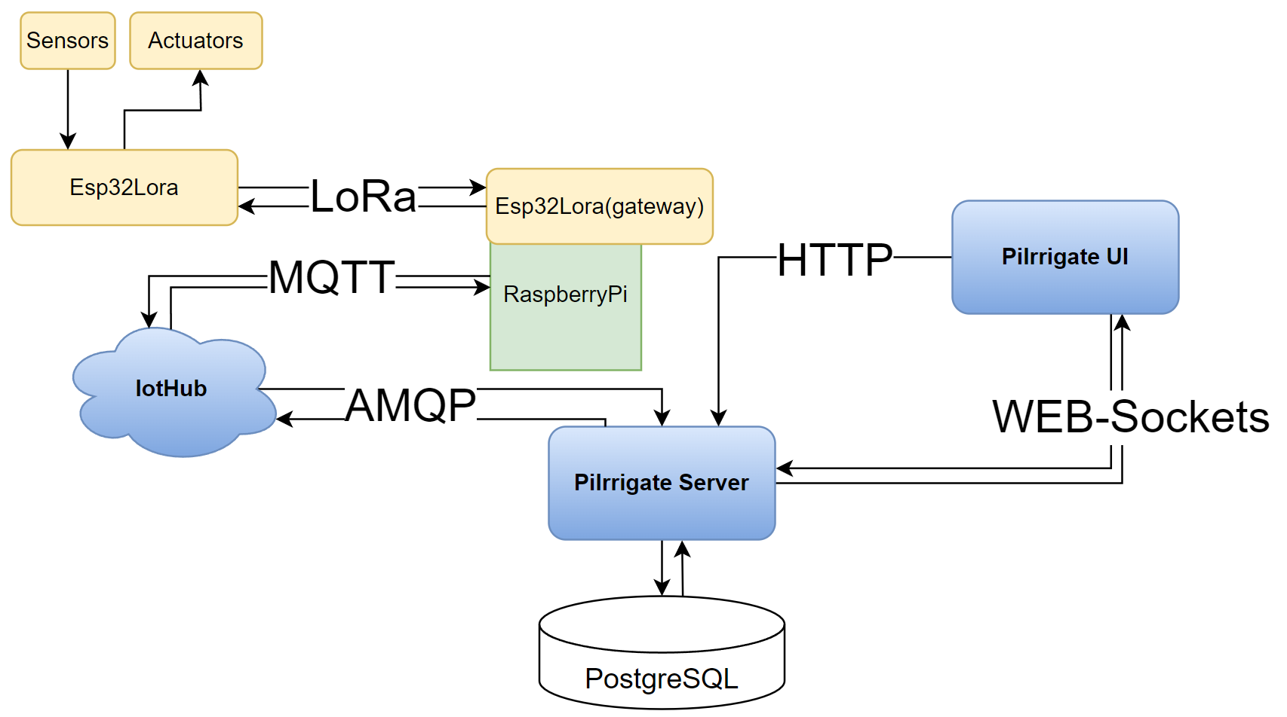
Data Path

Slide 9
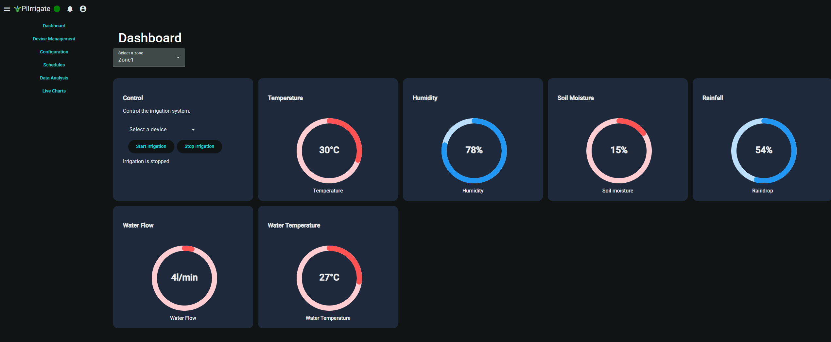
Dashboard and Charts

Slide 10
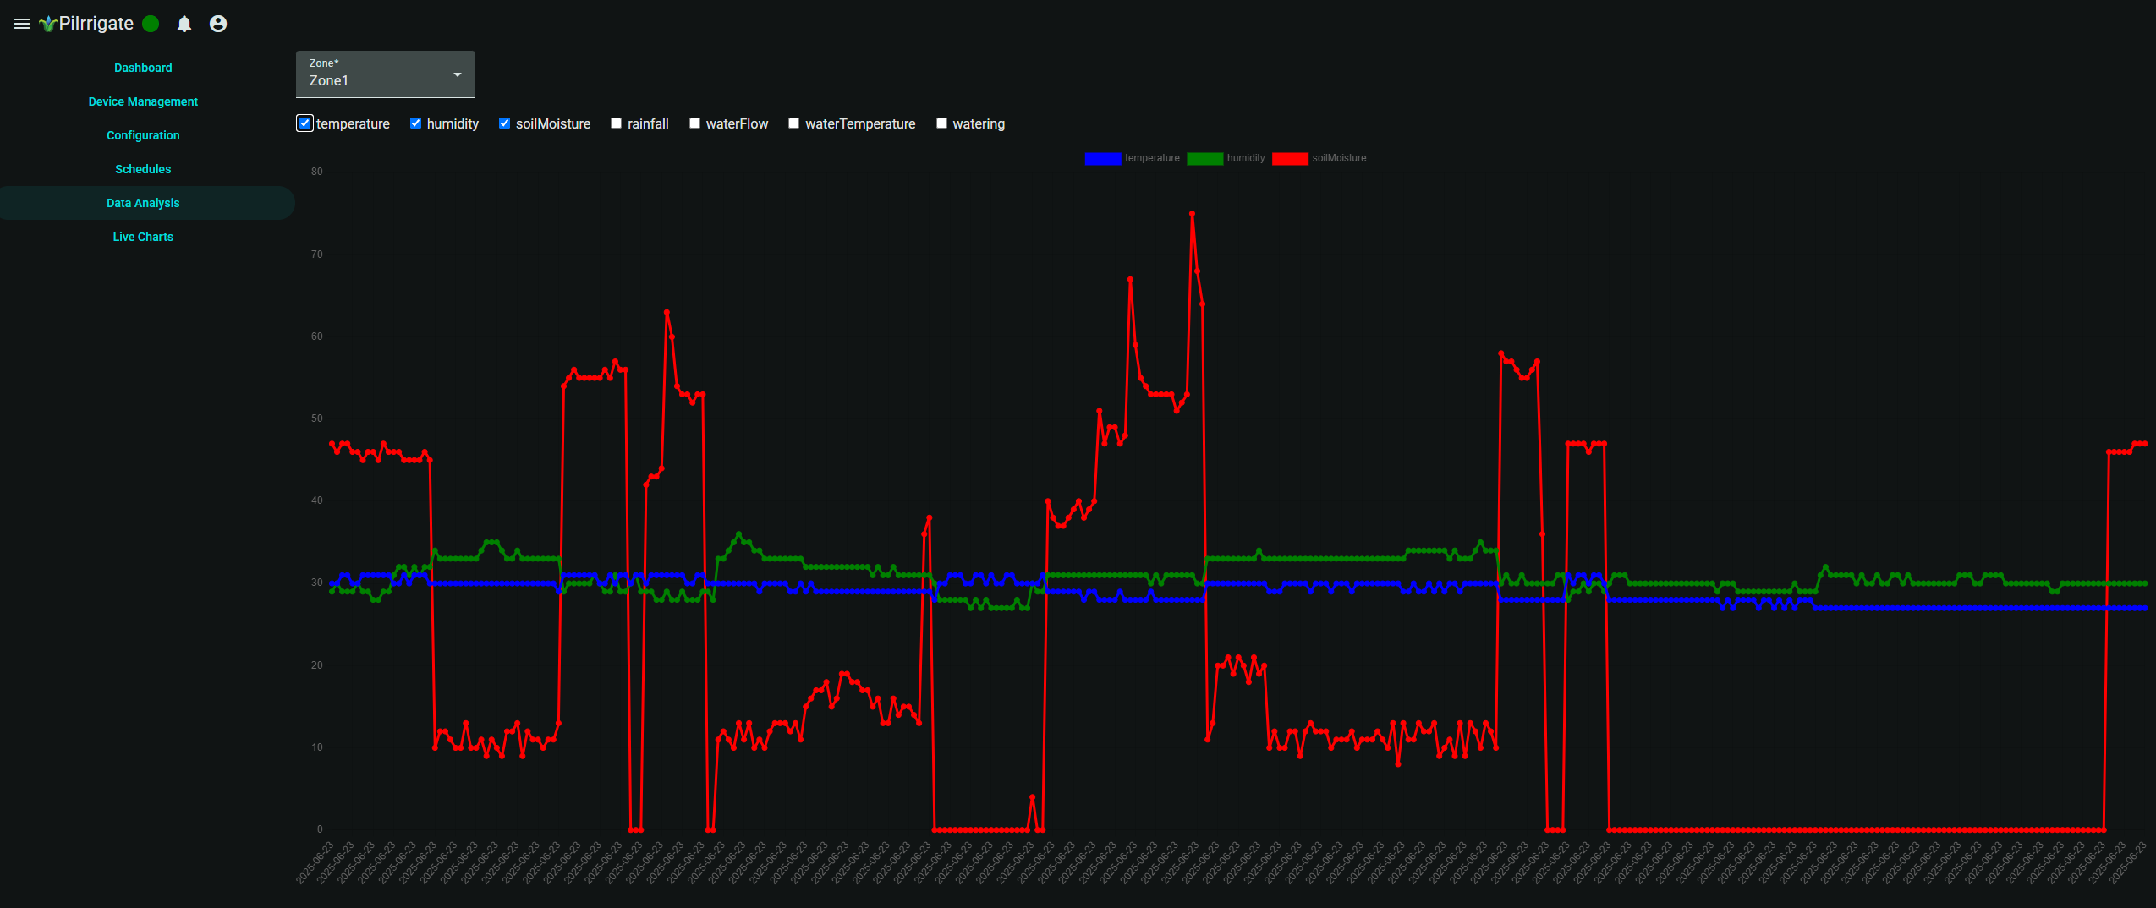
Dashboard and Charts

Slide 11
Conclusions
Project Summary Developed a functional IoT-based smart irrigation system that automates water control using sensor data and real-time communication.
Impact Demonstrates how low-cost hardware (ESP32, LoRa) and modern software can improve agricultural water efficiency.
System Integration Achieved full integration between sensors, LoRa communication, backend processing, and a web-based interface.

