Slide 1

Brain Tumor Classification Using Stacking Method
Cristian Daniel Rodríguez vázquez

Slide 2
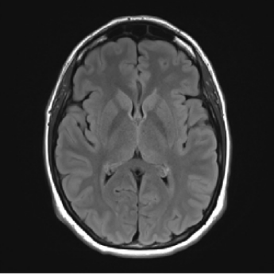
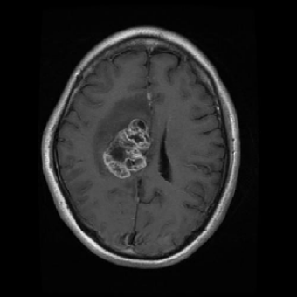
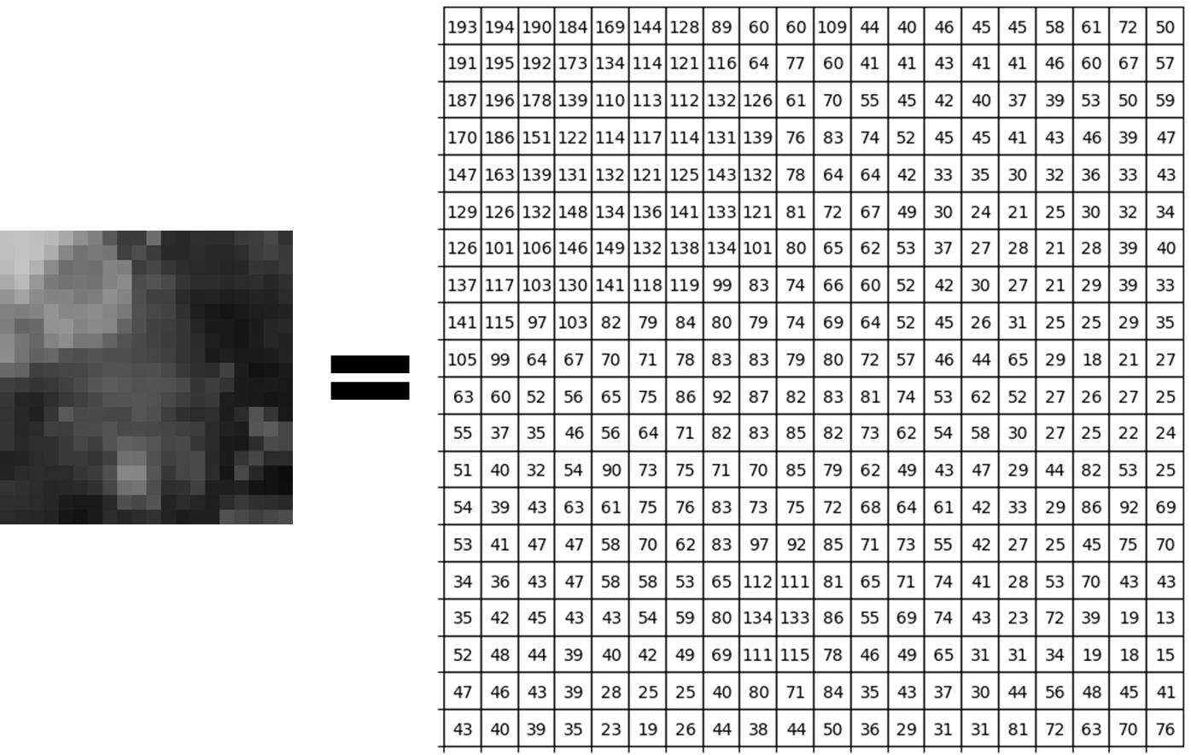
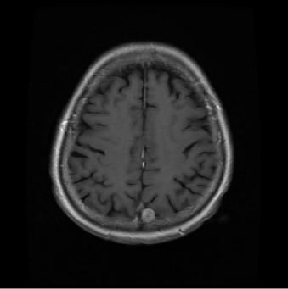
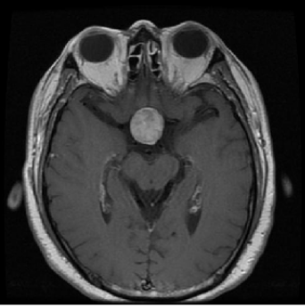
Implementation diagram
5 First order features
Stacking Model
Training 80%
Dataset
512 x 512
Testing 20%
6 Second order features
EDA
Accuracy

Slide 3


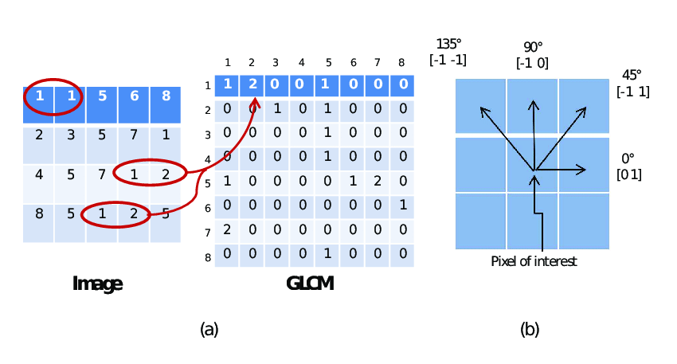

Features Extraction
First order features
Numpy functions (mean, variance, standard deviation)
Scipy functions (skewness, kurtosis)
Second order features
Grey Level Co-ocurrence Matrix
GLCM properties

Slide 4




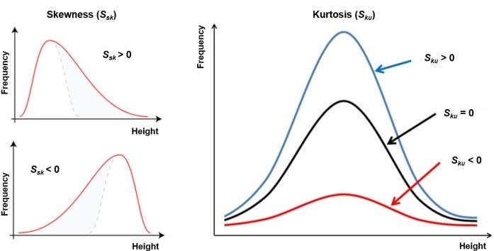

Dataset
Labels
0 = No tumor
1 = Glioma tumor
2 = Meningioma tumor
3 = Pituitary tumor
First order features
Second order features
Mean: the average of the values in the pixel’s matrix.
Variance: used to find how each pixel varies from the neighboring pixel.
Standard deviation: measures the deviation of measured values or data from its mean.
Skewness: measures the lack of symmetry.
Kurtosis: defines how heavily the tails of a distribution differ from the tails of a normal distribution.
Contrast: represents the difference in luminance across the image.
Dissimilarity: is a numerical measure of how different two points are.
Homogeneity: expresses how similar certain elements of the image are.
ASM: is a measure of textural uniformity of an image.
Energy: the rate of change in the brightness of the pixels over local areas.
Correlation: gives information about how correlated a pixel is to its neighboring pixels.

Slide 5
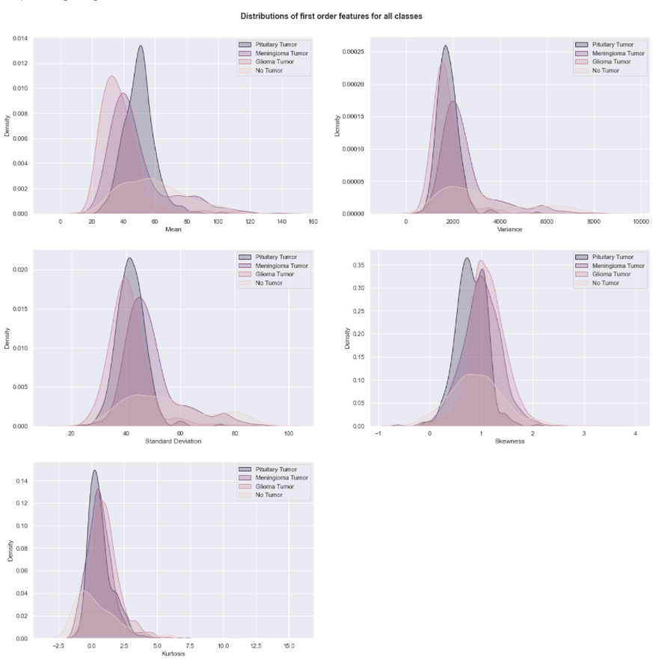
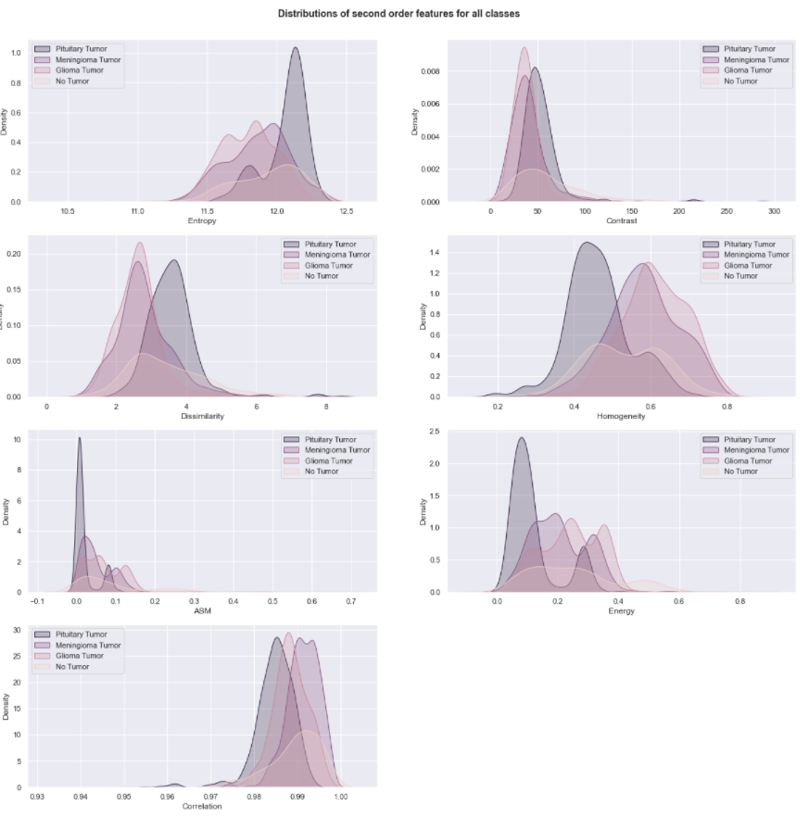
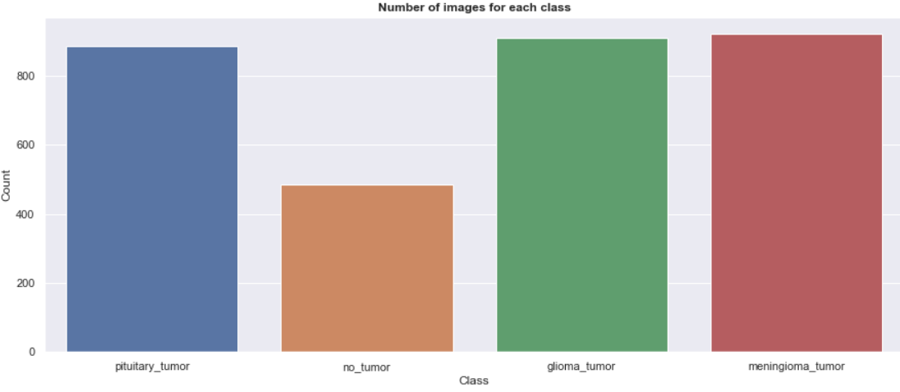
Exploratory Data Analysis
It's clear, from the figures, that the distributions of the majority of the second order features are more different from each class than the ones of first order. Which suggest that these features are more useful in determining the class of a certain image.

Slide 6
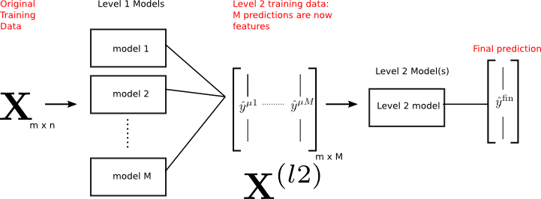
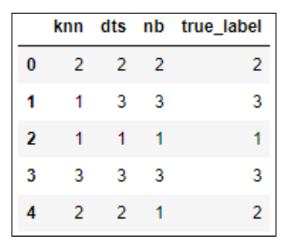
Stacking Model
Initial training data has 2565 observations, and 11 features.
There are three different weak learner models that are trained on the training data.
Each weak learner provides predictions for the outcome which are then cast into a second level training data.
A meta model is trained on this second level training data to produce the final predictions.
KNN
DT
KNN
NB
KNN

Slide 7
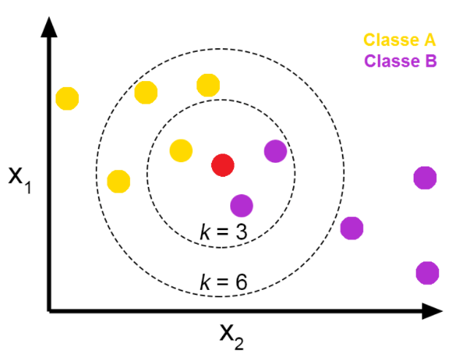
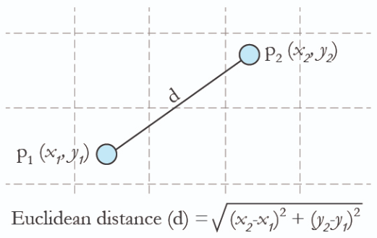
K-Nearest Neighbors
This algorithm assumes that similar things exist in proximity, so it classifies new data points based on their position to nearby data points.
The Euclidean distance is used to determine the distance between each data point.
The chosen number of neighbors identified is crucial in determining the results.
K = 5

Slide 8
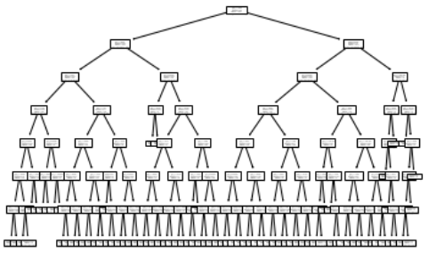
Decision Trees
Determine the system entropy
Determine sub entropies for each feature.
Calculate the information gain for each feature.
Choose as the next node the feature that obtain the highest information gain.
Repeat the process for each new branch until get the desired number of nodes.
Max_Depth = 7

Slide 9


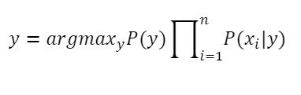
Naive Bayes
This algorithm is based on the Bayes Theorem.
We can find the probability of y happening, given that X occurred.
The assumption is that the features are independent, meaning that the presence of one feature does not affect the other.
P(0|X) = 0.3
P(1|X) = 0.1
P(2|X) = 0.7
P(3|X) = 0.5
Prediction
2

Slide 10
Models Accuracies
Model | From scratch | Scikit-learn
K-Nearest Neighbor | 58.28% | 59.55%
Naive Bayes | 55.65% | 54.02%
Decision Tree | 73.21% | 68.75%
Stacking | 66.98% | 65.21%

