Slide 1
Mini Project

Slide 2
Vote Here:
https://forms.gle/qHQKfFCeDR5Z2BKR9
https://tinyurl.com/miniprojectbootcamp

Slide 3
Mini Project
Read in a table/txt/csv file or make your own file
Make 2 plots
Present code/plots

Slide 4
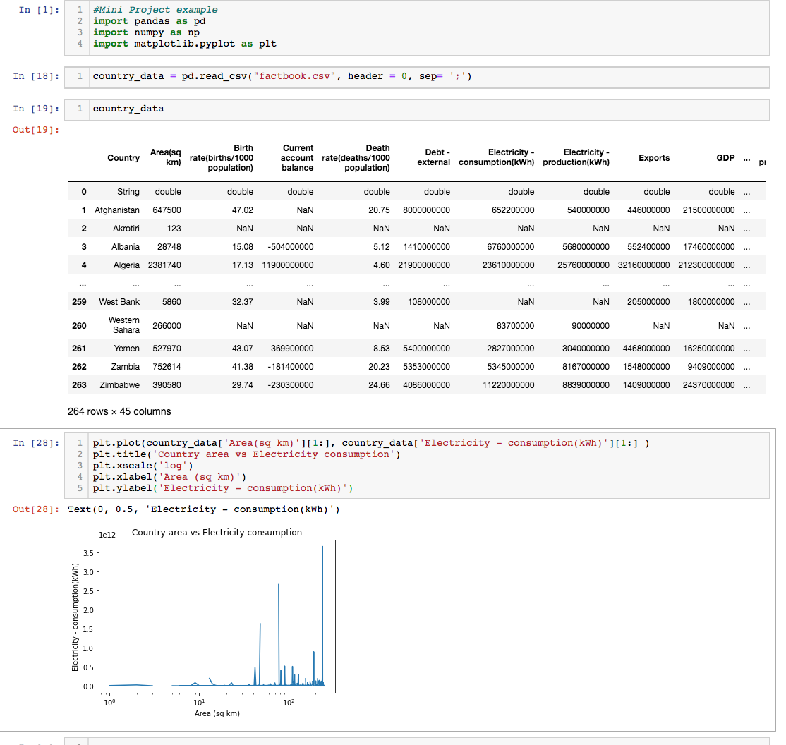
Datasets
https://perso.telecom-paristech.fr/eagan/class/igr204/datasets

Slide 5
Accounts
Github
https://github.com/
Overleaf
https://www.overleaf.com/

