Slide 1
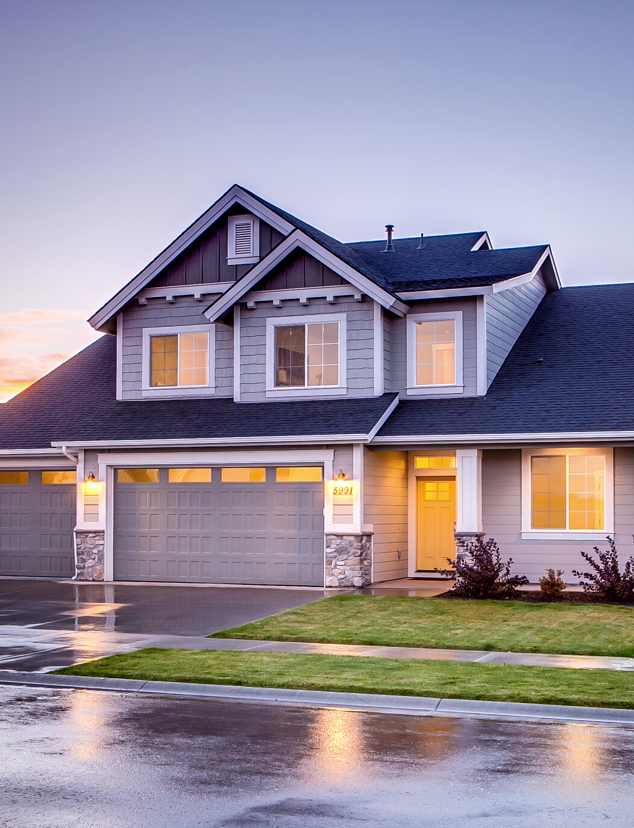
ZESTIMATOR LITE FOR REALTORS
Predicting Property Value
Presented by Cris Giovanoni

Slide 2
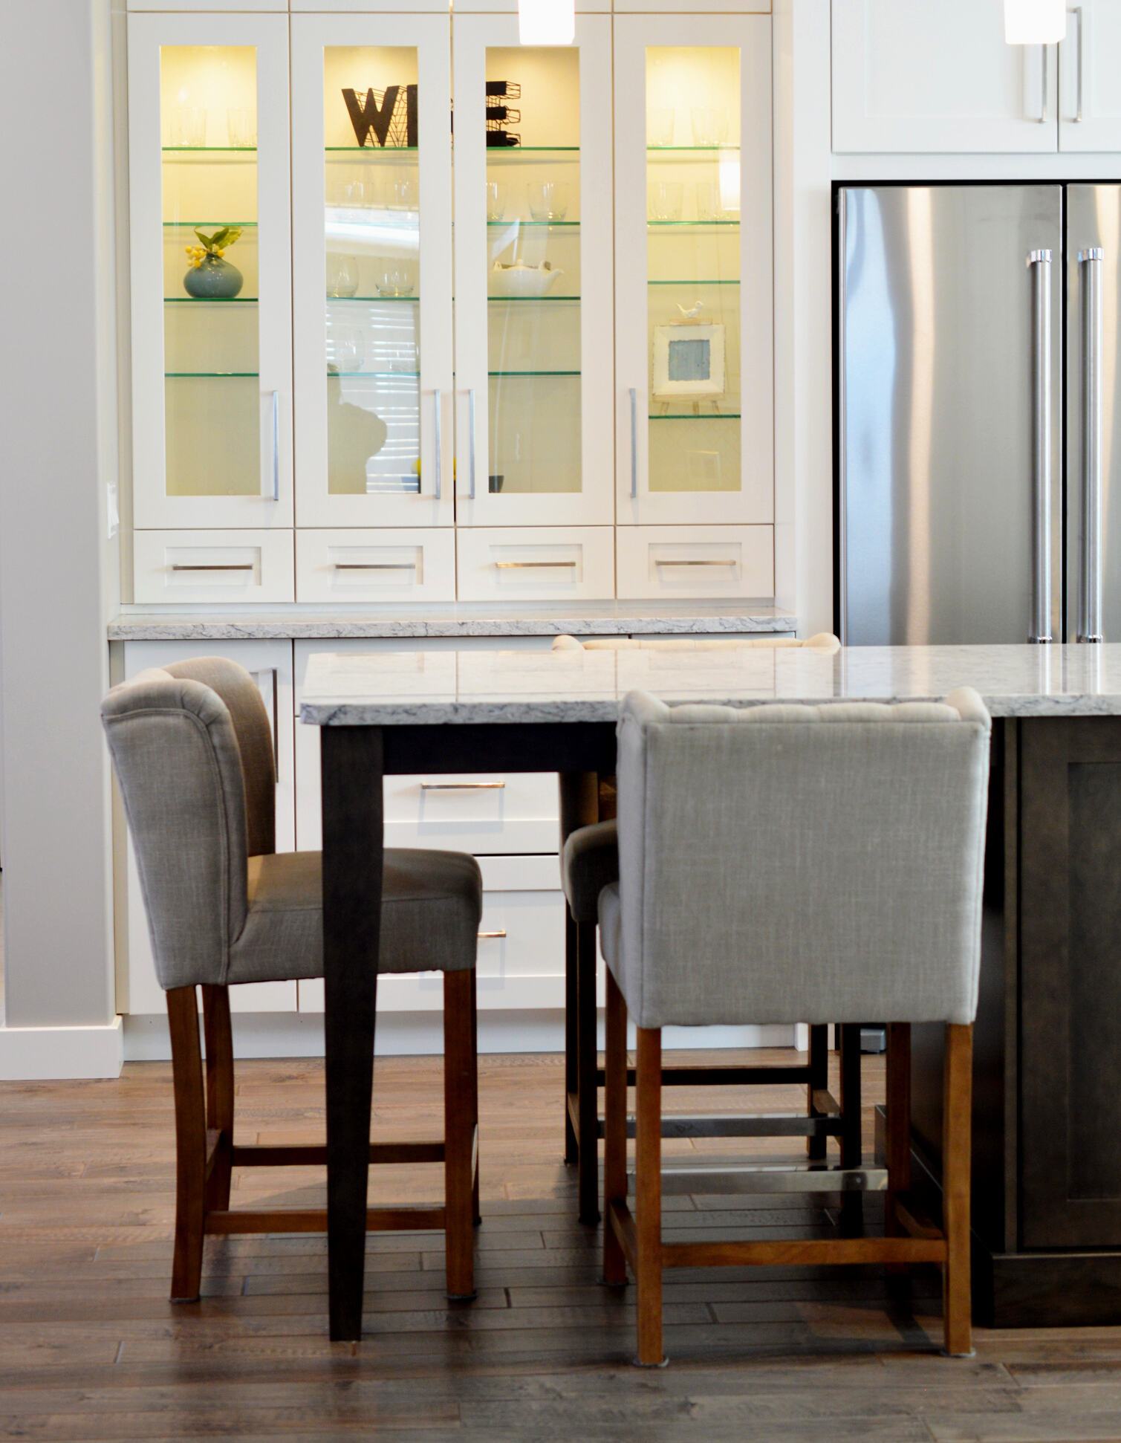
Can we use Square Footage, # of Bed and Bathroom as predictors for Zestimator Lite?
Zillow's Dev Team is rolling out Zestimator Lite for Realtors that predicts property values with as little information input as possible.

Slide 3
Can we use Square Footage, # of Bed and Bathroom as predictors for Zestimator Lite?
YES
MAYBE...
INDUSTRY KNOWLEDGE
Our street smart intuition says, yes we can. Because the bigger the property, the more expensive it is. # of bath and bed extends the price.
DATA-DRIVEN APPROACH
Create a model that predicts property values with Square Footage, # of Bed and Bathrooms as FEATURES. And see the model's predictive power.

Slide 4

Process
Created Baseline Model for Comparison
Created the Ω Model
Compare and Evaluate Predictive Power of Models
Is the industry right in saying that the 3 Features can predict property value?
Can I improve the Baseline Model and predict property value better?
1. Is Ω Model any better?
2. Does the 3 Features have strong enough predictive power?

Slide 5
Findings
There's a linear correlation between
3 Features and Property Value.
3 Features are multicollinear with each other. # of bed and bath are highly correlated with Square Footage.
Ω Model performed just a tad better than Baseline model

Slide 6

Yes, the 3 Features are
Statistically Significant & Correlated with Property Value.
Square Footage
# of Bathroom
# of Bedroom

Slide 7
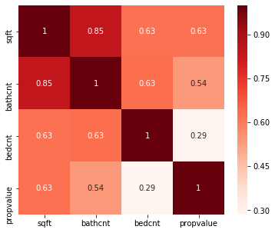
3 Features are
Multicollinear with Each Other.

Slide 8
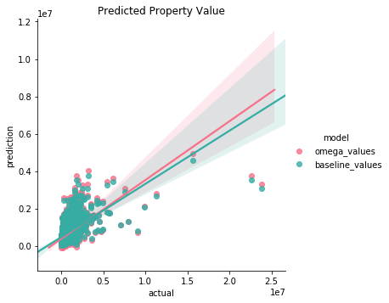
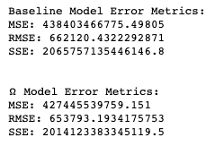
Ω Model just performed a tad better than Baseline Model.
 | Baseline | Ω
Explained Variance Ratio | 32.5% | 33.2%

Slide 9
Can we use Square Footage, # of Bed and Bathroom as predictors for Zestimator Lite?
With 33% EVS, I recommend that you should find other features that will supplement Square Footage, primarily.

