Slide 1






AUXILIA
AI-Powered Parametric Income Protection for Gig Workers

Slide 2
THE PROBLEM
Gig workers lose earnings during active shifts when disruptions hit — rain, traffic, road incidents, low demand.
No existing protection is built for short 10–20 min delivery windows.
City-wide insurance averages ignore zone-level risk differences.
Gig workers are reluctant to trust a new financial platform with their personal and payment data

Slide 3
WHAT IS AUXILIA
Weekly income-protection platform for Q-commerce and food delivery riders
A parametric model with predefined triggers, that facilitates automatic claim evaluation and fast payout.
Purely intended for operational disruption coverage

Slide 4
HOW IT WORKS?
1.
Rider buys weekly coverage via the app
2.
Backend continuously monitors live disruption signals
3.
Rider submits a claim; fraud checks run automatically
4.
Eligible claims are paid out instantly via simulated settlement

Slide 5
KEY DIFFERENTIATORS
Zone first logic : risk is evaluated at delivery zone level, not city average
Multi trigger model : Takes rain , traffic, road incidents and low demand surge into account.
Short window tuned : Focuses on 10 20 min delivery cycles.
Explainable claims: Transparent check by check status visible to ride and admin
Privacy-first design : anonymous logs used for risk prediction and payment processing, minimizing personal data exposure
Loyalty rewards : continuous usage is rewarded with loyalty points, building long-term trust and reducing churn

Slide 6
PLATFORM ARCHITECTURE
Rider App for onboarding, policy purchase, claim submission, live coverage card
Admin Dashboard for onboarding, policy purchase, claim submission, live coverage card
FastAPI backend for risk scoring, fraud agent, payout agent, trigger polling, analytics APIs

Slide 7
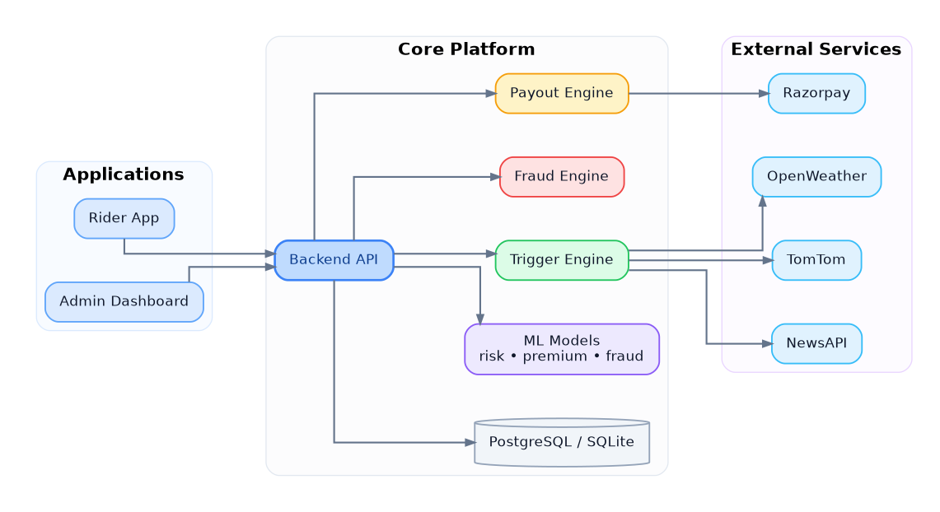
SYSTEM ARCHITECTURE

Slide 8
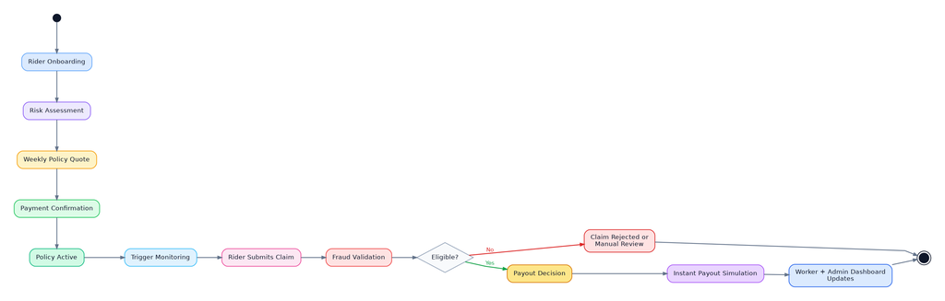
PRODUCT FLOW

Slide 9
CLAIM PROCESSING FLOW
Rider submits claim → trigger snapshot stored
Fraud agent runs: location · duplicate/frequency trigger evidence · behavior
Eligible → payout agent calculates amount
Instant payout simulated (Razorpay-compatible)
Status updated in both rider and admin views

Slide 10
INTELLIGENCE LAYER
ML-based risk scoring + premium pricing using live disruption signals + rider/zone context
Delivery-specific fraud detection
Predictive analytics: next-week claim volume forecast by zone
Premium preview shown to rider before purchase

Slide 11
WHAT WE BUILT
Fully functional rider app with auth, policy, claims flow
Admin dashboard with fraud review and live KPIs
Seeded demo data + model artifacts ready to run
REST APIs across auth, policies, claims, payments, triggers, zones

Slide 12
THANK
YOU

