Slide 1
Noise-space RL for arm–hand coordination in a frozen SignSparK
Final results: ACMS multi-seed replication and the FG-1 feasibility gate
How2Sign (ASL) · 7 November 2026
Released-checkpoint result, not a paper reproduction · motion statistics only
SignSparK RL study · released-checkpoint results, not a paper reproduction
1/25
Notes:
This talk closes the SignSparK RL project. Everything I show is a released-checkpoint result on How2Sign, not a reproduction of the paper, and every metric is a motion statistic. I make no claim about naturalness, intelligibility, meaning or ASL quality.

Slide 2
Bottom line
+0.0022
pooled Δ right arm–hand coordination, 4 new seeds
seed-sensitive
registered replication category
≈1/23
of the registered 0.05 relevance threshold
all pass
pre-registered preservation checks, 5 runs
Pooled 95% CI across runs +0.0022 [-0.0013, +0.0056] includes zero; I² = 0.97.
In the FG-1 fresh-noise gate: learned M-C negative (held-out Δ +0.0034); per-clip ACMS inconclusive (held-out Δ +0.1016); bilateral SC-MC positive (held-out Δ +0.0893).
Conclusion: the amortised RL policy gives no practically relevant gain; per-clip control is feasible.
SignSparK RL study · released-checkpoint results, not a paper reproduction
2/25
Notes:
The headline. Across four new training seeds the ACMS effect averages +0.0022 on right arm–hand coordination, with a run-level confidence interval that includes zero and very high heterogeneity, so the registered category is seed-sensitive. Even the best run is far below the 0.05 threshold we registered as the smallest relevant effect. Nothing broke: all preservation checks pass. The FG-1 gate results are summarised on the second bullet and detailed later.

Slide 3
The problem: generated hands ignore the arms
SignSparK samples body and each hand from independent noise in gloss-free text-to-pose generation.
Arm–hand coordination in generated How2Sign samples ≈ 0.02 vs ≈ 0.45 in references (chance level).
Goal: reduce this deficit with RL on top of the frozen released checkpoints, without changing per-stream motion.
Out of scope (user decisions): fine-tuning, test split, human evaluation, perceptual or semantic claims.
SignSparK RL study · released-checkpoint results, not a paper reproduction
3/25
Notes:
Stage 3 established the deficit: coordination between arm speed and hand articulation in generated samples is at the level expected from independent sampling, while references are around 0.45. The structural cause is that the hand generator never sees the body noise. We were asked to try RL without touching the weights.

Slide 4
Formulation: a contextual bandit over the initial noise
Action: initial noise of the right-hand stream; one decode per episode; terminal reward.
Per-frame MDPs rejected: the 10-step rectified-flow generator is non-autoregressive.
Reward: −|coord_ah^R − 0.4514| (frozen train-reference target, metric R v1.1).
Constraints (articulation, jerk, extremes, activity) by dual ascent; λ stayed 0 in all runs.
Primary statistic: paired clip-mean Δ trained − uncoupled on dev-256 × 4 shared noises.
SignSparK RL study · released-checkpoint results, not a paper reproduction
4/25
Notes:
Because the generator decodes the whole sequence at once, the right abstraction is a contextual bandit: the context is the text and the generated body, the action is the hand noise, the reward is terminal. The reward targets the train-reference coordination level rather than maximising it, so it cannot be gamed by over-coupling. Constraints never became active.

Slide 5
ACMS: arm-conditioned temporal mean shift
ε_R = ξ + μ_φ(ŝ), μ_φ = β · U · tanh(W ∗ ŝ + c); ŝ = generated arm speed profile.
Rank 4, 17-tap kernel, 433 parameters; KL = ½‖μ‖² per frame < 1 nat/frame by construction.
REINFORCE with leave-one-out baseline (G = 4), Adam 0.01, clip 1.0, 125 updates / 500 episodes.
Stage 5 run 7000: Δ = +0.0022 [+0.0014, +0.0031], pre-registered verdict positive but negligible.
SignSparK RL study · released-checkpoint results, not a paper reproduction
5/25
Notes:
ACMS shifts the mean of the hand noise in time with the arm's speed profile. It is tiny, 433 parameters, and the KL to the base sampler is exactly half the squared shift, so it is bounded. The original run gave a positive but negligible effect, which is why replication across seeds was the next registered step.

Slide 6
Protocol and safeguards
Seeds 7001–7004 vary init, clip sampling (5000 + d) and training noise (50M + d·1M) independently; eval noise shared.
Runs = unit of inference: per-run CIs, t-interval across runs, clip and hierarchical bootstrap, Q / I² / τ².
Category rule fixed before running; update 125 primary; no best-run or best-checkpoint selection.
Checkpoint SHA-256 before/after; Stage 4/5 artifacts hash-snapshotted; TRAIN/DEV only, test split never opened.
Metrics, validity rules, targets, rewards and thresholds unchanged.
SignSparK RL study · released-checkpoint results, not a paper reproduction
6/25
Notes:
The design was registered before any run. Each new seed changes three independent sources of randomness. The unit of inference is the training run, so the main interval is a t-interval over four runs; clip bootstrap intervals are shown separately because they only capture evaluation sampling.

Slide 7
1 · ACMS multi-seed replication
Four new seeds, original configuration, frozen SignSparK
SignSparK RL study · released-checkpoint results, not a paper reproduction
7/25
Notes:
First block: the replication.

Slide 8
Per-run results (dev-256 × 4, space R)
Run | Δ coord_ah^R [95% clip CI] | Verdict | KL mean | Train s
7000 | +0.0022 [+0.0014, +0.0031] | positive | 0.0037 | 284
7001 | -0.0003 [-0.0007, +0.0001] | negative | 0.0026 | 283
7002 | +0.0011 [+0.0005, +0.0016] | positive | 0.0029 | 282
7003 | +0.0041 [+0.0032, +0.0052] | positive | 0.0035 | 273
7004 | +0.0039 [+0.0030, +0.0049] | positive | 0.0088 | 273
Pooled 4 new (t) | +0.0022 [-0.0013, +0.0056] | seed-sensitive
Pooled all 5 (t) | +0.0022 [-0.0001, +0.0045] | seed-sensitive
All runs completed; weights unchanged; 0 undefined statistics; uncoupled samples bitwise identical across runs.
SignSparK RL study · released-checkpoint results, not a paper reproduction
8/25
Notes:
Per run: three of the four new seeds are positive with clip intervals excluding zero; seed 7001 is slightly negative. Pooled across runs the interval includes zero. The uncoupled baseline samples are bitwise identical in every run, so the differences are due to training only.

Slide 9
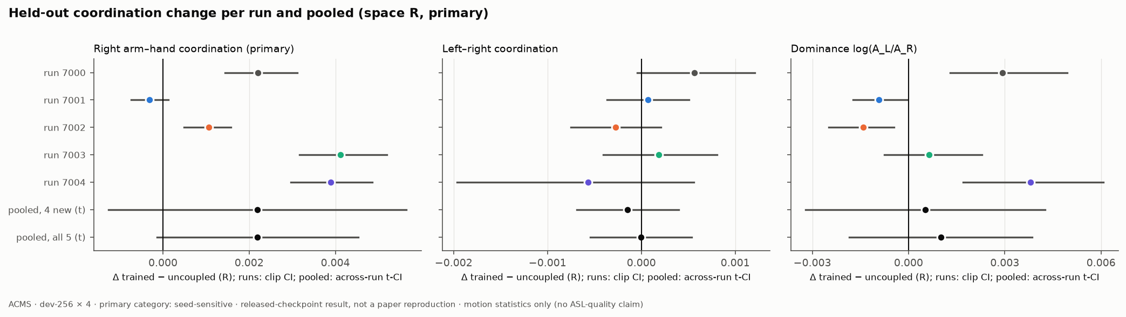
Effect per run and pooled
Pooled 4 new +0.0022 [-0.0013, +0.0056]
Clip bootstrap +0.0022 [+0.0018, +0.0026] (eval sampling only)
I² = 0.97; Q = 108 (df 3)
Dominance and L–R: no consistent direction
SignSparK RL study · released-checkpoint results, not a paper reproduction
9/25
Notes:
The forest plot. Each run has a tight clip interval, but runs disagree with each other far more than their intervals allow, which is what I² near one says. The pooled t-interval is wide and crosses zero. Dominance and left–right coordination move in no consistent direction.

Slide 10
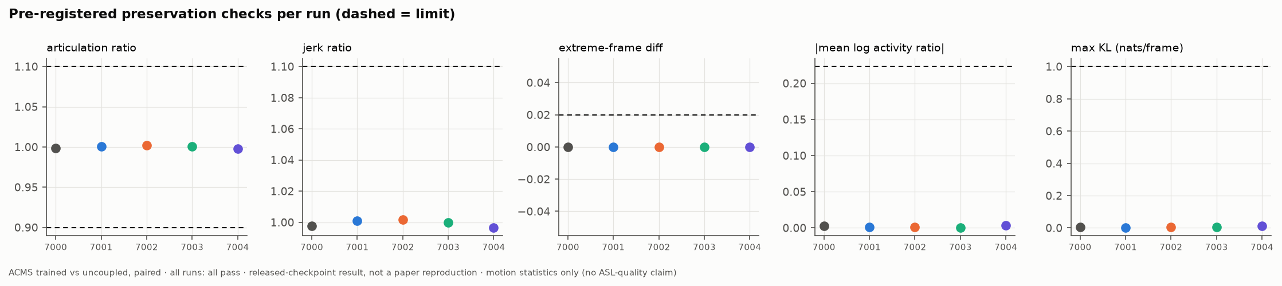
Preservation: nothing else changed
Articulation, jerk, extremes, activity, KL: all pass in all runs
Ratios within 0.5% of 1
Max KL 0.0114 nats/frame
SignSparK RL study · released-checkpoint results, not a paper reproduction
10/25
Notes:
Every pre-registered preservation check passes in every run, and the ratios are within half a percent of one. ACMS is a very small perturbation of the base sampler, which fits the very small effect.

Slide 11
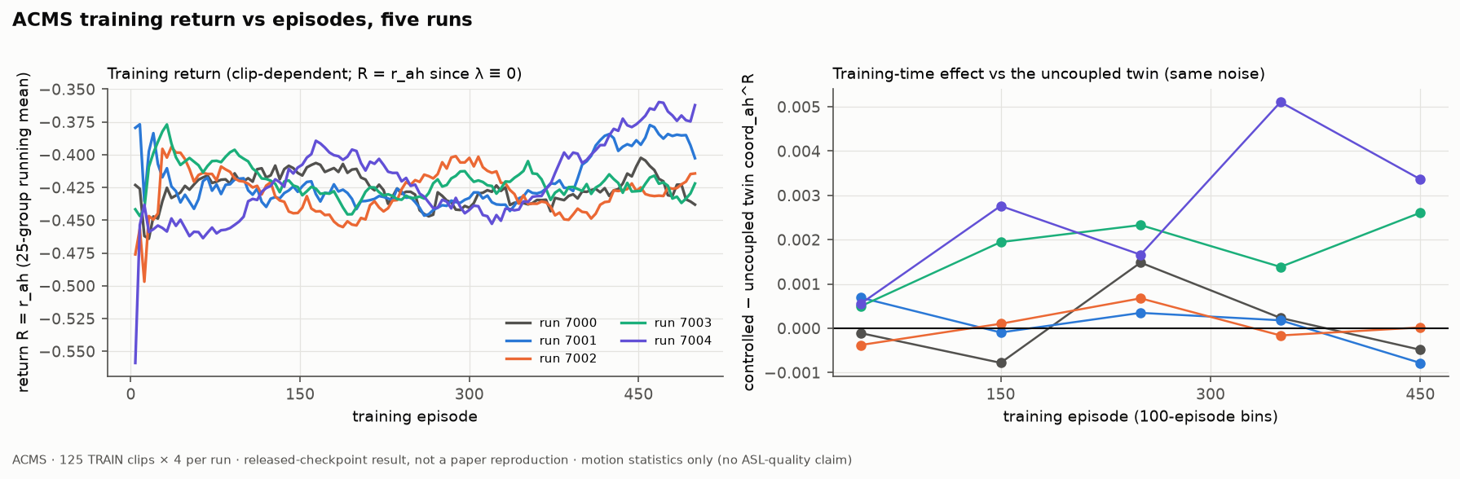
Training dynamics
Return is clip-dependent and noisy
Training-time controlled − twin effect small in all runs
No constraint ever active
SignSparK RL study · released-checkpoint results, not a paper reproduction
11/25
Notes:
Training curves for all five runs. The return is dominated by which clips are sampled. The controlled-minus-twin effect during training is in the thousandths throughout, matching the evaluation.

Slide 12
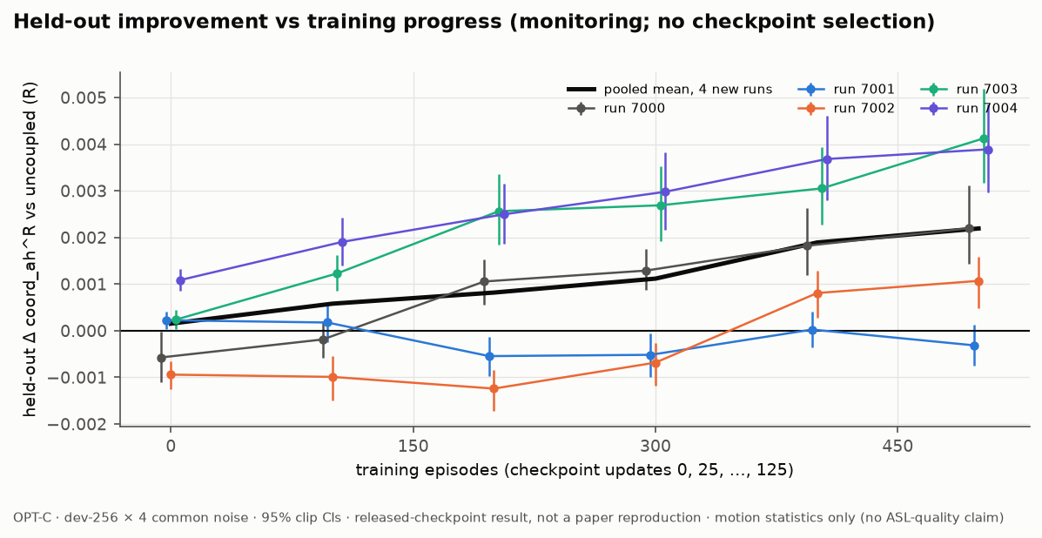
OPT-C: held-out effect across checkpoints (monitoring)
Updates 0, 25, 50, 75, 100, 125 evaluated (R only)
Update 125 stays primary; nothing selected
SignSparK RL study · released-checkpoint results, not a paper reproduction
12/25
Notes:
Intermediate checkpoints were evaluated as monitoring only. They show how the held-out effect develops; they were never used to choose a checkpoint.

Slide 13
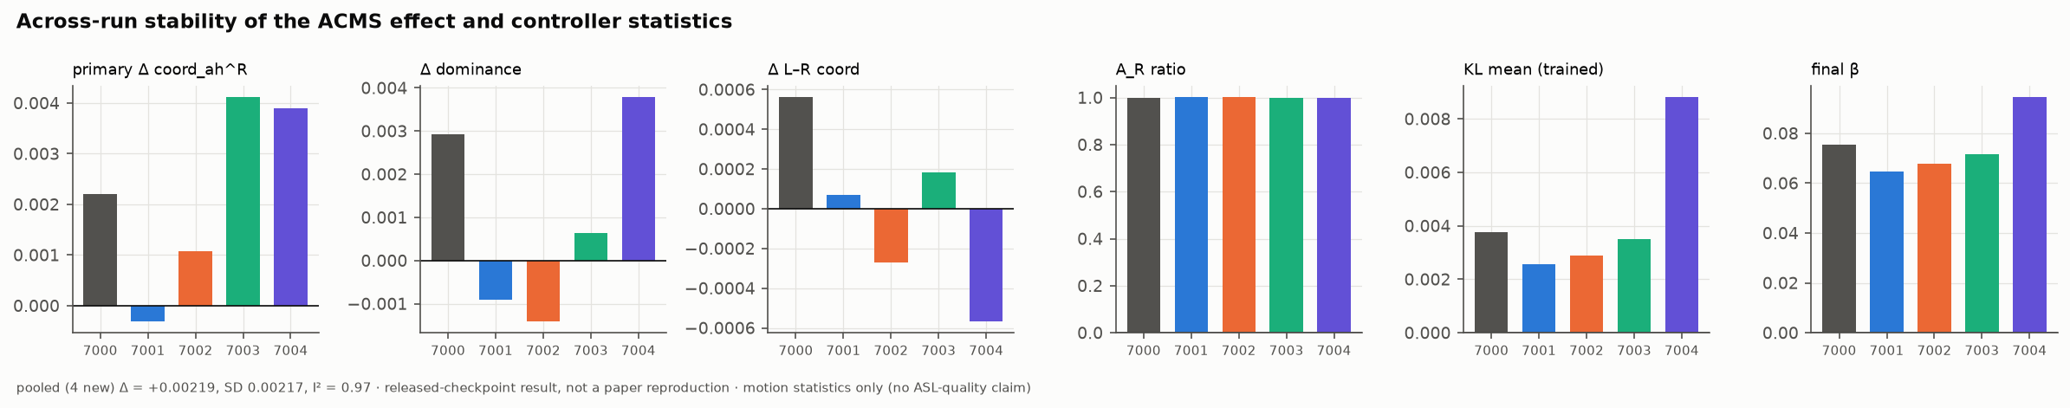
Stability across seeds
Effect, dominance, L–R, activity, KL and β per run
Spread between seeds dominates evaluation noise
SignSparK RL study · released-checkpoint results, not a paper reproduction
13/25
Notes:
Controller statistics per run: seeds that learned larger shifts (higher KL) show larger effects, but all stay tiny.

Slide 14
2 · FG-1 feasibility gate
Per-clip, like-for-like, fresh noise
SignSparK RL study · released-checkpoint results, not a paper reproduction
14/25
Notes:
Second block: can any controller family move coordination on clips it was fitted to, under fresh noise?

Slide 15
FG-1 design
16 TRAIN clips (8 short, 8 long), disjoint from ACMS training clips; 16 fit + 16 held-out noises per clip.
V0 uncoupled · V1 learned M-C coupling · V2 per-clip ACMS · V3 bilateral SC-MC (new direction).
Pathwise gradients through the frozen unrolled sampler; Adam 0.05, 30 iterations.
Positive: CI lower > 0, point ≥ 0.05, preservation passes · Negative: CI upper < 0.05 · else inconclusive.
Operational decisions D1–D10 documented before running (e.g. V3 cap 120 min); protocol unchanged.
SignSparK RL study · released-checkpoint results, not a paper reproduction
15/25
Notes:
FG-1 removes amortisation: each clip gets its own parameters, fitted on 16 noises and tested on 16 different ones. This is an upper bound on what a per-clip controller of each family can do. All variants share clips and noises, so this is the only like-for-like comparison in the project.

Slide 16
FG-1 results (right arm–hand, space R)
Variant | Params/clip | Held-out Δ vs V0 (R, right) | In-sample Δ (last iter) | Gap | KL max | Preserv. | Outcome
V1 | 9060 | +0.0034 [-0.0121, +0.0166] | +0.4938 [+0.4418, +0.5447] | +0.4904 | 2.980 | pass | negative
V2 | 433 | +0.1016 [+0.0753, +0.1288] | +0.2058 [+0.1849, +0.2245] | +0.1042 | 0.119 | FAIL | inconclusive
V3 | 866 | +0.0893 [+0.0703, +0.1091] | +0.1765 [+0.1559, +0.1983] | +0.0872 | 0.112 | pass | positive
In the FG-1 fresh-noise gate: learned M-C negative (held-out Δ +0.0034); per-clip ACMS inconclusive (held-out Δ +0.1016); bilateral SC-MC positive (held-out Δ +0.0893).
SignSparK RL study · released-checkpoint results, not a paper reproduction
16/25
Notes:
The FG-1 table. The uncoupled baseline V0 has held-out right arm–hand coordination +0.062 [+0.028, +0.098] on the 16 gate clips; the best-of-16 selection context (maximum over the 16 held-out V0 draws, an oracle that a policy cannot use) is +0.401 [+0.316, +0.494]. The registered threshold for a positive outcome is a held-out gain of 0.05 with the 95% clip CI lower bound above zero and all preservation checks passing. V1 (learned M-C coupling). Held-out Δ +0.0034 [-0.0121, +0.0166] (10/16 clips positive); in-sample Δ at the last iteration +0.4938 [+0.4418, +0.5447]; generalisation gap +0.4904 [+0.4365, +0.5451]. KL max 2.98 nats/frame (right). Preservation passes. Registered outcome: negative. V2 (per-clip ACMS). Held-out Δ +0.1016 [+0.0753, +0.1288] (15/16 clips positive); in-sample Δ at the last iteration +0.2058 [+0.1849, +0.2245]; generalisation gap +0.1042 [+0.0714, +0.1394]. KL max 0.119 nats/frame (right). Preservation fails. Registered outcome: inconclusive. State-shuffle ablation (ŝ from a different noise draw), shuffled − matched: -0.0853 [-0.1093, -0.0605]. V3 (bilateral SC-MC). Held-out Δ +0.0893 [+0.0703, +0.1091] (16/16 clips positive); in-sample Δ at the last iteration +0.1765 [+0.1559, +0.1983]; generalisation gap +0.0872 [+0.0645, +0.1117]. KL max 0.112 nats/frame (right). Preservation passes. Registered outcome: positive. Left arm–hand Δ +0.1071 [+0.0795, +0.1352] (positive); left–right Δ +0.0333 [+0.0049, +0.0594] (inconclusive); KL max left 0.126. State-shuffle ablation (ŝ from a different noise draw), shuffled − matched: -0.0730 [-0.0947, -0.0496].

Slide 17
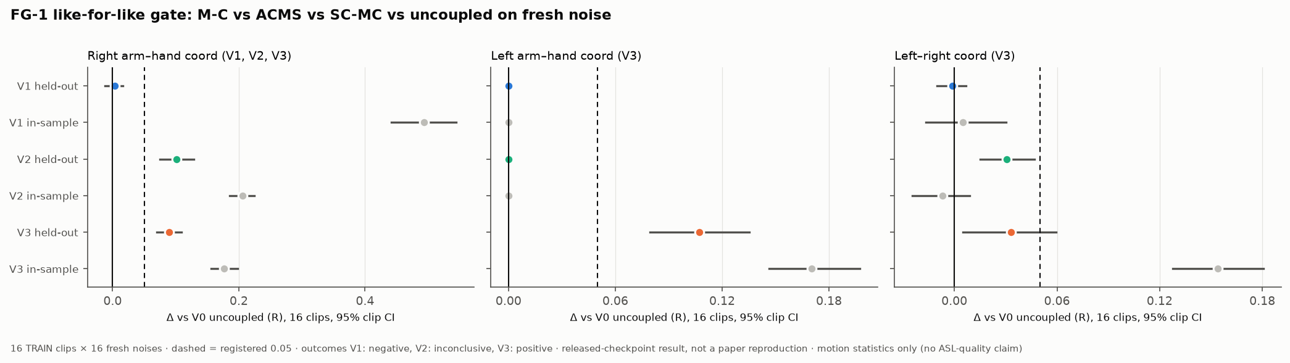
FG-1: in-sample vs held-out
Grey: in-sample (fit noises)
Coloured: held-out fresh noise
Dashed: registered 0.05
SignSparK RL study · released-checkpoint results, not a paper reproduction
17/25
Notes:
In-sample against held-out for each variant. The gap between grey and coloured is how much of the fitted gain is specific to the noise draws used for fitting.

Slide 18
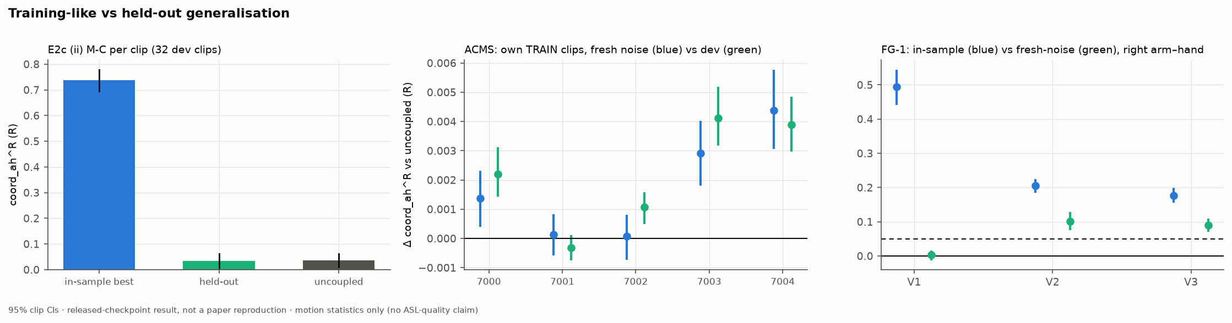
Generalisation across studies
E2c (ii): in-sample 0.74 vs held-out ≈ uncoupled
ACMS: own TRAIN clips vs dev
FG-1: in-sample vs fresh noise
SignSparK RL study · released-checkpoint results, not a paper reproduction
18/25
Notes:
Three views of the same question: does what is learned transfer to new noise? For per-clip M-C it clearly did not.

Slide 19
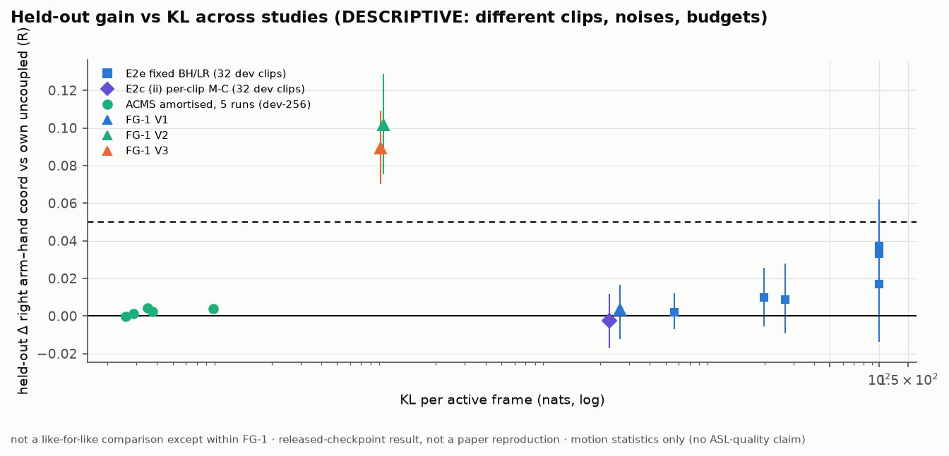
Gain vs KL across studies (descriptive)
Different clips, noises, budgets
Only FG-1 is like-for-like
SignSparK RL study · released-checkpoint results, not a paper reproduction
19/25
Notes:
A descriptive overview of held-out gain against KL budget for every controller we ran. It is not a controlled comparison.

Slide 20
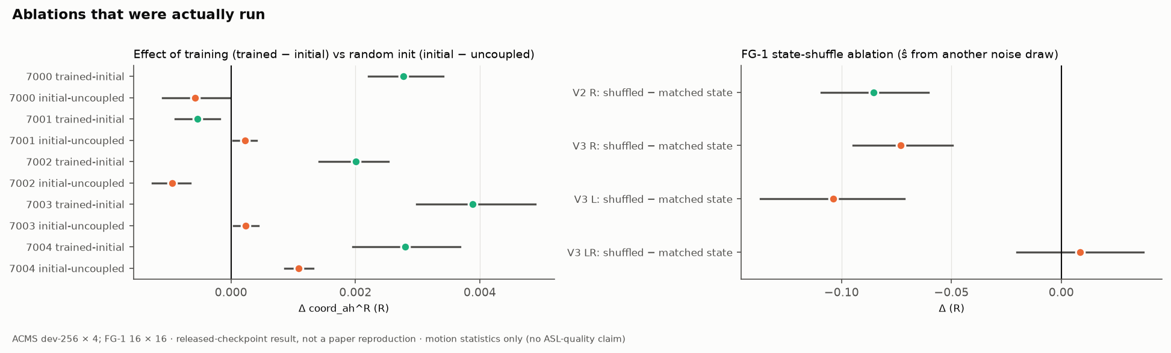
Ablations actually run
Trained − initial vs initial − uncoupled (ACMS)
State shuffle: ŝ from another noise draw (FG-1 V2/V3)
SignSparK RL study · released-checkpoint results, not a paper reproduction
20/25
Notes:
Only these ablations were run. Training versus random initialisation, and whether the conditioning signal matters.

Slide 21
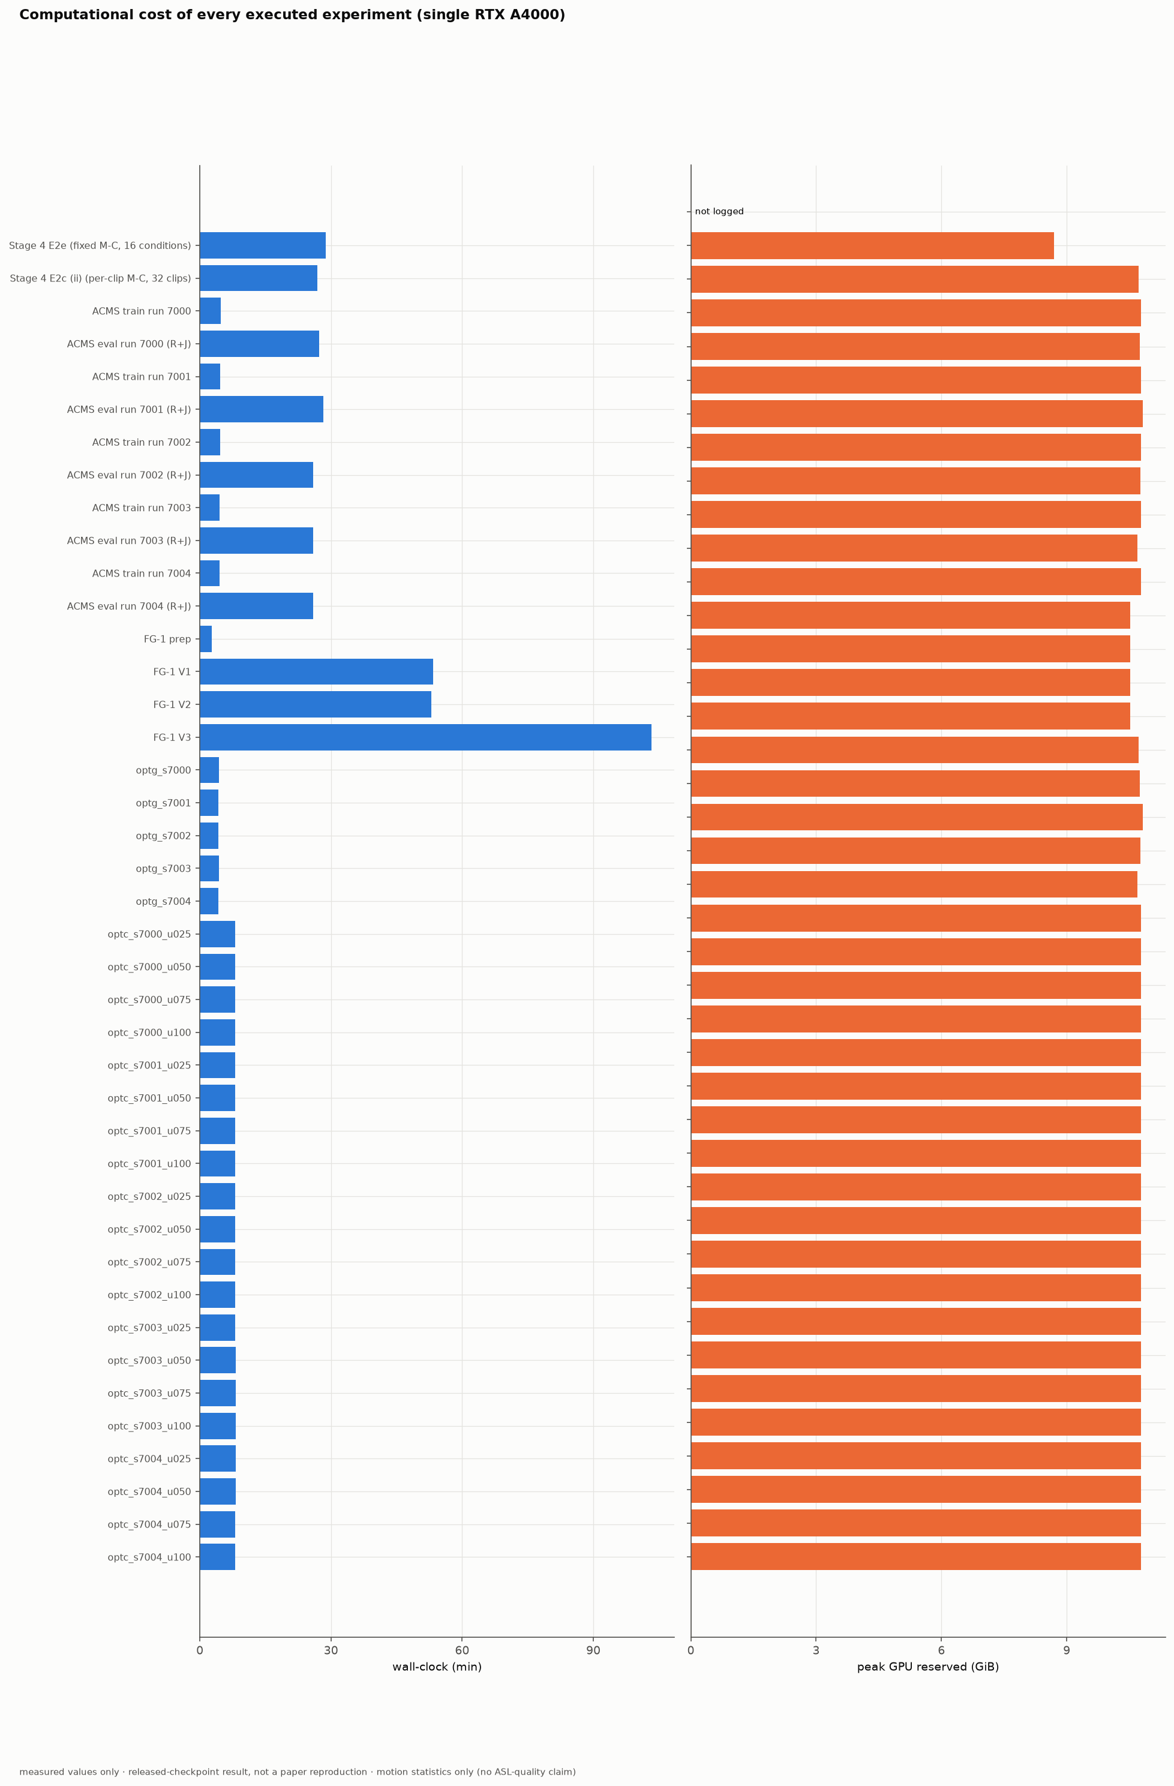
Compute (single RTX A4000 16 GB)
ACMS training ≈ 5 min, evaluation ≈ 26–28 min per run
No GPU rental; jobs run sequentially
SignSparK RL study · released-checkpoint results, not a paper reproduction
21/25
Notes:
Everything ran on one 16 GB card. ACMS training is cheap; evaluation dominates because of the full dev-256 × 4 decode.

Slide 22
Consolidated results
Experiment | Unit / n | Primary statistic (R) | Estimate [95% CI] | Outcome
Stage 4 E2e fixed M-C coupling | 16 conditions, 32 dev clips | Δ arm–hand (T3) | R 0.017, L 0.022 (CIs incl. 0) | FM13 stop (negative)
Stage 4 E2c (ii) per-clip M-C | 32 dev clips | held-out gain | -0.003 [-0.017, +0.012] | negative (FM4)
Stage 5 ACMS, run 7000 | dev-256 × 4 | Δ trained − uncoupled | +0.0022 [+0.0014, +0.0031] | positive, negligible
ACMS multi-seed (7001–7004) | 4 runs | pooled Δ (t) | +0.0022 [-0.0013, +0.0056] | seed-sensitive
ACMS all five runs (secondary) | 5 runs | pooled Δ (t) | +0.0022 [-0.0001, +0.0045] | seed-sensitive
OPT-G train-like generalisation | 4 new runs | pooled Δ on own TRAIN clips | +0.0019 [-0.0015, +0.0053] | monitoring
FG-1 V1 | 16 TRAIN clips × 16 | held-out Δ vs V0 | +0.0034 [-0.0121, +0.0166] | negative
FG-1 V2 | 16 TRAIN clips × 16 | held-out Δ vs V0 | +0.1016 [+0.0753, +0.1288] | inconclusive
FG-1 V3 | 16 TRAIN clips × 16 | held-out Δ vs V0 | +0.0893 [+0.0703, +0.1091] | positive
SignSparK RL study · released-checkpoint results, not a paper reproduction
22/25
Notes:
All executed experiments in one table, from the Stage 4 coupling studies to the final gate.

Slide 23
Metrics not reported, and why
Metric | Status | Reason
DTW-JPE / MPJPE vs. reference as success measure | not used | favours collapse in GF (static mean beats samples; M5–M6)
BLEU / back-translation | not used | within-text uncorrelated with pose error; hackable by selection (R6)
FID / diversity / multimodality | unavailable | no validated ASL feature extractor
Task success rate | unavailable | no episodic task or success criterion exists
Regret | unavailable | no oracle policy value is defined
PPO / GRPO / SAC comparison | unavailable | never run; no comparative claim made
Perceptual naturalness, intelligibility, ASL quality | out of scope | human evaluation removed (rev. 4.0)
How2Sign test split | never opened | only registered TRAIN and DEV used
Earlier slide deck not in workspace: deck-to-deck coverage verification unavailable.
SignSparK RL study · released-checkpoint results, not a paper reproduction
23/25
Notes:
What we deliberately do not report. Pose-error metrics favour collapse in this regime, back-translation is hackable, and success rate, regret and algorithm comparisons have no defined experiment here. The earlier deck was not available, so coverage was checked against the written coverage plan instead.

Slide 24
Limitations
Four new runs: wide across-run interval; seed-sensitive reflects heterogeneity and low power.
R coordination is validated automatically only; no perceptual validity.
J includes SMPL-X skinning leakage (~1–2%); descriptive only.
FG-1: 16 TRAIN clips, one fit each, pathwise gradients; controllability, not an RL policy.
V2 misses the articulation bound narrowly (1.102 vs 1.10); applied as registered.
Checkpoint pretraining split usage undocumented (absolute levels only).
SignSparK RL study · released-checkpoint results, not a paper reproduction
24/25
Notes:
The main limits. Power is low with four runs, but the effect is also far below the threshold, so more seeds would not change the practical conclusion.

Slide 25
Conclusion
ACMS gain +0.0022 pooled, seed-sensitive, ≈1/23 of the threshold
In the FG-1 fresh-noise gate: learned M-C negative (held-out Δ +0.0034); per-clip ACMS inconclusive (held-out Δ +0.1016); bilateral SC-MC positive (held-out Δ +0.0893).
Per-clip control works on fresh noise; one shared RL policy does not. Project closed on this evidence.
SignSparK RL study · released-checkpoint results, not a paper reproduction
25/25
Notes:
To conclude: the one positive training result replicates in direction but not robustly, and its size is negligible. The gate shows that a small state-conditioned controller fitted to one clip can raise coordination by more than the threshold on fresh noise, with preservation intact for the bilateral variant, and the state-shuffle ablation shows it depends on the arm signal. So the frozen sampler is controllable; what failed is learning one controller that works across clips. That gate used gradients, not RL, so it does not tell us whether amortisation or the estimator is to blame. Fine-tuning or architectural coupling would be the next questions, outside this project's scope.

