Slide 1
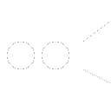
3D
3D
3D
1
2
1
2
3
3
1
1
2
1
2

Slide 2
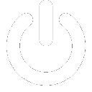
3D

Slide 4
CT
PET

