Slide 1
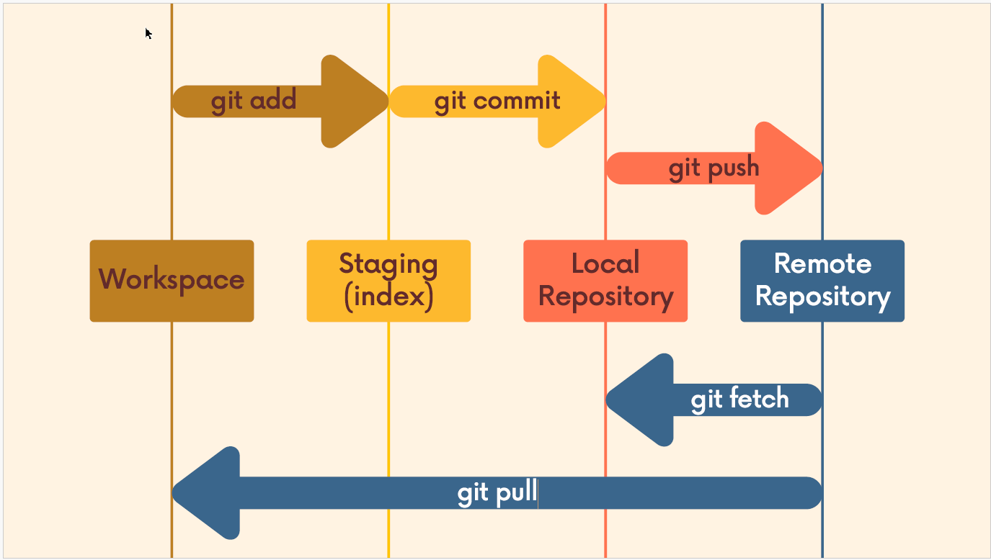
Basic Concept

Slide 2
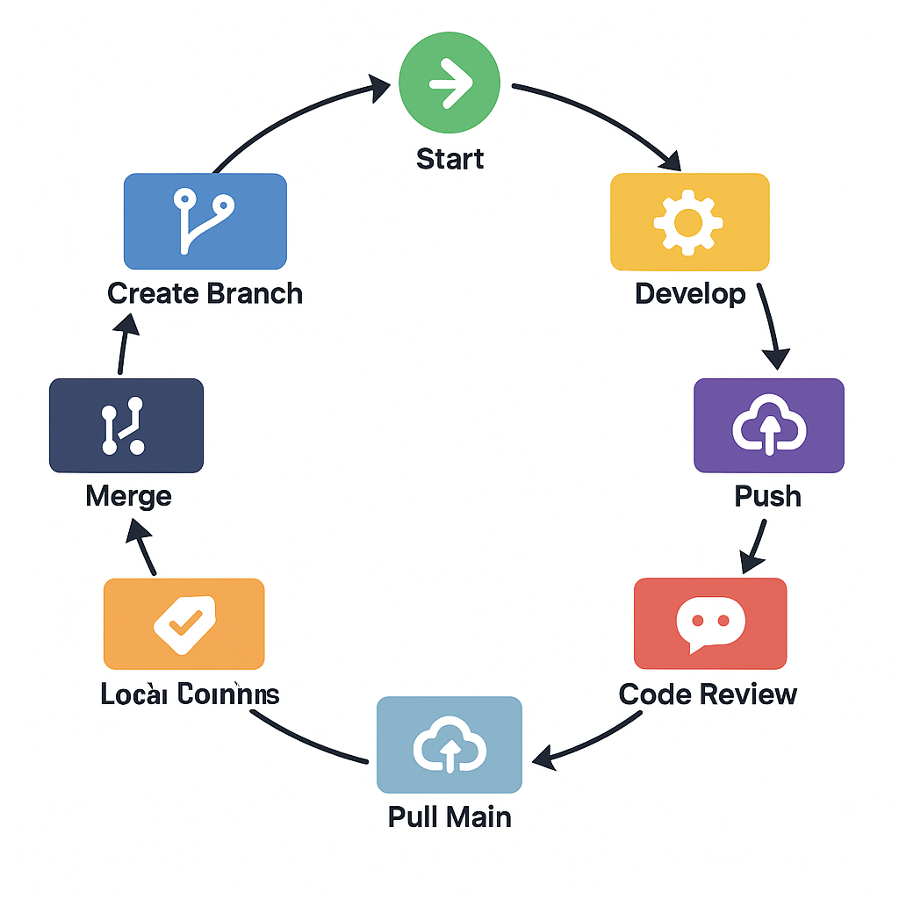
Workflow

Slide 3
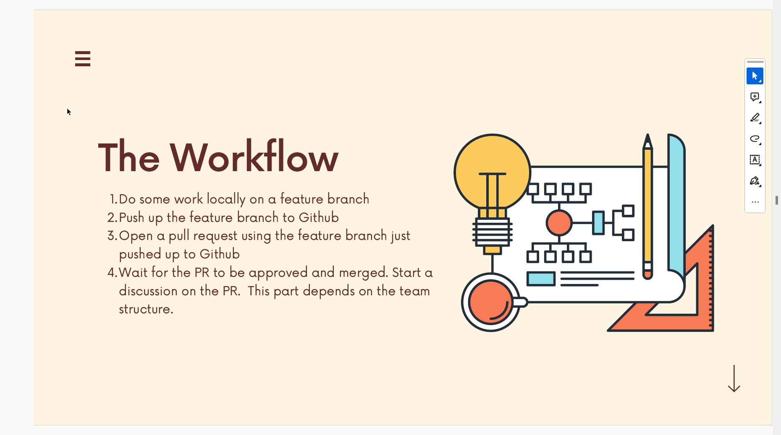
Workflow

Slide 4
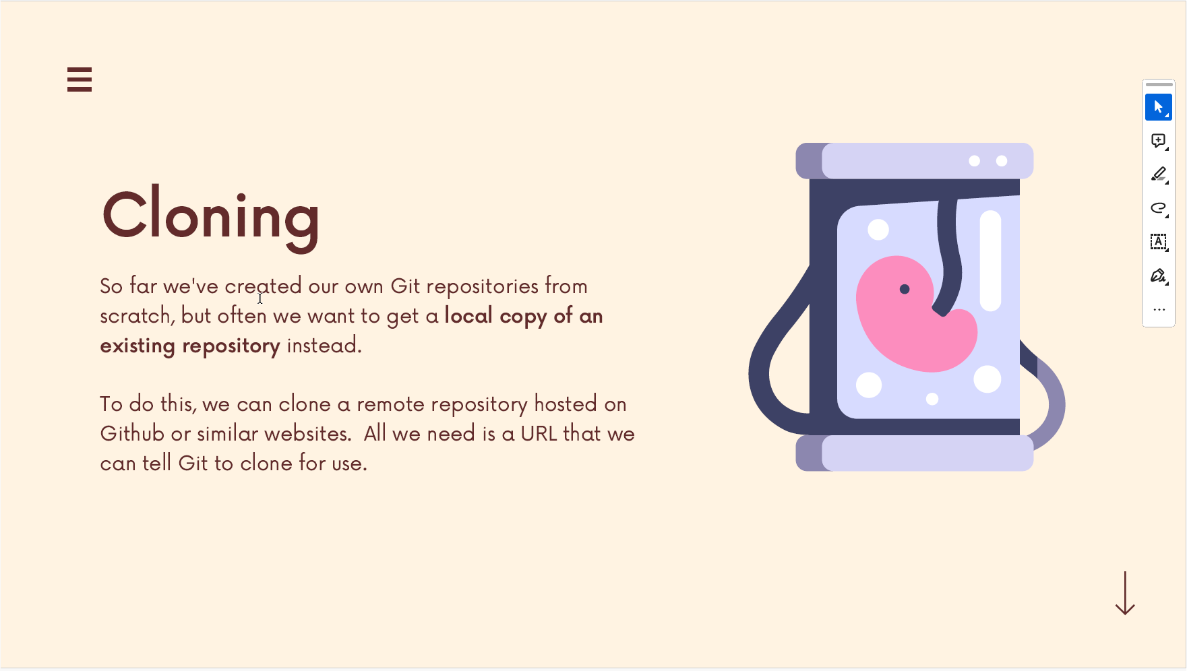
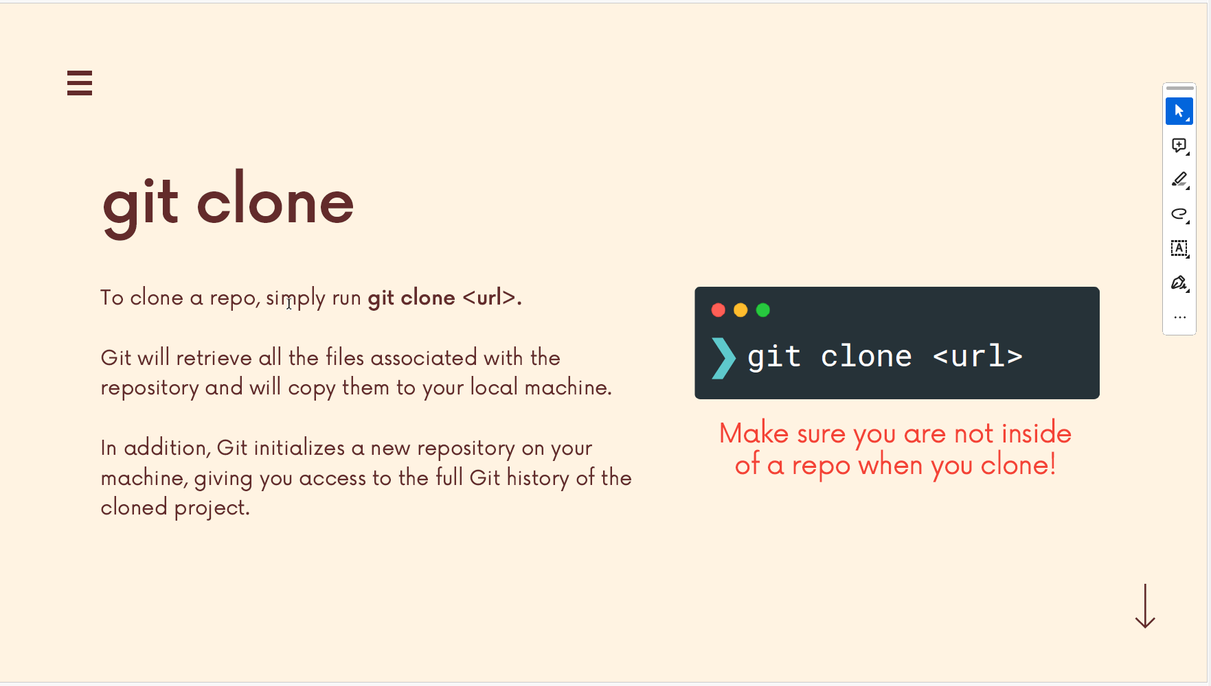
1. Clone from origin/master (remote repo)

Slide 5
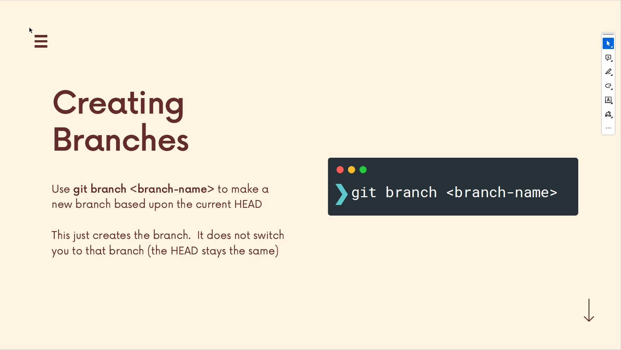
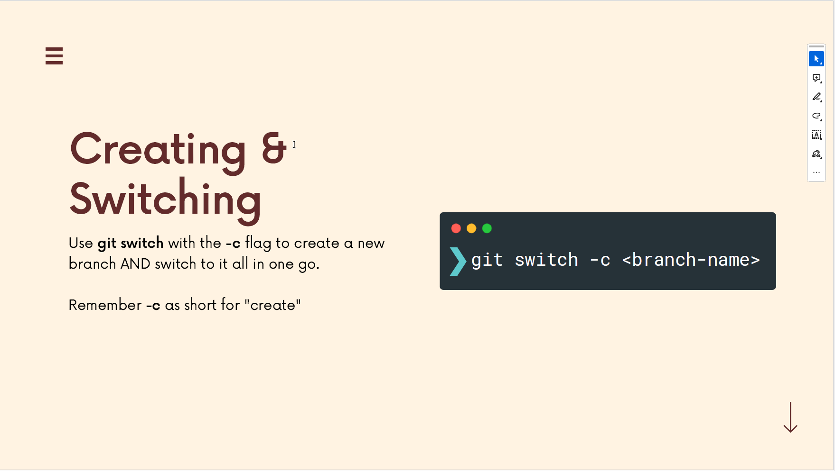
2. Checkout a new feature branch (2 options)

Slide 6
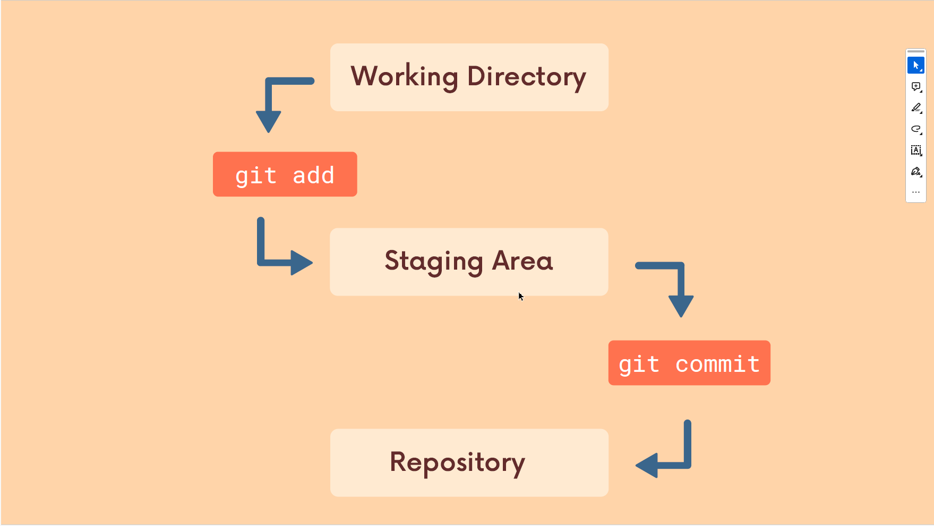
3. Make change, add and commit in our local repo

Slide 7
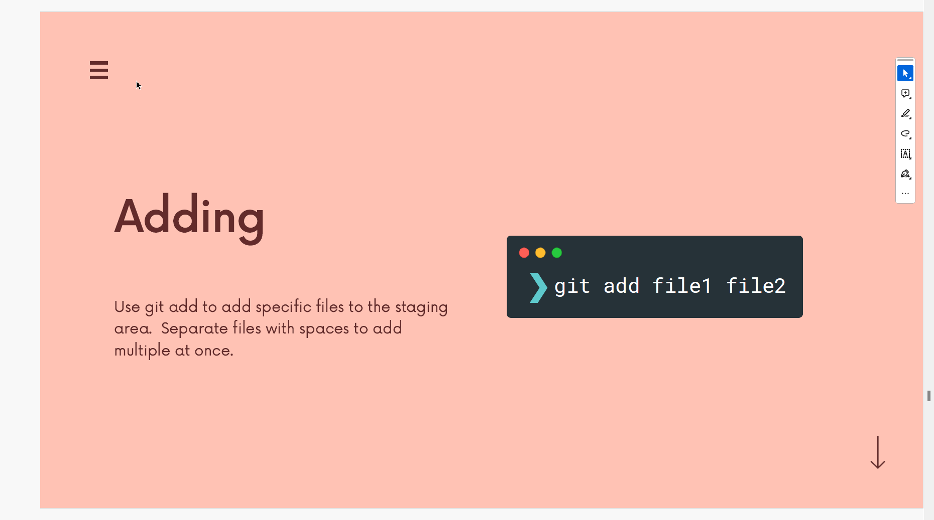
3.1. Add change

Slide 8
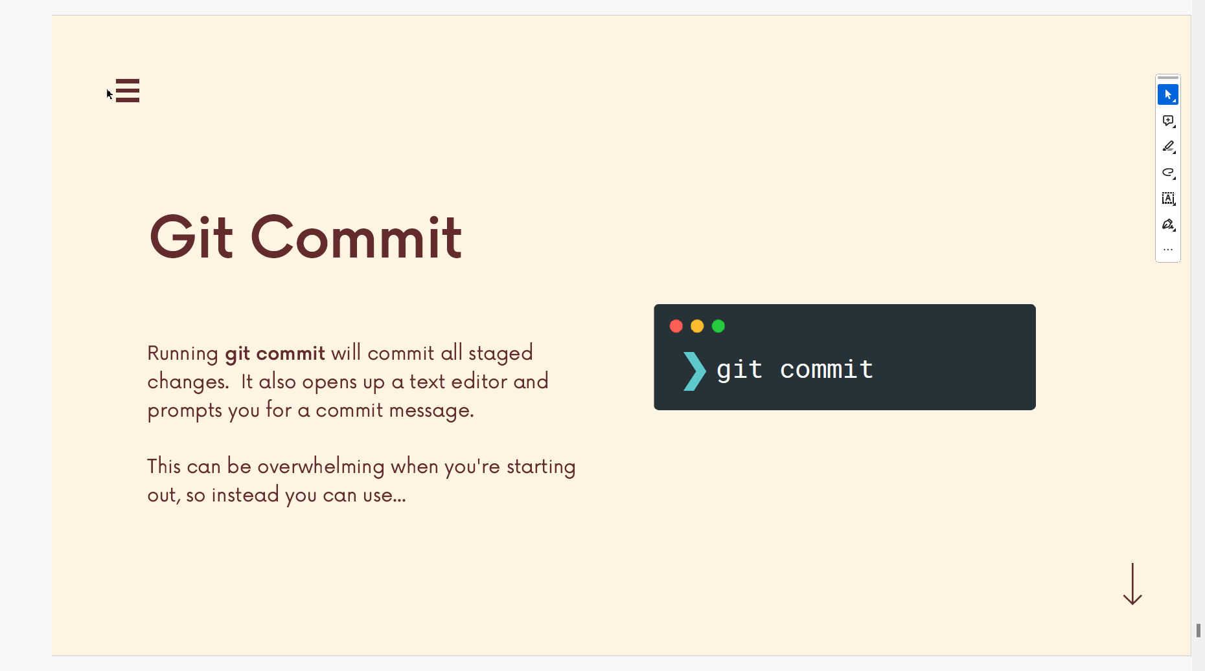
3.2. Commit change

Slide 9
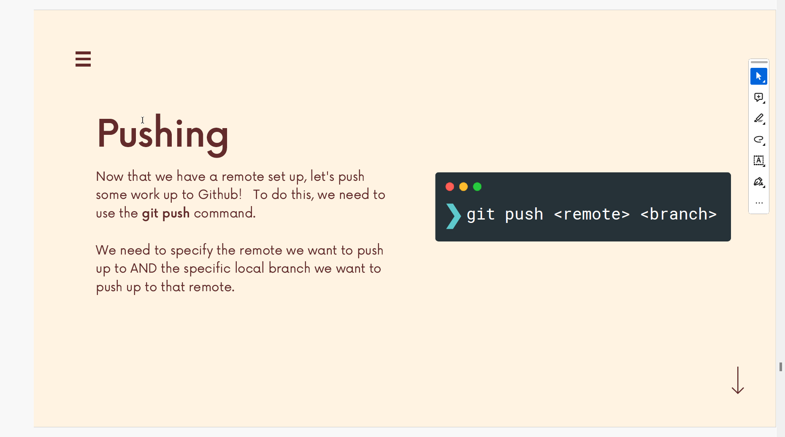
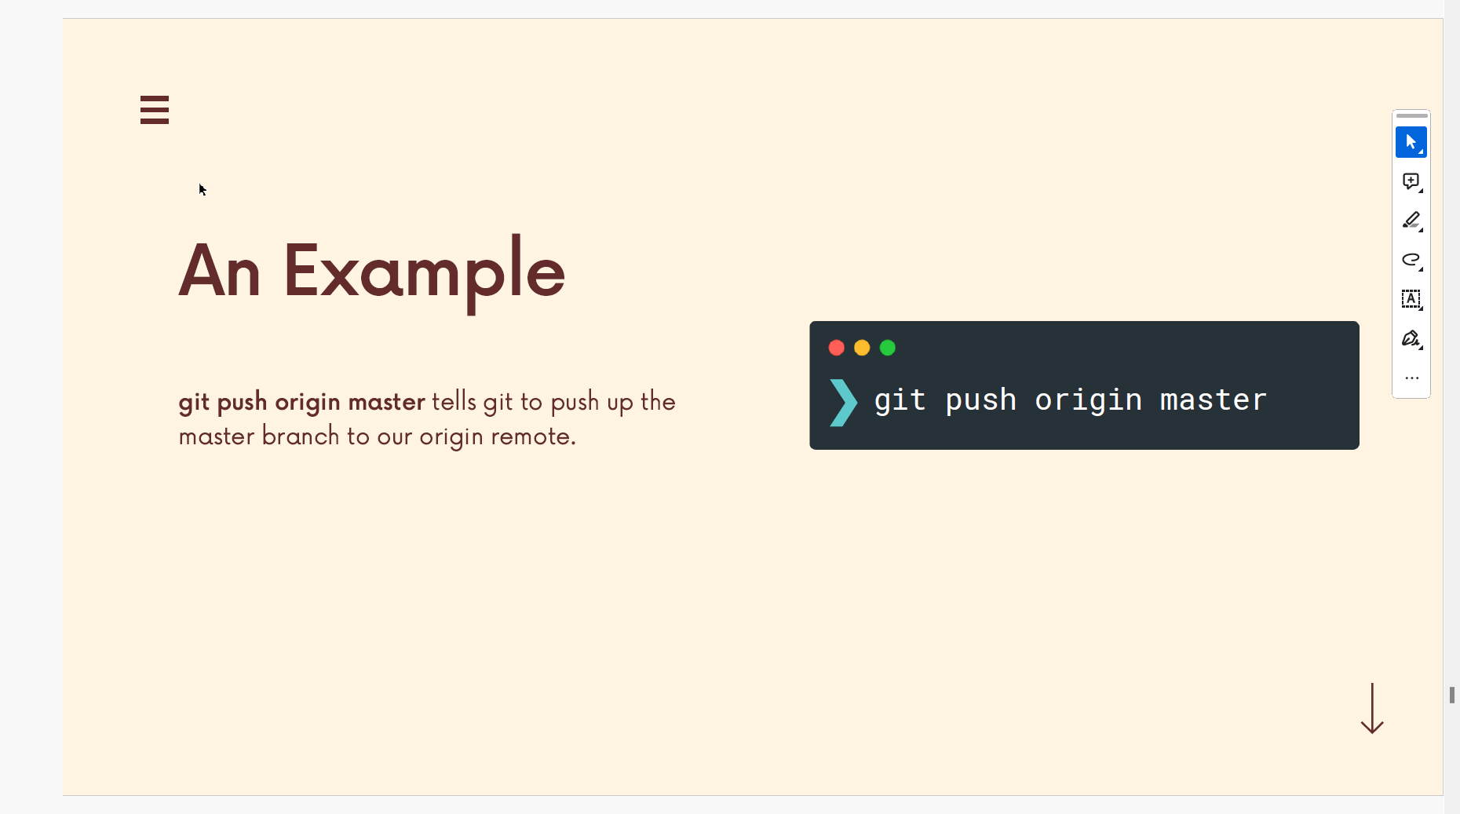
3.3. Push the commit change to remote branch (feature branch)

Slide 10
3.4. Keep the workflow from 3.1 to 3.3 for any further change

Slide 11
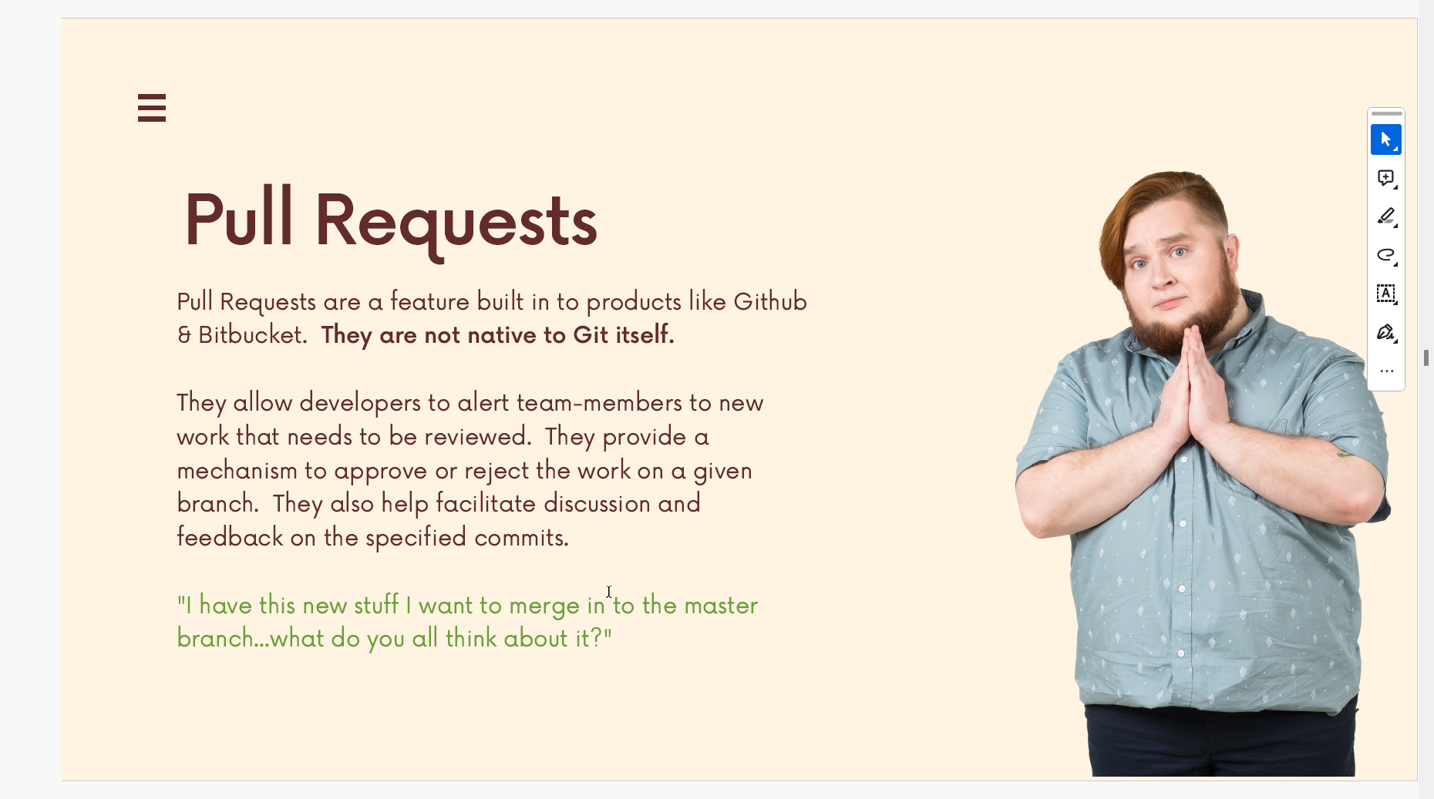
4. Create Pull Request after finishing developing feature branch

Slide 12
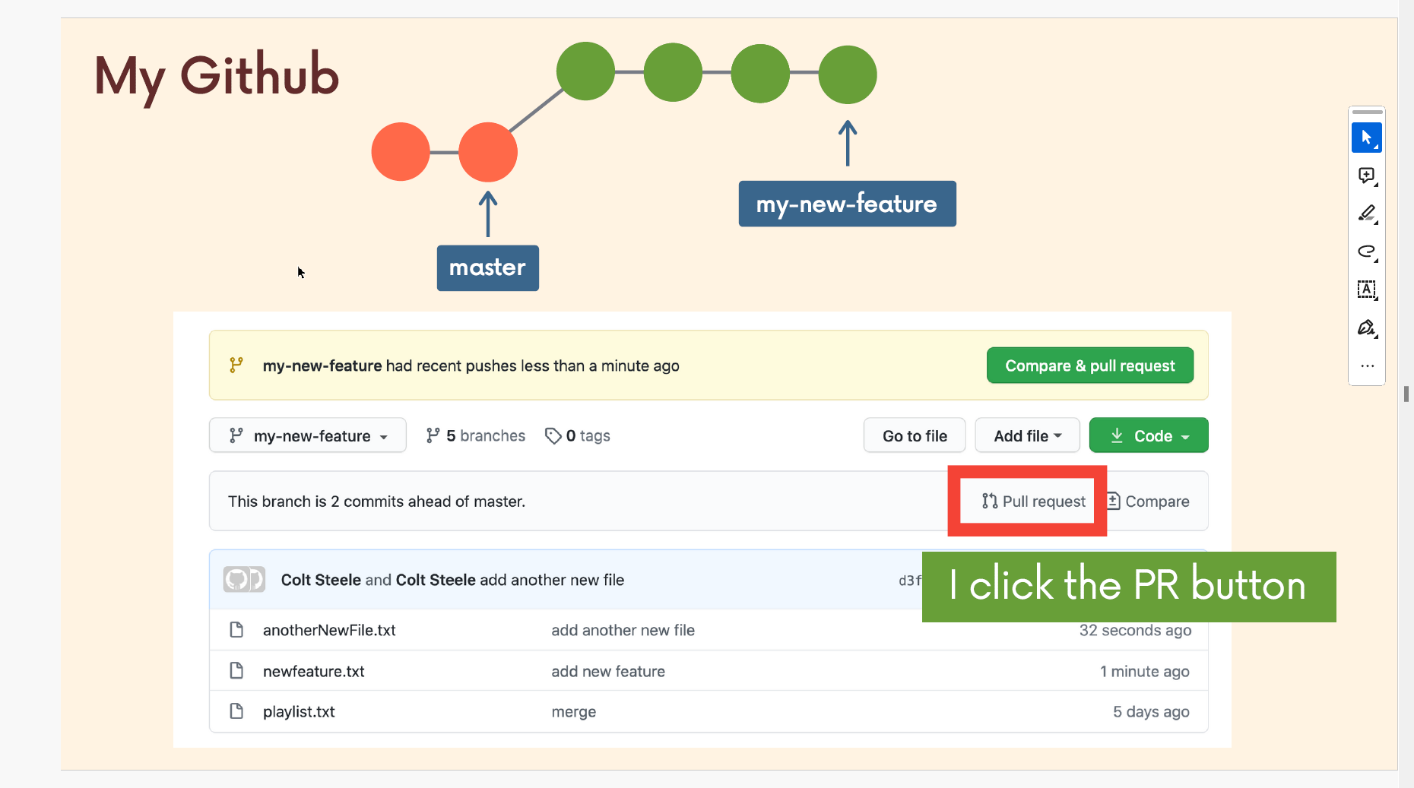
4.1. Create a new Pull Request

Slide 13
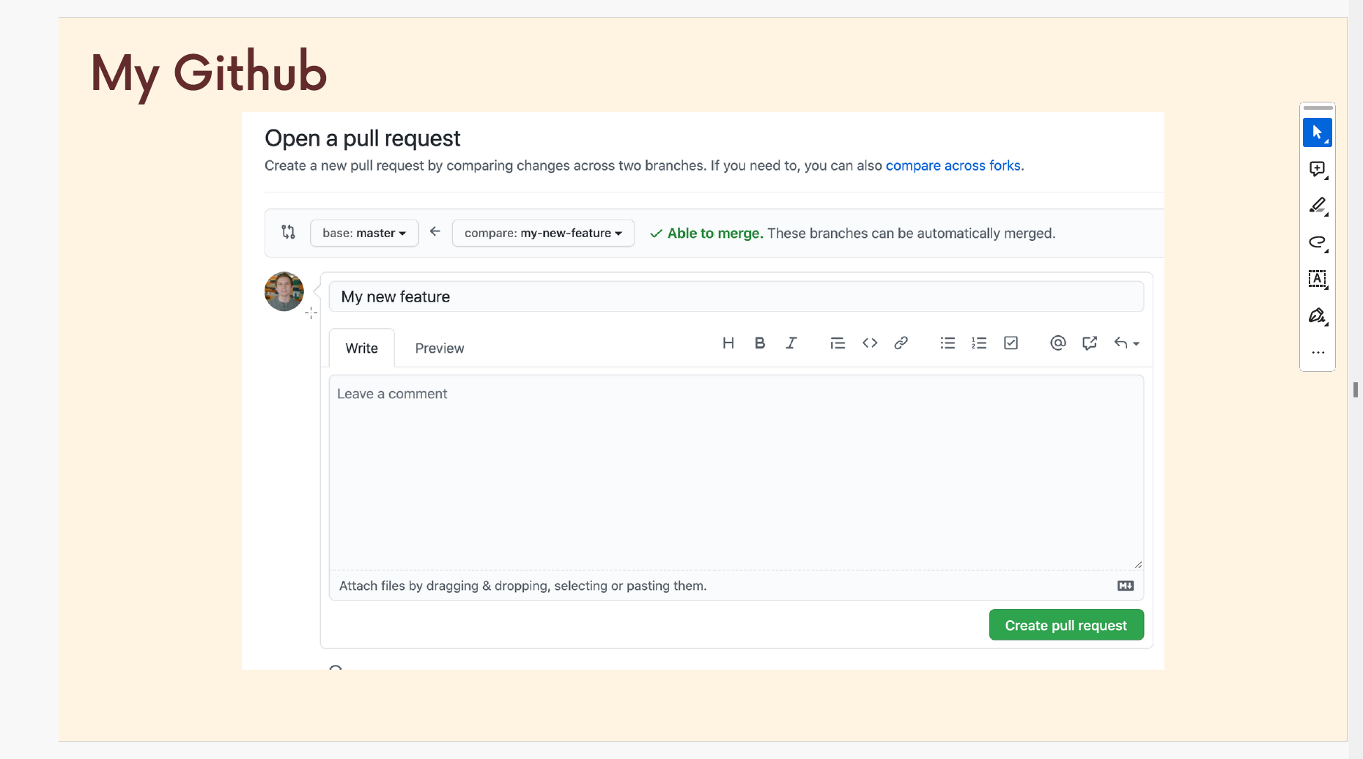
4.2. Open the PR

Slide 14
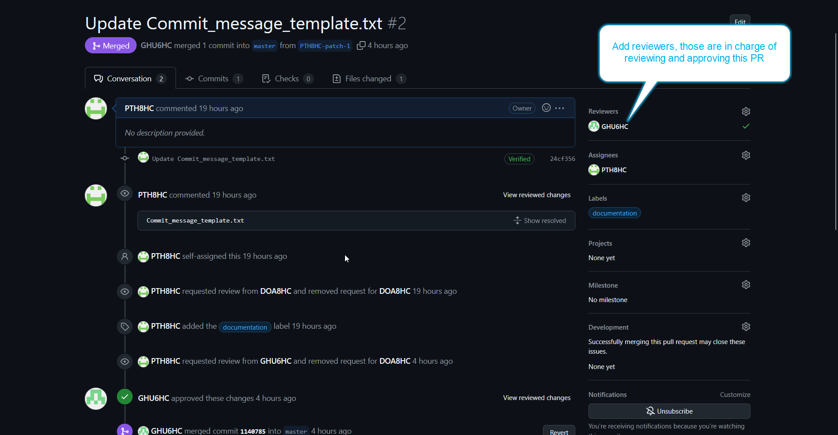
4.2. Add Reviewer(s)/Approval(s)
Our origin/master currently is required 1 approval to be eligible for merging

Slide 15
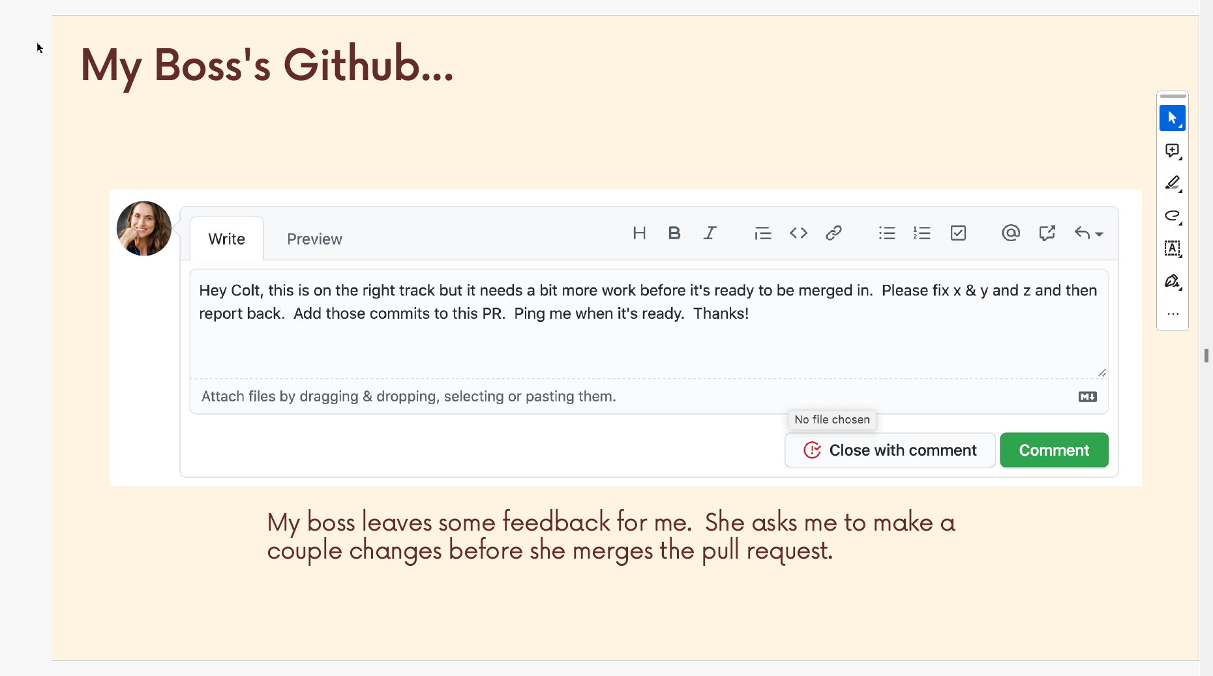
4.3. Leave Comment and Review
Comments can be given by any of collaborators

Slide 16
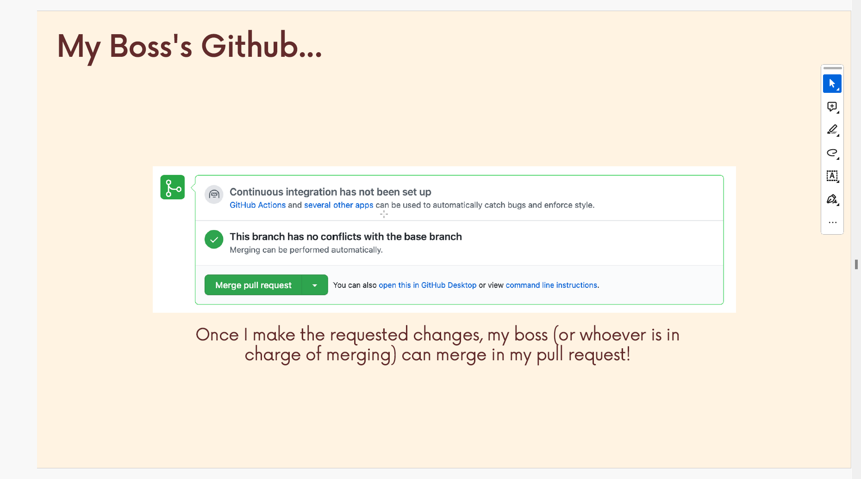
4.4. After approving, a Merge Pull Request is available

Slide 17
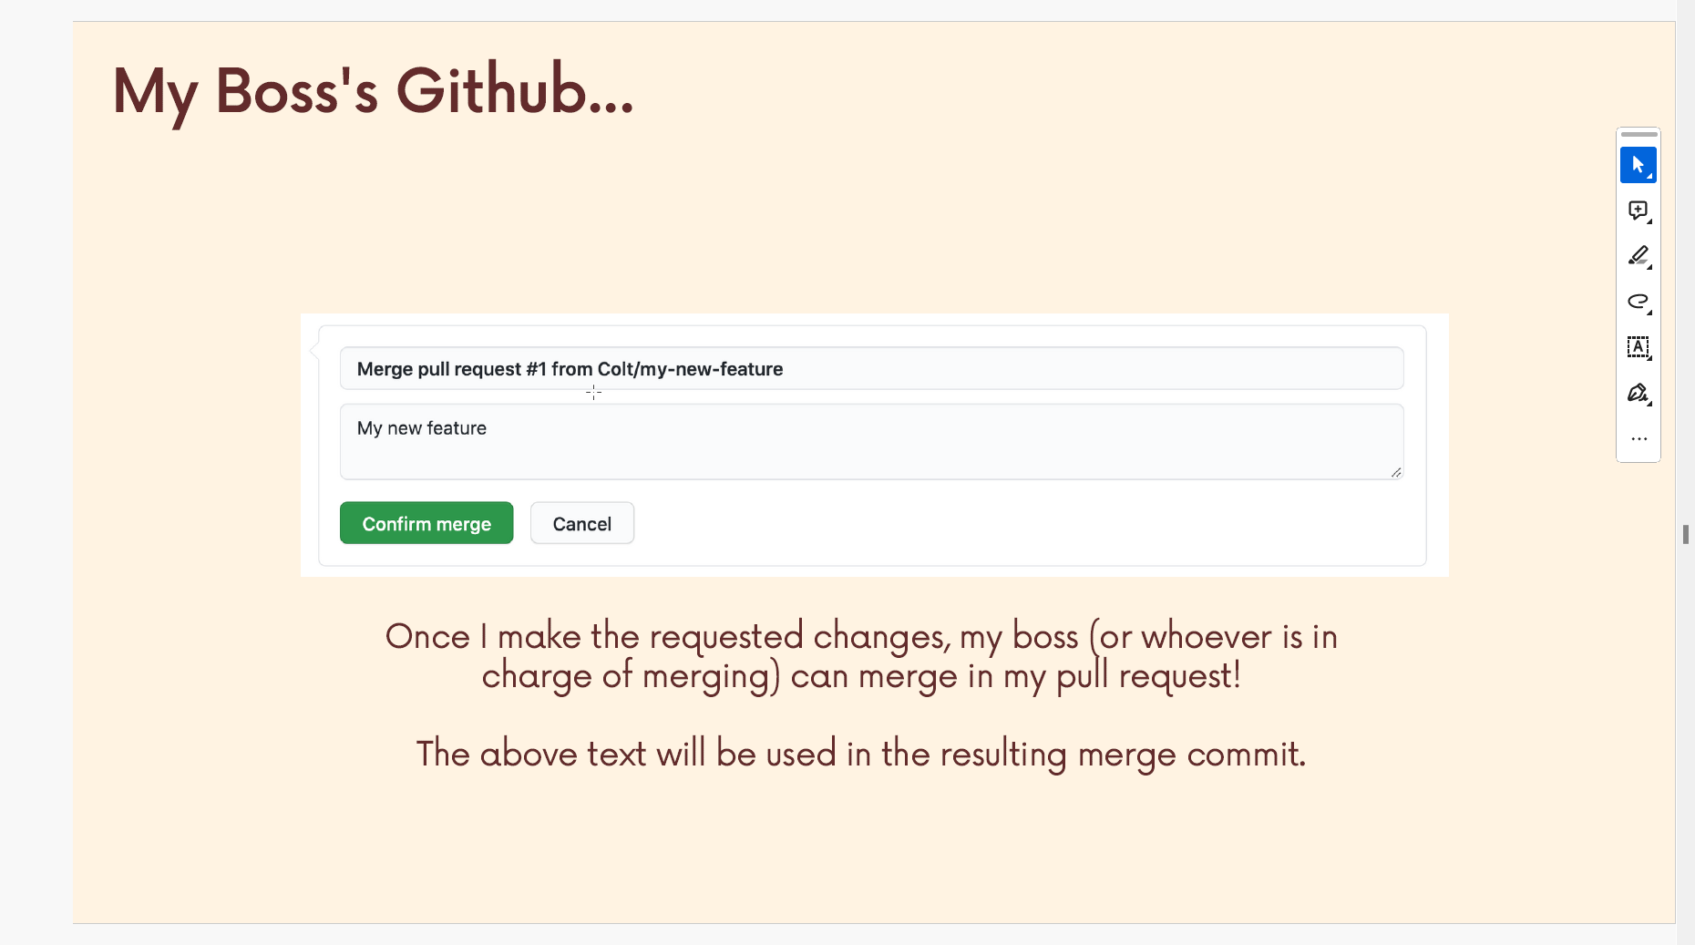
4.4. After approving, a Merge Pull Request is available

Slide 18
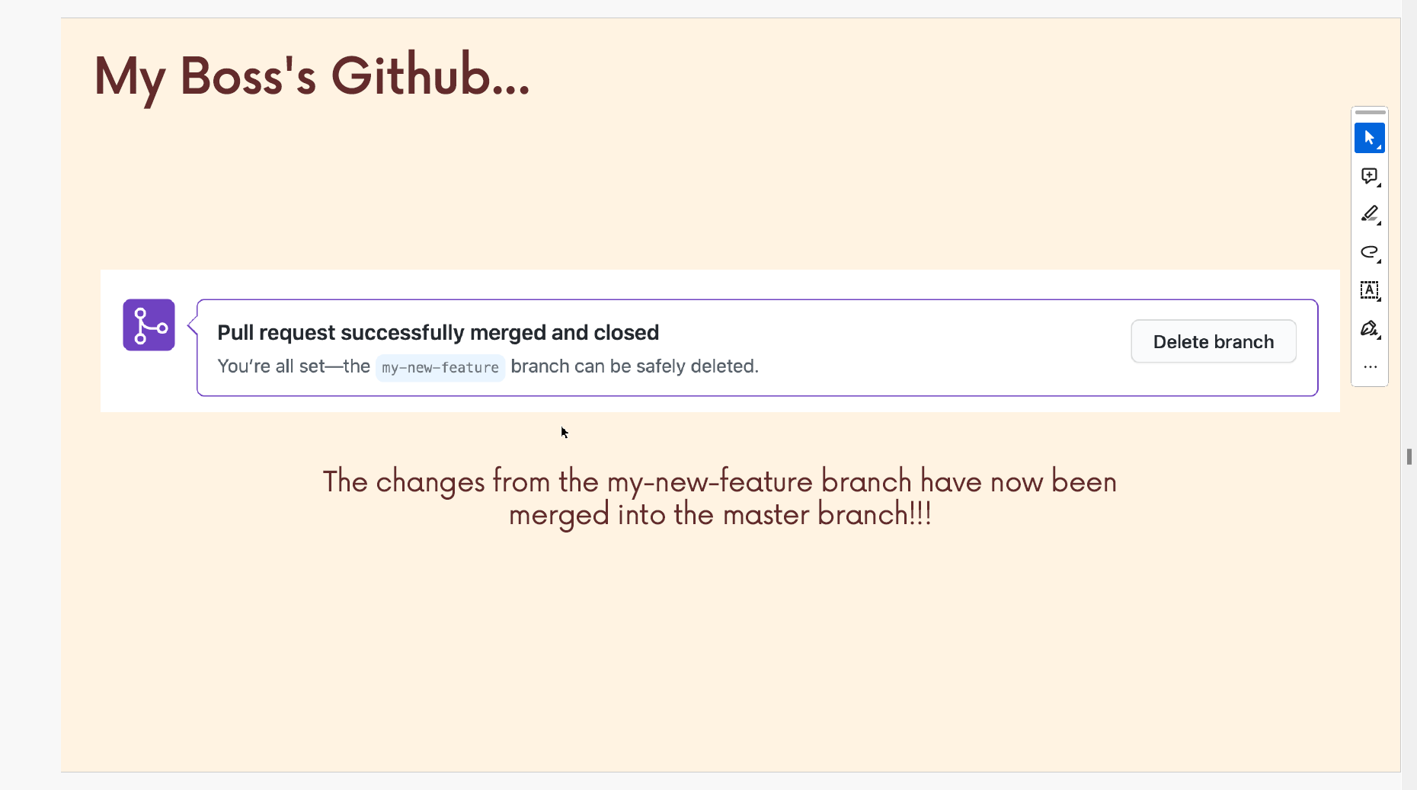
4.4. After approving, a Merge Pull Request is available

Slide 19
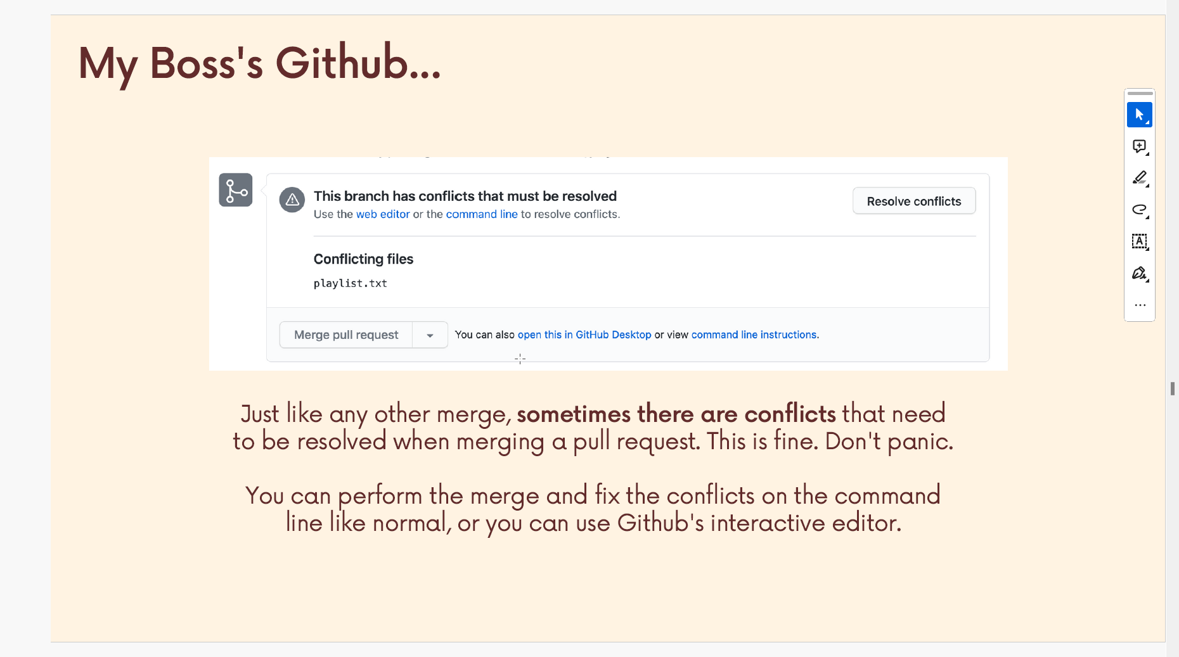
4.5. Conflict – How to resolve?

Slide 20
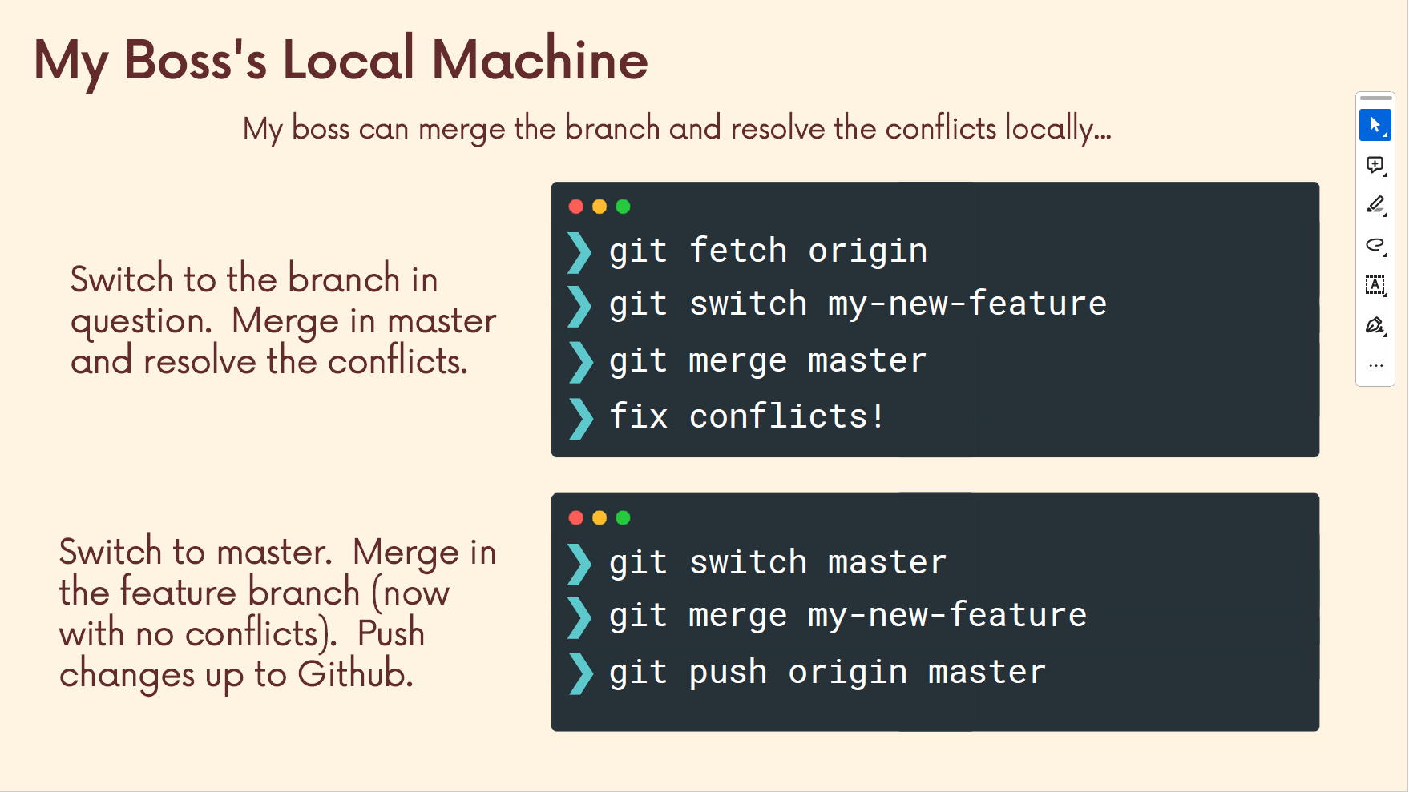
4.6. Resolve merge conflict

Slide 21
5. Cleanup before starting Again!
Cleanup locally
> git checkout master : Switch back to the local master
> git pull origin master : Fetch and merge the remote master to our local master
> git branch -d <feature/name> : Delete the old local feature branch
> git fetch –prune : remove any local remote-tracking branches that no longer exist on the remote repository.

Slide 22
