Slide 1
Exam Review SQL
Slides By: Ninad Subhedar and Nik Bear Brown

Slide 2
Quick overview of Relational Database.
Need for databases
Types of Databases
Components of a relational database
Database Schema
Database modeling
Entity relationships
UMLs
Normal forms
SQL Language
Syntax
Data Types
Data definition language (DDL)
Data manipulation language (DML)

Slide 3
Data Control Language
Fetching data from DB
Where/ Group by/ having, order by
Inner queries/ nested queries
Joins
Views
Indexing
Transactions
Functions
Stored Procedures
UDF (User defined functions)
Triggers
Cursors
Schedulers
Backup

Slide 4
What is a Database?
Data can be anything
Database is a collection of data
Symbol:

Slide 5
What is a Database Management System
A system that allows to organize and maintain a database
Its has to be
Efficient
Reliable
Convenient
Safe
Allow multi-access
CRUD operations

Slide 6
RDBMS Examples
MySQL
Oracle
IBM DB
Microsoft SQL
PostgreSQL
NuoDB

Slide 7
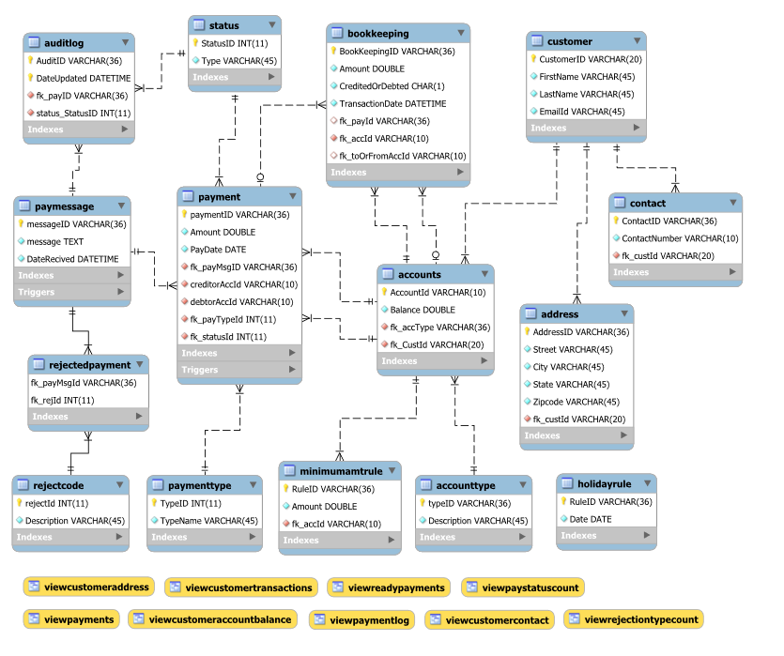
Relational Model

Slide 8
Components of a relational Database
Table
Data types
Constraints
Keys
Views
Stored Procedures
Functions
Triggers

Slide 9
Database modeling Tools
MySQL Workbench
draw.io
Visio
Oracle SQL Developer Data Modeler

Slide 10
Entity relationships
Entity
Attributes
Relations
One to one
One to many
Many to one
Many to many

Slide 11
Anomalies
Update Anomaly : Duplicated data not only wastes space but it also makes updating data time-consuming.
Delete Anomaly : Incorrectly associate two unrelated pieces of data so you cannot delete one without deleting the other.
Insert Anomaly : If we don’t have information for each of the primary key fields, we will not be able to enter a record

Slide 12
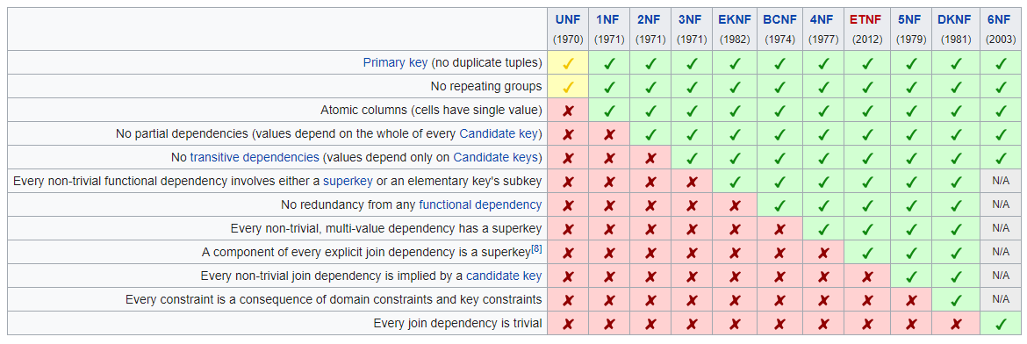
Normal forms

Slide 13
Is Normalization good ?
Moderation is the key
We need to keep in mind that to make sense of data we need to de-normalize the data.

Slide 14
SQL (Structured Query Language)
DDL – Defines the structure/schema for the database
DML – Manipulates the data
DQL – Queries the data
DCL – Controls access to the data

Slide 15
Data definition language
CREATE
ALTER
DROP
TRUNCATE
RENAME

Slide 16
Data manipulation and query language
INSERT
UPDATE
DELETE
SELECT
REPLACE

Slide 17
Select Statement
The SELECT statement is used to retrieve data from the database.
The basic syntax is:
SELECT <columnName>, <columnName>
FROM <TableName>
SELECT StudentFirstName, StudentLastName, StudentPhone
FROM Student

Slide 18
SELECT Statement
SELECT [DISTINCT | ALL]
{* | [columnExpression [AS newName]] [,...] }
FROM TableName [alias] [, ...]
[WHERE condition]
[GROUP BY columnList] [HAVING condition]
[ORDER BY columnList]

Slide 19
SELECT Statement
FROM Specifies table(s) to be used.
WHERE Filters rows.
GROUP BY Forms groups of rows with same
column value.
HAVING Filters groups subject to some
condition.
SELECT Specifies which columns are to
appear in output.
ORDER BY Specifies the order of the output.

Slide 20
SELECT Statement
Order of the clauses cannot be changed.
Only SELECT and FROM are mandatory.

Slide 21
Select All Columns, All Rows
List full details of all staff.
SELECT staffNo, fName, lName, address,
position, sex, DOB, salary, branchNo
FROM Staff;
Can use * as an abbreviation for ‘all columns’:
SELECT *
FROM Staff;

Slide 22
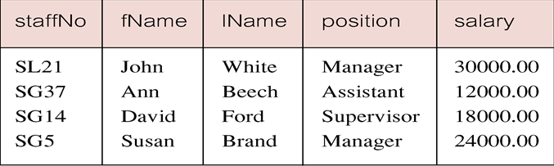
Select Comparison Search Condition
List all staff with a salary greater than 10,000.
SELECT staffNo, fName, lName, position, salary
FROM Staff
WHERE salary > 10000;

Slide 23
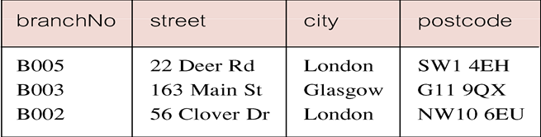
Select Compound Comparison Search Condition
List addresses of all branch offices in London or Glasgow.
SELECT *
FROM Branch
WHERE city = ‘London’ OR city = ‘Glasgow’;

Slide 24
Select Range Search Condition
List all staff with a salary between 20,000 and 30,000.
SELECT staffNo, fName, lName, position, salary
FROM Staff
WHERE salary BETWEEN 20000 AND 30000;
BETWEEN test includes the endpoints of range.

Slide 25
Select Range Search Condition
Also a negated version NOT BETWEEN.
BETWEEN does not add much to SQL’s expressive power. Could also write:
SELECT staffNo, fName, lName, position, salary
FROM Staff
WHERE salary>=20000 AND salary <= 30000;
Useful, though, for a range of values.

Slide 26
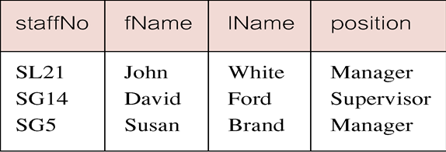
Select Set Membership
List all managers and supervisors.
SELECT staffNo, fName, lName, position
FROM Staff
WHERE position IN (‘Manager’, ‘Supervisor’);

Slide 27
The * WildCard
Instead of listing each of the columns, you can use an * to include all columns.
SELECT * FROM
Listing the columns does give you the ability to choose both which columns and which order to present them.
With the * you return all the columns in the order they have in the underlying table.

Slide 28
Distinct Key Word
Sometimes a query will return multiple duplicate values.
For instance the statement
SELECT Key FROM Session
Could return numerous instances of each customer.
The DISTINCT keyword will make it so it only returns one instance of each Key.

Slide 29
Distinct Key Word
SELECT DISTINCT Key
FROM Session
The DISTINCT keyword always operates on the whole role, not on individual columns.
It only returns distinct rows.

Slide 30
Calculations
You can do calculations in SELECT statements.
SELECT ItemNumber, ItemPrice, Quantity, ItemPrice * Quantity
FROM CustomerOrder

Slide 31
Order of Operations
The order of operation is the same as in algebra.
Whatever is in parentheses is executed first. If parentheses are nested, the innermost is executed first, then the next most inner, etc.
Then all division and multiplication left to right
And finally all addition and subtraction left to right

Slide 32
Sorting
You can sort the results of a query by using the keywords ORDER BY.
SELECT *
FROM Session ORDER BY SessionDate
ORDER BY does an ascending A-Z, 1-10, etc. sort by default.
You can change the direction by using the DESC keyword after the field to be sorted.

Slide 33
Aliasing
Sometimes it is useful to alias a column name to make a more readable result set.
SELECT StudentLastName AS [Last Name], StudentFirstName AS [First Name]
FROM Student
The AS keyword is optional.
Double quotes “ “ can be used instead of square brackets.

Slide 34
Where Clause
The WHERE clause allows you to limit the rows you return in a query.
You use the WHERE clause to specify the criteria by which the rows will be filtered.
SELECT LastName, FirstName, Phone, City
FROM Customer
WHERE City = ‘Boston’

Slide 35
Other Criteria
As well as equal you can use other operators for the criteria:
>
<
>=
=<
Character and date values in the criteria are quoted with single quotes.
Numerical values are not quoted.

Slide 36
Like
The LIKE keyword used in a WHERE operator with a wildcard (% or _) allows you to search for patterns in character-based fields.
The following returns all items whose name starts with “T.”
SELECT ItemName, ItemPrice
FROM Inventory
WHERE ItemName LIKE ‘T%’

Slide 37
Between
The BETWEEN keyword can be used in criteria to return values between to other values.
BETWEEN is inclusive of its ends.
SELECT Key, SessionDate, StudentKey
FROM Session
WHERE SessionDate BETWEEN ’11/1/2014’ AND ‘11/30/2014’

Slide 38
AND OR NOT
You can use keywords AND, OR, and NOT to combine criteria in a query.
AND is exclusive. Or is Inclusive.
WHERE City = ‘Boston’ OR City=‘Los Angeles’ returns all records that have either Boston or Los Angeles for their city.
WHERE City=‘Boston’ AND City=‘Los Angeles’ returns nothing because the record cannot have both at the same time.
NOT excludes.
WHERE NOT City = ‘Los Angeles’ returns every city except Los Angeles.

Slide 39
NULL
Nulls are special cases. They are not a value and so cannot be compared to a value using = or < or >.
To locate nulls you can use the IS keyword in a criteria:
WHERE StudentKey IS NULL
WHERE StudentKey IS NOT NULL

Slide 40
Select Set Membership
There is a negated version (NOT IN).
IN does not add much to SQL’s expressive power. Could have expressed this as:
SELECT staffNo, fName, lName, position
FROM Staff
WHERE position=‘Manager’ OR
position=‘Supervisor’;
IN is more efficient when set contains many values.

Slide 41
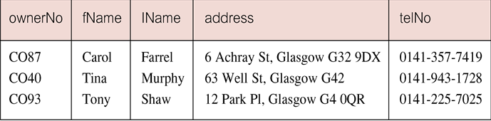
Select Pattern Matching
Find all owners with the string ‘Glasgow’ in their address.
SELECT ownerNo, fName, lName, address, telNo
FROM PrivateOwner
WHERE address LIKE ‘%Glasgow%’;

Slide 42
Select Pattern Matching
SQL has two special pattern matching symbols:
%: sequence of zero or more characters;
_ (underscore): any single character.
LIKE ‘%Glasgow%’ means a sequence of characters of any length containing ‘Glasgow’.

Slide 43
Select NULL Search Condition
List details of all viewings on property PG4 where a comment has not been supplied.
There are 2 viewings for property PG4, one with and one without a comment.
Have to test for null explicitly using special keyword IS NULL:
SELECT clientNo, viewDate
FROM Viewing
WHERE propertyNo = ‘PG4’ AND
comment IS NULL;

Slide 44
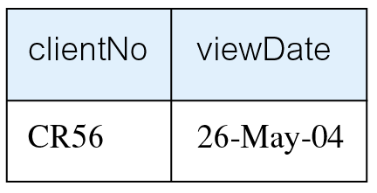
Select NULL Search Condition
Negated version (IS NOT NULL) can test for non-null values.

Slide 45
Select Single Column Ordering
List salaries for all staff, arranged in descending order of salary.
SELECT staffNo, fName, lName, salary
FROM Staff
ORDER BY salary DESC;

Slide 46
Select Multiple Column Ordering
Produce abbreviated list of properties in order of property type.
SELECT propertyNo, type, rooms, rent
FROM PropertyForRent
ORDER BY type;

Slide 47
Select Multiple Column Ordering
To arrange in order of rent, specify minor order:
SELECT propertyNo, type, rooms, rent
FROM PropertyForRent
ORDER BY type, rent DESC;

Slide 48
SELECT Statement - Aggregates
ISO standard defines five aggregate functions:
COUNT returns number of values in specified column.
SUM returns sum of values in specified column.
AVG returns average of values in specified column.
MIN returns smallest value in specified column.
MAX returns largest value in specified column.

Slide 49
SELECT Statement - Aggregates
Each operates on a single column of a table and returns a single value.
COUNT, MIN, and MAX apply to numeric and non-numeric fields, but SUM and AVG may be used on numeric fields only.
Apart from COUNT(*), each function eliminates nulls first and operates only on remaining non-null values.

Slide 50
SELECT Statement - Aggregates
COUNT(*) counts all rows of a table, regardless of whether nulls or duplicate values occur.
Can use DISTINCT before column name to eliminate duplicates.
DISTINCT has no effect with MIN/MAX, but may have with SUM/AVG.

Slide 51
SELECT Statement - Aggregates
Aggregate functions can be used only in SELECT list and in HAVING clause.
If SELECT list includes an aggregate function and there is no GROUP BY clause, SELECT list cannot reference a column out with an aggregate function. For example, the following is illegal:
SELECT staffNo, COUNT(salary)
FROM Staff;

Slide 52
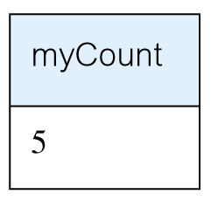
Select - Use of COUNT(*)
How many properties cost more than £350 per month to rent?
SELECT COUNT(*) AS myCount
FROM PropertyForRent
WHERE rent > 350;

Slide 53
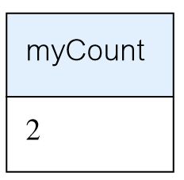
Select - Use of COUNT(DISTINCT)
How many different properties viewed in May ‘13?
SELECT COUNT(DISTINCT propertyNo) AS myCount
FROM Viewing
WHERE viewDate BETWEEN ‘1-May-13’
AND ‘31-May-13’;

Slide 54
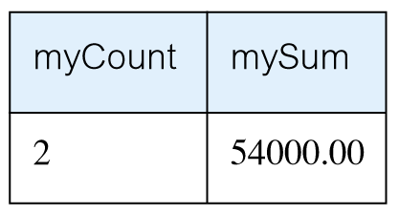
Select - Use of COUNT and SUM
Find number of Managers and sum of their salaries.
SELECT COUNT(staffNo) AS myCount,
SUM(salary) AS mySum
FROM Staff
WHERE position = ‘Manager’;

Slide 55
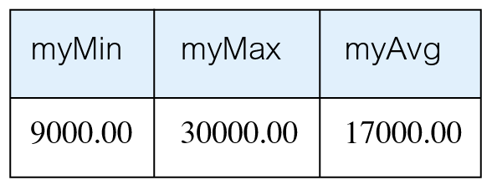
Select - Use of MIN, MAX, AVG
Find minimum, maximum, and average staff salary.
SELECT MIN(salary) AS myMin,
MAX(salary) AS myMax,
AVG(salary) AS myAvg
FROM Staff;

Slide 56
SELECT Statement - Grouping
Use GROUP BY clause to get sub-totals.
SELECT and GROUP BY closely integrated: each item in SELECT list must be single-valued per group, and SELECT clause may only contain:
column names
aggregate functions
constants
expression involving combinations of the above.

Slide 57
SELECT Statement - Grouping
All column names in SELECT list must appear in GROUP BY clause unless name is used only in an aggregate function.
If WHERE is used with GROUP BY, WHERE is applied first, then groups are formed from remaining rows satisfying predicate.
ISO considers two nulls to be equal for purposes of GROUP BY.

Slide 58
Select - Use of GROUP BY
Find number of staff in each branch and their total salaries.
SELECT branchNo,
COUNT(staffNo) AS myCount,
SUM(salary) AS mySum
FROM Staff
GROUP BY branchNo
ORDER BY branchNo;

Slide 59
Restricted Groupings – HAVING clause
HAVING clause is designed for use with GROUP BY to restrict groups that appear in final result table.
Similar to WHERE, but WHERE filters individual rows whereas HAVING filters groups.
Column names in HAVING clause must also appear in the GROUP BY list or be contained within an aggregate function.

Slide 60
Select - Use of HAVING
For each branch with more than 1 member of staff, find number of staff in each branch and sum of their salaries.
SELECT branchNo,
COUNT(staffNo) AS myCount,
SUM(salary) AS mySum
FROM Staff
GROUP BY branchNo
HAVING COUNT(staffNo) > 1
ORDER BY branchNo;

Slide 61
Subqueries
Some SQL statements can have a SELECT embedded within them.
A subselect can be used in WHERE and HAVING clauses of an outer SELECT, where it is called a subquery or nested query.
Subselects may also appear in INSERT, UPDATE, and DELETE statements.

Slide 62
Select - Subquery with Equality
List staff who work in branch at ‘163 Main St’.
SELECT staffNo, fName, lName, position
FROM Staff
WHERE branchNo =
(SELECT branchNo
FROM Branch
WHERE street = ‘163 Main St’);

Slide 63
Select - Subquery with Equality
Inner SELECT finds branch number for branch at ‘163 Main St’ (‘B003’).
Outer SELECT then retrieves details of all staff who work at this branch.
Outer SELECT then becomes:
SELECT staffNo, fName, lName, position
FROM Staff
WHERE branchNo = ‘B003’;

Slide 64
Select - Subquery with Aggregate
List all staff whose salary is greater than the average salary, and show by how much.
SELECT staffNo, fName, lName, position,
salary – (SELECT AVG(salary) FROM Staff) As SalDiff
FROM Staff
WHERE salary >
(SELECT AVG(salary)
FROM Staff);

Slide 65
Select - Subquery with Aggregate
Cannot write ‘WHERE salary > AVG(salary)’
Instead, use subquery to find average salary (17000), and then use outer SELECT to find those staff with salary greater than this:
SELECT staffNo, fName, lName, position,
salary – 17000 As salDiff
FROM Staff
WHERE salary > 17000;

Slide 66
Subquery Rules
ORDER BY clause may not be used in a subquery (although it may be used in outermost SELECT).
Subquery SELECT list must consist of a single column name or expression, except for subqueries that use EXISTS.
By default, column names refer to table name in FROM clause of subquery. Can refer to a table in FROM using an alias.

Slide 67
Subquery Rules
When subquery is an operand in a comparison, subquery must appear on right-hand side.
A subquery may not be used as an operand in an expression.

Slide 68
Select - Nested subquery: use of IN
List properties handled by staff at ‘163 Main St’.
SELECT propertyNo, street, city, postcode, type, rooms, rent
FROM PropertyForRent
WHERE staffNo IN
(SELECT staffNo
FROM Staff
WHERE branchNo =
(SELECT branchNo
FROM Branch
WHERE street = ‘163 Main St’));

Slide 69
ANY and ALL
ANY and ALL may be used with subqueries that produce a single column of numbers.
With ALL, condition will only be true if it is satisfied by all values produced by subquery.
With ANY, condition will be true if it is satisfied by any values produced by subquery.
If subquery is empty, ALL returns true, ANY returns false.
SOME may be used in place of ANY.

Slide 70
Select - Use of ANY/SOME
Find staff whose salary is larger than salary of at least one member of staff at branch B003.
SELECT staffNo, fName, lName, position, salary
FROM Staff
WHERE salary > SOME
(SELECT salary
FROM Staff
WHERE branchNo = ‘B003’);

Slide 71
Use of ALL
Find staff whose salary is larger than salary of every member of staff at branch B003.
SELECT staffNo, fName, lName, position, salary
FROM Staff
WHERE salary > ALL
(SELECT salary
FROM Staff
WHERE branchNo = ‘B003’);

Slide 72
Functions
Functions always have the same basic syntax:
<function name>(function arguments)
There are hundreds of built-in functions.
We will be concerned with two broad types of functions:
Scalar functions
Aggregate functions

Slide 73
Scalar Functions
Scalar functions operate on a single row at a time.
Here is a list of scalar functions used in this chapter.
Function Name | Description
GETDATE() | Returns current date and time
MONTH | Returns the month as an integer (1 to 12) from a Date value
YEAR | Returns the Year as a four-digit integer from a date value

Slide 74
Aggregate Functions
Aggregate functions operate on multiple rows at a time.
Here is a table of common aggregate functions:
Aggregate Function | Description
COUNT | Counts the number of values : COUNT(*) counts all the rows. COUNT(columnName) counts all the values in the column but ignores nulls
SUM | Sums or totals numeric values: SUM (InStock)
AVG | Returns the mean average of a set of numeric values: AVG(Price). By default nulls are ignored.
MAX | Returns the highest value in a set of numeric or datetime values: MAX(price)
MIN | Returns the smallest value in a set of numeric or datetime values: MIN(Price)

Slide 75
Using Distinct in Aggregate Functions
You can use the DISTINCT keyword with aggregate functions.
Doing so means the function will ignore duplicate values in its calculation.
SELECT COUNT(DISTINCT StudentKey) AS [Unduplicated]
FROM Session

Slide 76
Group By
When a SELECT clause includes an aggregate function and columns that are not a part of that function, you must use the GROUP BY keywords to group by each of the non-included columns.
This is necessary because you are mixing functions that operate on multiple rows with columns that refer to values in individual rows only.

Slide 77
Group By Example
SELECT Key, COUNT(SessionTimeKey) AS [Total Sessions]
FROM Session
GROUP BY Key

Slide 78
Having
The HAVING keyword is used when there is an aggregate function in the criteria of a query.
SELECT Key, COUNT(SessionTimeKey) AS [Total Sessions]
FROM Session
GROUP BY Key
HAVING COUNT(SessionTimeKey)<4

Slide 79
EXISTS and NOT EXISTS
EXISTS and NOT EXISTS are for use only with subqueries.
Produce a simple true/false result.
True if and only if there exists at least one row in result table returned by subquery.
False if subquery returns an empty result table.
NOT EXISTS is the opposite of EXISTS.

Slide 80
EXISTS and NOT EXISTS
As (NOT) EXISTS check only for existence or non-existence of rows in subquery result table, subquery can contain any number of columns.
Common for subqueries following (NOT) EXISTS to be of form:
(SELECT * ...)

Slide 81
Query using EXISTS
Find all staff who work in a London branch.
SELECT staffNo, fName, lName, position
FROM Staff s
WHERE EXISTS
(SELECT *
FROM Branch b
WHERE s.branchNo = b.branchNo AND
city = ‘London’);

Slide 82
Query using EXISTS
Note, search condition s.branchNo = b.branchNo is necessary to consider correct branch record for each member of staff.
If omitted, would get all staff records listed out because subquery:
SELECT * FROM Branch WHERE city=‘London’
would always be true and query would be:
SELECT staffNo, fName, lName, position FROM Staff
WHERE true;

Slide 83
Query using EXISTS
Could also write this query using join construct:
SELECT staffNo, fName, lName, position
FROM Staff s, Branch b
WHERE s.branchNo = b.branchNo AND
city = ‘London’;

Slide 84
Joins
In database design and normalization, the data are broken into several discrete tables.
Joins are the mechanism for recombining the data into one result set.
We will look at three kinds of joins:
Inner joins
Equi joins
Outer joins

Slide 85
Multi-Table Queries
Can use subqueries provided result columns come from same table.
If result columns come from more than one table must use a join.
To perform join, include more than one table in FROM clause.
Use comma as separator and typically include WHERE clause to specify join column(s).

Slide 86
Multi-Table Queries
Also possible to use an alias for a table named in FROM clause.
Alias is separated from table name with a space.
Alias can be used to qualify column names when there is ambiguity.

Slide 87
Simple Join
List names of all clients who have viewed a property along with any comment supplied.
SELECT c.clientNo, fName, lName,
propertyNo, comment
FROM Client c, Viewing v
WHERE c.clientNo = v.clientNo;

Slide 88
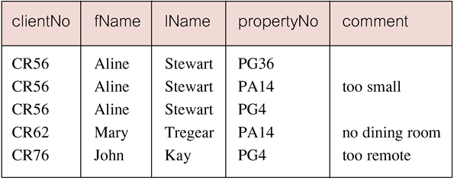
Simple Join
Only those rows from both tables that have identical values in the clientNo columns (c.clientNo = v.clientNo) are included in result.
Equivalent to equi-join in relational algebra.

Slide 89
Basic INNER JOIN Syntax
SELECT <column1, column2>
FROM <table1>
INNER JOIN <table2>
ON <table1>.<column>=<table2>.<column>

Slide 90
Inner Joins
Inner joins return related records from each of the tables joined.
SELECT LastName,
FirstName,
SessionDateKey,
SessionTimeKey,
StudentKey
SessionStatus
FROM
INNER JOIN Session
ON .Key = Session.Key

Slide 91
Alternative JOIN Constructs
SQL provides alternative ways to specify joins:
FROM Client c JOIN Viewing v ON c.clientNo = v.clientNo
FROM Client JOIN Viewing USING clientNo
FROM Client NATURAL JOIN Viewing
In each case, FROM replaces original FROM and WHERE. However, first produces table with two identical clientNo columns.

Slide 92
Equi Joins
Equi joins present an alternative way to perform inner joins. Some older RDMSs only support this alternative form. The example below also uses an alias for the table name.
SELECT t.Key,
LastName,
FirstName,
SessionDateKey,
SessionTimeKey,
StudentKey
FROM t,
Session s
WHERE t.Key = s.Key
AND LastName = ‘Brown’

Slide 93
Three Table Join
For each branch, list staff who manage properties, including city in which branch is located and properties they manage.
SELECT b.branchNo, b.city, s.staffNo, fName, lName,
propertyNo
FROM Branch b, Staff s, PropertyForRent p
WHERE b.branchNo = s.branchNo AND
s.staffNo = p.staffNo
ORDER BY b.branchNo, s.staffNo, propertyNo;

Slide 94
Sorting a join
For each branch, list numbers and names of staff who manage properties, and properties they manage.
SELECT s.branchNo, s.staffNo, fName, lName,
propertyNo
FROM Staff s, PropertyForRent p
WHERE s.staffNo = p.staffNo
ORDER BY s.branchNo, s.staffNo, propertyNo;

Slide 95
Multiple Grouping Columns
Find number of properties handled by each staff member.
SELECT s.branchNo, s.staffNo, COUNT(*) AS myCount
FROM Staff s, PropertyForRent p
WHERE s.staffNo = p.staffNo
GROUP BY s.branchNo, s.staffNo
ORDER BY s.branchNo, s.staffNo;

Slide 96
Computing a Join
Procedure for generating results of a join are:
1. Form Cartesian product of the tables named in FROM clause.
2. If there is a WHERE clause, apply the search condition to each row of the product table, retaining those rows that satisfy the condition.
3. For each remaining row, determine value of each item in SELECT list to produce a single row in result table.

Slide 97
Computing a Join
4. If DISTINCT has been specified, eliminate any duplicate rows from the result table.
5. If there is an ORDER BY clause, sort result table as required.
SQL provides special format of SELECT for Cartesian product:
SELECT [DISTINCT | ALL] {* | columnList}
FROM Table1 CROSS JOIN Table2

Slide 98
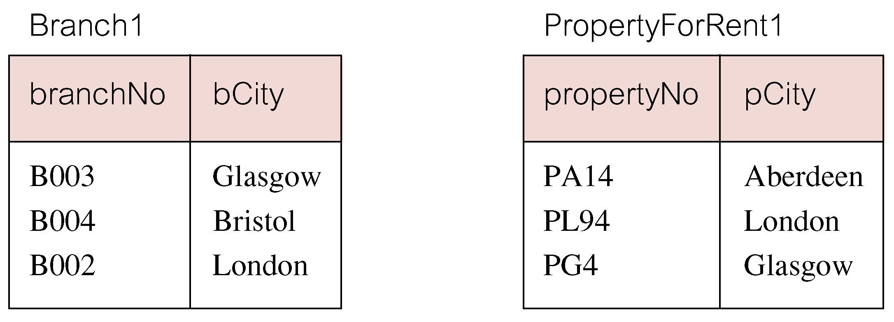
Outer Joins
If one row of a joined table is unmatched, row is omitted from result table.
Outer join operations retain rows that do not satisfy the join condition.
Consider following tables:

Slide 99
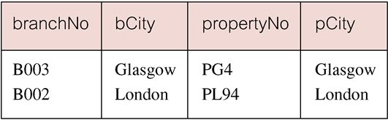
Outer Joins
The (inner) join of these two tables:
SELECT b.*, p.*
FROM Branch1 b, PropertyForRent1 p
WHERE b.bCity = p.pCity;

Slide 100
Outer Joins
Result table has two rows where cities are same.
There are no rows corresponding to branches in Bristol and Aberdeen.
To include unmatched rows in result table, use an Outer join.

Slide 101
Left Outer Join
List branches and properties that are in same city along with any unmatched properties.
SELECT b.*, p.*
FROM Branch1 b LEFT JOIN
PropertyForRent1 p ON b.bCity = p.pCity;

Slide 102
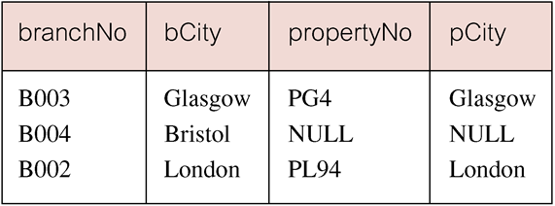
Left Outer Join
Includes those rows of first (left) table unmatched with rows from second (right) table.
Columns from second table are filled with NULLs.

Slide 103
Right Outer Join
List branches and properties in same city and any unmatched properties.
SELECT b.*, p.*
FROM Branch1 b RIGHT JOIN
PropertyForRent1 p ON b.bCity = p.pCity;

Slide 104
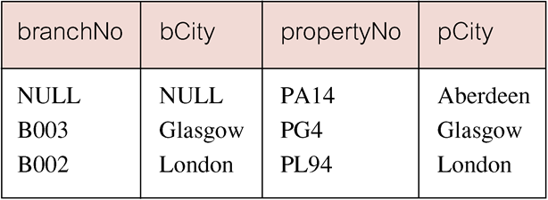
Right Outer Join
Right Outer join includes those rows of second (right) table that are unmatched with rows from first (left) table.
Columns from first table are filled with NULLs.

Slide 105
Full Outer Join
List branches and properties in same city and any unmatched branches or properties. (on both sides)
SELECT b.*, p.*
FROM Branch1 b FULL JOIN
PropertyForRent1 p ON b.bCity = p.pCity;

Slide 106
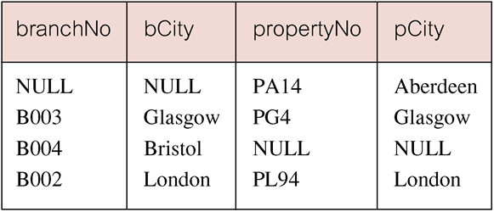
Full Outer Join
Includes rows that are unmatched in both tables.
Unmatched columns are filled with NULLs.

Slide 107
OUTER JOIN Syntax
Outer joins return records that are not matched. The following query returns s that have no sessions scheduled.
SELECT <column1>, <column2>
FROM <table1>
LEFT OUTER JOIN <table2> ON <table1>.<column>=<table2>.<column>

Slide 108
Outer Join Example
SELECT t.Key,
LastName,
SessionDateKey
FROM t
LEFT OUTER JOIN Session s
ON t.Key = s.Key
WHERE SessionDateKey IS Null

Slide 109
Inserts
To insert a record into a table, you use the following syntax:
INSERT INTO <tablename>(<ColumnName>, <columnName>, ...)
VALUES(<value1>, <value2>, ...)

Slide 110
Updates
Updates allow you to change existing records. The syntax is:
UPDATE <TableName>
SET <ColumnName> = <New Value>,
<ColumnName>=<new value>
WHERE <ColumnName> = <criteria>

Slide 111
Deletes
Deletes allow you to remove a record from a table:
DELETE FROM <TableName>
WHERE <columnName> = <criteria>

Slide 112
Deletes and Updates
Deletes and updates are dangerous. If you do not specify a criteria, the update or delete will be applied to all the rows in a table.
Also, referential integrity may prevent a deletion. You cannot delete a parent that has children in another table.

Slide 113
SubQuery Example
SELECT DISTINCT COUNT(*) AS Total,
(SELECT COUNT(*)
FROM Session
WHERE SessionStatus='NS') AS NoShow,
(SELECT COUNT(*)
FROM Session
WHERE SessionStatus='c') AS Completed
FROM Session
This example shows subqueries used in the SELECT clause to return Aggregate values.

Slide 114
Locating Duplicates
SELECT Lastname, firstname, email, phone, COUNT(*) AS [duplicates]
FROM contact
GROUP BY Lastname, firstName, email, Phone
HAVING COUNT(*) >1
This SQL finds duplicate values in in a table.

Slide 115
Documentation: Testing Plans
When testing the database, you should document all your SQL queries and their results.
On the next slide is a sample of a test table, showing the test and results.

Slide 116
Union, Intersect, and Difference
Can use normal set operations of Union, Intersection, and Difference to combine results of two or more queries into a single result table.
Union of two tables, A and B, is table containing all rows in either A or B or both.
Intersection is table containing all rows common to both A and B.
Difference is table containing all rows in A but not in B.
Two tables must be union compatible.

Slide 117
Union, Intersect, and Difference
Format of set operator clause in each case is:
op [ALL] [CORRESPONDING [BY {column1 [, ...]}]]
If CORRESPONDING BY specified, set operation performed on the named column(s).
If CORRESPONDING specified but not BY clause, operation performed on common columns.
If ALL specified, result can include duplicate rows.

Slide 118
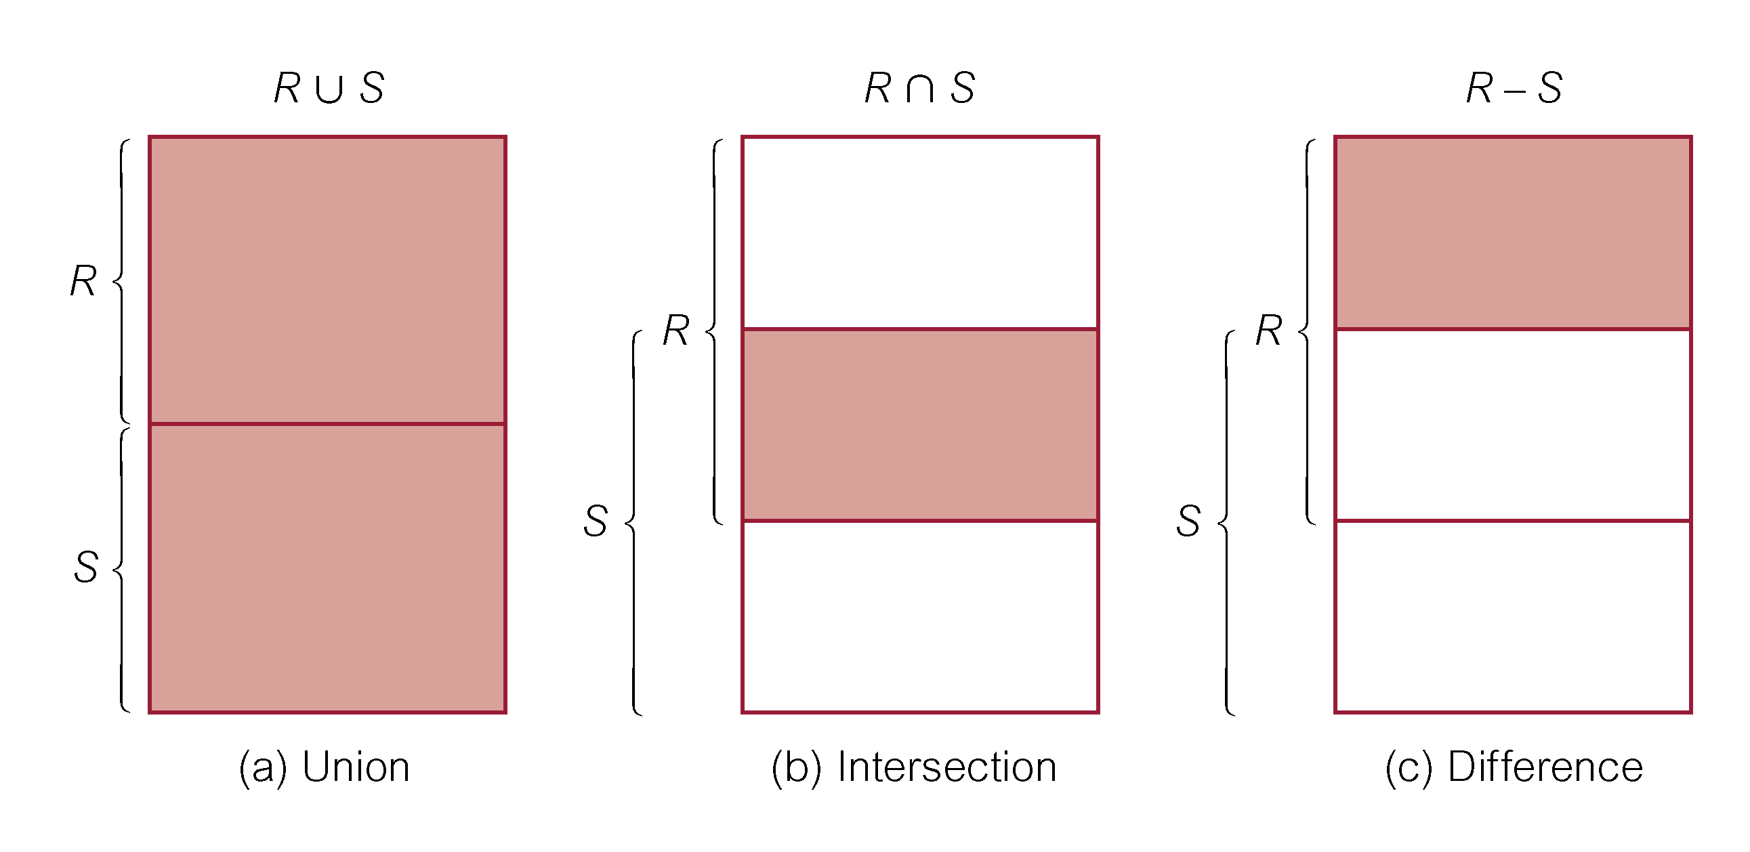
Union, Intersect, and Difference

Slide 119
Use of UNION
List all cities where there is either a branch office or a property.
(SELECT city
FROM Branch
WHERE city IS NOT NULL) UNION
(SELECT city
FROM PropertyForRent
WHERE city IS NOT NULL);

Slide 120
Use of UNION
Or
(SELECT * FROM Branch WHERE city IS NOT NULL) UNION CORRESPONDING BY city (SELECT * FROM PropertyForRent WHERE city IS NOT NULL);

Slide 121
Union Example
INSERT INTO Contact(LastName, FirstName, Email, Phone)
SELECT StudentLastName AS LastName,
StudentFirstName AS FirstName,
StudentEmail AS Email,
StudentPhone AS Phone
FROM Student
WHERE StudentEmail IS NOT NULL
UNION
SELECT LastName,
FirstName,
Email,
Phone
FROM
WHERE Email IS NOT NULL
This UNION query joins the tables Student and into a single result and writes them to the table Contact.

Slide 122
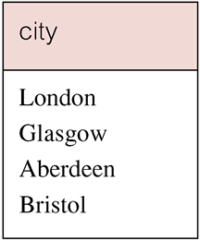
Use of UNION
Produces result tables from both queries and merges both tables together.

Slide 123
Use of INTERSECT
List all cities where there is both a branch office and a property.
(SELECT city FROM Branch)
INTERSECT
(SELECT city FROM PropertyForRent);

Slide 124
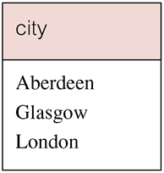
Use of INTERSECT
Or
(SELECT * FROM Branch)
INTERSECT CORRESPONDING BY city
(SELECT * FROM PropertyForRent);

Slide 125
Use of INTERSECT
Could rewrite this query without INTERSECT operator:
SELECT b.city
FROM Branch b PropertyForRent p
WHERE b.city = p.city;
Or:
SELECT DISTINCT city FROM Branch b
WHERE EXISTS
(SELECT * FROM PropertyForRent p
WHERE p.city = b.city);

Slide 126
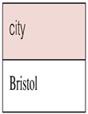
Use of EXCEPT
List of all cities where there is a branch office but no properties.
(SELECT city FROM Branch)
EXCEPT
(SELECT city FROM PropertyForRent);
Or
(SELECT * FROM Branch)
EXCEPT CORRESPONDING BY city
(SELECT * FROM PropertyForRent);

Slide 127
Use of EXCEPT
Could rewrite this query without EXCEPT:
SELECT DISTINCT city FROM Branch
WHERE city NOT IN
(SELECT city FROM PropertyForRent);
Or
SELECT DISTINCT city FROM Branch b
WHERE NOT EXISTS
(SELECT * FROM PropertyForRent p
WHERE p.city = b.city);

Slide 128
INSERT
INSERT INTO TableName [ (columnList) ]
VALUES (dataValueList)
columnList is optional; if omitted, SQL assumes a list of all columns in their original CREATE TABLE order.
Any columns omitted must have been declared as NULL when table was created, unless DEFAULT was specified when creating column.

Slide 129
INSERT
dataValueList must match columnList as follows:
number of items in each list must be same;
must be direct correspondence in position of items in two lists;
data type of each item in dataValueList must be compatible with data type of corresponding column.

Slide 130
INSERT … VALUES
Insert a new row into Staff table supplying data for all columns.
INSERT INTO Staff
VALUES (‘SG16’, ‘Alan’, ‘Brown’, ‘Assistant’, ‘M’, Date‘1957-05-25’, 8300, ‘B003’);

Slide 131
INSERT using Defaults
Insert a new row into Staff table supplying data for all mandatory columns.
INSERT INTO Staff (staffNo, fName, lName,
position, salary, branchNo)
VALUES (‘SG44’, ‘Anne’, ‘Jones’,
‘Assistant’, 8100, ‘B003’);
Or
INSERT INTO Staff
VALUES (‘SG44’, ‘Anne’, ‘Jones’, ‘Assistant’, NULL,
NULL, 8100, ‘B003’);

Slide 132
INSERT … SELECT
Second form of INSERT allows multiple rows to be copied from one or more tables to another:
INSERT INTO TableName [ (columnList) ]
SELECT ...

Slide 133
INSERT … SELECT
Assume there is a table StaffPropCount that contains names of staff and number of properties they manage:
StaffPropCount(staffNo, fName, lName, propCnt)
Populate StaffPropCount using Staff and PropertyForRent tables.

Slide 134
INSERT … SELECT
INSERT INTO StaffPropCount
(SELECT s.staffNo, fName, lName, COUNT(*)
FROM Staff s, PropertyForRent p
WHERE s.staffNo = p.staffNo
GROUP BY s.staffNo, fName, lName)
UNION
(SELECT staffNo, fName, lName, 0
FROM Staff
WHERE staffNo NOT IN
(SELECT DISTINCT staffNo
FROM PropertyForRent));

Slide 135
UPDATE
UPDATE TableName
SET columnName1 = dataValue1
[, columnName2 = dataValue2...]
[WHERE searchCondition]
TableName can be name of a base table or an updatable view.
SET clause specifies names of one or more columns that are to be updated.

Slide 136
UPDATE
WHERE clause is optional:
if omitted, named columns are updated for all rows in table;
if specified, only those rows that satisfy searchCondition are updated.
New dataValue(s) must be compatible with data type for corresponding column.

Slide 137
UPDATE All Rows
Give all staff a 3% pay increase.
UPDATE Staff
SET salary = salary*1.03;
Give all Managers a 5% pay increase.
UPDATE Staff
SET salary = salary*1.05
WHERE position = ‘Manager’;

Slide 138
UPDATE Multiple Columns
Promote David Ford (staffNo=‘SG14’) to Manager and change his salary to £18,000.
UPDATE Staff
SET position = ‘Manager’, salary = 18000
WHERE staffNo = ‘SG14’;

Slide 139
DELETE
DELETE FROM TableName
[WHERE searchCondition]
TableName can be name of a base table or an updatable view.
searchCondition is optional; if omitted, all rows are deleted from table. This does not delete table. If search_condition is specified, only those rows that satisfy condition are deleted.

Slide 140
DELETE Specific Rows
Delete all viewings that relate to property PG4.
DELETE FROM Viewing
WHERE propertyNo = ‘PG4’;
Delete all records from the Viewing table.
DELETE FROM Viewing;

Slide 141
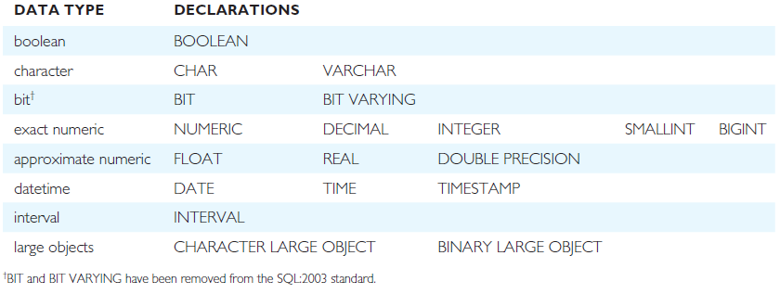
ISO SQL Data Types

Slide 142
Data Control Language
CREATE & ALTER USER/ ROLE
DROP USER/ ROLE
GRANT
REVOKE

Slide 143
Querying Data
Where Clause
Group By
Having Clause
Order By

Slide 144
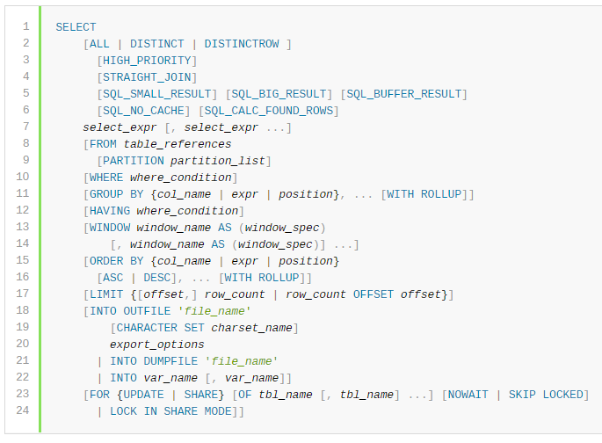
Where Clause
Expressions

Slide 145
Group By Clause
group-by-modifiers
group-by-functions

Slide 146
Having Clause
HAVING clause can refer to aggregate functions, which the WHERE clause cannot

Slide 147
Order By Clause

Slide 148

Sub Queries Clause
Comparisons Using Subqueries
Subqueries with ANY, IN, or SOME

Slide 149

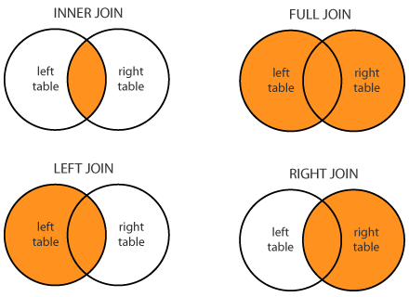
Joins

Slide 150
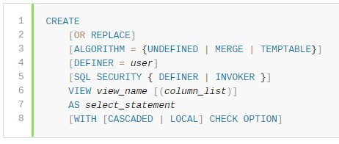
Views
View Algorithms
For MERGE, the text of a statement that refers to the view and the view definition are merged such that parts of the view definition replace corresponding parts of the statement.
For TEMPTABLE, the results from the view are retrieved into a temporary table, which then is used to execute the statement.
For UNDEFINED, MySQL chooses which algorithm to use. It prefers MERGE over TEMPTABLE if possible, because MERGE is usually more efficient and because a view cannot be updatable if a temporary table is used.
Updatable View Rules

Slide 151
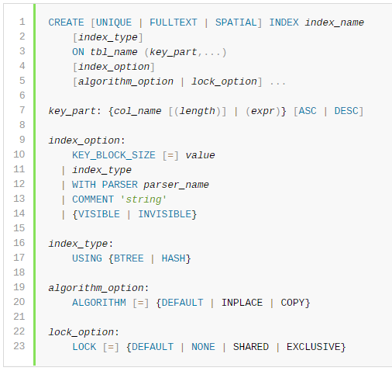
Indexing
Indexes

Slide 152
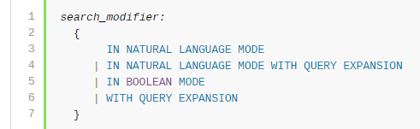
Full Text Search
create table books (
bookid int primary key,
title varchar(200) not null,
author varchar(200) not null,
publishYear year,
rating float,
fulltext(title, author)
);
insert into books values (1,'The Hunger Games','Suzanne Collins',2008,4.34);
insert into books values (2,'Harry Potter and the Philosopher''s Stone','J.K. Rowling',1997,4.44);
insert into books values (3,'Twilight','Stephenie Meyer',2005,3.57);
insert into books values (4,'To Kill a Mockingbird','Harper Lee',1960,4.25);
insert into books values (5,'The Great Gatsby','F. Scott Fitzgerald',1925,3.89);
insert into books values (6,'The Fault in Our Stars','John Green',2012,4.26);
insert into books values (7,'The Hobbit or There and Back Again','J.R.R. Tolkien',1937,4.25);
insert into books values (8,'The Catcher in the Rye','J.D. Salinger',1951,3.79);
insert into books values (9,'Angels & Demons ','Dan Brown',2000,3.85);
select * from books where match(title, author) against ('Lee' in natural language mode);

Slide 153
Need for Isolation
A dirty read occurs when a transaction is allowed to read data from a row that has been modified by another running transaction and not yet committed
A non-repeatable read occurs, when during the course of a transaction, a row is retrieved twice and the values within the row differ between reads.
A phantom read occurs when, in the course of a transaction, new rows are added or removed by another transaction to the records being read.
https://en.wikipedia.org/wiki/Isolation_(database_systems)#Read_phenomena

Slide 154
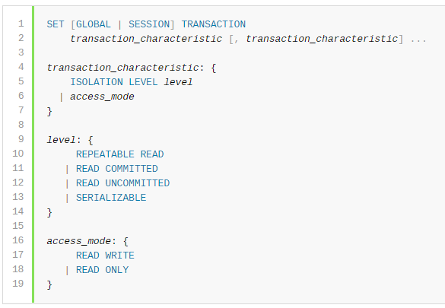
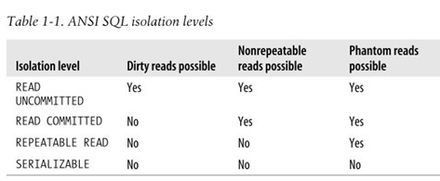
Transactions

Slide 155
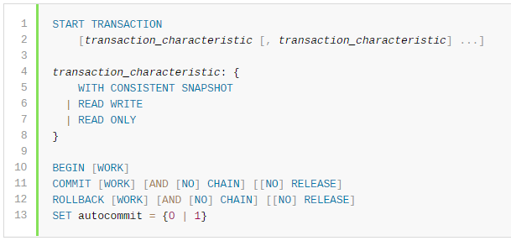
Transactions
START TRANSACTION or BEGIN start a new transaction.
COMMIT commits the current transaction, making its changes permanent.
ROLLBACK rolls back the current transaction, canceling its changes.
SET autocommit disables or enables the default autocommit mode for the current session.

Slide 156
Functions
Functions
String Functions
Date and Time Functions
XML Functions
Aggregate (GROUP BY) Functions

Slide 157
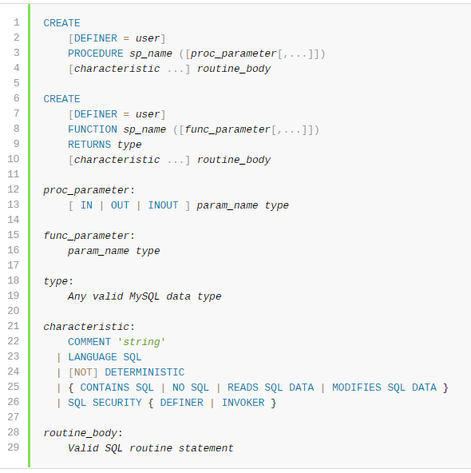
Stored Procedures
Note: While defining stored procedures remember to change the delimiter so as to enable the entire definition to be passed to the server as a single statement and then restore the delimiter back to ;

Slide 158
User Defined Functions

Slide 159
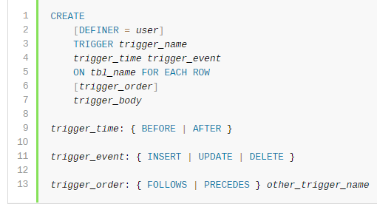
Triggers

Slide 160
Cursors
Used for traversing records in a database
Steps:
Declare a cursor that defines a result set.
Open the cursor to establish the result set.
Fetch the data into local variables as needed from the cursor, one row at a time.
Close the cursor when done.

Slide 161
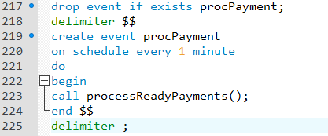
Scheduler
Allows Users to schedule event at specific time intervals (similar to cron jobs in UNIX)
SELECT event_name, LAST_EXECUTED FROM INFORMATION_SCHEMA.EVENTS;

Slide 162
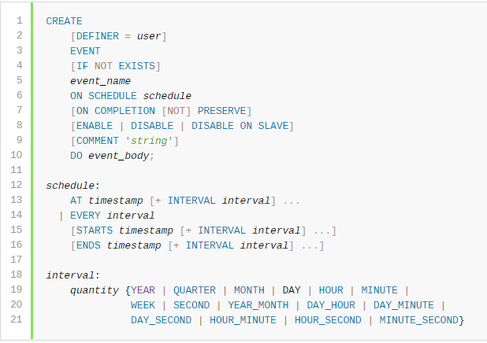
Event Syntax

Slide 163

Backup and Restore
Options:
Complete directory backup
Database dump (mysqldump)

Slide 164
Interview Questions
Text suggestions in a search
Describe a use case for Left Join
Difference between UNION and JOIN
Rewriting Subqueries as JOINS (LINK)
What is the best way to perform multiple operation on a set of data

Slide 165
Misc. Topics
Database Engines
Character Sets and Collation
Information Tables

Slide 166
Thank You

