Slide 1

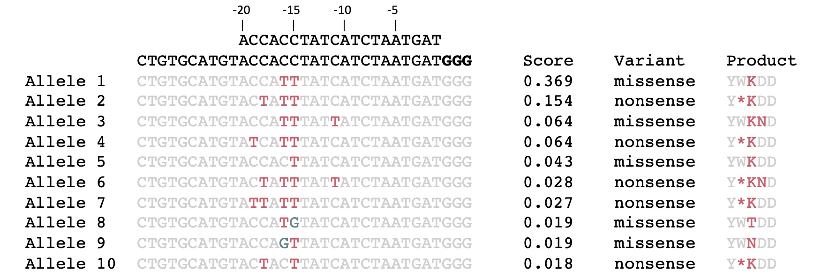
BRCA1
exons
BaseEditor
object
a
Editing weights for BE4max
Inputs
BE4max
Relative weight
Design protospacer sequences
Editing weights for BE4max
GuideSet
b
Top predicted alleles for selected gRNA
Find edited alleles
Gene
model
c
gRNA-level mutation scores
Score gRNAs for editing
Nonsense mutation score
Sensitivity
Characterize off-targets
1 - Specificity
Amino acid residue
bowtie
index
d
On-target activity scores
Rule Set 1
Azimuth
DeepHF
Add on-target scores
and sequence features
Log₂ (FC)
Score
Score
Score

