Slide 1
Argo Workflows 101
Devtalks 2021
Cristian Lucaci

Slide 2
What is Argo Workflows?
Workflow engine that orchestrate complex jobs in kubernetes clusters.
Opensource.
Workflow, is a sequence of tasks (path) to be executed.
Job, is a container containing the code to run, together with all its libraries and settings.
Pod, is an execution unit of a group of containers.

Slide 3
Applications
Data ingestion (excels, catalogs).
Data statistics (count, analyze and interpret records).
Maintenance jobs (cleaning, backups, stability tests).
Machine Learning training (feature engineering, cross-validation, model training, batch inference).
Continous Integration.

Slide 4
Features
Parallelize intensive jobs using thousands of pods.
Pipelines, run multiple tasks sequentially.
Directed Acyclic Graph (DAG), run tasks in dependence to other tasks.
Cron workflows, schedule workflows at specified hours or intervals.
Events, trigger workflows from on external events.
Artifacts, pass the results of one task to another.
Archives, keep history of completed workflows.

Slide 5
Installation
Kubernetes cluster (Minikube, Docker for desktop, GKE, EC2)
kubernetes CLI (kubectl)
`kubectl cluster-info`
`kubectl apply -n default -f https://raw.githubusercontent.com/argoproj/argo-workflows/master/manifests/quick-start-postgres.yaml`
`kubectl get pods –n default | grep argo`
`kubectl port-forward svc/argo-server 2746 -n default`

Slide 6
Job types
Flow control with steps or dags.
Run a container.
Run a script (bash, python, node).
Manage cluster resources (get, create, apply, delete, replace, patch).
Suspend execution flow based on some condition, timeout or action.

Slide 7
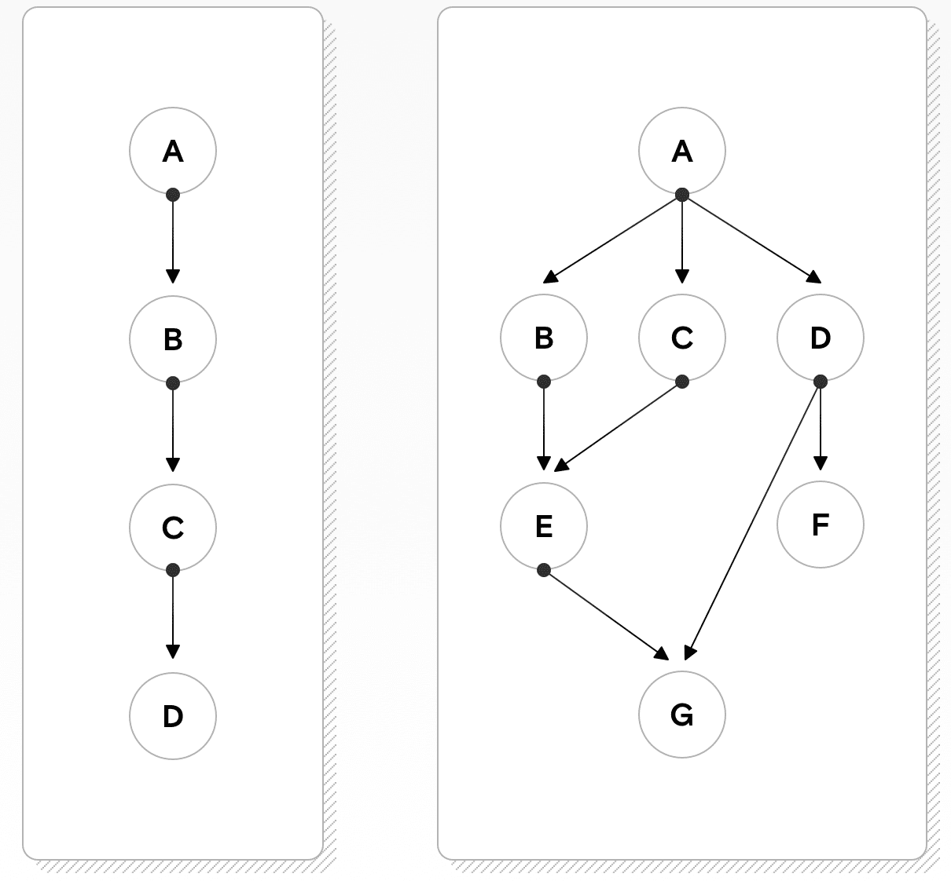
Steps vs Directed Acyclic Graphs

Slide 8
Parameters vs Artifacts vs Arguments
Input parameters (list of variables in template declaration).
Output parameters (list of variables from template execution).
Output result (script stdout)
Input artifacts (files, directories)
Output artifacts (files, directories)
Arguments (values of parameters or artifacts neccesary to invoke a task)

Slide 9
More
Service accounts (Roles, RoleBindings, and ServiceAccounts)
Artifacts repository, push artifacts to git or cloud storages.
Sidecars, concurrent containers.
Events, trigger workflows upon a message from other systems.
Rest API, manipulate workflows using Http requests.
Memoization, store tasks outputs in fast memory.

Slide 10
Others
Apache Airflow if you want the most full-featured, mature tool and you can dedicate time to learning how it works, setting it up, and maintaining it.
Luigi if you need something with an easier learning curve than Airflow. It has fewer features, but it’s easier to get off the ground.
Prefect if you want something that’s very familiar to Python programmers and stays out of your way as much as possible.
Argo if you’re already deeply invested in the Kubernetes ecosystem and want to manage all of your tasks as pods, defining them in YAML instead of Python.
KubeFlow if you want to use Kubernetes but still define your tasks with Python instead of YAML.
MLFlow if you care more about tracking experiments or tracking and deploying models using MLFlow’s predefined patterns than about finding a tool that can adapt to your existing custom workflows.

