Slide 1
Communication is Key
By: Giovanni Knight, Christina Brown, Aki Kim, Fatima Rengifo, Marco-Tomás Ambrogi-Torres

Slide 2



How do you prefer to be contacted?
Notes:
When you volunteer, how do you prefer to be contacted?

Slide 3
The Impact of Different Communication Methods
Is there a way to tell what communication method (email, text, call) is more successful with clients with regards to completed Volunteer Agreements?
Goal: Find out which communication method is most effective in increasing the number of completed volunteer agreements in order to be more successful with clients.

Slide 4
Journey with the Data
Preliminary review of data columns in Excel
Many nulls
Cleaning the data in Tableau Prep to reduce the number of columns
Creating a visual representation in Tableau of the communication methods and completed volunteer agreements
Calculating the success rates of each communication method against completed volunteer agreements
Notes:
-Nulls

Slide 5
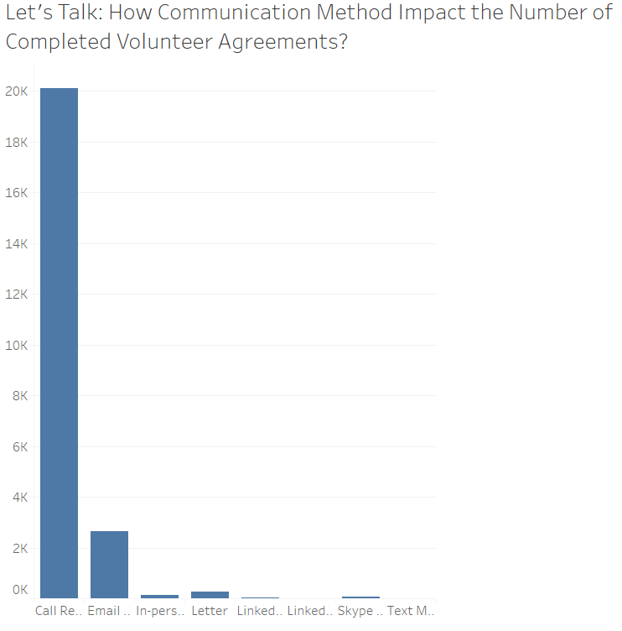
Call | 20.292%
Email | 0.872%
Text | 0.175%
Notes:
Calling has a 20% effectiveness rate in having clients complete volunteer agreements compared to email and text messaging.
Calling is 25 times more effective than emailing, but emailing is by far the most used method

Slide 6
Recommendation
Determine how many volunteer agreements were completed in a given year
Calculate how many were completed in relation to each method
Project next year’s success rate using the previous year
Over time, we don’t believe these numbers will drastically change
Communication methods can survive the test of time

Slide 7
Advantages of the Recommendation
As a result, Hire Heroes can potentially save $25.43 per volunteer
Hire Heroes already pays for the calling service, so they don’t have to make a big change in the organization.
More volunteers build rapport with companies by building reputation
Notes:
Save $25.43 per volunteer by bringing in more volunteers through the most effective service: Calling
In discussing HH processes with Yenny Yang, the company representative,
Easier to manage change management within the company: increasing/decreasing volume, etc.

