Slide 1
CONCURRENCY II
Instructors: Crista Lopes
Copyright © Instructors.

Slide 2
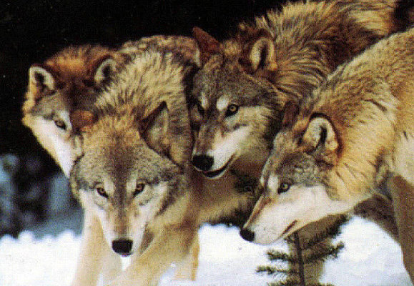
Threads
Cute and furry beasts

Slide 3
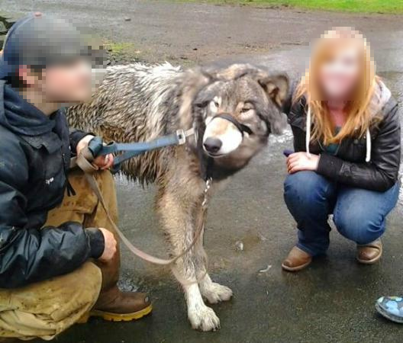
Threads
Must be restrained

Slide 4
Restrained concurrency models
Actors
  Good for independent tasks
  Good for discriminate producers/consumers of data
Tuple spaces
  Good for indiscriminate producers/consumers of data
Map-reduce
  Good for data-intensive, parallelizable situations

Slide 5
Actors

Slide 6
Actor model
Letterbox style (Ch 11) + Threads
Actor = Object with its own thread
  Aka “active object”
Actors send messages to each other
  Avoid shared memory
Messages are placed in actors’ queues
  Queues must be “thread-safe”
  Sender places message and moves on
    Asynchronous request

Slide 7
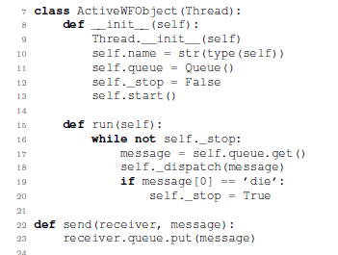
Active Object (Python)
Thread-safe queue
Block until there
is a message
Message loop
Utility (could be a method)

Slide 8

Active Object Queue

Slide 9
Queues
Put / Enqueue / Send
Get / Dequeue / Receive
Operations must be thread safe
  No items can be lost

Slide 10
Thread-safe queues
Java: ArrayBlockingQueue
C#: ConcurrentQueue
C++ / Boost: message_queue
Other langs: search for it or do it yourself

Slide 11
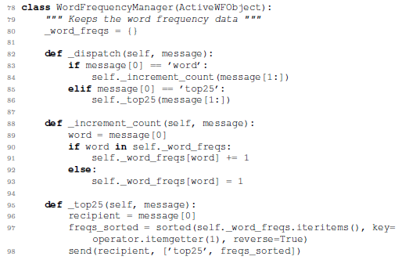
Actor example
superclass
dispatch messages
Send messages to other actors

Slide 12

Actor model
Concurrency constrained by
  Associating [certain] objects with threads
  Using message queues in each actor
  Having threads on a loop
Programmer needs to refrain from passing shared mutable objects around or else...

Slide 13
Tuple Spaces

Slide 14
Tuple space model
Concurrent threads
  Consumers and producers of data items
Shared data structures (queues, lists, trees, etc.)
  Must be “thread-safe”
Producers add items and move on
    Asynchronous deposit
Consumers take items and process them
Similar to previous model, but where the queues are outside the objects/functions, and may not be queues

Slide 15
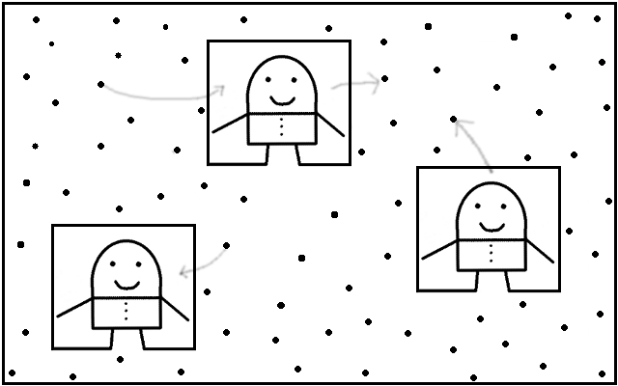
Tuple space model

Slide 16

TF Tuple spaces

Slide 17

TF Producer

Slide 18
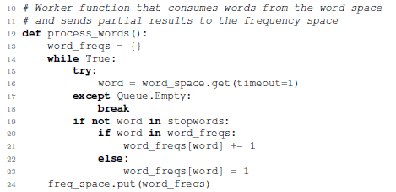
TF Consumer / Producer worker

Slide 19

Starting workers
(functional style of creating threads in Python)

Slide 20
Tuple space model
Can be functional or OOP style
OOP style: worker functions are threaded objects
Best fit: data processing parallelization
Actors example decomposition:
DataStorageManager
StopWordManager
WordFrequencyManager
WordFrequencyController
Tuple space example decomposition:
Producers of words
Consumers of words / producers of
word frequencies
Consumers of word frequencies

Slide 21
Tuple space model
Concurrency constrained by
  Having shared, thread-safe collections of items
  Having producers/consumers of items in those collections
  No further communication between threaded code
Programmer needs to refrain from passing shared mutable objects around or else...

Slide 22
Map-Reduce

Slide 23
Map-Reduce model
Big data situations
  Problem at hand must be data-parallelizable
Data is split into chunks
Chunks are processed independently, produce partial results
  A function is “mapped” to the chunks of data, potentially in parallel
Partial results are then “reduced” to final result
  This step is sequential

Slide 24
file
Read
File
Partition
[chunk1, chunk2, ...]
Map
Split
Words
[result1, result2, ...]
Reduce
Sort
display
Count
Words
functions
splits = map(split_words,partition(read_file(sys.argv[1]),200))
splits.insert(0, []) # normalize input to reduce
word_freqs = sort(reduce(count_words, splits))

Slide 25
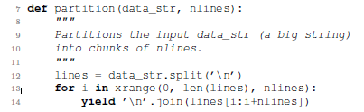
Data partitioning

Slide 26
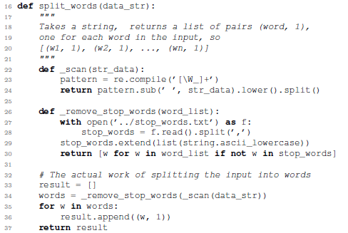
Mapper – parsing words – emit

Slide 27
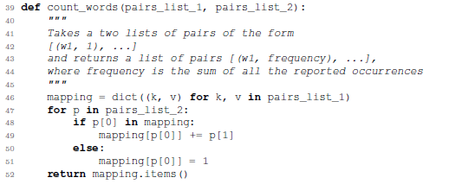
Reducer – counting words

Slide 28
Map-Reduce, Hadoop
The previous style allows for parallelization of the map step, but requires serialization of the reduce step. Google map-reduce and Hadoop use a slight variation that makes the reduce step also potentially parallelizable. The main idea is to regroup, or reshuffle, the list of results from the map step so that the regroupings are amenable to further mapping of a reducible function.

Slide 29
file
Read
File
Partition
[chunk1, chunk2, ...]
Map
Split
Words
[result1, result2, ...]
Regroup
[(w1, (...)), (w2, (..)), ...]
Map
Sort
display
Count
Words
functions
Reduce
reduce inside
splits = map(split_words,partition(read_file(sys.argv[1]),200))
splits_per_word = regroup(splits)
word_freqs = sort(map(count_words, splits_per_word.items()))

Slide 30
Regroup
def regroup(pairs_list):
"""
Takes a list of lists of pairs of the form
[[(w1, 1), (w2, 1), ..., (wn, 1)],
[(w1, 1), (w2, 1), ..., (wn, 1)],
...]
and returns a dictionary mapping each unique word to the
corresponding list of pairs, so
{ w1 : [(w1, 1), (w1, 1)...],
w2 : [(w2, 1), (w2, 1)...],
...}
"""
mapping = {}
for pairs in pairs_list:
for p in pairs:
if p[0] in mapping:
mapping[p[0]].append(p)
else:
mapping[p[0]] = [p]
return mapping

Slide 31
Map-reduce
Java: try Functional Java library
  Or do “mapper” and “reducer” classes yourself
PHP: try this

Slide 32
Map-Reduce model
Concurrency constrained by
  Having worker threads work on mutually exclusive chunks of data
  No communication between threaded code

