Slide 1
PLUGINS
Instructors: Crista Lopes
Copyright © Instructors.

Slide 2
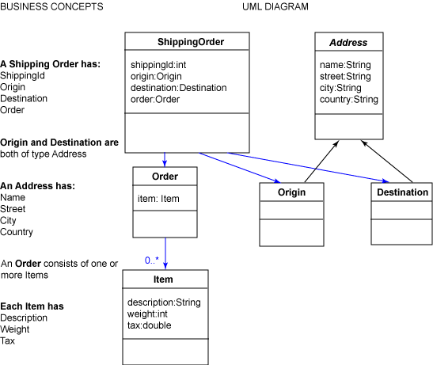
Modules as conceptual units

Slide 3
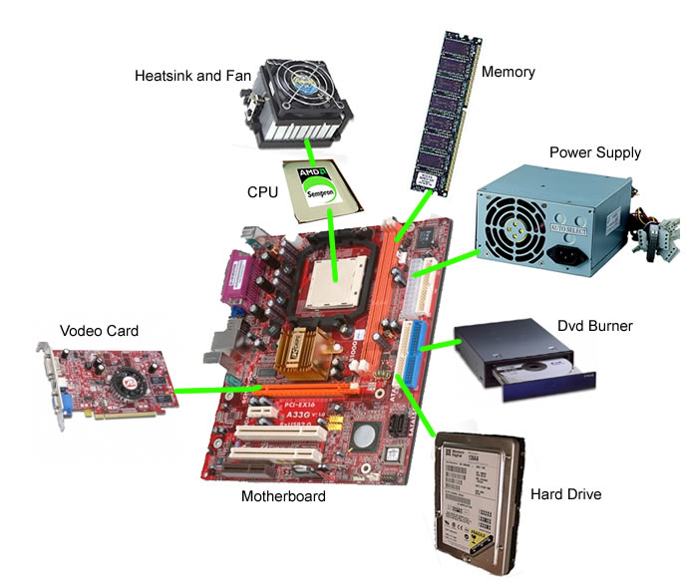
Modules as physical components

Slide 4
Software modules as physical components
Source components
  Get the source, make it yours. Simple.
Binary components
  Java: jar files
  .NET: DLL files
  C/C++: so files
  ...
  Not so simple

Slide 5
Source vs. Binary
Discuss

Slide 6
Linking binary components
3 steps
  Independent compilation
  Dynamic Loading
  Instantiation of classes

Slide 7
Linking binary components
Dynamically-typed languages
  Simple
Statically-typed languages
  Not so simple
Discuss

Slide 8
Binary components -- Python
1 #!/usr/bin/env python
2 import sys, ConfigParser, imp
3
4 def load_plugins():
5 config = ConfigParser.ConfigParser()
6 config.read("config.ini")
7 words_plugin = config.get("Plugins", "words")
8 frequencies_plugin = config.get("Plugins", "frequencies")
9 global tfwords, tffreqs
10 tfwords = imp.load_compiled(’tfwords’, words_plugin)
11 tffreqs = imp.load_compiled(’tffreqs’, frequencies_plugin)
12
13 load_plugins()
14 word_freqs = tffreqs.top25(tfwords.extract_words(sys.argv[1]))
15
16 for (w, c) in word_freqs:
17 print w, ’ - ’, c

Slide 9
Binary components – Python
Python
  No need to worry about types during independent compilation

Slide 10
Binary components – Typed
class TFApp {
static void main(String[] args) {
HashMap<String, int> wordFreqs;
wordFreqs = tffreqs.top25(tfwords.extract_words(sys.argv[0]));
}
}
Types?

Slide 11
Binary components – Typed
interface TFWords {
public List<String> extractWords(string path);
}
interface TFFreqs {
public HashMap<String, int> top25(List<String> words);
}
class TFApp {
static void main(String[] args) {
HashMap<String, int> wordFreqs;
TFWords tfwords; //= ???
TFFreqs tffreqs ;//= ???
wordFreqs = tffreqs.top25(tfwords.extract_words(sys.argv[0]));
}
}
Types ok!

Slide 12
Binary components – Typed
<<class>>
Words1
<<interface>>
TFWords
<<class>>
Words2
<<class>>
TFApplication
<<class>>
Freqs1
<<interface>>
TFFreqs
<<class>>
Freqs2
How do we partition into jars?

Slide 13
Physical modularization 1 – Typed
<<class>>
Words1
pack2
<<interface>>
TFWords
<<class>>
Words2
pack3
<<class>>
TFApplication
<<class>>
Freqs1
pack4
<<interface>>
TFFreqs
pack1
<<class>>
Freqs2
pack5
Compilation dependencies:
pack1?
pack2?
same

Slide 14
Physical modularization 2 – Java
<<class>>
Words1
pack3
<<interface>>
TFWords
<<class>>
Words2
pack4
<<class>>
TFApplication
<<class>>
Freqs1
pack5
pack1
<<interface>>
TFFreqs
<<class>>
Freqs2
pack6
pack2
Compilation dependencies:
pack1?
pack2?
pack3?

Slide 15
Physical modularization 3 – Typed
<<class>>
Words1
pack2
<<interface>>
TFWords
<<class>>
Words2
<<class>>
TFApplication
<<class>>
Freqs1
<<interface>>
TFFreqs
pack1
<<class>>
Freqs2
pack3
Compilation dependencies:
pack1?
pack2?
pack3?

Slide 16
Physical modularization 4 – Typed
<<class>>
Words1
pack3
<<interface>>
TFWords
<<class>>
Words2
<<class>>
TFApplication
pack1
<<class>>
Freqs1
<<interface>>
TFFreqs
pack2
<<class>>
Freqs2
pack4
Compilation dependencies:
pack1?
pack2?
pack3?

Slide 17
Physical modularization 5 – Typed
<<class>>
Words1
<<interface>>
TFWords
<<class>>
Words2
<<class>>
TFApplication
pack1
<<class>>
Freqs1
<<interface>>
TFFreqs
<<class>>
Freqs2
pack2
Compilation dependencies:
pack1?
pack2?
?????

Slide 18

Linking binary components
3 steps
  Independent compilation
  Dynamic Loading
  Instantiation of classes

Slide 19
Binary components – Typed
interface TFWords {
public List<String> extractWords(string path);
}
interface TFFreqs {
public HashMap<String, int> top25(List<String> words);
}
class TFApp {
static void main(String[] args) {
HashMap<String, int> wordFreqs;
TFWords tfwords; //= ???
TFFreqs tffreqs ;//= ???
wordFreqs = tffreqs.top25(tfwords.extract_words(sys.argv[0]));
}
}

Slide 20
Binary components – Typed
class TFApp {
static void main(String[] args) {
HashMap<String, int> wordFreqs;
TFWords tfwords = new Words1();
TFFreqs tffreqs = new Freqs1();
wordFreqs = tffreqs.top25(tfwords.extract_words(sys.argv[0]));
}
}
?????
Coupling between physical components!
TFApp needs one of the other components
in order to compile!

Slide 21
Binary components – Typed
class TFApp {
static void main(String[] args) {
HashMap<String, int> wordFreqs;
TFWords tfwords = create instance dynamically (“...”);
TFFreqs tffreqs = create instance dynamically (“...”);
wordFreqs = tffreqs.top25(tfwords.extract_words(sys.argv[0]));
}
}
You need to research how to do it
in your language of choice
Given by .ini file

Slide 22
Dynamic loading of libraries
Java:
  ClassLoader class
.NET
  Assembly class
Raw C++, Linux:
  dlopen, dlsym, dlclose
Raw C++, Win32
  LoadLibrary()

Slide 23
Linking binary components
3 steps
  Independent compilation
  Dynamic Loading
  Instantiation of classes

Slide 24
Instantiation
Java
  Class.forName(“...”).newInstance();
.NET
  Activator.CreateInstance(type)
Raw C++
  ?? Factory pattern in linked lib, maybe??

Slide 25
Linking binary components
3 steps
  Independent compilation
  Dynamic Loading
  Instantiation of classes

