Slide 1
SQL AND SPREADSHEETS
Instructors: Crista Lopes
Copyright © Instructors.

Slide 2
Data-Centric Programming
Focus on data
Interactive data: SQL
Dataflow: Spreadsheets
Dataflow: Iterators, generators, coroutines

Slide 3
SQL
Standard Query Language

Slide 4
History
Data banks since 1950s
Disks (direct access storage) in 1960s
How to store and retrieve data from disk
  Efficiently, cleanly
Before 1970:
  Hierarchical models (trees)
  Network models (graphs)
E. Codd, 1970:
  Relational model

Slide 5
Relational model
Logic deductive system minus deductions ☺
  Data independence – isolate applications from data representations
  Data inconsistency
“Relation” as in Mathematics:
  Given sets S₁, S₂, ... S_{n}: R is a relation on these sets iff
  R = {{e₁, e₂, ..., e_{n}}, ...} where e_{i} ∈ S_{i}
  R ⊆ S₁x S₂x ... xS_{n}
  (R is a subset of the Cartesian product)

Slide 6
Relations
Each column represents a domain
  Ordering of columns is important – order of the domains of R
Each row represents an n-tuple of R
  Ordering of rows is immaterial
  All rows are distinct
S₁
S₂
S₃
S₄
S₅
S₆

Slide 7
Math: Relations vs. Functions
Relation >> Function
Function = relation where each element of the domain corresponds to one element of the range
Int Int
-2 3
5 3
7 3
12 3
Int Int
-2 3
-2 0
7 3
12 1
Relation?
Function?
Relation?
Function?

Slide 8
Relations in data bases
Relations define subsets of the domain:
R ⊆ S₁x S₂x ... xS_{n}
supply (supplier part project quantity)
1 2 5 17
1 3 5 23
2 3 7 9
2 7 5 4
4 1 1 12
Supply is a relation (subset) from
supplier x part x project x quantity → supplier x part x project x quantity
And
supplier, part, project, quantity all subsets of Int

Slide 9
Relations in data bases
Relations may include repeated domains
component (part part quantity)
1 5 9
2 5 7
3 5 2
2 6 12
3 6 3
“Part 1 is a subpart of part 5, and there needs to be 9 part 1s to make a part 5”
Component is a relation (subset) from
part x part x quantity → part x part x quantity
And
part, part, project, quantity all subsets of Int

Slide 10
Relationships
A relationship is an equivalence class of those relations that are equivalent under permutation of domains
Order not important
Same domains are distinguished by role names
User-facing model
component (subpart part quantity)
1 5 9
2 5 7
3 5 2
2 6 12
3 6 3

Slide 11
Cross-references
Elements of a relation can cross-reference elements of the same or another relation
Done via Keys
Student (id name)
1 John Smith
2 Alice
3 Bob
Log (id action student_id)
1 upload 2
2 upload 3
3 delete 2

Slide 12
Operations on relations
Permutation
  Interchanging columns yields converse relations
Subsetting
  Selecting only a subset of tuples
Projection
  Selection of only a subset of columns
Join
  Merging two or more relations without loss of information

Slide 13
Relational Model → SQL
Data Definition Language (DDL)
  Create/alter/delete tables and their attributes
Data Manipulation Language (DML)
  Query one or more tables
  Insert/delete/modify tuples in tables

Slide 14
Subsetting
Product
PName | Price | Category | Manufacturer
Gizmo | $19.99 | Gadgets | GizmoWorks
Powergizmo | $29.99 | Gadgets | GizmoWorks
SingleTouch | $149.99 | Photography | Canon
MultiTouch | $203.99 | Household | Hitachi
SELECT *
FROM Product
WHERE category=‘Gadgets’
PName | Price | Category | Manufacturer
Gizmo | $19.99 | Gadgets | GizmoWorks
Powergizmo | $29.99 | Gadgets | GizmoWorks
“selection”

Slide 15
Projection+Subsetting
Product
PName | Price | Category | Manufacturer
Gizmo | $19.99 | Gadgets | GizmoWorks
Powergizmo | $29.99 | Gadgets | GizmoWorks
SingleTouch | $149.99 | Photography | Canon
MultiTouch | $203.99 | Household | Hitachi
SELECT PName, Price, Manufacturer
FROM Product
WHERE Price > 100
PName | Price | Manufacturer
SingleTouch | $149.99 | Canon
MultiTouch | $203.99 | Hitachi
“selection” and
“projection”

Slide 16
Joins
Product (pname, price, category, manufacturer)
Company (cname, stockPrice, country)
Find all products under $200 manufactured in Japan;
return their names and prices.
Join
between Product
and Company
SELECT PName, Price
FROM Product, Company
WHERE Manufacturer=CName AND Country=‘Japan’
AND Price <= 200

Slide 17
Joins
Product
Company
PName | Price | Category | Manufacturer
Gizmo | $19.99 | Gadgets | GizmoWorks
Powergizmo | $29.99 | Gadgets | GizmoWorks
SingleTouch | $149.99 | Photography | Canon
MultiTouch | $203.99 | Household | Hitachi
Cname | StockPrice | Country
GizmoWorks | 25 | USA
Canon | 65 | Japan
Hitachi | 15 | Japan
SELECT PName, Price
FROM Product, Company
WHERE Manufacturer=CName AND Country=‘Japan’
AND Price <= 200
PName | Price
SingleTouch | $149.99

Slide 18
Full SQL
Very powerful query language
  Ordering, Grouping, aggregation, rich type system, ...
Declarative
  Say what you want, not how you want it to happen
  Nothing related to query processing or internal data representations

Slide 19
Spreadsheets

Slide 20
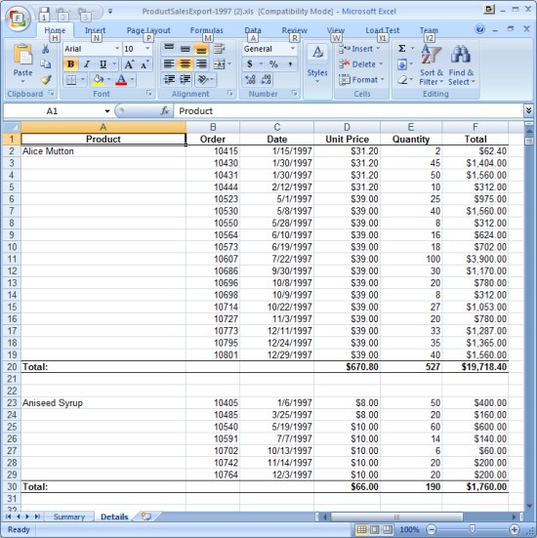
Spreadsheets

Slide 21
Spreadsheets
One of the most successful software genres
Centuries-old accounting practices...
  Some cells contain primitive values
  Some cells contain values derived from formulas
...with computers
  Automatic update of derived values when primitive values change
→ Dataflow programming

Slide 22
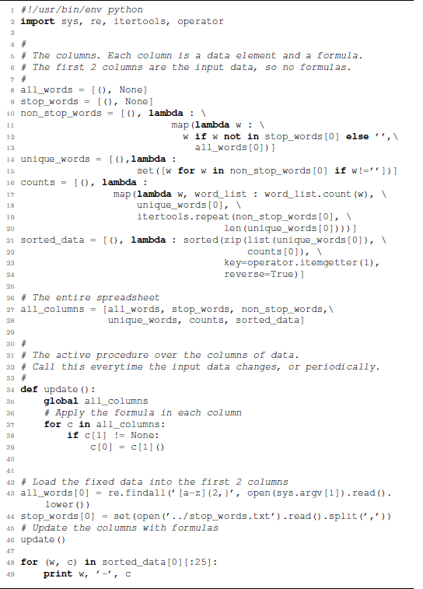
In Python:
Columns = 2-part lists:
data
formula
All formulas run on updates

Slide 23
In OOP
Columns = Objects with 2 parts, data and formula
Formulas = Objects with method “execute”
“Map” function: applies a given function to one or more list of values
  Check for equivalents in C++ (Boost maybe?), C# (Select)
  Not hard to do by hand: iterate
Homework: no ugly code!
  Think carefully. Model it nicely. Use the right words. Use ADTs.

