Slide 1
PROCEDURES & FUNCTIONS
Instructors: Crista Lopes
Copyright © Instructors.

Slide 2
Subroutines aka Procedures
Historically: blocks of instructions executed several times during program execution
May have 0 or more input arguments
May have 0 or more output arguments
May perform IO, side effects
Mid-50s

Slide 3
Functions
Take 0 or more input arguments
Return one value
Used as expressions
Additional constraint for pure functions:
  No IO, no side effects

Slide 4
Procedures vs. Functions
Distinction existed as early as 1958 (FORTRAN)
subroutine square_cube(i,isquare,icube)
integer, intent(in) :: i ! input
integer, intent(out) :: isquare,icube ! output
isquare = i**2
icube = i**3
end subroutine square_cube
program xx
implicit none
integer :: i,isq,icub
i = 4
call square_cube(i,isq,icub)
print*,"i,i^2,i^3=",i,isq,icub
end program xx

Slide 5
Procedures vs. Functions
Distinction existed as early as 1958 (FORTRAN)
function func(i) result(j)
integer, intent(in) :: i ! input
integer :: j ! output
j = i**2 + i**3
end function func
program xfunc
implicit none
integer :: i
integer :: func
i = 3
print*,"sum of the square and cube of",i," is",func(i)
end program xfunc
Additionally, Fortran has a pure keyword for pure functions

Slide 6
Procedures vs. Functions
Distinction was lost at some point, mainstream PLs merged the two concepts into one
  C/C++, Java, Python, Perl, PHP, ... No distinction:
    Procedures can also return values
  Lisp, ML, Haskell, ... Only functions, but:
    Functions can be pure or impure

Slide 7
“Pure” Functional Programming
Mathematical functions
  No side effects
  No IO (other than at the beginning and the end)
“High-order” functions
  Functions can take functions as arguments
  Functions can return functions as values
More on this later...

Slide 8
Function/procedure calls
Implementation details

Slide 9
Simplified Machine Model
slide <number>
Registers
Code
Data
Stack
Program counter
Environment pointer
Heap

Slide 10
Function definition
def: fact(n) = if n<=1 then 1
else n * fact(n-1)
...
call: fact(3)
...
?

Slide 11
Activation Records for Functions
slide <number>
Block of information (“frame”) associated with each function call, including:
  Parameters
  Local variables
  Return address
  Location to put return value when function exits
  Control link to the caller’s activation record
  Saved registers
  Temporary variables and intermediate results
  (not always) Access link to the function’s static parent

Slide 12
Activation Record Layout
slide <number>
Control link
Return address
  Location of code to execute on function return
Return-result address
  Address in activation record of calling block to receive returned value
Parameters
  Locations to contain data from calling block
Return address
Return-result addr
Parameters
Local variables
Intermediate results
Environment pointer

Slide 13
Example
slide <number>
Function
  fact(n) = if n<=1 then 1
  else n * fact(n-1)
  Return result address:
  location to put fact(n)
Parameter
  Set to value of n by calling sequence
Intermediate result
  Locations to contain value of fact(n-1)
Control link
Return address
Return result addr
Parameters
Local variables
Intermediate results
Environment pointer

Slide 14
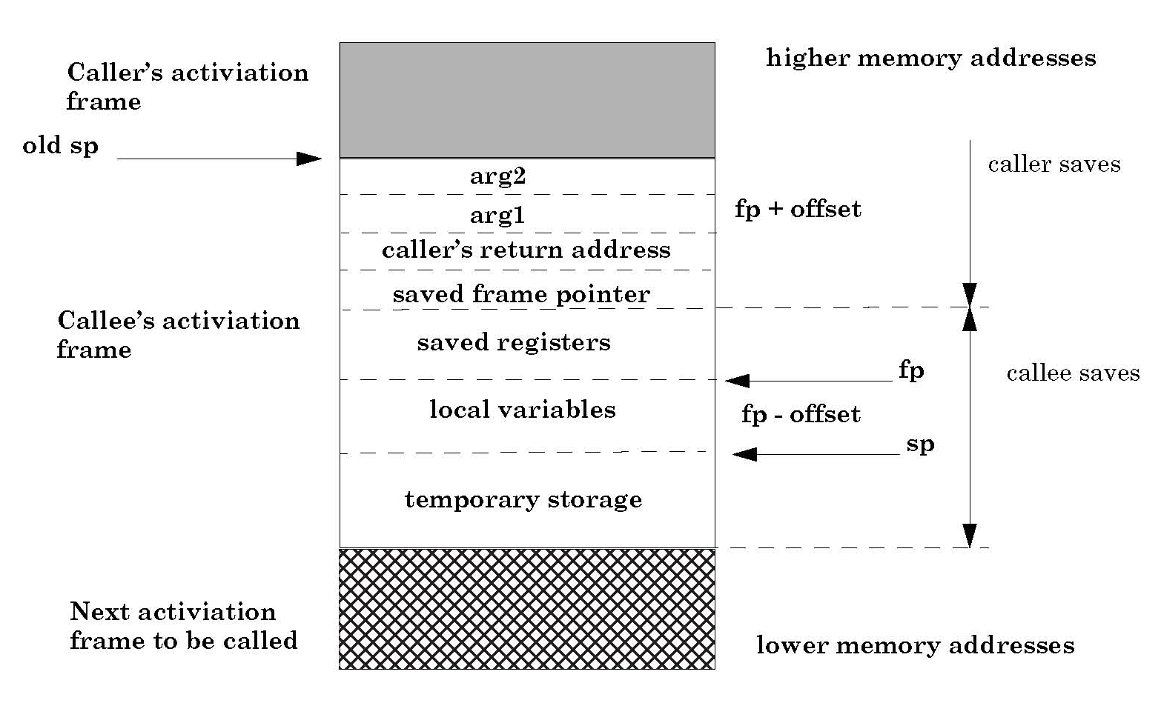
Typical x86 Activation Record
slide <number>
frame pointer
stack pointer

Slide 15
Run-Time Stack
slide <number>
Activation records are kept on the stack
  Each new call pushes an activation record
  Each completing call pops the topmost one
  Stack has all records of all active calls at any moment during execution (topmost record = most recent call)
Example: fact(3)
  Pushes one activation record on the stack, calls fact(2)
  This call pushes another record, calls fact(1)
  This call pushes another record, resulting in three activation records on the stack

Slide 16
Function Call
slide <number>
fact(k)
fact(3)
Control link
Control link
Return-result addr
Return-result addr
n
k
n
3
fact(n-1)
fact(n-1)
fact(2)
Control link
Environment pointer
Return-result addr
n
2
fact(n-1)
fact(1)
Control link
  fact(n) = if n<= 1 then 1
  else n * fact(n-1)
Return-result addr
n
1
Return address omitted; would be a pointer into code segment
fact(n-1)

Slide 17
Function Return
slide <number>
fact(3)
Control link
fact(3)
Control link
High
addresses
Return-result addr
Return-result addr
n
3
n
3
fact(n-1)
fact(n-1)
2
fact(2)
Control link
fact(2)
Control link
Return-result addr
Return-result addr
n
2
n
2
fact(n-1)
1
fact(n-1)
1
fact(1)
Control link
Return-result addr
  fact(n) = if n<=1 then 1
  else n * fact(n-1)
Low
addresses
n
1
fact(n-1)

Slide 18
Takeaway about functions
Functions are ephemeral
  They execute and go away
Pure functions are the most ephemeral of all
  They don’t leave any traces of their execution
  Good for concurrency, testing, etc.

