Slide 1
INF 212
ANALYSIS OF PROG. LANGS
INVERSION OF CONTROL
PUBLISH-SUBSCRIBE
Instructors: Crista Lopes
Copyright © Instructors.

Slide 2
Inversion of Control

Slide 3
Inversion of Control (IoC)
Usually your code calls the library code
IoC: Library code calls your code
Your code
Library code
Your code
Library code

Slide 4
IoC
Accumulation of callbacks to be called at specific times
Popularized in OOP frameworks in the 80s
Beware of posts on the Internet...
  Such words! Much confusion! Wow!
  Most describe dependency injection

Slide 5
IoC enablers
In general:
  Higher-order functions
  Objects
In statically-typed languages:
  Abstract Data Types
  Inheritance

Slide 6
Callbacks
main() {
libraryFunction(myFunction);
}
myFunction(a, b) {
...
}
libraryFunction(func) {
...
func(1, 2);
...
}
main() {
IA myObj = new A();
lib.f(myObj);
}
class A implements IA {
m(a, b) { ...}
}
interface IA {...}
class Lib {
f(IA a) {
...
a.m(1, 2);
...
}

Slide 7
What is a framework?
More than a library, a generic component or even application
Parts of it are customized by user’s code via inversion of control
Allows developers to build complete components/applications, with small customizations on deployment sites

Slide 8
Event-Driven

Slide 9
Basic Idea
1. Register for event, i.e. “call me back when it happens”
A
B
2. Event
3. Call back

Slide 10
Event-driven frameworks
Popularized by GUIs
Popularized by OOP
Typically OO, but OO not necessary
  In FP, higher-order functions are the handlers

Slide 11
Publish-Subscribe

Slide 12
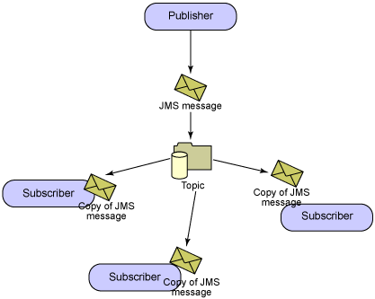
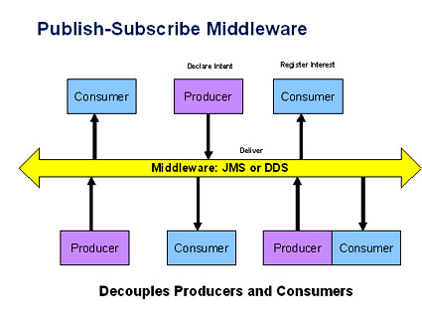
Publish Subscribe

Slide 13
Pub Sub
Producers
  Publish events
Consumers
  Register for events
Decouples components

