Slide 1
INF 212
ANALYSIS OF PROG. LANGS
ABSTRACT DATA TYPES
Instructors: Crista Lopes
Copyright © Instructors.

Slide 2
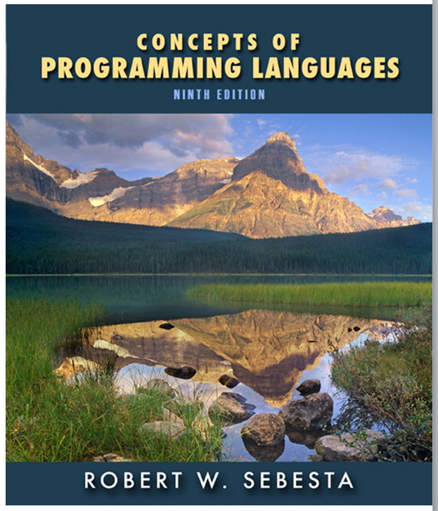
CHAPTER 11
Abstract Data Types and Encapsulation Concepts

Slide 3
Chapter 11 Topics
The Concept of Abstraction
Introduction to Data Abstraction
Design Issues for Abstract Data Types
Language Examples
Parameterized Abstract Data Types
Encapsulation Constructs
Naming Encapsulations
1-<number>
Copyright © 2009 Addison-Wesley. All rights reserved.

Slide 4
The Concept of Abstraction
An abstraction is a view or representation of an entity that includes only the most significant attributes
The concept of abstraction is fundamental in programming (and computer science)
Nearly all programming languages support process abstraction with subprograms
Nearly all programming languages designed since 1980 support data abstraction
1-<number>
Copyright © 2009 Addison-Wesley. All rights reserved.

Slide 5

Introduction to Data Abstraction
An abstract data type is a user-defined data type that satisfies the following two conditions:
  The representation of, and operations on, objects of the type are defined in a single syntactic unit
  The representation of objects of the type is hidden from the program units that use these objects, so the only operations possible are those provided in the type's definition
1-<number>
Copyright © 2009 Addison-Wesley. All rights reserved.

Slide 6
Advantages of Data Abstraction
Advantage of the first condition
  Program organization, modifiability (everything associated with a data structure is together), and separate compilation
Advantage the second condition
  Reliability--by hiding the data representations, user code cannot directly access objects of the type or depend on the representation, allowing the representation to be changed without affecting user code
1-<number>
Copyright © 2009 Addison-Wesley. All rights reserved.

Slide 7
Language Requirements for ADTs
A syntactic unit in which to encapsulate the type definition
A method of making type names and subprogram headers visible to clients, while hiding actual definitions
Some primitive operations must be built into the language processor
1-<number>
Copyright © 2009 Addison-Wesley. All rights reserved.

Slide 8
Design Issues
What is the form of the container for the interface to the type?
Can abstract types be parameterized?
What access controls are provided?
1-<number>
Copyright © 2009 Addison-Wesley. All rights reserved.

Slide 9
Language Examples: Ada
The encapsulation construct is called a package
  Specification package (the interface)
  Body package (implementation of the entities named in the specification)
Information Hiding
  The spec package has two parts, public and private
  The name of the abstract type appears in the public part of the specification package. This part may also include representations of unhidden types
  The representation of the abstract type appears in a part of the specification called the private part
    More restricted form with limited private types
    Private types have built-in operations for assignment and comparison
    Limited private types have NO built-in operations
1-<number>
Copyright © 2009 Addison-Wesley. All rights reserved.

Slide 10
Language Examples: Ada (continued)
Reasons for the public/private spec package:
1. The compiler must be able to see the representation after seeing only the spec package (it cannot see the private part)
2. Clients must see the type name, but not the representation (they also cannot see the private part)
1-<number>
Copyright © 2009 Addison-Wesley. All rights reserved.

Slide 11

An Example in Ada
package Stack_Pack is
type stack_type is limited private;
max_size: constant := 100;
function empty(stk: in stack_type) return Boolean;
procedure push(stk: in out stack_type; elem:in Integer);
procedure pop(stk: in out stack_type);
function top(stk: in stack_type) return Integer;
private -- hidden from clients
type list_type is array (1..max_size) of Integer;
type stack_type is record
list: list_type;
topsub: Integer range 0..max_size) := 0;
end record;
end Stack_Pack
1-<number>
Copyright © 2009 Addison-Wesley. All rights reserved.

Slide 12
Language Examples: C++
Based on C struct type and Simula 67 classes
The class is the encapsulation device
All of the class instances of a class share a single copy of the member functions
Each instance of a class has its own copy of the class data members
Instances can be static, stack dynamic, or heap dynamic
1-<number>
Copyright © 2009 Addison-Wesley. All rights reserved.

Slide 13
Language Examples: C++ (continued)
Information Hiding
  Private clause for hidden entities
  Public clause for interface entities
  Protected clause for inheritance (Chapter 12)
1-<number>
Copyright © 2009 Addison-Wesley. All rights reserved.

Slide 14
Language Examples: C++ (continued)
Constructors:
  Functions to initialize the data members of instances (they do not create the objects)
  May also allocate storage if part of the object is heap-dynamic
  Can include parameters to provide parameterization of the objects
  Implicitly called when an instance is created
  Can be explicitly called
  Name is the same as the class name
1-<number>
Copyright © 2009 Addison-Wesley. All rights reserved.

Slide 15
Language Examples: C++ (continued)
Destructors
  Functions to cleanup after an instance is destroyed; usually just to reclaim heap storage
  Implicitly called when the object’s lifetime ends
  Can be explicitly called
  Name is the class name, preceded by a tilde (~)
1-<number>
Copyright © 2009 Addison-Wesley. All rights reserved.

Slide 16

An Example in C++
class Stack {
private:
int *stackPtr, maxLen, topPtr;
public:
Stack() { // a constructor
stackPtr = new int [100];
maxLen = 99;
topPtr = -1;
};
~Stack () {delete [] stackPtr;};
void push (int num) {…};
void pop () {…};
int top () {…};
int empty () {…};
}
1-<number>
Copyright © 2009 Addison-Wesley. All rights reserved.

Slide 17
A Stack class header file
// Stack.h - the header file for the Stack class
#include <iostream.h>
class Stack {
private: //** These members are visible only to other
//** members and friends (see Section 11.6.4)
int *stackPtr;
int maxLen;
int topPtr;
public: //** These members are visible to clients
Stack(); //** A constructor
~Stack(); //** A destructor
void push(int);
void pop();
int top();
int empty();
}
1-<number>
Copyright © 2009 Addison-Wesley. All rights reserved.

Slide 18
The code file for Stack
// Stack.cpp - the implementation file for the Stack class
#include <iostream.h>
#include "Stack.h"
using std::cout;
Stack::Stack() { //** A constructor
stackPtr = new int [100];
maxLen = 99;
topPtr = -1;
}
Stack::~Stack() {delete [] stackPtr;}; //** A destructor
void Stack::push(int number) {
if (topPtr == maxLen)
cerr << "Error in push--stack is full\n";
else stackPtr[++topPtr] = number;
}
...
1-<number>
Copyright © 2009 Addison-Wesley. All rights reserved.

Slide 19
Language Examples: Java
Similar to C++, except:
  All user-defined types are classes
  All objects are allocated from the heap and accessed through reference variables
  Individual entities in classes have access control modifiers (private or public), rather than clauses
  Java has a second scoping mechanism, package scope, which can be used in place of friends
    All entities in all classes in a package that do not have access control modifiers are visible throughout the package
1-<number>
Copyright © 2009 Addison-Wesley. All rights reserved.

Slide 20
An Example in Java
class StackClass {
private:
private int [] *stackRef;
private int [] maxLen, topIndex;
public StackClass() { // a constructor
stackRef = new int [100];
maxLen = 99;
topPtr = -1;
};
public void push (int num) {…};
public void pop () {…};
public int top () {…};
public boolean empty () {…};
}
1-<number>
Copyright © 2009 Addison-Wesley. All rights reserved.

Slide 21
Abstract Data Types in Ruby
Encapsulation construct is the class
Local variables have “normal” names
Instance variable names begin with “at” signs (@)
Class variable names begin with two “at” signs (@@)
Instance methods have the syntax of Ruby functions (def … end)
Constructors are named initialize (only one per class)—implicitly called when new is called
  If more constructors are needed, they must have different names and they must explicitly call new
Class members can be marked private or public, with public being the default
Classes are dynamic
1-<number>
Copyright © 2009 Addison-Wesley. All rights reserved.

Slide 22
Abstract Data Types in Ruby (continued)
class StackClass {
def initialize
@stackRef = Array.new
@maxLen = 100
@topIndex = -1
end
def push(number) … end
def pop … end
def top … end
def empty … end
end
1-<number>
Copyright © 2009 Addison-Wesley. All rights reserved.

Slide 23
Summary
The concept of ADTs and their use in program design was a milestone in the development of languages
Two primary features of ADTs are the packaging of data with their associated operations and information hiding
Ada provides packages that simulate ADTs
C++ data abstraction is provided by classes
Java’s data abstraction is similar to C++
Ada, C++, Java 5.0, and C# 2005 support parameterized ADTs
C++, C#, Java, Ada, and Ruby provide naming encapsulations
1-<number>
Copyright © 2009 Addison-Wesley. All rights reserved.

Slide 24
Reset

Slide 25
What’s an Abstract Data Type?
From http://stackoverflow.com/tags/abstract-data-type/info:
“An abstract data type (ADT) is a specification for a certain class of data structures that have similar behavior; or for certain data types of one or more programming languages that have similar semantics. An abstract data type is defined indirectly, only by the operations that may be performed on it and by mathematical constraints on the effects of those operations.”

Slide 26
ABSTRACT
Does not specify how the data type is implemented
1 ADT → multiple implementations

Slide 27
CONCRETE
Has 1 implementation

Slide 28
What about subtyping?
class A extends B {...}
Doesn’t make A abstract
Regular subtyping relation, see type systems

Slide 29
Specifying ADTs in Java
public interface Queue<E> extends Collection<E> {
boolean add(E e);
E element();
boolean offer(E e);
E peek();
E poll();
E remove();
}

Slide 30
Implementing ADTs in Java
public class LinkedList<E> implements Queue<E> {
boolean add(E e) {…}
E element() {…}
boolean offer(E e) {…}
E peek() {…}
E poll() {…}
E remove() {…}
}
public class PriorityQueue<E> implements Queue<E> {
boolean add(E e) {…}
E element();
boolean offer(E e) {…}
E peek() {…}
E poll() {…}
E remove() {…}
}

Slide 31
Are Java classes ADTs?

Slide 32
Are Java classes ADTs?
No, unless they are marked abstract
(yes, abstract Java classes are ADTs, like interfaces)

Slide 33
Are C++ classes ADTs?

Slide 34
Are C++ classes ADTs?
No, unless they are marked abstract

Slide 35
Are Python classes ADTs?
No, unless they are marked abstract.

Slide 36
Are classes ADTs?
No, unless they are marked abstract.

Slide 37
Abstract Data Types
What part of the word ABSTRACT is unclear?!?
abstract = no concrete implementation

