Slide 1
INF 212
ANALYSIS OF PROG. LANGS
ADVERSITY
Instructors: Crista Lopes
Copyright © Instructors.

Slide 2
random quotes. just because
We have forty million reasons for failure, but not a single excuse.
It's fine to celebrate success but it is more important to heed the lessons of failure.
I can accept failure, everyone fails at something. But I can't accept not trying.
I've come to believe that all my past failure and frustration were actually laying the
foundation for the understandings that have created the new level of living I now enjoy.
My great concern is not whether you have failed, but whether you are content with
your failure.
Success represents the 1% of your work which results from the 99% that is called failure.
Failure is always an option.

Slide 3
My quote
Failure happens!

Slide 4
Approaches to failure
Let it fail
  Good in development: understand failure mode
Defend against the possible and the impossible
  Good in production. Detect and...
    Correct?
    Ignore?
    Report?
    Pass up?
    Stop?
Prevent
  Ideal(ist)

Slide 5
Obliviousness
Failure is an option!
  Especially when you learn from it to avoid it in the future
Obliviousness exposes problems
  Better than hiding them
  Shows you failure conditions you might not have considered
Fix as you go, during development
Avoid in production

Slide 6
Defensive
Detect every possible failure
Paranoid: detect unlikely failures too

Slide 7
Reaction to failures
Detect and correct (constructivist)
Detect and ignore (lazy)
Detect and report (tantrum)
Detect and pass up the stack (passive-aggressive)
Recover vs. Stop immediately

Slide 8
Overreaction is bad
Integer one = 1;
Integer two = one + one;
if (two > one) {
...do stuff...
}

Slide 9
Overreaction is bad
public class Person {
private String name = null;
public void setName(String name) { this.name = name; }
public String getName() { return name; }
}
public Person newPerson(String name) {
Person person = new Person();
if (name != null) {
person.setName(name);
}
return person;
}

Slide 10
Lazyness is bad
void addFriendToList(List<Friend> friends, Friend newFriend) {
if (friends != null && newFriend != null) {
friends.add(newFriend);
}
}
bad
void addFriendToList(List<Friend> friends, Friend newFriend) {
friends.add(newFriend);
}
better
void addFriendToList(List<Friend> friends, Friend newFriend) {
if (friends != null && newFriend != null) {
friends.add(newFriend);
}
else throw new Exception(“...”);
}
better

Slide 11
Lazyness is bad
public List<Friend> findFavoriteFriends(Person person) {
List<Friend> favoriteFriends = new ArrayList<Friend>();
if (person != null) {
List<Friend> friends = person.getFriends();
if (friends != null) {
for (Friend friend : friends) {
if (friend != null) {
if (friend.isFavorite()) {
favoriteFriends.add(friend);
}
}
}
}
}
return favoriteFriends;
}
bad

Slide 12
Spectrum of reactions
Recover: do you have a good guess for reasonable state?
Report & proceed
Pass up
Fail fast: avoid corruptions by stopping immediately after a failure occurs

Slide 13
Recover
public class Person {
private String name = “Unknown User”;
public void setName(String name) { this.name = name; }
public String getName() { return name; }
}
public Person(String name) {
if (name != null) {
person.setName(name);
}
// otherwise, use default
return person;
}

Slide 14
Report & Proceed
public class Person {
private String name = “Unknown User”;
public void setName(String name) { this.name = name; }
public String getName() { return name; }
}
public Person(String name) {
if (name == null) {
log.Warn(“Person constructor given null name arg”);
}
person.setName(name);
// otherwise, use default
return person;
}

Slide 15
Pass up
public class Person {
private String name = “Unknown User”;
public void setName(String name) { this.name = name; }
public String getName() { return name; }
}
public Person(String name) {
if (name == null) {
raise new Exception(“null name”);
}
person.setName(name);
// otherwise, use default
return person;
}

Slide 16
Fail fast
public class Person {
private String name = “Unknown User”;
public void setName(String name) { this.name = name; }
public String getName() { return name; }
}
public Person(String name) {
if (name == null) {
log.Warn(“Person constructor given null name arg”);
System.exit(1);
}
person.setName(name);
// otherwise, use default
return person;
}

Slide 17
Preventing failures
Before the program runs:
  Quarantine vulnerable code
  Type checking (next lecture)
  Test (won’t be covered)

Slide 18
Vulnerable code
Anything that deals with IO
  From users
  From network
  From database

Slide 19
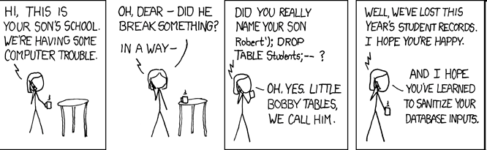
Exploits of a Mom
http://xkcd.com/327/

Slide 20
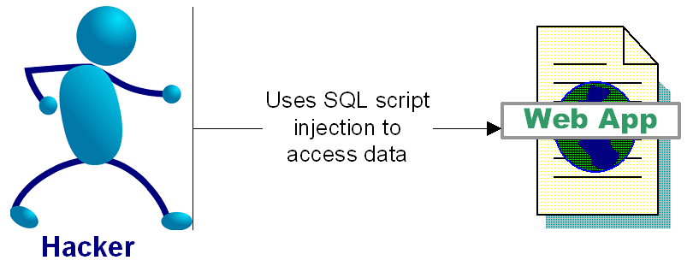
SQL Injection Attacks
“SQL injection is a security vulnerability that occurs in the database layer of an application. Its source is the incorrect escaping of dynamically-generated string literals embedded in SQL statements. “ (Wikipedia)

Slide 21
Impact of SQL Injection - Dangerous
At best: you can leak information
Depending on your configuration, a hacker can
  Delete, alter or create data
  Grant direct access to the hacker
  Escalate privileges and even take over the OS

Slide 22
SQL Injection Attacks
Login Example Attack
  Text in blue is your SQL code, Text in orange is the hacker input, black text is your application code
  Login: Password:
Dynamically Build SQL String performing authentication:
  “SELECT * FROM users WHERE login = ‘” + userName + “’ and password= ‘” + password + “’”;
Hacker logs in as: ‘ or ‘’ = ‘’; --
  SELECT * FROM users WHERE login = ‘’ or ‘’ = ‘’; --‘ and password=‘’

Slide 23
More Dangerous SQL Injection Attacks
Hacker creates a Windows Account:
  SELECT * FROM users WHERE login = ‘’; exec master..xp_cmdshell 'net users username password /add';--’ and password= ’’
And then adds himself as an administrator:
  SELECT * FROM users WHERE login = ‘'; exec master..xp_cmdshell 'net localgroup Administrators username /add';--’ and password= ‘’
SQL Injection examples are outlined in:
  http://www.spidynamics.com/papers/SQLInjectionWhitePaper.pdf
  http://www.unixwiz.net/techtips/sql-injection.html

Slide 24
Preventing SQL injection
Use Prepared Statements (aka Parameterized Queries)
  $id=1234
  “select * from accounts where id = “ + $id
  vs
  “select * from accounts where id =1234”
Validate input
  Strong typing
    If the id parameter is a number, try parsing it into an integer
  Business logic validation
Escape questionable characters (ticks, --, semi-colon, brackets, etc.)

Slide 25
More than SQL
“Injection Flaw” is a blanket term
SQL Injection is most prevalent
Other forms:
  XPath Injection
  Command Injection
  LDAP (Lightweight Directory Access Protocol) Injection
  DOM (Document Object Model) Injection
  JSON (Javascript Object Notation) Injection
  Log Spoofing
  On and on and on…

Slide 26
IO Monad
A explicit reminder that you can’t trust IO
“Promote” IO-bound functions to higher-order
  They don’t run until you make an effort

