Slide 1
INF 212
ANALYSIS OF PROG. LANGS
FINAL LECTURE
Instructors: Crista Lopes
Copyright © Instructors.

Slide 2
Programming Languages
Universe of design ideas
Crazy concepts often became mainstream
  E.g. garbage collection, recursion, closures, …
  (other crazy concepts were just crazy)
Language design concepts often pop out into systems design concepts
  E.g. Map-Reduce, stateless – REST, …

Slide 3
Course Objectives
Understand concepts in PLs
  100’s of PLs, all look different ➔ they aren’t that different
  Appreciate history, diversity of ideas in PLs
  Be prepared for new languages
  See beyond hype & sales pitches
Learn some important facts about existing language systems and techniques
Learn and think critically about tradeoffs

Slide 4
Where this course stands
Program Design
Programming Language Design
This course
Compilers/Interpreters
We will cover how PLs influence program design and vice-versa
Not covered: implementation of PLs. Recommended:
CS 241 Advanced Compiler Construction
EECS 221 Program Analysis

Slide 5
The Course
Historical Languages
Basics of PLs
Function composition
Objects and object interactions
Reflection and metaprogramming
Adversity: dealing with the outside world
Data-centric concepts
Concurrency
Interactivity

Slide 6
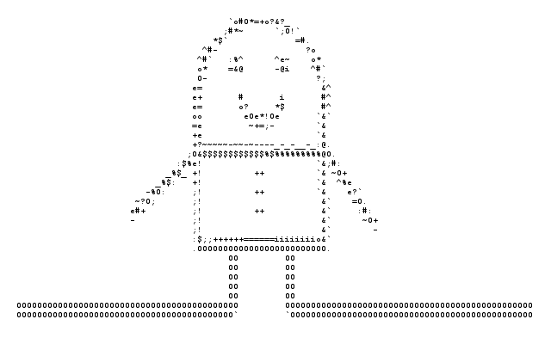
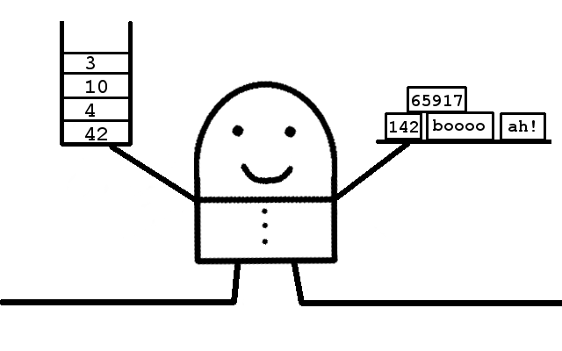
Historical concepts
Good Old Times
Flat memory
No names
Go Forth
Stack machine

Slide 7

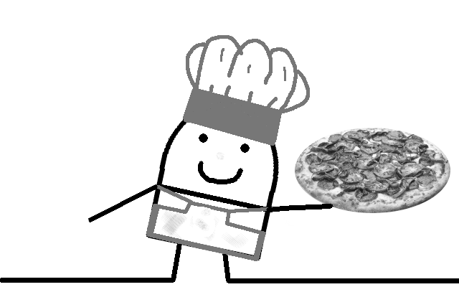
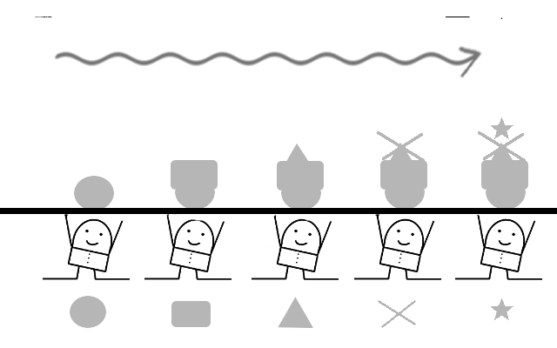

Basic Concepts
Monolithic
No definition of abstractions
No use of abstractions
Cookbook
Shared state
Steps
Candy Factory
No shared state
Pipeline of functions
Code Golf
As few LOCs as possible

Slide 8
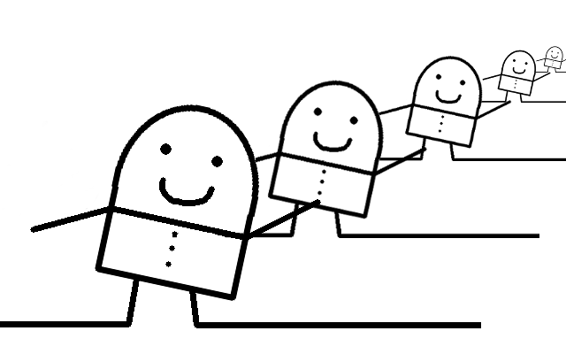
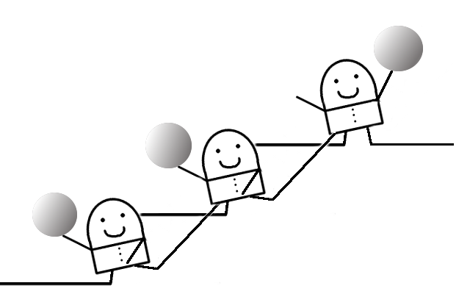
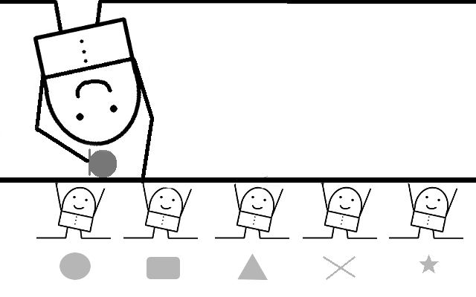
Function Composition Concepts
Infinite mirror
Induction
Kick Teammate Forward
Extra function parameter
That function called at the end
The One
Universal object wraps around values
Chains functions via bind

Slide 9
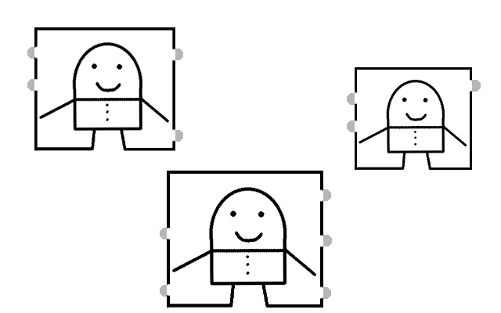
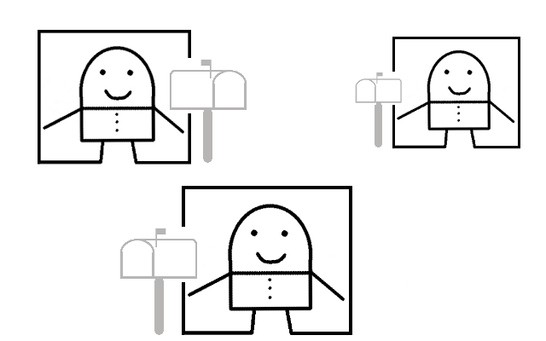
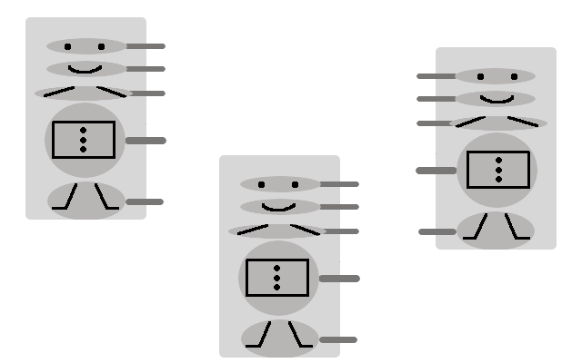
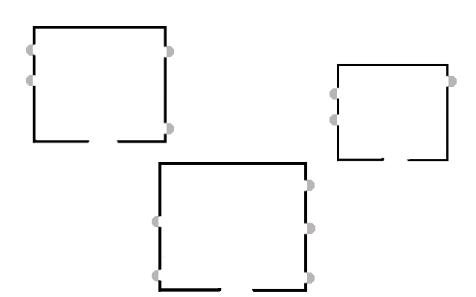
Objects and...
Things
Capsules of data
exposing procedures
Letterbox
Single procedure:
receive message
Closed maps
Hashes mapping keys
to data or procedures
ADTs
Abstract interfaces
to things

Slide 10
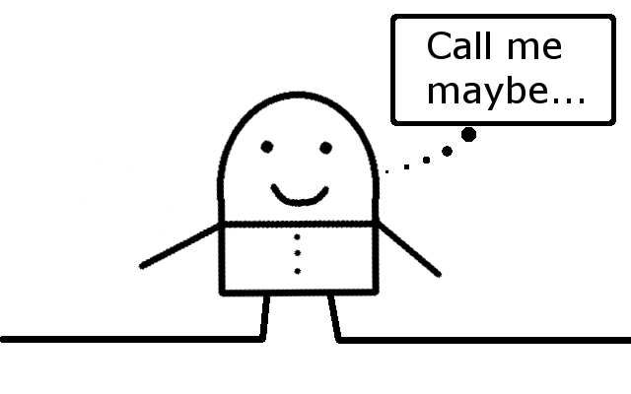
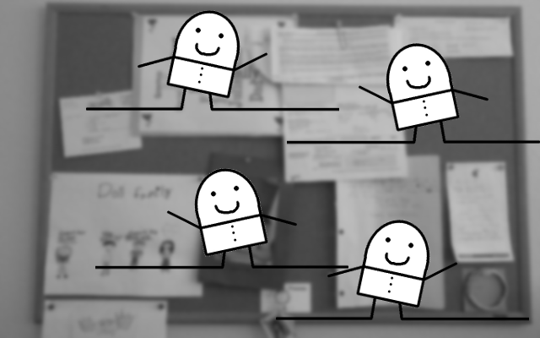
...Object Interactions
Hollywood
“Don’t call me, I’ll call you”
Bulletin Board
Publish events
Subscribe to events

Slide 11

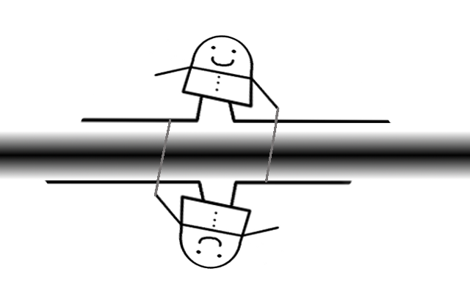
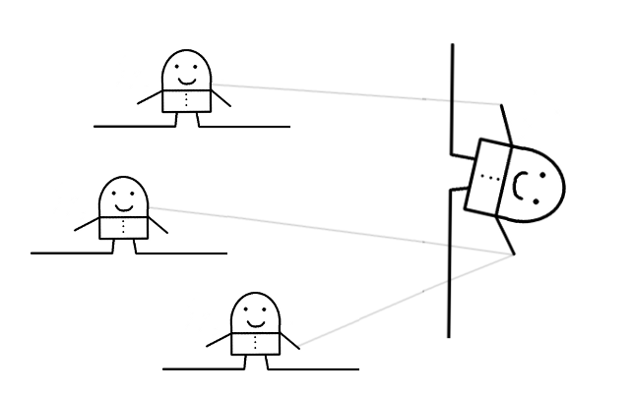
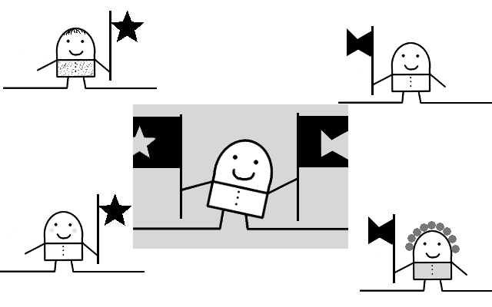
Reflection and Metaprogramming
Introspection
The program sees itself
Reflection
The program changes itself
Asides
A separate piece of code
affects base functions
Plugins
Alternatives loaded
dynamically

Slide 12
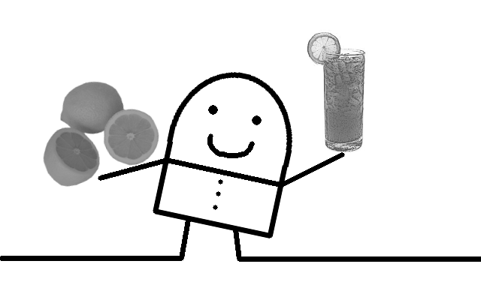
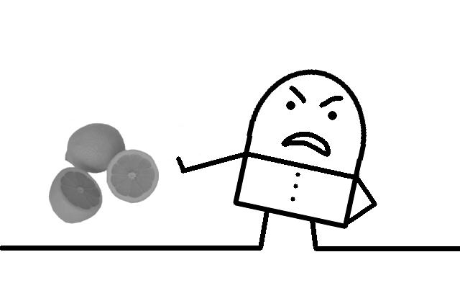
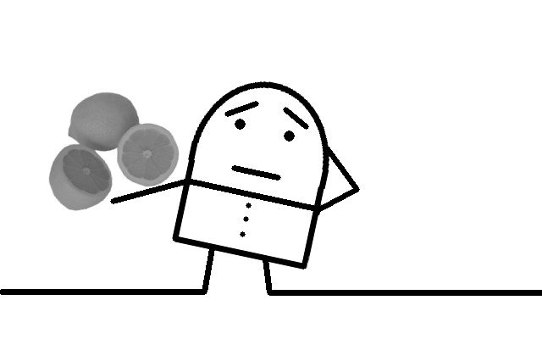
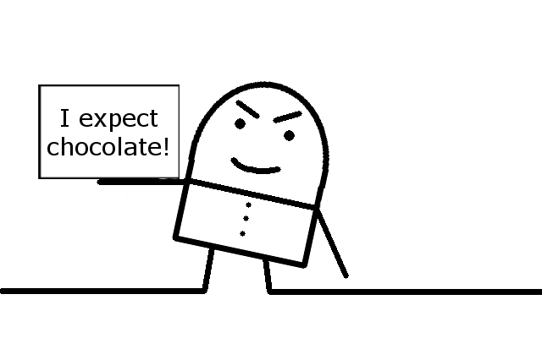
Adversity Concepts
Constructivist
Just fix it
Hope for the best
Tantrum
NO GO!
Passive-Aggressive
No go, but
I don’t want to deal with it
Declared intentions
Good types or else

Slide 13
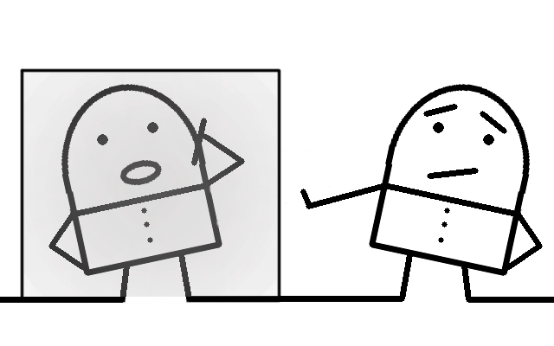
Adversity Concepts
Quarantine
IO: eeeeewww!
Isolate IO functions

Slide 14
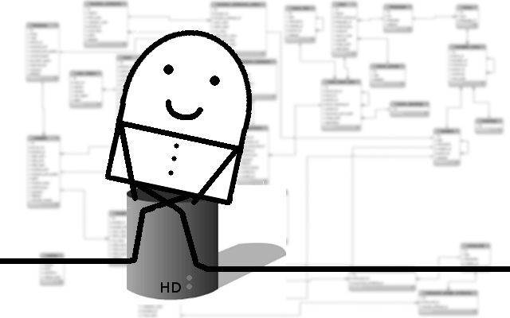
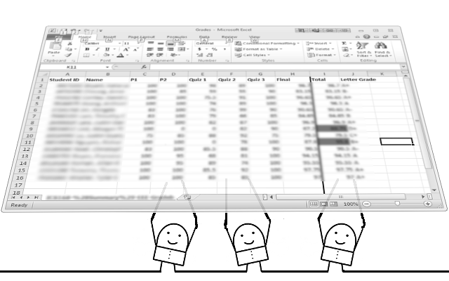
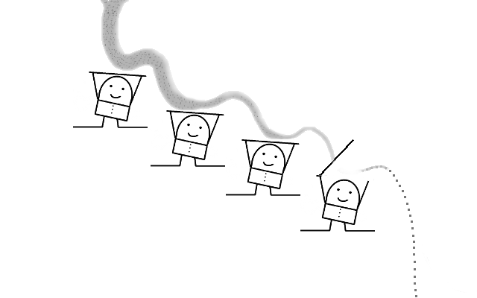
Data-Centric Concepts
Persistent Tables
Relational data
Queries over data
Spreadsheet
Data with associated
update functions
Functions invoked when
data changes
Lazy rivers
Iterators
Generators

Slide 15
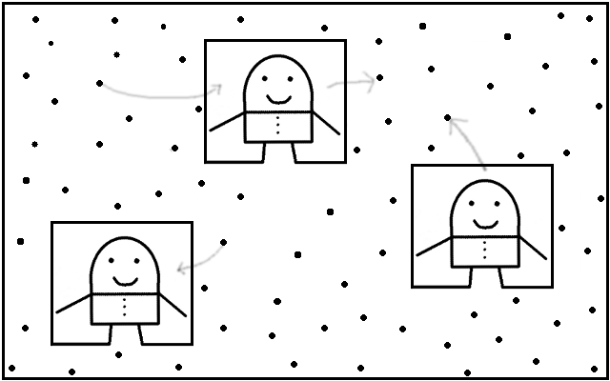
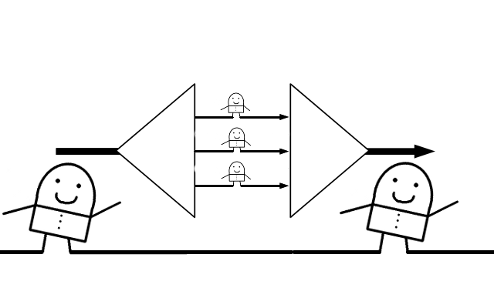
Concurrency Concepts
Free Agents
Things with threads
Message passing
Thread-safe queues
Dataspaces
Thread-safe data spaces
Workers get/put data in them
Map Reduce
Data is partitioned in independent chunks
Chunks given to workers (mappers)
Partial results given to workers (reducers)

Slide 16
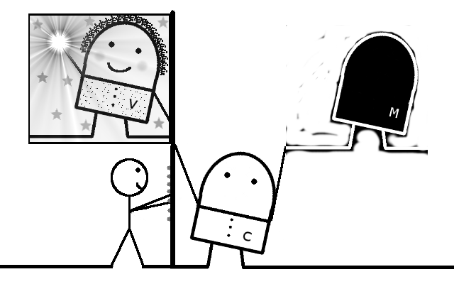
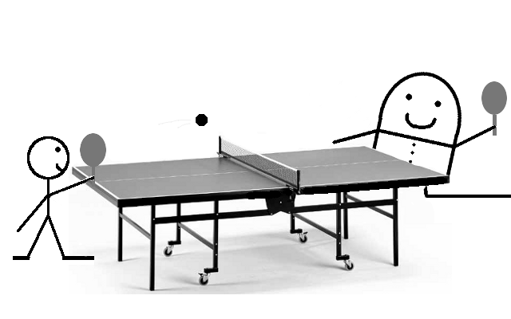
Interactivity Concepts
Trinity Model/View/Controller
3 categories of code elements
RESTful / Forgetful
Request-Response interaction
Resources
Uniform interfaces
Hypermedia as engine of app state

Slide 17
What’s worth studying?
Dominant languages and paradigms
  Leading languages for general systems programming
  Explosion of programming technologies for the web
Important implementation ideas
Performance challenges
Design tradeoffs
Concepts that research community is exploring for new programming languages and tools
  E.g. Multi-core

