Slide 1
INF 212
ANALYSIS OF PROG. LANGS
FUNCTION OBJECTS
Instructors: Crista Lopes
Copyright © Instructors.

Slide 2
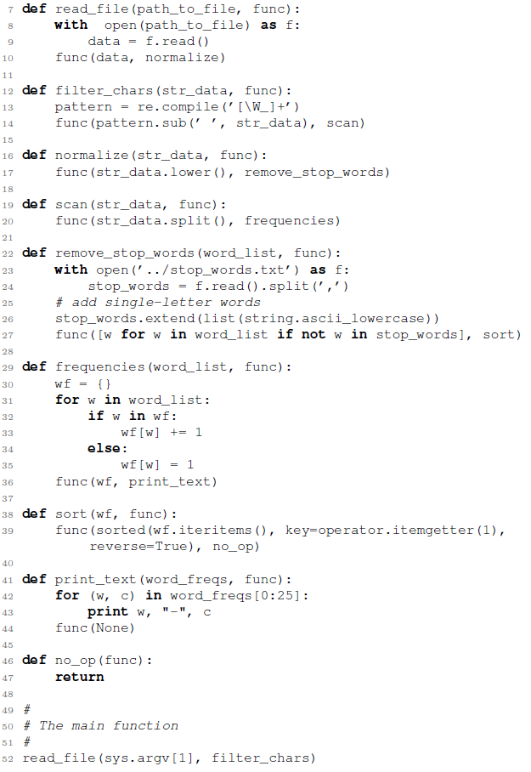
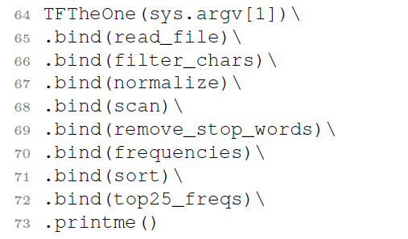
How to model functions as data in OOP?

Slide 3
First attempt
class ReadFile {
String readFile(string arg)
{
string contents = // Code for reading a file
return contents;
}
}
and then
new ReadFile().readFile(...);
or
ReadFile rf = new ReadFile();
someObj.meth(rf);

Slide 4
First attempt
class FilterChars
{
String filter(String arg)
{
string fcontents = // Code for filtering
return fcontents;
}
}
same

Slide 5
Problem: no commonality between function classes
class TFTheOne
{
private Object value;
TFTheOne(Object v) { value = v; }
public TFTheOne bind(??? func) {
value = func.???(value);
return this;
}
public printme() {
System.out.println(value);
}
}
Object?
➔ Giant switch statement

Slide 6
Problem: no commonality between function classes
class TFTheOne
{
private Object value;
TFTheOne(Object v) { value = v; }
public TFTheOne bind(Object func) {
if (func instanceof ReadFile)
value = func.ReadFile(value);
else if (func instanceof FilterChars)
value = func.FilterChars(value);
else if ...
return this;
}
}
➔ Giant switch statement

Slide 7
A Function Object Interface
interface IFunction
{
Object call(Object arg);
}
More variations are possible...

Slide 8
The One – Function examples
class ReadFile implements IFunction
{
Object call(Object arg)
{
string fileName = (String)arg;
string contents = // Code for reading a file
return contents;
}
}
class FilterChars implements IFunction
{
Object call(Object arg)
{
string data = (String)arg;
string fcontents = // Code for filtering
return fcontents;
}
}

Slide 9
The One
class TFTheOne
{
private Object value;
TFTheOne(Object v) { value = v; }
public TFTheOne bind(IFunction func) {
value = func.call(value);
return this;
}
public printme() {
System.out.println(value);
}
}
Beautifully
generic!

Slide 10
The One – Main
public static void main(String[] args) {
TFTheOne one = new TFTheOne(args[...]);
one.bind(new ReadFile()).bind(new FilterChars()).bind ...
}

Slide 11
Kick Forward (CPS)
interface IFunction
{
void call(Object arg, IFunction func);
}
and then
class ReadFile implements IFunction
{
void call(Object arg, IFunction func)
{
string fileName = (String)arg;
string contents = // Code for reading a file
func(contents, new FilterChars());
}
}

Slide 12
Functions as Objects
Define a clean “function” interface
Define one class per function, each implementing the interface
When you need to pass the function, instantiate the class and pass that object

Slide 13
More generally
Objects are capsules of procedures/functions
  with or without state
Functions as data in pure OOP → function objects
If you need to manipulate them independent of their type → use interface / super

