Slide 1
INF 212
ANALYSIS OF PROG. LANGS
ELEMENTS OF IMPERATIVE PROGRAMMING STYLE
Instructors: Crista Lopes
Copyright © Instructors.

Slide 2
Objectives
Level up on things that you may already know…
  Machine model of imperative programs
  Structured vs. unstructured control flow
  Assignment
  Variables and names
  Lexical scope and blocks
  Expressions and statements
…so to understand existing languages better

Slide 3
Imperative Programming
slide <number>
Oldest and most popular paradigm
  Fortran, Algol, C, Java …
Mirrors computer architecture
  In a von Neumann machine, memory holds instructions and data
Control-flow statements
  Conditional and unconditional (GO TO) branches, loops
Key operation: assignment
  Side effect: updating state (i.e., memory) of the machine

Slide 4
Simplified Machine Model
slide <number>
Registers
Code
Data
Stack
Program counter
Environment pointer
Heap

Slide 5
Memory Management
slide <number>
Registers, Code segment, Program counter
  Ignore registers (for our purposes) and details of instruction set
Data segment
  Stack contains data related to block entry/exit
  Heap contains data of varying lifetime
  Environment pointer points to current stack position
    Block entry: add new activation record to stack
    Block exit: remove most recent activation record

Slide 6
Control Flow
slide <number>
Control flow in imperative languages is most often designed to be sequential
  Instructions executed in order they are written
  Some also support concurrent execution (Java)
But…

Slide 7
Goto in C
# include <stdio.h>
int main(){
float num,average,sum;
int i,n;
printf("Maximum no. of inputs: ");
scanf("%d",&n);
for(i=1;i<=n;++i){
printf("Enter n%d: ",i);
scanf("%f",&num);
if(num<0.0)
goto jump;
sum=sum+num;
}
jump:
average=sum/(i-1);
printf("Average: %.2f",average);
return 0;
}

Slide 8
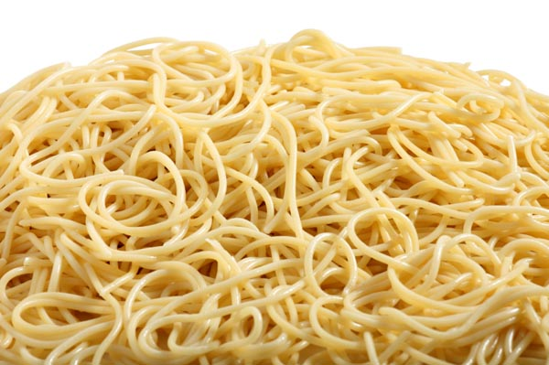
Before C: Goto in Fortran
C AREA OF A TRIANGLE - HERON'S FORMULA
C INPUT - CARD READER UNIT 5, INTEGER INPUT, ONE BLANK CARD FOR END-OF-DATA
C OUTPUT - LINE PRINTER UNIT 6, REAL OUTPUT
C INPUT ERROR DISPAY ERROR MESSAGE ON OUTPUT
501 FORMAT(3I5)
601 FORMAT(4H A= ,I5,5H B= ,I5,5H C= ,I5,8H AREA= ,F10.2,12HSQUARE UNITS)
602 FORMAT(10HNORMAL END)
603 FORMAT(23HINPUT ERROR, ZERO VALUE)
INTEGER A,B,C
10 READ(5,501) A,B,C
IF(A.EQ.0 .AND. B.EQ.0 .AND. C.EQ.0) GO TO 50
IF(A.EQ.0 .OR. B.EQ.0 .OR. C.EQ.0) GO TO 90
S = (A + B + C) / 2.0
AREA = SQRT( S * (S - A) * (S - B) * (S - C))
WRITE(6,601) A,B,C,AREA
GO TO 10
50 WRITE(6,602)
STOP
90 WRITE(6,603)
STOP
END

Slide 9
Structured Control Flow
slide <number>
Program is structured if control flow is evident from syntactic (static) structure of program text
  Hope: programmers can reason about dynamic execution of a program by just analysing program text
  Eliminate complexity by creating language constructs for common control-flow patterns
    Iteration, selection, procedures/functions

Slide 10
Historical Debate
slide <number>
Dijkstra, “GO TO Statement Considered Harmful”
  Letter to Editor, Comm. ACM, March 1968
  Linked from the course website
Knuth, “Structured Prog. with Go To Statements”
  You can use goto, but do so in structured way …
Continued discussion
  Welch, “GOTO (Considered Harmful)^{n}, n is Odd”
General questions
  Do syntactic rules force good programming style?
  Can they help?

Slide 11
Structured Programming
slide <number>
Standard constructs that structure jumps
  if … then … else … end
  while … do … end
  for … { … }
  case …
Group code in logical blocks
Avoid explicit jumps (except function return)
Cannot jump into the middle of a block or function body

Slide 12
Cyclomatic Complexity
A metric to measure the amount of control flow paths in a block of code
CC = E - N + 2P
where
E = number of edges
N = number of nodes
P = number of exit nodes
Less is better

Slide 13
Cyclomatic Complexity
Rule of thumb:
  CC < 10 : ok
  10 < CC < 20 : moderate risk
  20 < CC < 50 : high risk
  CC > 50 : extremely high risk
Less is better

Slide 14
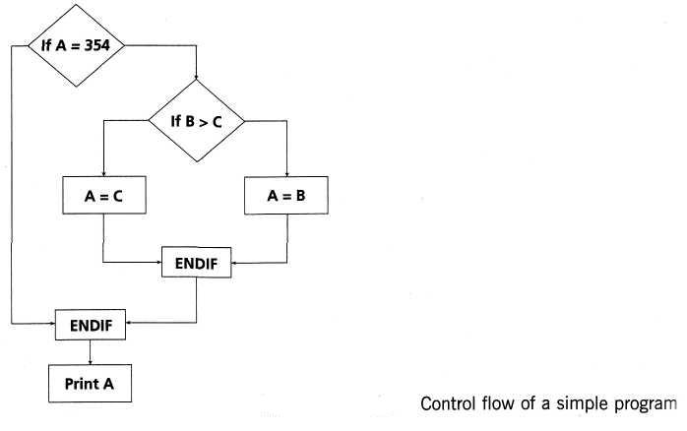
CC example
IF A = 354 THEN
IF B > C THEN
A = B
ELSE
A= C
ENDIF
ENDIF
Print A
CC = 8 – 7 + 2*1 = 3

Slide 15
Another example
insertion_procedure (int a[], int p [], int N)
{
int i,j,k;
for (i=0; i<=N; i++)
p[i] = i;
for (i=2; i<=N; i++) {
k = p[i];
j = 1;
while (a[p[j-1]] > a[k]) {
p[j] = p[j-1];
j--;
}
p[j] = k;
}
}
Source: stackoverflow

Slide 16
Another example
insertion_procedure (int a[], int p [], int N)
{
(1) int i,j,k;
(2) for ((2a)i=0; (2b)i<=N; (2c)i++)
(3) p[i] = i;
(4) for ((4a)i=2; (4b)i<=N; (4c)i++)
{
(5) k=p[i];j=1;
(6) while (a[p[j-1]] > a[k]) {
(7) p[j] = p[j-1];
(8) j--
}
(9) p[j] = k;
}
}
Source: stackoverflow

Slide 17
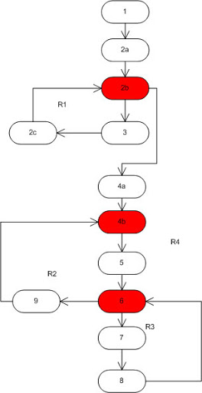
Another example
CC = 4
Source: stackoverflow

Slide 18
Assignment (you thought you knew)
x = 3
x = y+1
x = x+1
Informal:
“Set x to 3”
“Set x to the value of y plus 1”
“Add 1 to x”
Let’s look at some other examples

Slide 19
Assignment (you thought you knew)
i = (a>b) ? j : k
m[i] = m[(a>b)? j : k]
m[(a>b) ? j : k] = m[i]
Exp₁ = Exp₂ ?
Assume x is 5 x = x+1 means 5 = 6 ????
What exactly does assignment mean?

Slide 20
Assignment (you thought you knew)
x = x+1
Exp₁ = Exp₂ ?
Left side
Not quite!
Right side
Location-value
(L-value)
Regular-value
(R-value)

Slide 21
Assignment
slide <number>
On the RHS of an assignment, use the variable’s R-value; on the LHS, use its L-value
  Example: x = x+1
  Meaning: “get R-value of x, add 1, store the result into the L-value of x”
An expression that does not have an L-value cannot appear on the LHS of an assignment
  What expressions don’t have l-values?
    Examples: 1=x+1, x++ (why?)
    What about a[1] = x+1, where a is an array? Why?

Slide 22
Locations and Values
slide <number>
When a name is used, it is bound to some memory location and becomes its identifier
  Location could be in global, heap, or stack storage
L-value: memory location (address)
R-value: value stored at the memory location identified by l-value
Assignment: A (target) = B (expression)
  Destructive update: overwrites the memory location identified by A with a value of expression B
    What if a variable appears on both sides of assignment?

Slide 23
l-Values and r-Values (1)
slide <number>
Any expression or assignment statement in an imperative language can be understood in terms of l-values and r-values of variables involved
  In C, also helps with complex pointer dereferencing and pointer arithmetic
Literal constants
  Have r-values, but not l-values
Variables
  Have both r-values and l-values
  Example: x=x*y means “compute rval(x)*rval(y) and store it in lval(x)”

Slide 24
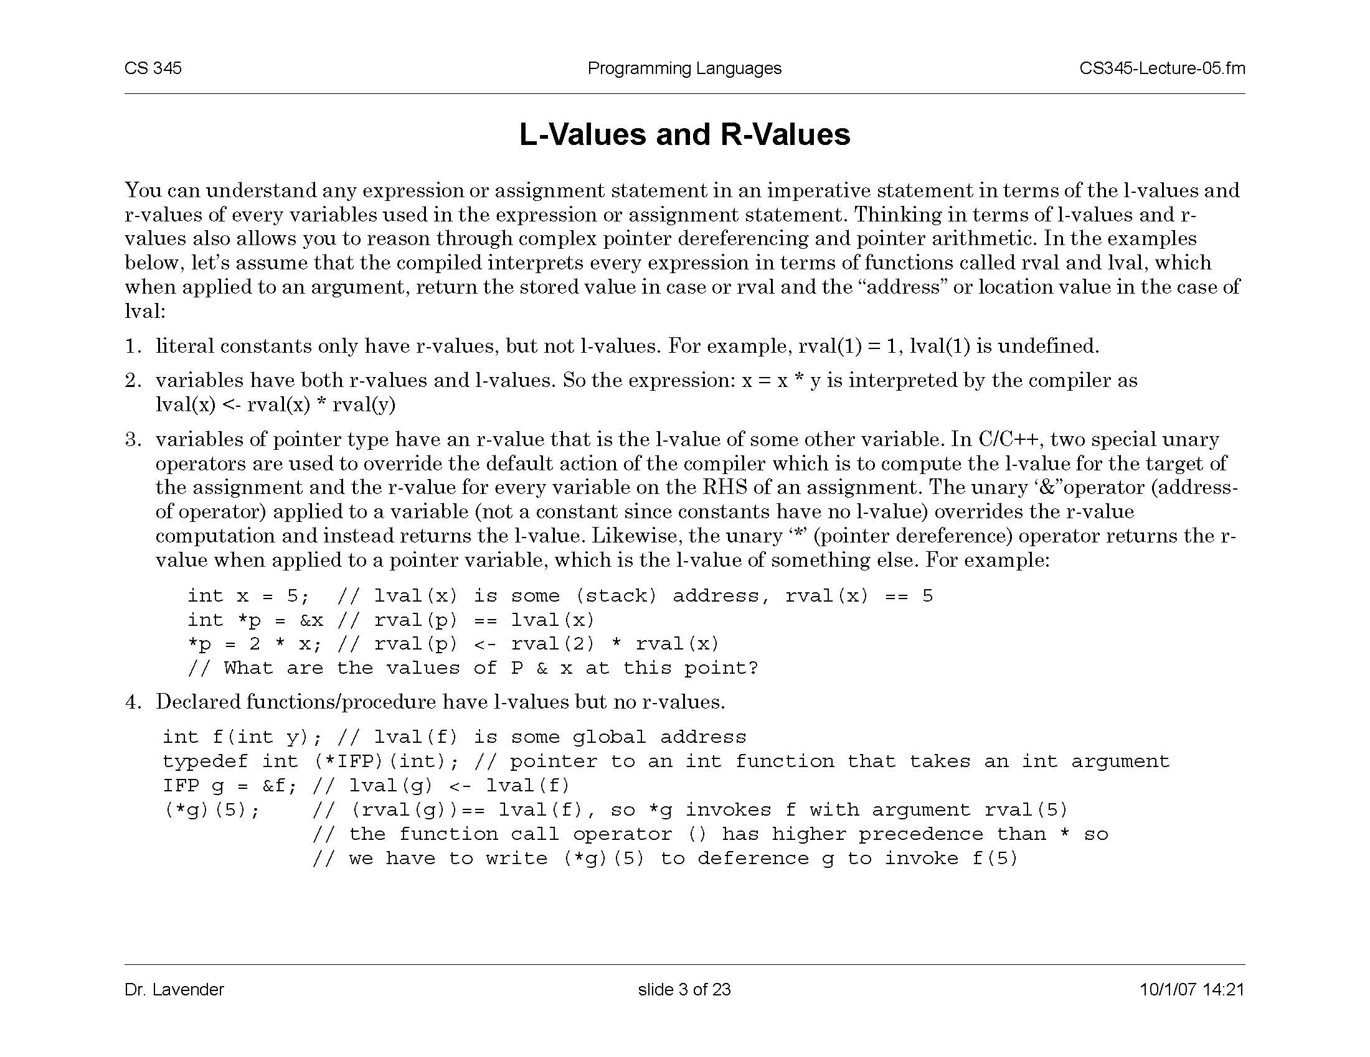
l-Values and r-Values (2)
slide <number>
Pointer variables
  Their r-values are l-values of another variable
    Intuition: the value of a pointer is an address
Overriding r-value and l-value computation in C
  &x always returns l-value of x
  *p always return r-value of p
    If p is a pointer, this is an l-value of another variable
What are the values of
p and x at this point?

Slide 25
Copy vs. Reference Semantics
slide <number>
Copy semantics: expression is evaluated to a value, which is copied to the target
  Used by imperative languages
Reference semantics: expression is evaluated to an object, whose pointer is copied to the target
  Used by object-oriented languages

Slide 26
Copy vs. Reference Semantics
slide <number>
In Java/C/C++:
x = 1;
x = 3;
In Java/C++/Python/Ruby:
x = new Foo;
x = new FooBar;
In Python/Ruby:
x = 1;
x = 3;
Copy semantics
Reference semantics
Reference semantics
foo
1
x
1 then 3
x
x
foobar
3
Overwrites the r-value of x
from int 1 to int 3
Overwrites the r-value of x too,
but that value is a “pointer”
Overwrites the r-value of x too,
but that value is a “pointer”

Slide 27
l-Values and r-Values (3)
slide <number>
Declared functions and procedures
  Have l-values, but no r-values

Slide 28
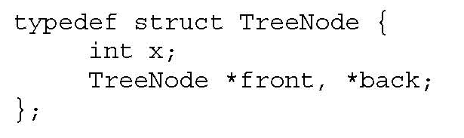
Typed Variable Declarations
slide <number>
Typed variable declarations restrict the values that a variable may assume during program execution
  Built-in types (int, char …) or user-defined
  Initialization: Java integers to 0. What about C?
Variable size
  How much space needed to hold values of this variable?
    C on a 32-bit machine: sizeof(char) = 1 byte, sizeof(short) = 2 bytes, sizeof(int) = 4 bytes, sizeof(char*) = 4 bytes (why?)
    What about this user-defined datatype:

Slide 29
Variables without declarations (names)
Names that bind to values
Names don’t have types; values do
Python, Perl, Ruby, ...
x = 1
x = “hello”

Slide 30
Block-Structured Languages
slide <number>
Nested blocks with local variables
  { int x = 2;
  { int y = 3;
  x = y+2;
  }
  }
  Storage management
    Enter block: allocate space for variables
    Exit block: some or all space may be deallocated
new variables declared in nested blocks
outer block
inner block
local variable
global variable

Slide 31
Blocks in Common Languages
slide <number>
Examples
  C, JavaScript * { … }
  Algol begin … end
  ML let … in … end
Two forms of blocks
  Inline blocks
  Blocks associated with functions or procedures
    We’ll talk about these later
* JavaScript functions provides blocks

Slide 32
Scope and Lifetime
Scope
  Region of program text where declaration is visible
Lifetime
  Period of time when location is allocated to program
  { int x = … ;
  { int y = … ;
  { int x = … ;
  ….
  };
  };
  };
  Inner declaration of x hides outer one
  (“hole in scope”)
  Lifetime of outer x includes time when inner block is executed
  Lifetime ≠ scope
slide <number>

Slide 33
Inline Blocks
Activation record
  Data structure stored on run-time stack
  Contains space for local variables
  { int x=0;
  int y=x+1;
  { int z=(x+y)*(x-y);
  };
  };
  Push record with space for x, y
  Set values of x, y
  Push record for inner block
  Set value of z
  Pop record for inner block
  Pop record for outer block
May need space for variables and intermediate results like (x+y), (x-y)
slide <number>

Slide 34
Activation Record For Inline Block
Control link
Control link
  Pointer to previous record on stack
Push record on stack
  Set new control link to point to old env ptr
  Set env ptr to new record
Pop record off stack
  Follow control link of current record to reset environment pointer
Local variables
Intermediate results
Control link
Local variables
Intermediate results
Environment pointer
slide <number>
In practice, can be optimized away

Slide 35
Example
  { int x=0;
  int y=x+1;
  { int z=(x+y)*(x-y);
  };
  };
Control link
x
0
y
1
Control link
  Push record with space for x, y
  Set values of x, y
  Push record for inner block
  Set value of z
  Pop record for inner block
  Pop record for outer block
z
-1
x+y
1
x-y
-1
Environment pointer
slide <number>

Slide 36
Expressions vs. Statements
Expressions: mathematical expressions
  x
  a*(b+c)+d
  No side effects
  Evaluate to a value (pleonasm!)
Statements (or commands)
  x = expr
  writeline(f, line)
  Affect/interact with the world (side effects)
  Executed rather than evaluated

Slide 37
Expressions vs. Statements
print x ?
[1, 2, 3] + [4, 5, 6] ?
x = [1, 2, 3] ?
readline() ?
raise e ?

