Slide 1
INF 212
ANALYSIS OF PROG. LANGS
JAVASCRIPT
Instructors: Crista Lopes
Copyright © Instructors.

Slide 2
Outline
Objects and Functions
The mysterious Prototype
Emulating inheritance

Slide 3
JavaScript
Classless objects
Objects are dictionaries (hash maps)
Functions are objects

Slide 4
Instantiating objects
Via literals
Via functions

Slide 5
An object via object literals
var apple = {
type: "macintosh",
color: "red",
getInfo: function () {
return this.color + ' ' + this.type + ' apple';
}
}
and then
apple.color = "reddish";
alert(apple.getInfo());

Slide 6
An object via functions
function Apple (type) {
this.type = type;
this.color = "red";
this.getInfo = getAppleInfo;
}
// anti-pattern!
function getAppleInfo() {
return this.color + ' ' + this.type + ' apple';
}
and then
var apple = new Apple('macintosh');
apple.color = "reddish";
alert(apple.getInfo());

Slide 7
An object via functions (better)
function Apple (type) {
this.type = type;
this.color = "red";
this.getInfo = function getAppleInfo() {
return this.color + ' ' + this.type + ' apple';
}
}
and then
var apple = new Apple('macintosh');
apple.color = "reddish";
alert(apple.getInfo());

Slide 8
Hybrid
var apple = new function() {
this.type = "macintosh";
this.color = "red";
this.getInfo = function () {
return this.color + ' ' + this.type + ' apple';
};
}

Slide 9
‘this’
function Apple (type) {
this.type = type;
this.color = "red";
this.getInfo = getAppleInfo;
}
// anti-pattern!
function getAppleInfo() {
return this.color + ' ' + this.type + ' apple';
}
????
unbound at this point
and then
var apple = new Apple('macintosh');
apple.color = "reddish";
alert(apple.getInfo());
bound to apple

Slide 10
Function contexts
Hidden magic of JS function calls:
Function.call(context: Object, arg1: Object, arg2: Object, ...)
Function.apply(context: Object, args: Array)
var linkEntities = function(leftSide, rightSide) {
console.log(leftSide, this.relationship, rightSide);
};
var context = { relationship: 'likes' },
lSide = 'John Mason',
rSide = 'Falling Skies';
linkEntities.call(context, lSide, rSide);
linkEntities.apply(context, [lSide, rSide]);
unbound
bound!

Slide 11
Function contexts
Given automatically to function calls
Includes at least the object bound to the keyword ‘this’
var apple = new Apple('macintosh');
apple.color = "reddish";
apple.getInfo();
var context = { this : apple };
getInfo.call(context)

Slide 12
Prototypes
Prototypes are ‘hidden’ objects associated with every ‘visible’ object
Prototypes hold additional information about the objects
If a property is not found in an object, JS looks for it in the object’s prototype
Mechanism for code reuse

Slide 13
An object via functions (better)
function Apple (type) {
this.type = type;
this.color = "red";
this.getInfo = function getAppleInfo() {
return this.color + ' ' + this.type + ' apple';
}
}
and then
var apple1 = new Apple('macintosh');
var apple2 = new Apple(‘gala');
getAppleInfo is duplicated

Slide 14
An object via functions (better)
function Apple (type) {
this.type = type;
this.color = "red";
}
Apple.prototype.getInfo = function() {
return this.color + ' ' + this.type + ' apple';
}
and then
var apple1 = new Apple('macintosh');
var apple2 = new Apple(‘gala');
getAppleInfo: only one

Slide 15
Pictorially…
First version
{type:…,
color:…}
Apple
prototype
{ }
{type:…,
color:…,
getInfo:… }
Apple
prototype
{ }
Apple.prototype.getInfo = function() {…}
{type:…,
color:…}
Apple
prototype
{getInfo :… }
apple1
{type:…,
color:…,
getInfo:… }
apple1
{type:…,
color:…}
apple2
{type:…,
color:…,
getInfo:… }
apple2
{type:…,
color:…}

Slide 16
Inheritance with prototypes
function Mammal(name){
this.name=name;
this.offspring=[];
}
Mammal.prototype.haveABaby=function(){
var newBaby=new Mammal("Baby "+this.name);
this.offspring.push(newBaby);
return newBaby;
}
Mammal.prototype.toString=function(){
return '[Mammal "'+this.name+'"]';
}
Cat.prototype = new Mammal();
Cat.prototype.constructor=Cat;
function Cat(name){
this.name=name;
}
Cat.prototype.toString=function(){
return '[Cat "'+this.name+'"]';
}
var someAnimal = new Mammal('Mr. Biggles');
var myPet = new Cat('Felix');
alert('someAnimal is '+someAnimal);
alert('myPet is '+myPet);
myPet.haveABaby();
alert(myPet.offspring.length);
alert(myPet.offspring[0]);

Slide 17
Linkage
Objects can be created with a secret link to another object.
If an attempt to access a name fails, the secret linked object will be used.
The secret link is not used when storing. New members are only added to the primary object.

Slide 18
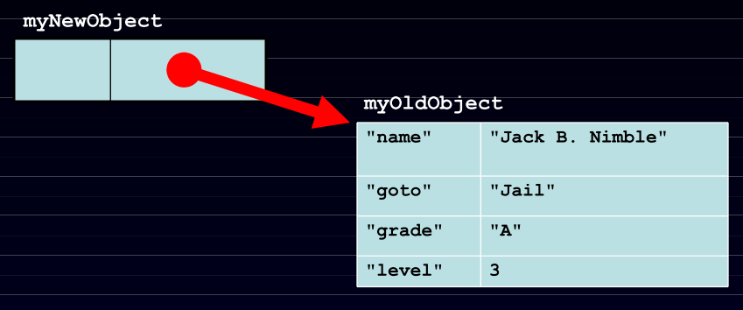
Linkage
var myNewObject = new Object(myOldObject);

Slide 19
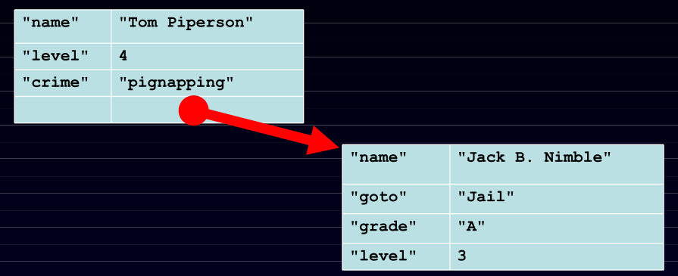
Linkage
myNewObject.name = "Tom Piperson";
myNewObject.level += 1;
myNewObject.crime = 'pignapping';

Slide 20
JS Classless Objects
3 ways to define a class
http://www.phpied.com/3-ways-to-define-a-javascript-class/
Function prototypes
http://ejohn.org/apps/learn/#76

Slide 21
Riddle me this
In JavaScript,
  Classes are functions
    https://developer.mozilla.org/en-US/docs/Learn/JavaScript/Objects/Object-oriented_JS
  Functions are Objects
    https://developer.mozilla.org/en-US/docs/Web/JavaScript/Reference/Functions
  They are all key-value maps anyway!

Slide 22
Extra

Slide 23
Outline
Java Script History
What is Java Script
Key Ideas of Java Script
Java Script Design
Examples
Functions, Objects, Linkages, Inheritance
Web Development
Comparison with other Languages
Demo and Practical Applications

Slide 24
What is a Scripting Language?
  In computing, a scripting language is a set of commands for controlling some specific piece of hardware, software, or operating system
  Used to write programs that produce inputs to another language processor
  Scripting languages intended to allow end users to extend the functionality of specific software packages are a subset commonly called extension languages
  Simple program structure without complicated declarations

Slide 25
JavaScript History
Developed by Brendan Eich at Netscape
  Scripting language for Navigator 2
Later standardized for browser compatibility
  ECMAScript Edition 3 (aka JavaScript 1.5)
Related to Java in name only
  “JavaScript is to Java as carpet is to car”
  Name was part of a marketing deal
Various implementations available
  SpiderMonkey C implementation (from Mozilla)
  Rhino Java implementation (also from Mozilla)

Slide 26
Why JavaScript?
Easy to implement. Just put your code in the HTML document and tell the browser that it is JavaScript.
Creates highly responsive interfaces that improve the user experience and provide dynamic functionality, without having to wait for the server to react and show another page.
Enhances Web pages with dynamic and interactive features: Active web pages
JavaScript can load content into the document if and when the user needs it, without reloading the entire page: Ajax
  JavaScript can help fix browser problems or patch holes in browser support: CSS Layout Issues
  .
Notes:
JavaScript works on web users’ computers — even when they are offline!
JavaScript can test for what is possible in your browser and react accordingly — this is called Principles of unobtrusive JavaScript or sometimes defensive Scripting.

Slide 27
What Is JavaScript?
JavaScript, aka Mocha, aka LiveScript, aka JScript, aka ECMAScript is a loosely-typed, embedded in HTML/Browser scripting language.
It is an interpreted object-oriented programming language.
It is used to manipulate the contents of HTML documents.
It is used for writing client-side applications that cannot access information on a host computer.
JavaScript is the world’s most misunderstood programming language

Slide 28
Misconceptions In JavaScript
The Name
Mispositioning
Design Errors
Bad Implementations
The Browser
Bad Books
Substandard Standard
JavaScript is a Functional Language
Notes:
http://javascript.crockford.com/javascript.html

Slide 29
Key Ideas Of Java Script
Load and go delivery
Loose typing
Objects as general containers
Prototypal inheritance
Lambda
Linkage though global variables

Slide 30
What You Can Do With JavaScript:
Creates highly responsive interfaces that improve the user experience and provide dynamic functionality, replacing server-side scripting
Can react to events - can be set to execute when something happens (i.e. page loaded or when a user clicks on an HTML element)
Can read and write HTML elements - change the content of an HTML element - not just form elements!
Can be used to validate data - although a user could easily turn it off in web browser
Can be used to create/manipulate cookies - store information on the client through a very controlled mechanism

Slide 31
What Else Can It Do?
Defensive computing: Can test what is possible in your browser and react accordingly
Control browser functions: Can detect the visitor's browser - detect if it is Mozilla/Firefox based, or riddled with holes, non-standards compliant, piece of junk Internet Explorer
JavaScript enables shopping carts, form validation, calculations, special graphic and text effects, image swapping, image mapping, clocks, and more.
Page embellishments and special effects, Navigation systems, Basic math calculations

Slide 32
JavaScript Design
Functions are based on Lisp/Scheme
  first-class inline higher-order functions
  function (y) { return y+100; }
Objects are based on Smalltalk/Self
  var pt = {y : 100, move : function(dy){this.y -= dy}}
  JavaScript is syntactically a C. It differs from C mainly in its type system, which allows functions to be values.

Slide 33
Language Design
Extreme permissiveness: Error-tolerant language which reports very less errors.
Lack of modularity: Java script objects are represented in tree structure
No information hiding capabilities: Does not distinguish public and private functions from data
Syntactic Issues: ‘this’ keyword required to refer every instance variable.

Slide 34
Software Configuration
No 'include' or 'load' directive in Core JavaScript: no mechanisms for loading in additional JavaScript code while an application is already running
No support for unloading parts of a program: unloading capabilities would be essential in a long-running system that relies on modules that can be upgraded without shutting down the system.
Loading multiple JavaScript applications into the same virtual machine is problematic

Slide 35
Development Style
Evolutionary development approach is a necessity: due to , error-tolerant nature, JavaScript programming requires an incremental, evolutionary software development approach
Code coverage testing is important: In an interactive command shell and the 'eval' function, each piece of code can be tested immediately after it has been written
Completeness of applications is difficult to determine: flexible and dynamic languages make it easy to get applications up and running quickly
Event-oriented programming model works surprisingly well: external occurrence such as a user interface activity or network event is defined as an event

Slide 36
Example 1: Browser Events
Mouse event causes page-defined function to be called
  <script type="text/JavaScript">
  function mouse Button(event) {
  if (event.button==1) {
  alert("You clicked the right mouse button!") }
  else {
  alert("You clicked the left mouse button!")
  }}
  </script>
  …
  <body onmousedown=" mouse Button(event)">
  …
  </body>
Other events: onLoad, onMouseMove, onKeyPress, onUnLoad

Slide 37
Example 2: Page Manipulation
Some possibilities
  createElement(elementName)
  createTextNode(text)
  appendChild(newChild)
  removeChild(node)
Example: add a new list item
var list = document.getElementById('list1')
var newitem = document.createElement('li')
var newtext = document.createTextNode(text)
list.appendChild(newitem)
newitem.appendChild(newtext)
This uses the browser Document Object Model (DOM). We will focus on
JavaScript as a language,
not its use in the browser

Slide 38
Example 3: Using Cookies
Creating cookies:
document.cookie = "myContents=Quackit JavaScript cookie experiment; expires=Fri, 19 Oct 2007 12:00:00 UTC; path=/";
Reading cookies:
document.write(document.cookie);
Deleting cookies:
document.cookie = "myContents=Quackit JavaScript cookie experiment; expires=Fri, 14 Oct 2005 12:00:00 UTC; path=/";
Notes:
http://www.quackit.com/javascript/tutorial/javascript_cookies.cfm

Slide 39
Language Syntax
JavaScript is case sensitive
  HTML is not case sensitive
Statements terminated by returns or semi-colons (;)
  y = y+2; is the same as y = y+2
  Using semi-colons is a good idea to reduce errors
“Blocks” of statements enclosed using { … }
Variables
  Define a variable using the “var” statement
  Define implicitly by its first use, which must be an assignment
    Implicit definition has global scope, even if it occurs in nested scope!
Notes:
; ONCLICK, onClick are HTML

Slide 40
JavaScript Primitive Datatypes
Boolean :
  true and false
number
  64-bit floating point, similar to Java double and Double
  No integer type
  Special values NaN (not a number and Infinity
String
  Sequence of zero or more Unicode characters
  No separate character type (just strings of length 1)
  Literal strings using ' or " characters (must match)
Special objects:
  null and undefined

Slide 41
JavaScript Blocks
Use { } for grouping; not a separate scope
  js> var x=3;
  js> x
  3
  js> {var x=4; x}
  4
  js> x
  4
Not blocks in the sense of other languages
  Only function calls and the with statement cause a change of scope

Slide 42
Functions
Functions are first-class objects
Functions can be passed, returned, and stored just like any other value
Functions inherit from Object and can store name/value pairs.
The function operator takes an optional name, a parameter list, and a block of statements, and returns a function object.
function name ( parameters ) {statements }
A function can appear anywhere that an expression can appear.

Slide 43
Functions (cont’d)
Declarations can appear in function body
  Local variables, “inner” functions
Parameter passing
  Basic types passed by value, objects by reference
Call can supply any number of arguments
  functionname.length : # of arguments in definition
  functionname.arguments.length : # args in call
“Anonymous” functions (expressions for functions)
  (function (x,y) {return x+y}) (2,3);
Closures and Curried functions
  function CurAdd(x){ return function(y){return x+y} };

Slide 44
Examples Of Functions
Curried functions
    function CurriedAdd(x) { return function(y){ return x+y} };
    g = CurriedAdd(2);
    g(3)
Variable number of arguments
    function sumAll() {
    var total=0;
    for (var i=0; i< sumAll.arguments.length; i++)
    total+=sumAll.arguments[i];
    return(total); }
    sumAll(3,5,3,5,3,2,6)

Slide 45
JavaScript functions and this
  var x = 5; var y = 5;
  function f() {return this.x + y;}
  var o1 = {x : 10}
  var o2 = {x : 20}
  o1.g = f; o2.g = f;
  o1.g()
  15
  o2.g()
  25
  Both o1.g and o2.g refer to the same function.
  Why are the results for o1.g() and o2.g() different ?

Slide 46
More About this
Property of the activation object for fctn call
  In most cases, this points to the object which has the function as a property (or method).
  Example :
  var o = {x : 10, f : function(){return this.x}}
  o.f();
  10
this is resolved dynamically when the method is executed

Slide 47
Anonymous Functions
Anonymous functions very useful for callbacks
  setTimeout(function() { alert("done"); }, 10000)
  Evaluation of alert("done") delayed until function call
Simulate blocks by function definition and call
  var u = { a:1, b:2 }
  var v = { a:3, b:4 }
  (function (x,y) {
  var tempA = x.a; var tempB =x.b; // local variables
  x.a=y.a; x.b=y.b;
  y.a=tempA; y.b=tempB
  }) (u,v) // Works because objs are passed by ref

Slide 48
Detour: Lambda Calculus
Expressions
  x + y x + 2*y + z
Functions
  λx. (x+y) λz. (x + 2*y + z)
Application
  (λx. (x+y)) (3) = 3 + y
  (λz. (x + 2*y + z))(5) = x + 2*y + 5

Slide 49
Higher-Order Functions
Given function f, return function f ° f
  λf. λx. f (f x)
How does this work?
  (λf. λx. f (f x)) (λy. y+1)
  = λx. (λy. y+1) ((λy. y+1) x)
  = λx. (λy. y+1) (x+1)
  = λx. (x+1)+1
In pure lambda calculus, same result if step 2 is altered.

Slide 50
Same Procedure, Lisp Syntax
Given function f, return function f ° f
  (lambda (f) (lambda (x) (f (f x))))
How does this work?
  ((lambda (f) (lambda (x) (f (f x)))) (lambda (y) (+ y 1))
  = (lambda (x) ((lambda (y) (+ y 1))
  ((lambda (y) (+ y 1)) x))))
  = (lambda (x) ((lambda (y) (+ y 1)) (+ x 1))))
  = (lambda (x) (+ (+ x 1) 1))

Slide 51
Same Procedure, JavaScript Syntax
Given function f, return function f ° f
  function (f) { return function (x) { return f(f(x)); }; }
How does this work?
  (function (f) { return function (x) { return f(f(x)); }; )
  (function (y) { return y +1; })
  function (x) { return (function (y) { return y +1; })
  ((function (y) { return y + 1; }) (x)); }
  function (x) { return (function (y) { return y +1; }) (x + 1); }
  function (x) { return ((x + 1) + 1); }

Slide 52
Objects
An object is a collection of named properties
  Simple view: hash table or associative array
  Can define by set of name:value pairs
    objBob = {name: “Bob", grade: 'A', level: 3};
  New members can be added at any time
    objBob.fullname = 'Robert';
  Can have methods, can refer to this
    Not a common feature of hash tables or associative arrays
Arrays, functions “regarded” as objects
  A property of an object may be a function (=method)
  A function defines an object with method called “( )”
    function max(x,y) { if (x>y) return x; else return y;};
    max.description = “return the maximum of two arguments”;

Slide 53
Object Construction
Make a new empty object
All three of these expressions have exactly the same result:
new Object()
{}
object(Object.prototype)
{} is the preferred form.

Slide 54
Basic Object Features
Use a function to construct an object
  function car(make, model, year) {
  this.make = make;
  this.model = model;
  this.year = year;
  }
Objects have prototypes, can be changed
  var c = new car(“Ford”,”Mustang”,2013);
  car.prototype.print = function () {
  return this.year + “ “ + this.make + “ “ + this.model;}
  c.print();

Slide 55
Inheritance
Linkage provides simple inheritance.
An object can inherit from an older object.
Instead of Classical Inheritance, JavaScript has Prototypal Inheritance.
Instead of organizing objects into rigid classes, new objects can be made that are similar to existing objects, and then customized.

Slide 56
Vehicle-Car Inheritance Example
Constructor function for Vehicle:
function Vehicle(hasEngine, hasWheels) {
this.hasEngine = hasEngine || false;
this.hasWheels = hasWheels || false; }
Constructor function for Car:
function Car (make, model, hp) {
this.hp = hp; this.make = make;
this.model = model; }
Set up dynamic inheritance:
Car.prototype = new Vehicle(true, true);
Notes:
http://www.klauskomenda.com/code/javascript-inheritance-by-example/

Slide 57
Example (cont’d)
Extending Car using prototype:
Car.prototype.displaySpecs = function () { console.log(this.make + ", " + this.model + ", " + this.hp + ", " + this.hasEngine + ", " + this.hasWheels); }
Creating a new car:
var myAudi = new Car ("Audi", "A4", 150);
Extend Vehicle using prototype:
Vehicle.prototype.hasTrunk = true;

Slide 58
Local Variables Stored In “scope object”
  Special treatment for nested functions
  var o = { x: 10
  f : function() {
  function g(){ return this.x } ;
  return g();
  }
  };
  o.f()
  Function g gets the global object as its this property !

Slide 59
Language Features In This Class
Stack memory management
  Parameters, local variables in activation records
Garbage collection
  Automatic reclamation of inaccessible memory
Closures
  Function together with environment (global variables)
Exceptions
  Jump to previously declared location, passing values
Object features
  Dynamic lookup, Encapsulation, Subtyping, Inheritance
Concurrency
  Do more than one task at a time (JavaScript is single-threaded)

Slide 60
Stack Memory Management
Local variables in activation record of function
  function f(x) {
  var y = 3;
  function g(z) { return y+z;};
  return g(x);
  }
  var x= 1; var y =2;
  f(x) + y;

Slide 61
Garbage Collection
Automatic reclamation of unused memory
Navigator 2: per-page memory management
  Reclaim memory when browser changes page
Navigator 3: reference counting
  Each memory region has associated count
  Count modified when pointers are changed
  Reclaim memory when count reaches zero
Navigator 4: mark-and-sweep, or equivalent
  Garbage collector marks reachable memory
  Sweep and reclaim unreachable memory

Slide 62
Closures
A closure takes place when a function creates an environment that binds local variables to it in such a way that they are kept alive after the function has returned.
A closure is a special kind of object that combines two things: a function, and any local variables that were in-scope at the time that the closure was created.
Used to bind variables to functions that are called at a later time

Slide 63
Example 1
function setupSomeGlobals() {
// Local variable that ends up within closure
var num = 666;
// Store some references to functions as global variables
gAlertNumber = function() { alert(num); }
gIncreaseNumber = function() { num++; }
gSetNumber = function(x) { num = x; }
}

Slide 64
Exceptions
Throw an expression of any type
  throw "Error2";
  throw 42;
  throw {toString: function() { return "I'm an object!"; } };
Catch
  try {
  } catch (e if e == “FirstException") {
  } catch (e if e == “SecondException") {
  } catch (e){ }

Slide 65
Concurrency
JavaScript itself is single-threaded
  How can we tell if a language provides concurrency?
AJAX provides a form of concurrency
  Create XMLHttpRequest object, set callback function
  Call request method, which continues asynchronously
  Reply from remote site executes callback function
  Event waits in event queue…
  Closures important for proper execution of callbacks
Another form of concurrency
  Use SetTimeout to do cooperative multi-tasking

Slide 66
JavaScript eval
Evaluate string as code (seen this before?)
  The eval function evaluates a string of JavaScript code, in scope of the calling code
    var code = "var a = 1";
    eval(code); // a is now '1‘
    var obj = new Object();
    obj.eval(code); // obj.a is now 1
  Common use: efficiently deserialize a complicated data structure received over network via XMLHttpRequest
What does it cost to have eval in the language?
  Can you do this in C? What would it take to implement?

Slide 67
Unusual Features of JavaScript
Some built-in functions
  Eval (next slide), Run-time type checking functions, …
Regular expressions
  Useful support of pattern matching
Add, delete methods of an object dynamically
  Seen examples adding methods. Do you like this? Disadvantages?
  myobj.a = 5; myobj.b = 12; delete myobj.a;
Redefine native functions and objects (incl undefined)
Iterate over methods of an object
  for (variable in object) { statements }
With statement (“considered harmful” – why??)
  with (object) { statements }

Slide 68
Web Development
JavaScript(in HTML5) vs. Flash
JavaScript supports any platform
JavaScript has easier development cycle.
Because It’s impossible to debug a flash
object on a remote server
It’s easier to find/ develop HTML/JavaScript
expertise
JavaScript(in HTML5) also get great
presentation.

Slide 69
Java vs. JavaScript(General)
Compilation
JavaScript is not compiled. It runs interpretively.
Java is compiled into an intermediate bytecode (which is machine-independent). A machine-specific Java Virtual Machine then interprets this code to run on the specific platform.
Language Philosophy
JavaScript tries to continue running unless it encounters an insurmountable syntax error.
Java is on the stricter end of software tools. The compiler disallows many situations that might be allowed in other languages and the runtime engine raises an exception when questionable or dangerous actions take place.
Learning Curve
JavaScript is a smaller and more straightforward to learn.
Java is larger. While it is less complex than C++, it is still a substantial language.

Slide 70
Java vs. JavaScript(Web Capabilities)
Web Presentation
JavaScript can build dynamic webpages. JavaScript provides more direct control over the browser (e.g. controlling the back button, refreshing the page, etc.)
Java can be used to build Applet pages but this technology is dated and no longer widely used.
Developing User Interfaces
Interfaces are developed in HTML which is relatively straightforward to learn. JavaScript is included in the webpage and it interacts with the HTML form elements.
In plain Java, user interfaces are developed in AWT or Swing. Working directly with these Java libraries is challenging and the user interfaces were often not all that easy to use. Java mostly lost this market.
Client-side Security
JavaScript does not allow direct access to a user’s hard-drive (beyond Cookies which the browser directly controls).Over the year, security holes have been found in JavaScript.
Java is very strict about not allowing access to memory or devices outside the applet. Certain actions are allowed as long as t

Slide 71
Java vs. JavaScript (Middle Tier Capabilities)
Middle Tier Capabilities
In the early days of the Internet, server-side JavaScript could be used to produce webpages with dynamic content (e.g. including database content).
Java has a comprehensive model for supporting middle tier content called Java 2 Enterprise Edition (J2EE). It is a considerably more comprehensive model than JavaScript.
Middle Tier Presence
Server-side JavaScript is virtually non-existent.
Java (J2EE) is widely supported in the middle tier (IBM, Oracle, Apache/Tomcat, etc.) Many vendors produce tools to help create, debug and deploy middle-tier Java solutions. Java has a very strong presence in the middle tier. Its major middle-tier competitor is Microsoft (whose solution uses dot-Net suite in the middle tier).

Slide 72
JSLint
JSLint can help improve the robustness and portability of your programs.
It enforces style rules.
It can spot some errors that are very difficult to find in debugging.
It can help eliminate implied globals.
Currently available on the web and as a Konfabulator widget.
Soon, in text editors and Eclipse.

Slide 73
JavaScript Applications Demo
HTML5 + Canvas + JavaScript
Replace Flash with stunning visual effect
Game Engine

Slide 74
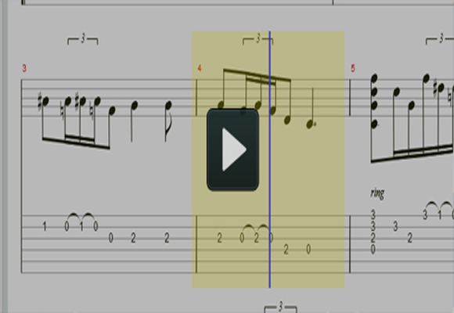
alphaTab
alphaTab is a JavaScript library that allows one to embed notation/guitar tablatures into websites

Slide 75
HTML5 Canvas Experiment
This is a self-described “little experiment” which involves 100 tweets related to HTML5 that are loaded and subsequently displayed using a Javascript-based particle engine.

Slide 76
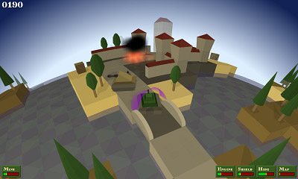
Tank World
3D Shooting games implemented by HTML5 and JavaScript

Slide 77
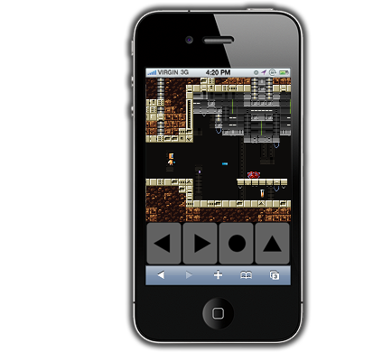
Impact Game Engine
Impact is a JavaScript Game Engine that allows you to develop HTML5 Games in no time.

Slide 78
References
Brendan Eich, slides from ICFP conference talk
  www.mozilla.org/js/language/ICFP-Keynote.ppt
Tutorial
  http://www.w3schools.com/js/
JavaScript 1.5 Guide
  http://developer.mozilla.org/en/docs/Core_JavaScript_1.5_Guide
Douglas Crockford
  http://www.crockford.com/JavaScript/
  JavaScript: The Good Parts, O’Reilly, 2008. (book)
Reference: http://developer.mozilla.org/en/docs/
Core_JavaScript_1.5_Guide :Exception_Handling_Statements
  http://www.unix.org.ua/orelly/web/jscript/ch11_07.html

Slide 79
References (Continue)
JavaScript VS. Flash
  http://flexblog.edchipman.ca/javascript-vs-flash-who-will-win-the-client-side-scripting-battle
JavaScript VS. JAVA
  http://www.sislands.com/coin70/week1/javajs.htm
JavaScript Canvas
  http://billmill.org/static/canvastutorial/index.html
JavaScript HTML5
  http://dev.w3.org/html5/spec/Overview.html
JavaScript Game Egnine1
  http://rocketpack.fi/engine/
JavaScript Game Egnine2
  http://ntt.cc/2011/01/31/66-open-source-javascript-game-engine-for-serious-developers.html

