Slide 1
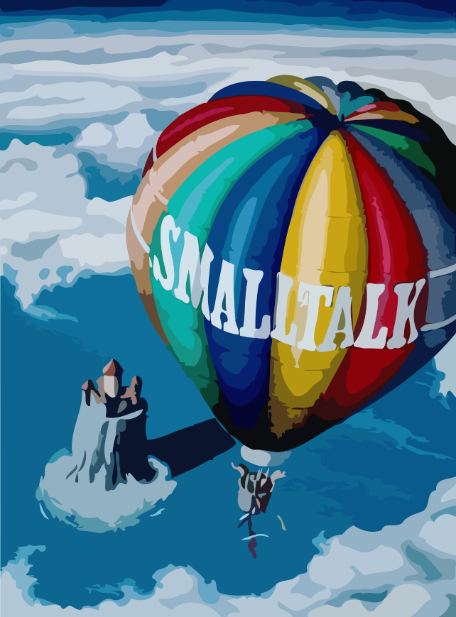
Dynamic Object-Oriented Programming with Smalltalk
1. Introduction
Prof. O. Nierstrasz
Autumn Semester 2009

Slide 2
What is surprising about Smalltalk
LECTURE TITLE
Everything is an object
Everything happens by sending messages
All the source code is there all the time
You can't lose code
You can change everything
You can change things without restarting the system
The Debugger is your Friend
© Oscar Nierstrasz

Slide 3
Why Smalltalk?
ST — Introduction
Pure object-oriented language and environment
  “Everything is an object”
Origin of many innovations in OO development
  RDD, IDE, MVC, XUnit …
Improves on many of its successors
  Fully interactive and dynamic
© Oscar Nierstrasz
1.<number>

Slide 4
What is Smalltalk?
ST — Introduction
Pure OO language
  Single inheritance
  Dynamically typed
Language and environment
  Guiding principle: “Everything is an Object”
  Class browser, debugger, inspector, …
  Mature class library and tools
Virtual machine
  Objects exist in a persistent image [+ changes]
  Incremental compilation
© Oscar Nierstrasz
1.<number>

Slide 5
Smalltalk vs. C++ vs. Java
ST — Introduction
 | Smalltalk | C++ | Java
Object model | Pure | Hybrid | Hybrid
Garbage collection | Automatic | Manual | Automatic
Inheritance | Single | Multiple | Single
Types | Dynamic | Static | Static
Reflection | Fully reflective | Introspection | Introspection
Concurrency | Semaphores, Monitors | Some libraries | Monitors
Modules | Categories, namespaces | Namespaces | Packages
© Oscar Nierstrasz
1.<number>

Slide 6
Smalltalk: a State of Mind
ST — Introduction
Small and uniform language
  Syntax fits on one sheet of paper
Large library of reusable classes
  Basic Data Structures, GUI classes, Database Access, Internet, Graphics
Advanced development tools
  Browsers, GUI Builders, Inspectors, Change Management Tools, Crash Recovery Tools, Project Management Tools
Interactive virtual machine technology
  Truly platform-independent
Team Working Environment
  Releasing, versioning, deploying
© Oscar Nierstrasz
1.<number>

Slide 7
Origins of Smalltalk
ST — Introduction
Project at Xerox PARC in 1970s
  Language and environment for new generation of graphical workstations (target: “Dynabook”)
In Smalltalk-72, every object was an independent entity
  Language was designed for children (!)
  Evolved towards a meta-reflective architecture
Smalltalk-80 is the standard
© Oscar Nierstrasz
1.<number>

Slide 8
Smalltalk — The Inspiration
ST — Introduction
Flex (Alan Kay, 1969)
Lisp (Interpreter, Blocks, Garbage Collection)
Turtle graphics (The Logo Project, Programming for Children)
Direct Manipulation Interfaces (Sketchpad, Alan Sutherland, 1960)
NLS, (Doug Engelbart, 1968), “the augmentation of human intellect”
Simula (Classes and Message Sending)
Xerox PARC (Palo Alto Research Center)
DynaBook: a Laptop Computer for Children
  www.smalltalk.org/smalltalk/TheEarlyHistoryOfSmalltalk_Abstract.html
© Oscar Nierstrasz
1.<number>
Notes:
Flex - an early desktop computer with graphical user interface and object-oriented operating system
NLS - “oNLine System”, early interactive system with mouse. Demo: http://sloan.stanford.edu/mousesite/1968Demo.html

Slide 9
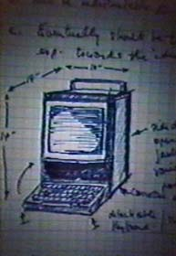
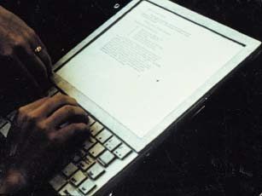
Dynabook Mockup
ST — Introduction
www.artmuseum.net/w2vr/archives/Kay/01_Dynabook.html
© Oscar Nierstrasz
1.<number>

Slide 10
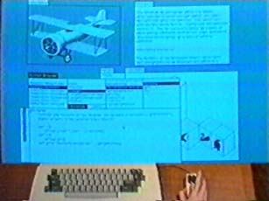
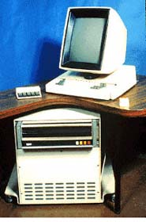
Alto: a Machine to Run Smalltalk
ST — Introduction
Smalltalk on Alto III
© Oscar Nierstrasz
1.<number>

Slide 11
Precursor, Innovator & Visionary
ST — Introduction
First to be based on Graphics
  Multi-Windowing Environment (Overlapping Windows)
  Integrated Development Environment: Debugger, Compiler, Text Editor, Browser
With a pointing device  yes, a Mouse
Ideas were taken over
  Apple Lisa, Mac
  Microsoft Windows 1.0
Platform-independent Virtual Machine
Garbage Collector
Just-in-time Compilation
Everything was there, the complete Source Code
© Oscar Nierstrasz
1.<number>

Slide 12
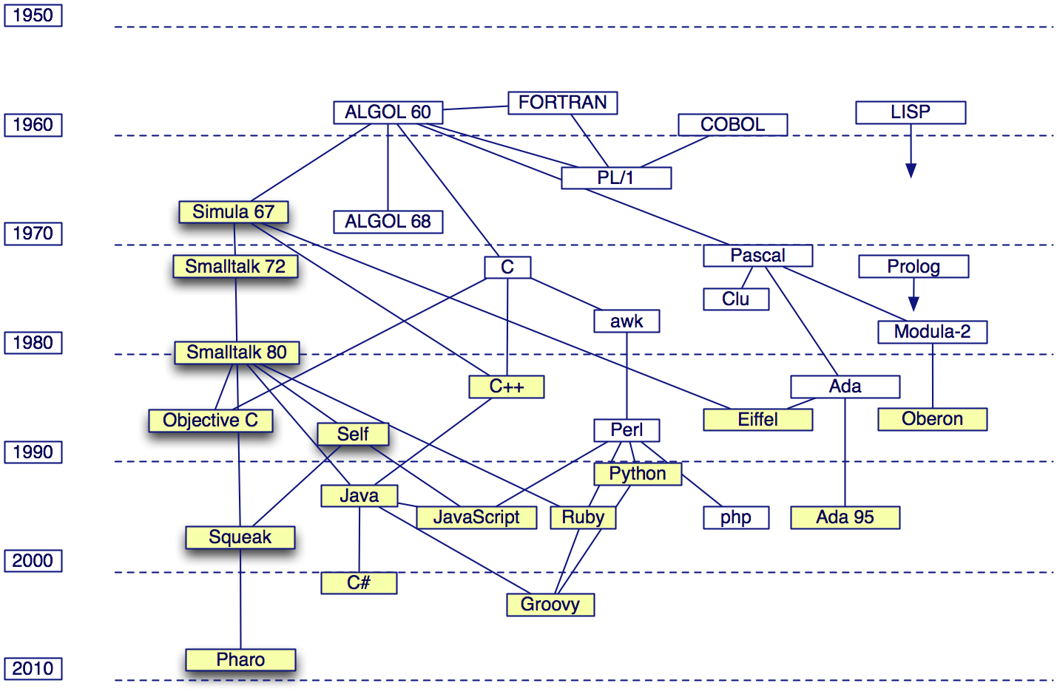
History
ST — Introduction
© Oscar Nierstrasz
1.<number>

Slide 13
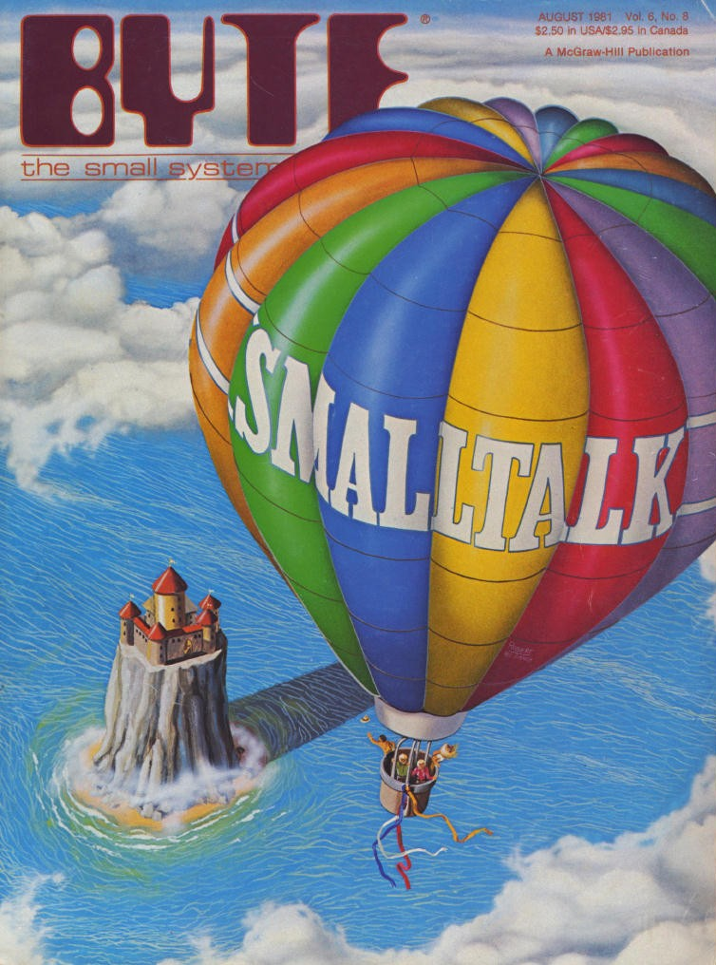
ST — Introduction
© Oscar Nierstrasz
1.<number>

Slide 14
The History (External)
ST — Introduction
1980 — Smalltalk-80
  ASCII, cleaning primitives for portability, metaclasses, blocks as first-class objects, MVC.
  Projects: Gallery Editor (mixing text, painting and animations) + Alternate Reality Kit (physics simulation)
1981 — Books + 4 external virtual machines
  Dec, Apple, HP and Tektronix
  GC by generation scavenging
1988 — Creation of Parc Place Systems
1992 — ANSI Draft
1995 — New Smalltalk implementations
  MT, Dolphin, Squeak, Smalltalk/X, GNU Smalltalk
2000 — Fscript, GNU Smalltalk, SmallScript
2002 — Smalltalk as OS: 128k ram
© Oscar Nierstrasz
1.<number>

Slide 15


What are Squeak and Pharo?
ST — Introduction
Squeak is a modern, open-source, highly portable, fast, full-featured Smalltalk implementation
  Based on original Smalltalk-80 code
Pharo is a lean and clean fork of Squeak
  www.pharo-project.org
© Oscar Nierstrasz
1.<number>

Slide 16
Smalltalk — Key Concepts
ST — Introduction
Everything is an object
  numbers, files, editors, compilers, points, tools, booleans …
Everything happens by sending messages
Every object is an instance of one class
  which is also an object
  A class defines the structure and the behavior of its instances.
Objects have private (protected) state
  Encapsulation boundary is the object
Dynamic binding
  Variables are dynamically typed and bound
© Oscar Nierstrasz
1.<number>

Slide 17
Objects and Classes
ST — Introduction
Every object is an instance of a class
  A class specifies the structure and the behaviour of all its instances
  Instances of a class share the same behavior and have a specific state
  Classes are objects that create other instances
  Metaclasses are classes that create classes as instances
  Metaclasses describe class behaviour and state (subclasses, method dictionary, instance variables...)
© Oscar Nierstrasz
1.<number>

Slide 18
Messages and Methods
ST — Introduction
Message — which action to perform
Method — how to carry out the action
aWorkstation accept: aPacket
aMonster eat: aCookie
accept: aPacket
(aPacket isAddressedTo: self)
ifTrue:[
Transcript show:
'A packet is accepted by the Workstation ',
self name asString ]
ifFalse: [super accept: aPacket]
© Oscar Nierstrasz
1.<number>

Slide 19
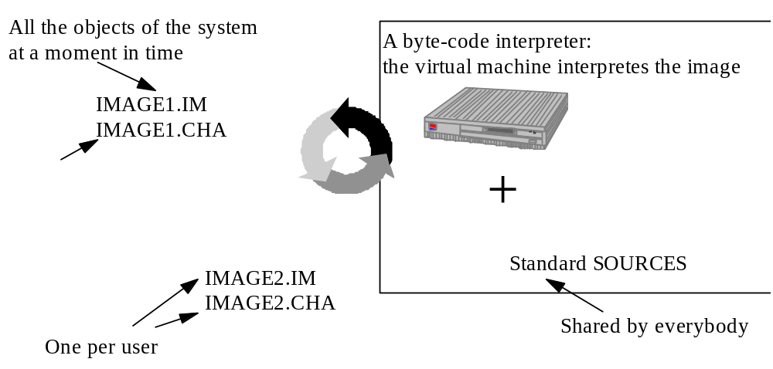
Smalltalk Run-Time Architecture
ST — Introduction
Virtual Machine + Image + Changes and Sources
Image = bytecodes
Sources and changes = code (text)
© Oscar Nierstrasz
1.<number>

Slide 20
Smalltalk Run-Time Architecture
ST — Introduction
Byte-code is translated to native code by a just-in-time compiler
  Some Smalltalks, but not Pharo
Source and changes are not needed to interpret the byte-code.
  Just needed for development
  Normally removed for deployment
An application can be delivered as byte-code files that will be executed with a VM.
  The development image is stripped to remove the unnecessary development components.
© Oscar Nierstrasz
1.<number>

Slide 21
Mouse Semantics
ST — Introduction
Operate
Select
Window
© Oscar Nierstrasz
1.<number>

Slide 22
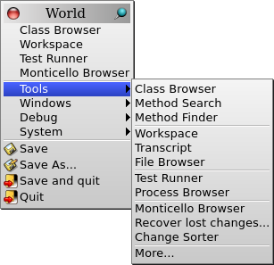
World Menu
ST — Introduction
© Oscar Nierstrasz
1.<number>

Slide 23
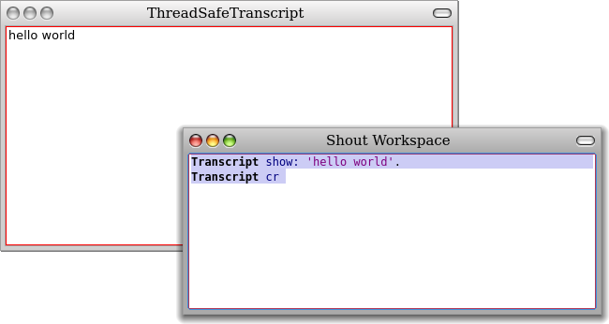
“Hello World”
ST — Introduction
© Oscar Nierstrasz
1.<number>

Slide 24
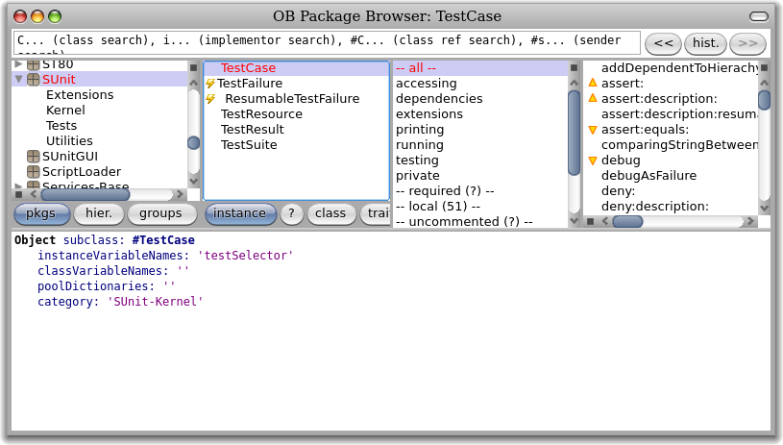
The Smalltalk Browser
ST — Introduction
© Oscar Nierstrasz
1.<number>

Slide 25
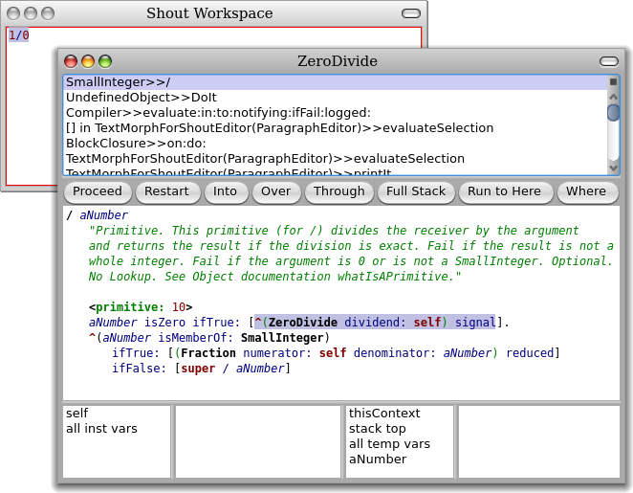
The Debugger
ST — Introduction
© Oscar Nierstrasz
1.<number>

Slide 26
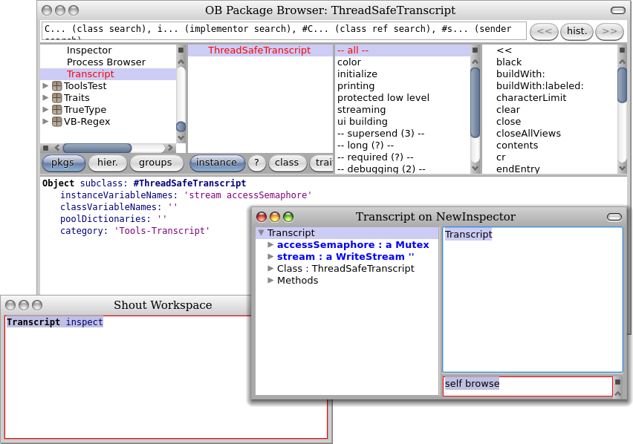
The Inspector
ST — Introduction
© Oscar Nierstrasz
1.<number>

Slide 27
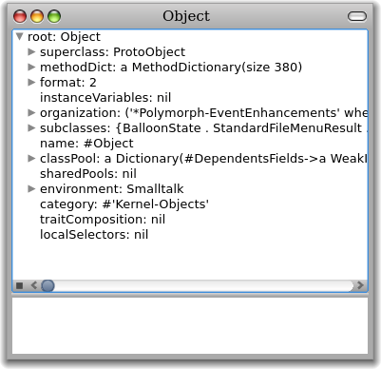
The Explorer
ST — Introduction
© Oscar Nierstrasz
1.<number>

Slide 28
Other Tools
ST — Introduction
File Browser
  Browse, import, open files
Method Finder, Message Name tool
  Find methods by name, behaviour
Change Sorter
  Name, organize all source code changes
SUnit Test Runner
  Manage & run unit tests
© Oscar Nierstrasz
1.<number>

Slide 29
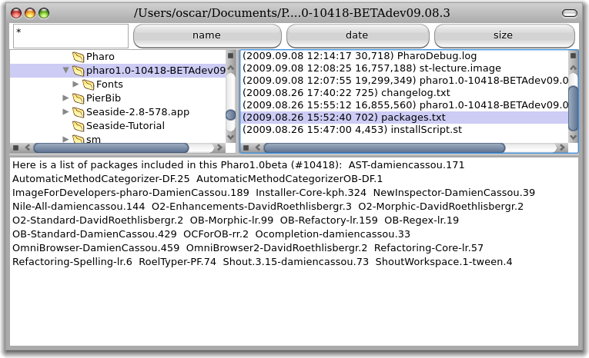
File Browser
ST — Introduction
© Oscar Nierstrasz
1.<number>

Slide 30
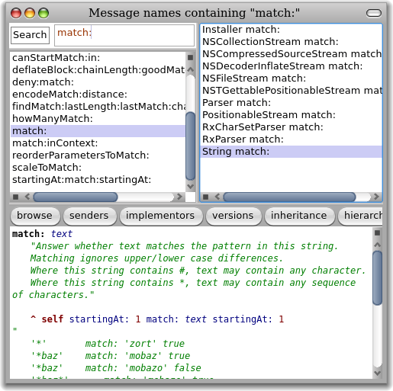
Message Name Finder
ST — Introduction
© Oscar Nierstrasz
1.<number>

Slide 31
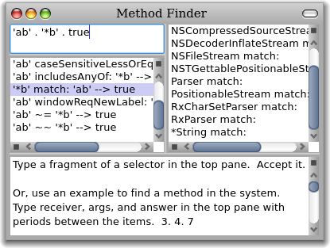
Method Finder
ST — Introduction
© Oscar Nierstrasz
1.<number>

Slide 32
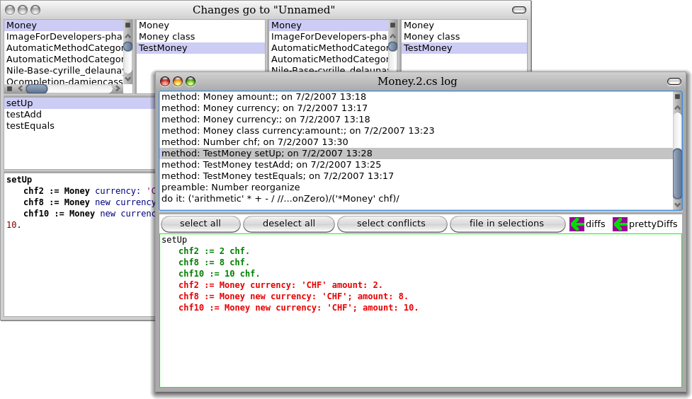
Methods in ChangeSets & Versions
ST — Introduction
© Oscar Nierstrasz
1.<number>

Slide 33
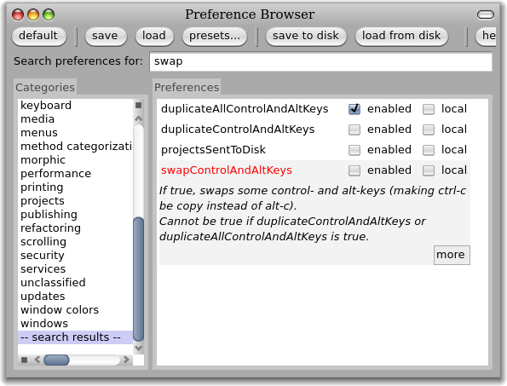
Preferences
ST — Introduction
© Oscar Nierstrasz
1.<number>

Slide 34
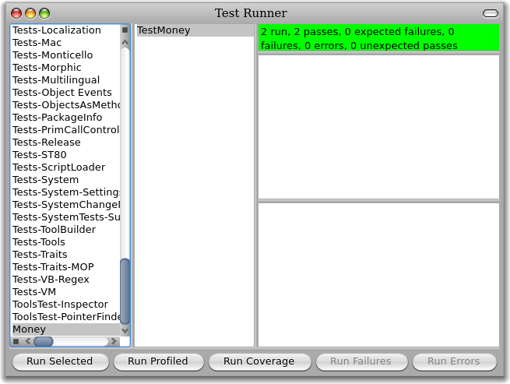
SUnit
ST — Introduction
© Oscar Nierstrasz
1.<number>

Slide 35
What you should know!
ST — Introduction
How does Smalltalk differ from Java or C++?
Where are Smalltalk programs stored?
Where are objects stored?
What was the Dynabook?
Is a class an object?
What is dynamic binding?
What is the difference between a message and a method?
© Oscar Nierstrasz
1.<number>

Slide 36

License
ST — Introduction
http://creativecommons.org/licenses/by-sa/3.0/
Attribution-ShareAlike 3.0 Unported
You are free:
  to Share — to copy, distribute and transmit the work
  to Remix — to adapt the work
Under the following conditions:
  Attribution. You must attribute the work in the manner specified by the author or licensor (but not in any way that suggests that they endorse you or your use of the work).
  Share Alike. If you alter, transform, or build upon this work, you may distribute the resulting work only under the same, similar or a compatible license.
For any reuse or distribution, you must make clear to others the license terms of this work. The best way to do this is with a link to this web page.
Any of the above conditions can be waived if you get permission from the copyright holder.
Nothing in this license impairs or restricts the author's moral rights.
© Oscar Nierstrasz
1.<number>

