Slide 1


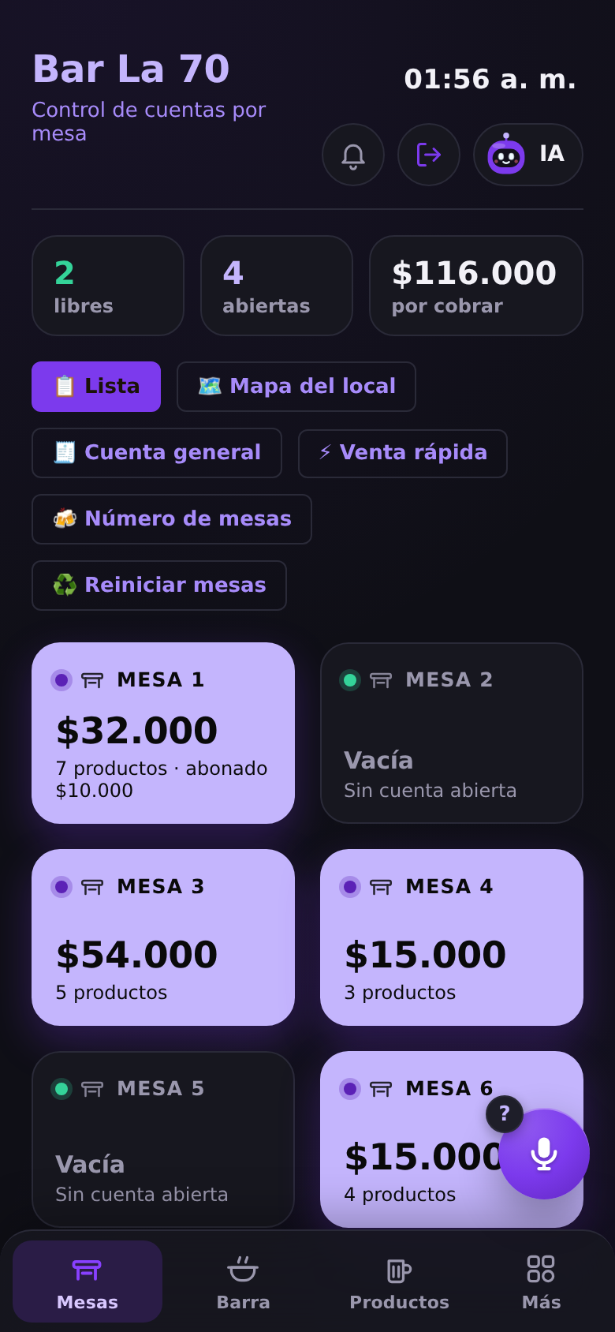
Vento
The voice-first operating system for Latin America’s small businesses.
Sell, verify payments, run inventory and talk to your business — from the phone you already own.
LIVE · WEB + ANDROID
MADE IN COLOMBIA

Slide 2





Run on paper. Paid by screenshot.
THE PROBLEM
Tabs on paper
2.3M
Orders get lost, mis-charged or forgotten when the place fills up.
Fake payment screenshots
micro-businesses in Colombia’s 24 main cities alone.
Transfers are “confirmed” by looking at a screenshot that anyone can edit.
Inventory by eye
Bars, restaurants, corner stores, salons and workshops — most without a real system.
Best sellers run out mid-shift; supplier invoices are typed by hand.
Five apps, no system
POS, notebook, calculator, WhatsApp and spreadsheets that never talk.
Source: DANE, Encuesta de Micronegocios (EMICRON) 2024 — 2,321,469 micro-businesses in 24 cities and metro areas.

Slide 3







One app. It listens, sells and verifies.
THE SOLUTION
Talk to it
Verified payments
Vento AI
“Hola Vento, table 3, two beers.” Hands-free orders, payments and questions.
Detects fake transfer screenshots and SMS. Zero fees from Vento.
Reads supplier invoices, answers with real numbers, predicts stock-outs.
QR ordering
Music on the TV
Pocket accountant
Guests order from their table; it lands in the tab and the kitchen.
Guests request songs by QR; they play on the venue’s TV, fairly queued.
Cash close, real profit, VAT and Excel exports for the accountant.

Slide 4
Hands-free: just say “Hola Vento”
VOICE-FIRST · LIVE TODAY
“Undo the last order”
Reverts instantly.
“Table 3 pays 20 thousand”
Logs a partial payment, says what’s left.
“Hola Vento, table 3, two Póker.”
“Juan owes me 20 thousand”
Goes to the credit notebook, dated.
✓ 2 Póker added to Table 3
“How many Póker are left?”
Answers from live inventory.
Stays attentive after each command — no need to repeat the wake word.
“How much did I sell today?”
Answers out loud with real data.
Notes:
Commands shown in English for the audience; Vento understands Colombian Spanish, including local beer and product names.

Slide 5



No fake screenshots. No fees.
VERIFIED PAYMENTS · LIVE TODAY
1. Show your QR
2. Customer pays
3. Vento confirms
The business’s Nequi / Bre-B QR prints on the tab and receipt.
From Nequi, DaviPlata or any Bre-B bank app.
The bank’s own notification reaches Vento: amount, sender and which table.
Every screenshot is read on-device and cross-checked against money that actually arrived:
Matches a real deposit
Reference already used
Paid to another number
Same amount & time → accept
Same receipt shown twice → fake
Money never reached you → fake
Future or old date
Not arrived yet
SMS from a phone number
Edited screenshot → flagged
Don’t hand over → alert on arrival
Banks don’t text from phones → fake
Notes:
Live in the product. Bank notifications are forwarded to Vento (today with the free MacroDroid app on the business phone, or through the Vento server). Vento charges no transaction or verification fee; any fees set by banks or wallets are theirs.

Slide 6
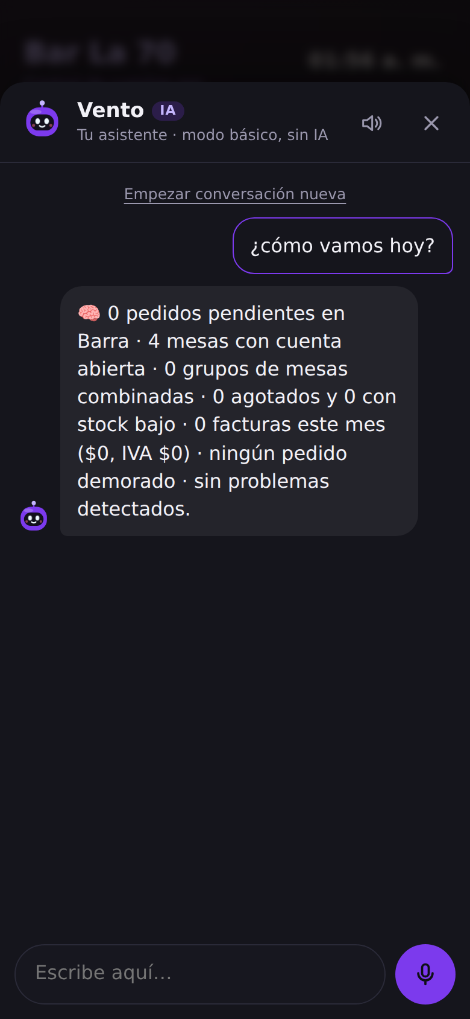
An AI that knows the business
VENTO AI
2.4 s
Dual-engine
to read a supplier invoice on-device, no internet (internal test)
on-device and cloud readers race; the fastest result wins
Scans invoices → stock, VAT and true unit cost, automatically
Answers “what did I sell today?” with the business’s real data
Flags stock-outs, price increases and delayed orders; predicts how long stock lasts
Pre-configured: the business never handles an API key

Slide 7

Five apps, replaced by one
BREADTH
Voice orders in Colombian Spanish
Fake-payment detection
AI invoice reading, even offline
Tables, split bills, partial payments
Credit notebook (fiados) by voice
Inventory with alerts & forecasting
QR menu & table ordering
Guest music queue on the TV
Kitchen / bar display
Waiter app, roles & permissions
Cash close, profit, VAT, Excel
Delivery, tips, receipts with tax ID
Barcode selling & quick sale
Floor map, merge & split tables
Multi-device, multi-branch, cloud backup

Slide 8
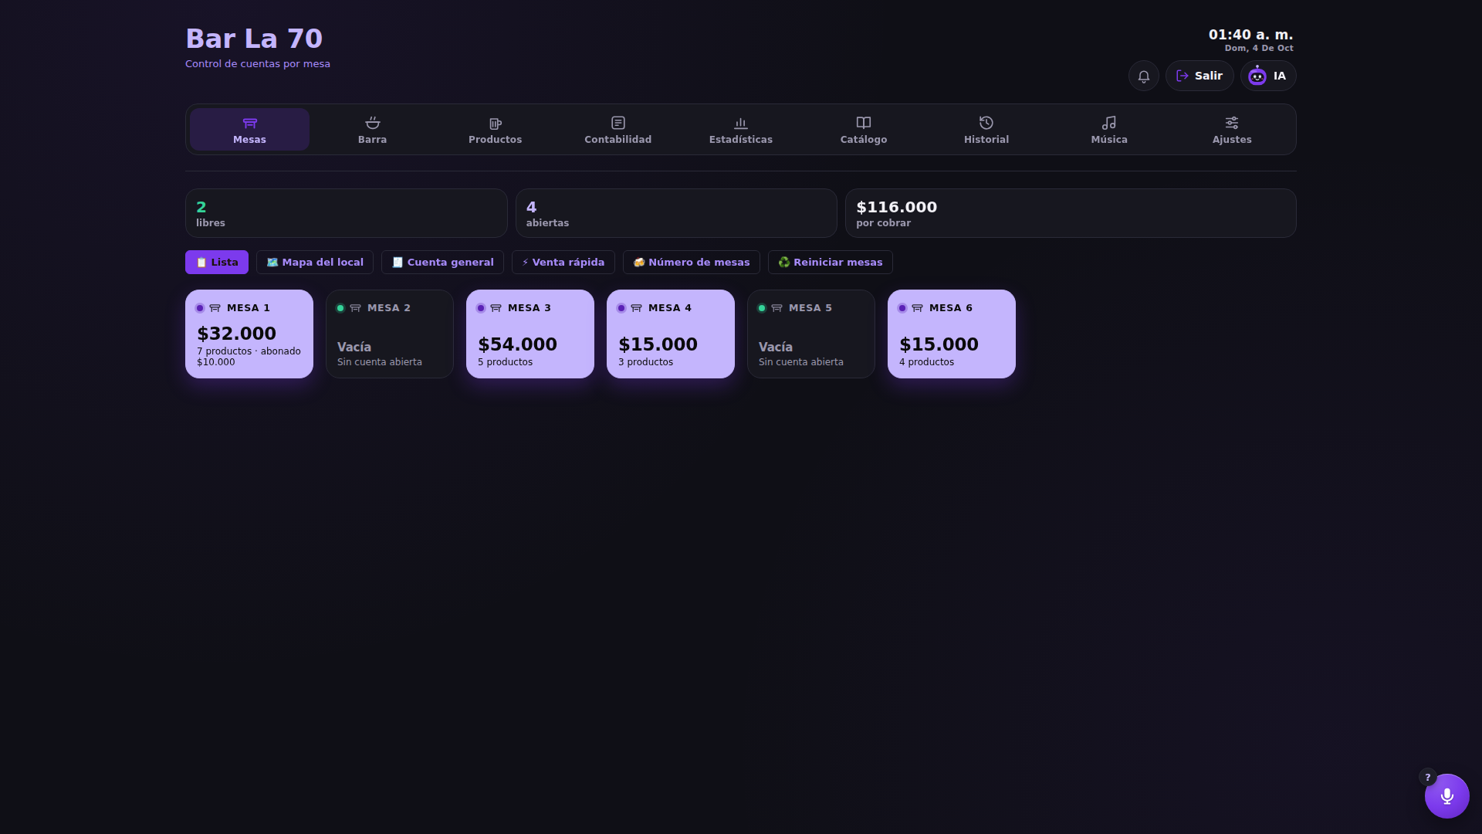
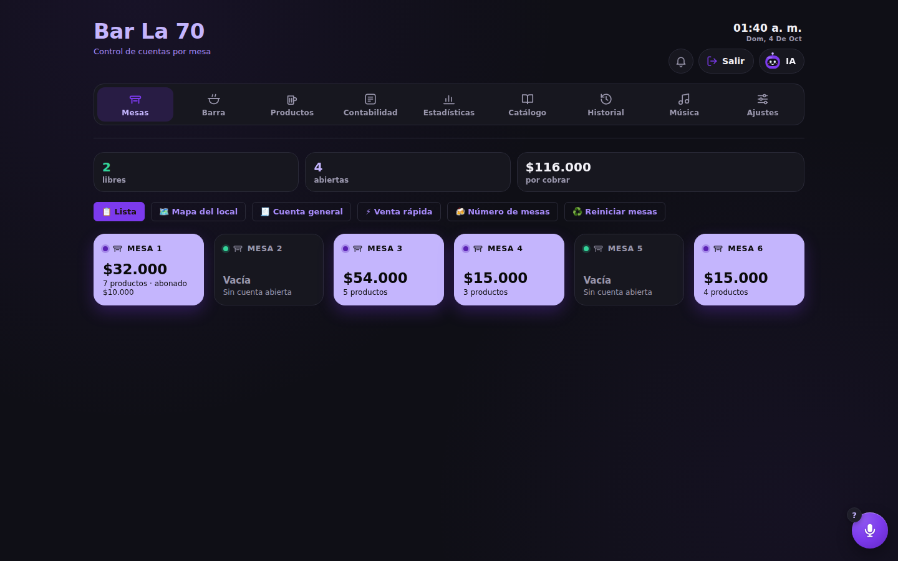
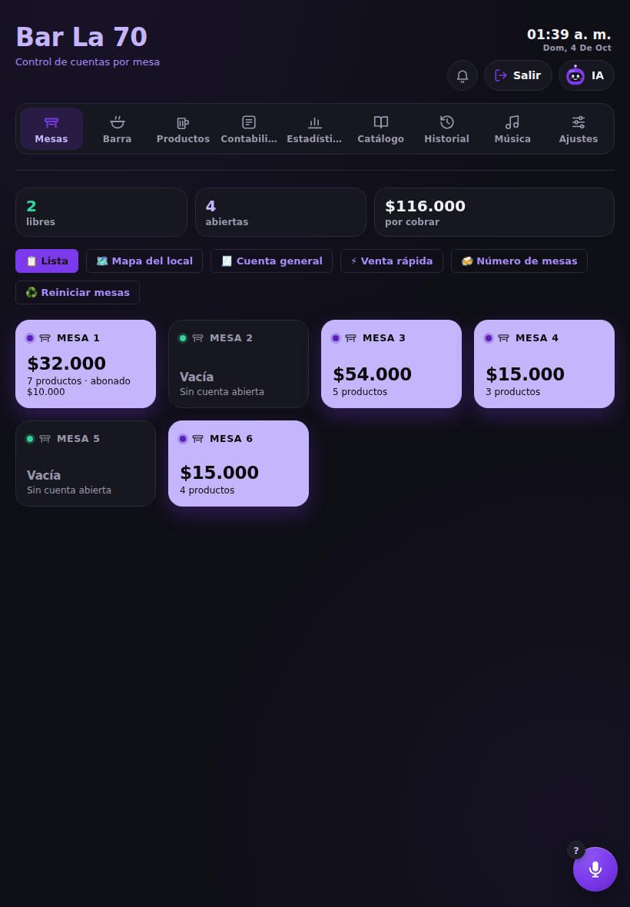



Runs on any screen they already own
NO HARDWARE TO BUY
Smart TV / TV box
Laptop / PC
Tablet
Phone
Works offline
Real-time sync
Nothing to install
Keeps selling without signal; syncs later.
Waiter’s phone → register → kitchen.
Browser or Android app.

Slide 9
Instant payments just went national
WHY NOW
Oct 2025
25M
Any phone
Bre-B goes live
Nequi users
On-device AI & voice
Colombia’s central bank launches free, 24/7 instant transfers across 227 financial institutions.
Mid-2025: one digital wallet alone reaches over 25 million Colombians.
Speech recognition and OCR now run on the Android phones businesses already carry.
Source: Banco de la República (Bre-B, open to all users from Oct 6, 2025); El Colombiano, Nequi 2025 results (25M users).

Slide 10
Start in Colombia. Built for LatAm.
MARKET
Beachhead
Latin America
2.3 million micro-businesses in Colombia’s 24 main cities (DANE 2024) — bars, restaurants, stores, salons, workshops.
Colombia
Built to expand
75+ business templates already in the product: the same voice, AI and payments engine adapts its vocabulary to tables, rooms, chairs or work orders.
2.3M
beachhead
Next markets
Countries with real-time payment rails and wallet adoption, where screenshot fraud is the same problem.
Source: DANE, EMICRON 2024. Market sizing beyond Colombia to be completed with country data.

Slide 11



Simple SaaS. No cut of the money.
BUSINESS MODEL
Free trial
Monthly subscription
Lifetime licenses
All features, no card. The business sees value on night one.
Priced by business size: more devices, branches and AI included.
One-time option for owners who prefer to buy, not rent.
0% transaction fees from Vento. Payments go straight to the merchant’s own Nequi, DaviPlata or Bre-B account — Vento only verifies them. Licenses and plans are managed from the Vento Admin console.

Slide 12
A category of one
WHY VENTO WINS
 | Paper + WhatsApp | Traditional POS | Payment gateways | Vento
Hands-free voice operation | — | — | — | ✓
Fake-screenshot & SMS detection | — | — | — | ✓
No fee on each sale | ✓ | ✓ | — | ✓
No dedicated hardware | ✓ | — | ✓ | ✓
AI invoices & inventory | — | — | — | ✓
Works offline | ✓ | ✓ | — | ✓
Typical characteristics of each category; individual products vary.

Slide 13
Half the price of the incumbents
PRICING
Tienda
Monthly price in Colombia (US$)
US$12
Corner store · 1 device
Siigo Nube Emprendedor
US$58
Voice, credit book, inventory, payment checks
COP 39,900/mo
Alegra Pyme
US$50
Restobar
US$24
Fudo (international)
US$40
Bars & restaurants · 5 devices
+ tables, QR orders, TV music, AI
COP 79,900/mo
Siigo POS Gastrobar
US$38
Plus
US$45
Vento (avg. customer)
US$22
Multi-branch · unlimited
+ branches, priority support
COP 149,900/mo
Treinta (basic, free)
free
Annual plan: 2 months free · free trial · lifetime license option
Source: Alegra blog · Descubre.vc · Capterra (public prices, Oct 2026). Fudo at midpoint of US$35–45. FX COP 3,313/US$.

Slide 14




How we sell and grow
GO-TO-MARKET
Field sales
LAND
Door-to-door in commercial zones: a 10-minute demo by voice closes the sale.
Tienda or Restobar plan
Referrals
EXPAND
Owners talk to owners: a free month for each business they bring.
More devices, Plus, branches, e-invoicing add-on
Partners
NEW SECTORS
Accountants and suppliers who already visit thousands of stores.
Salons, hotels, workshops: 75+ templates ready
Google Play & content
NEW COUNTRIES
Short videos of real businesses; organic installs from the store.
Markets with instant-payment rails
Notes:
Referral and partner programs are planned; validate conversion rates in the pilots.

Slide 15
Each customer pays back in < 4 months
UNIT ECONOMICS · MODEL
US$22
89%
25 mo
ARPU / month
Gross margin
Customer lifetime
COP 74,400 — tier mix 40 / 45 / 15 %
Cloud, AI, support and billing fees ≈ COP 8,200
Assumes 4% monthly churn
US$500
US$75
6.6x
Lifetime value
CAC
LTV / CAC
Gross margin × lifetime
Field sales cost ≈ COP 250,000 per account
Payback in 3.8 months
Source: Vento financial model (assumptions to be validated with paid pilots). FX: TRM COP 3,313 per US$.

Slide 16
US$1.2M ARR by month 36 (base case)
PROJECTIONS · MODEL
ARR (US$)
Conservative
Base
Optimistic
$4.2M
4,383
paying businesses at month 36 (base)
0.19%
of Colombia’s 2.3M micro-businesses
Month 27
$1.1M
$1.2M
operating break-even (base)
US$315K
$230K
$365K
$328K
$41K
$97K
$125K
cash needed to break-even (base)
Month 12
Month 24
Month 36
Source: Vento financial model — estimates, not results. Churn 5/4/3% and new-customer growth 8/10/12% per month; costs from the hiring plan.

Slide 17
From app to the voice of every counter
ROADMAP
LIVE
NEXT
VISION
Voice & “Hola Vento”
Verified payments
Vento AI · QR · TV music
Android + web + admin console
E-invoicing (DIAN)
Pay at the table from the QR
Easy mode for older owners
Loyalty & bookings
Vento with a screen: a dedicated voice device for the counter
Every sector: salons, hotels, workshops, events
LatAm expansion

Slide 18




Vento with a screen
VISION
Always on at the counter
A dedicated Vento device — no phone needed.
You talk, it shows
See the tab, the order or the total while it answers.
Announces orders
“New order from table 5,” out loud.
Built-in camera
Reads invoices, barcodes and payment receipts.
Notes:
Vision: hardware that turns Vento into the voice of the counter. Today the same experience works with a tablet running Vento and “Hola Vento”.

Slide 19


A father-and-son team, ready to scale
TEAM
First hires with this round
Founder
Co-founder
Product & technology
Operations & business
Full-stack developer
Android / QA developer
UX designer (part-time)
2 field sales reps
Customer support
Designed and built Vento end-to-end: web app, Android app, AI, payments and the admin console.
Day-to-day operations and relationships with the businesses Vento serves.
Looking for: advisors in payments, SMB sales in LatAm and Google Play distribution.
Notes:
Add both founders’ names, photos and one line of background each.

Slide 20
Raising US$350K pre-seed
THE ASK
45%
30%
10%
Product & engineering
Sales & marketing
Support & operations
Infrastructure & reserve
Legal, brand & e-invoicing
US$158K
US$105K
US$35K
US$28K
US$25K
Launch on Google Play
Paid pilots → 360 businesses
Store-ready app: Android 16, offline start, privacy & account deletion
Year-1 target in the base case
Break-even in month 27
19 months of runway
Base case covered: model needs US$315K
With the full hiring plan, before revenue
Alternatives: US$100K angel round (lean launch) · US$700K seed (two cities + faster hiring).

Slide 21

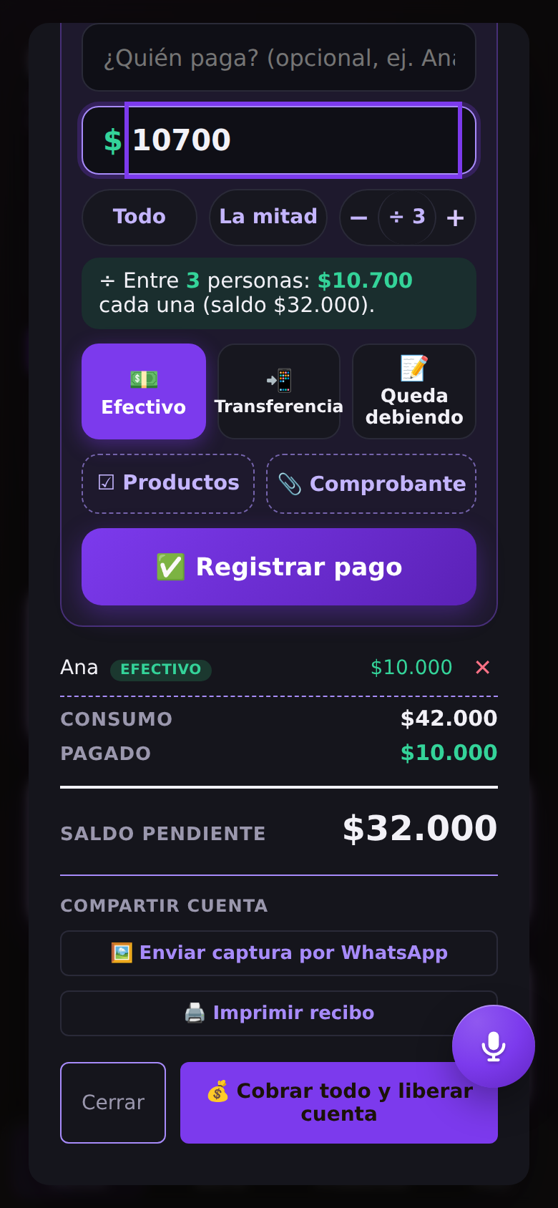
Vento works for you.
Let’s build the voice of Latin America’s small businesses.
WhatsApp +57 313 895 0277
cristhianlujan45-blip.github.io/cuentas

