Slide 1

Group 8
DATA7001 Introduction to Data Science
Group Project
Notes:
Planned duration for this slide: 0:15.

Slide 2
Group 8
Siamak Adeli Koodehi
Cristhyan Cardona Garcia
Matthew Colwell
Christopher Symons
Hai Hung Vu
Notes:
Planned duration for this slide: 0:15.

Slide 3
The Problem (Solving with Data)
1
2
3
Notes:
Planned duration for this slide: 0:45.

Slide 4
[ initial live demo of web tool here ]
1
2
3
Notes:
Planned duration for this item: 0:30.

Slide 5
Getting the Data (I need)
2016 Census data consists of more than 15,000 features for 89 State Electoral Divisions. Initial EDA and feature selection was carried out based on its metadata. Transformation of demographic data by merging into three major age groups (under 20, 21-65, over 65)
16 inconsistencies between 2016 and 2017 SED names due to an electoral boundary redistribution prior to the election. The names were reconciled by estimating Census data for new 2017 electorates.
Some were just direct name changes
Some were formed by combing or transferring parts of old electorate. Averaging method was used to estimate Census data
Notes:
Planned duration for this slide: 1:00.

Slide 6
Is my data fit for use?
1
2
3
Notes:
Planned duration for this slide: 0:30.

Slide 7
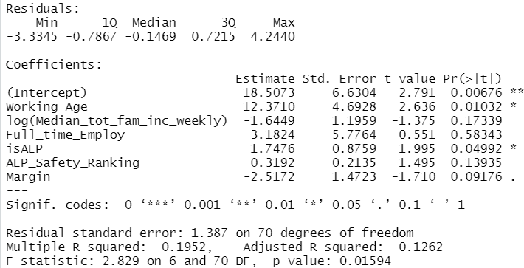
Multiple Linear Regression Model
Log-transformed the response variable (TotalEstimateCost)
A multiple linear regression model was fitted with 6 explanatory variables, of which Working_Age and isALP appear to be statistically significant
Results are below
Notes:
Planned duration for this slide: 1:00.

Slide 8
Assumption Validation and Interpretation
Model assumptions on residual were validated and proved to be reasonably held based on various plots
The model shows strong relationship between how much was spent and proportion of the working age group (21-65 years old)
Greater amount of money would be spent if ALP was elected in an electorate as compared to one where ALP was not elected
Notes:
Planned duration for this slide: 1:00.

Slide 9
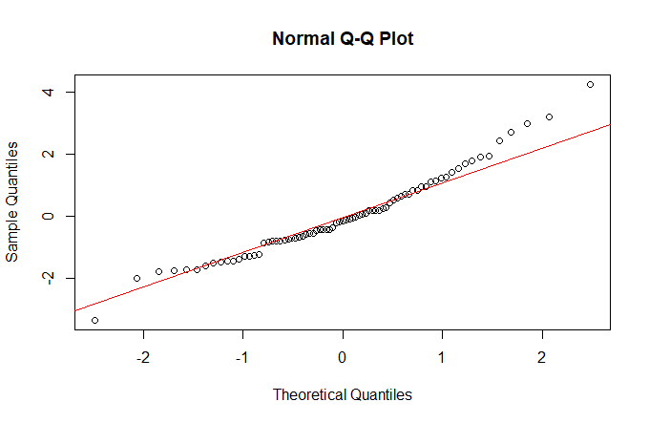
Residual Normality – QQ Plot
Notes:
Planned duration for this slide: 1:00.

Slide 10
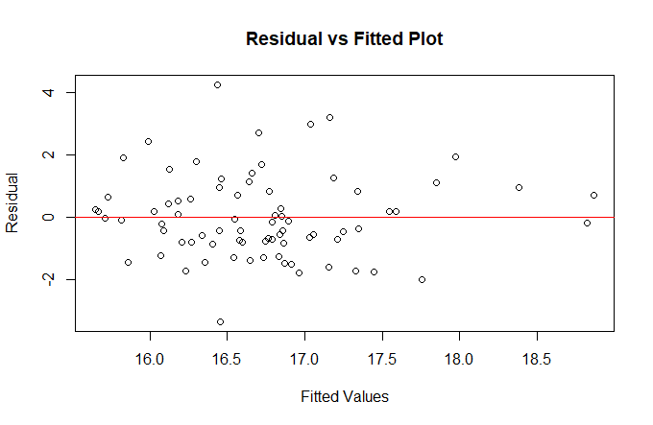
Residual vs Fitted Plot
Notes:
Planned duration for this slide: 1:00.

Slide 11
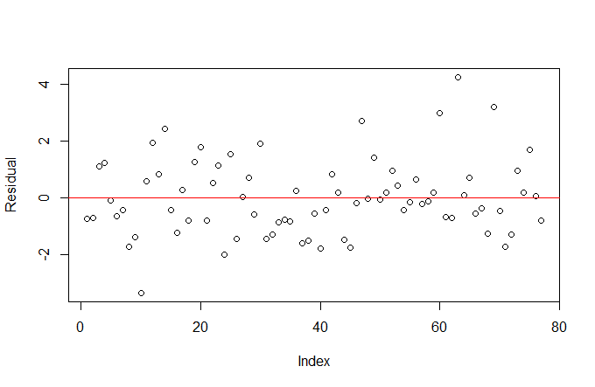
Residual Randomness
Notes:
Planned duration for this slide: 1:00.

Slide 12
Fitted vs Actual Plot
Notes:
Planned duration for this slide: 1:00.

Slide 13
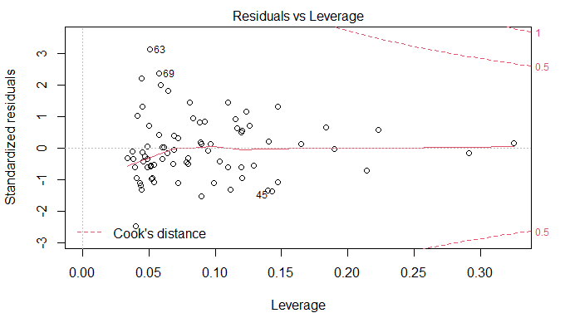
Influential Values
No influential value
Notes:
Planned duration for this slide: 1:00.

Slide 14
[ live demo / storytelling with data ]
1
2
3
Notes:
Planned duration for this item: 2:00.

Slide 15
Conclusion
1
2
To improve understanding of how the budget was decided, more details and data would be required, such as business and economic data, Queensland-related federal budget, immigration data
Notes:
Planned duration for this slide: 0:30.

Slide 16
Thank you / any questions
1
2
3
Notes:
Planned duration for this slide: 0:15.

Slide 17
?References
Maybe we should have this… maybe not.
Would be along lines of what’s requested in project specification document: “An appendix listing the names and sources of the data sets as well as code libraries, or tools you used in your project”
Could be too much to fit on a slide.
Notes:
Planned duration for this slide: 0:00.

