Slide 1
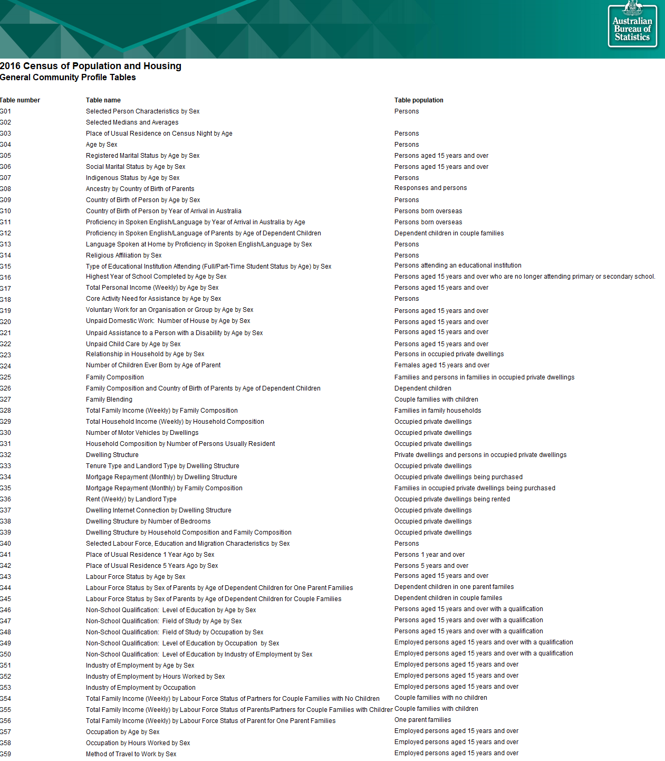
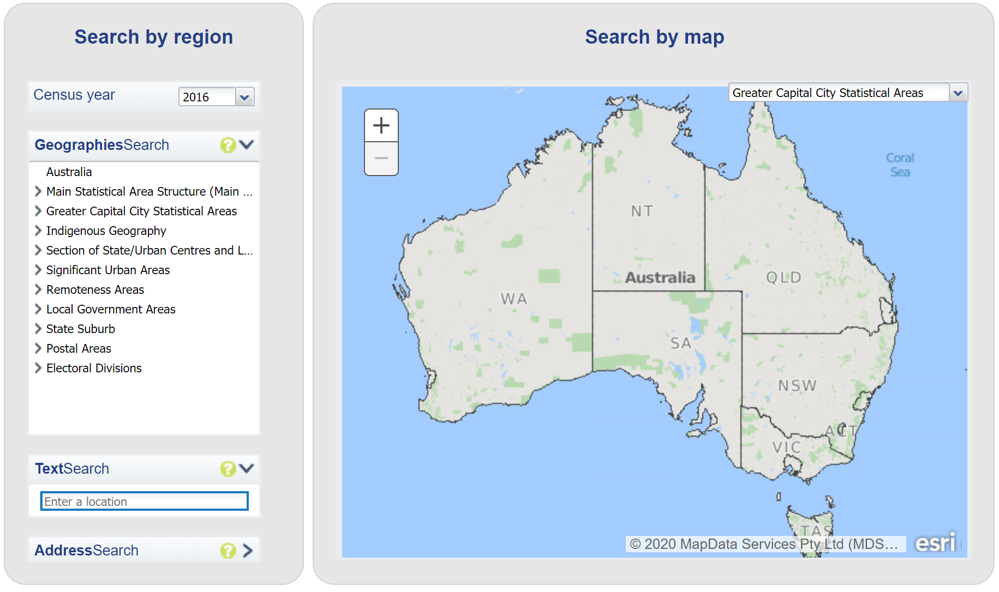
Getting the Data (I need)
1
2
3
https://www.abs.gov.au/websitedbs/D3310114.nsf/Home/2016%20search%20by%20geography
https://www.abs.gov.au/AUSSTATS/abs@.nsf/DetailsPage/1270.0.55.001July%202016
https://www.abs.gov.au/AUSSTATS/abs@.nsf/DetailsPage/1410.02014-19?OpenDocument
Notes:
Planned duration for this slide: 0:45.

Slide 2
Getting the Data (I need)
2016 Census data consists of more than 15,000 features for 89 State Electoral Divisions. Initial EDA and feature selection was carried out based on its metadata. Transformation of demographic data by merging into three major age groups (under 20, 21-65, over 65)
16 inconsistencies between 2016 and 2017 SED names due to an electoral boundary redistribution prior to the election. The names were reconciled by estimating Census data for new 2017 electorates.
Some were just direct name changes
Some were formed by combing or transferring parts of old electorate. Averaging method was used to estimate Census data
Notes:
Planned duration for this slide: 0:45.

Slide 3
Getting the Data (I need)
Avoid redundancy
Data in the cloud
Develop a webtool
Completeness
Consistency
Notes:
Planned duration for this slide: 0:45.

Slide 4
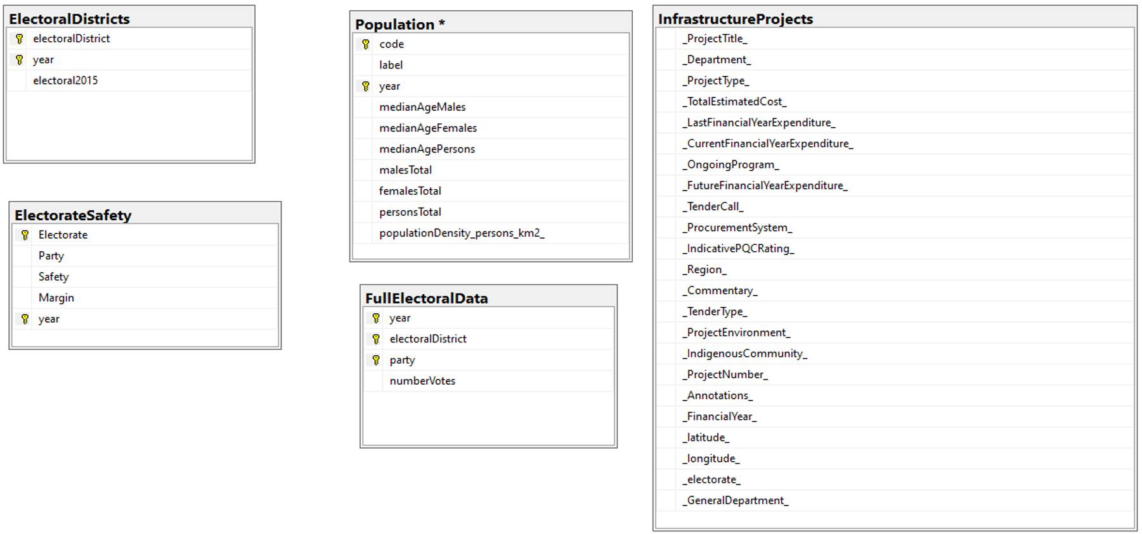
Getting the Data (I need)
Notes:
Planned duration for this slide: 0:45.

Slide 5
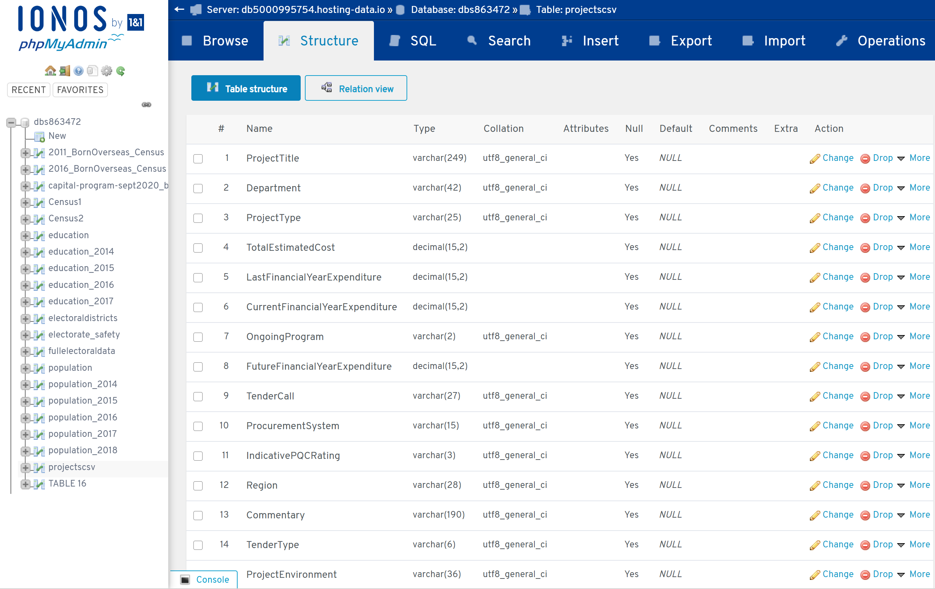
Getting the Data (I need)
Notes:
Planned duration for this slide: 0:45.

