Slide 1
Network Science Co-authorship Analysis
dimacs10-netscience vs Erdos-Renyi and Barabasi-Albert
Pop Cristian, Pop Răzvan, Selegean Victor, Tripon David

Slide 2
Network Description
dimacs10-netscience (co-authorship network)
Nodes (authors): 1461
Edges (co-authorship links): 2742
Graph type: undirected, unweighted, no self-loop
Random Network: Erdos-Renyi model
Nodes: 1461
Edges: 2728
Scale-free Network: Barabasi-Albert model
Nodes: 1461
Edges: 2918

Slide 3
Network Properties
 | Real network | Random network | Scale-free network
Min/Max/Average Degree | 1 / 34 / 3.75 | 0 / 12 / 3.73 | 2 / 103 / 3.99
Diameter | 17 | 12 | 8
Connected Components | 268 | 46 | 1
Largest Component Size | 379 | 1415 | 1461
Average shortest path | 6.04 | 5.59 | 4.24
Average clustering coefficient | 0.69 | 0.004 | 0.02

Slide 4
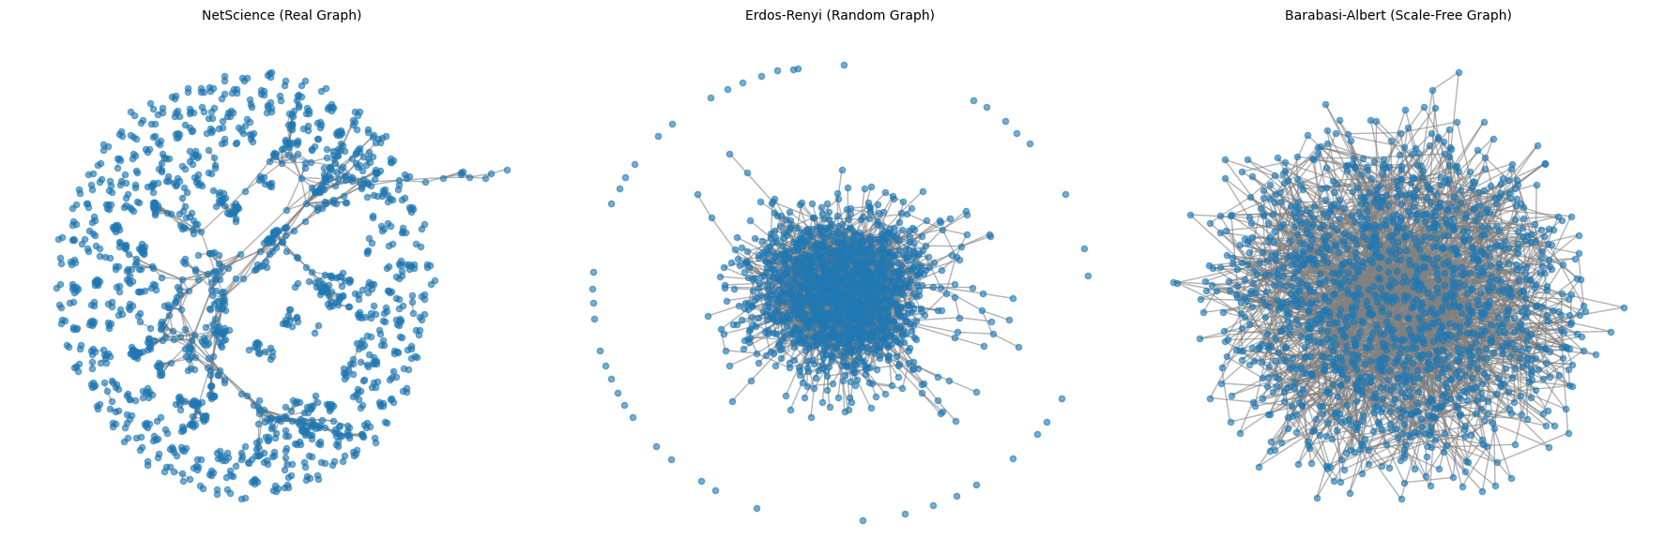
Network Visualization I

Slide 5
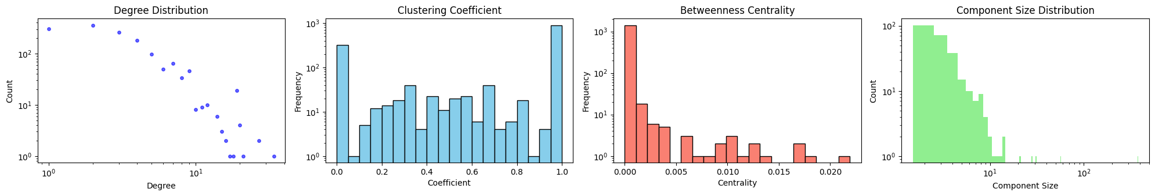
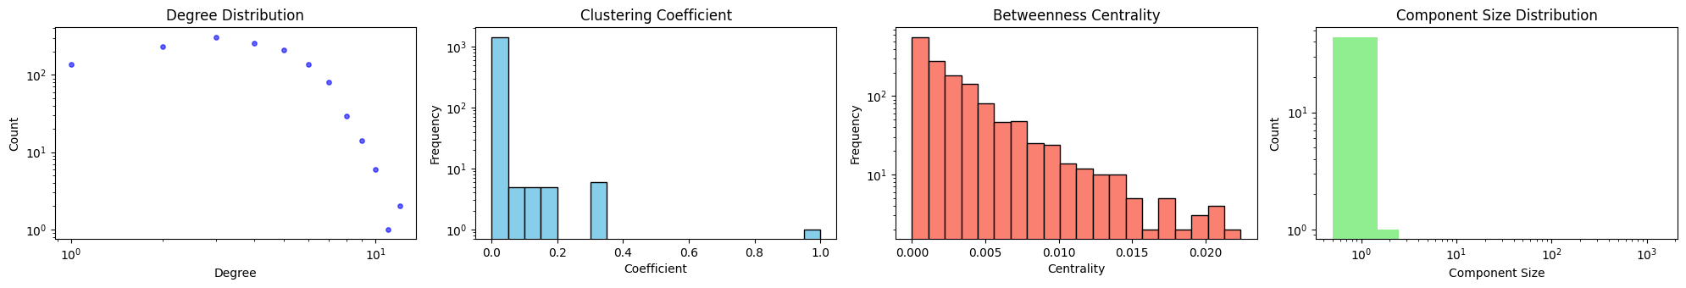
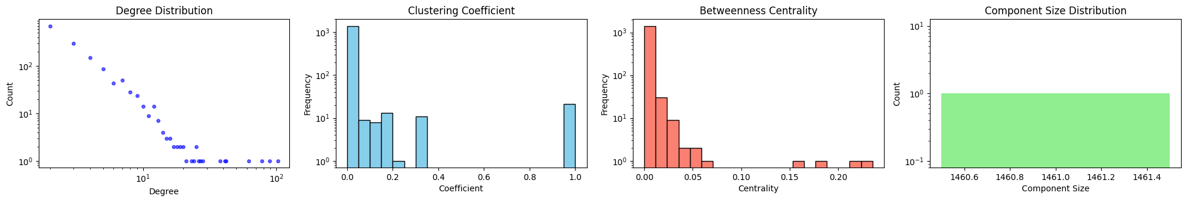
Network Visualization II
Real
Random
Scale-free

Slide 6
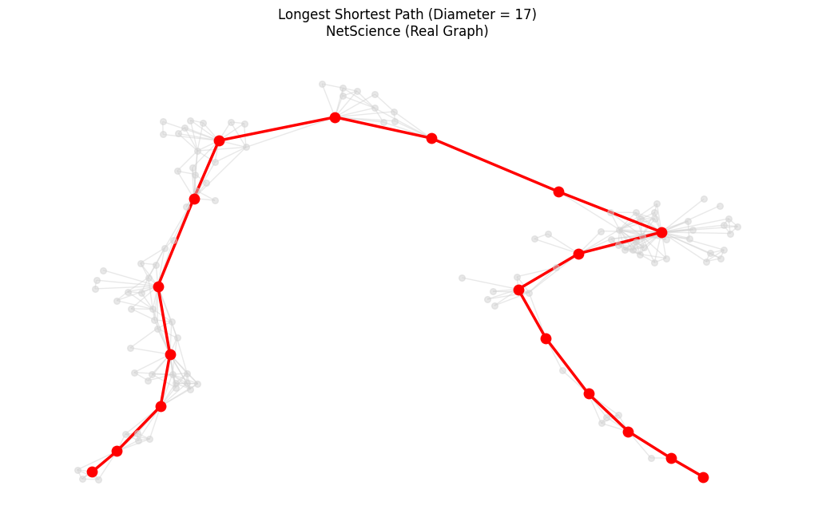
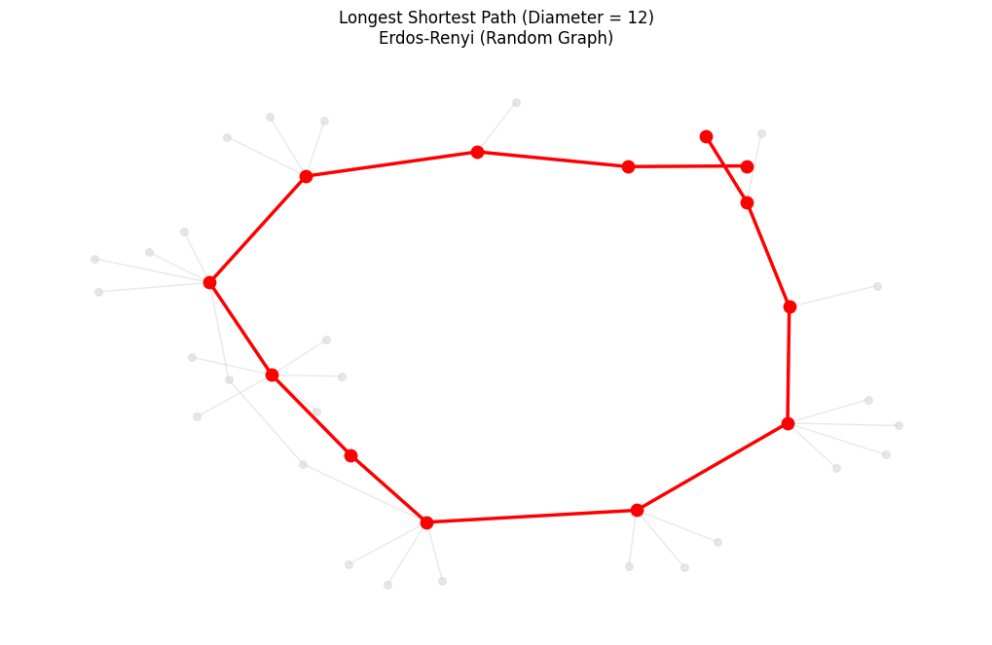
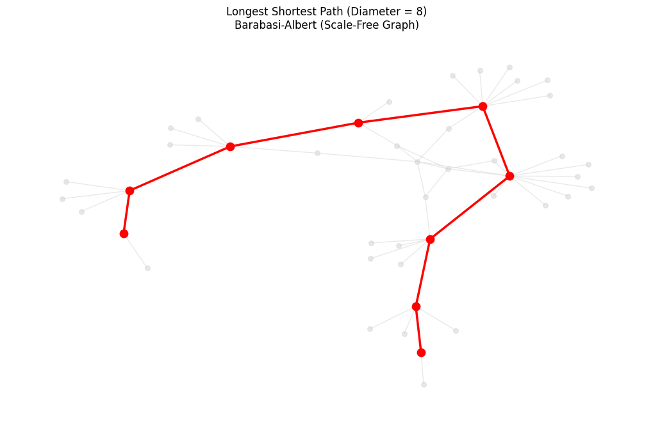
Network Visualization III

Slide 7
Important Nodes
Largest 5 Degrees:
Largest 5 Betweenness Centralities:
Real Network | Random Network | Scale Free Network
34 | 12 | 103
27 | 12 | 89
27 | 11 | 78
21 | 10 | 62
20 | 10 | 42
Real Network | Random Network | Scale Free Network
0.021924 | 0.022408 | 0.235513
0.017579 | 0.022274 | 0.214777
0.017510 | 0.021199 | 0.178849
0.017130 | 0.020611 | 0.160739
0.013582 | 0.020269 | 0.060915

Slide 8
What type of network is the selected real network?
It is a Co-authorship/Collaboration Network.
Reflects human collaboration and distinct research communities.
Small-World properties: a high clustering coefficient, as co-authors of a researcher are very likely to co-author with each other.
Scale-Free characteristics: a heavy-tailed degree distribution where a few highly published researchers act as massive hubs.
These observations are made relative to the metrics of the Erdős-Rényi and Barabási-Albert models.

Slide 9
Thank you!

