Slide 1

Real Estate Evaluation
Cristian Guerrero

Slide 2
Overview
Introduction
REIT Analysis
Mortgage Day Late Analysis
Code Breakdown

Slide 3
Introduction

Slide 4
Introduction
The Real Estate Market is a fluctuation of market elements
The main drivers of market influence are the perception and human intelligence directed towards value of financial instruments that are a byproduct of physical assets
The actors include both buyer and seller

Slide 5
Since 2010, the average sales price of a home has risen from 275,300
Since 2013, that price would reach $383,000
Just recently, the average listing price would reach $553,000 in Q2 2022
Why have home prices risen so drastically over the past decade?

Slide 6
ReITS
The buyers in real estate come from basic retail and many investor types
The main types of investors involved in the real estate market include:
    Retail Investors
    Institutional Investors
    Corporations

Slide 7
Analysis
The main type of investors we will examine are institutional investors
  More specifically Mutual Fund Corporations
Looking at the past decade, the growth of REITs in the S&P 500 have grown
  The composition of REITs in the SP have stagnated at 2% from 2010-2013
  In 2014 we see the composition grow from 2% to 3%

Slide 8
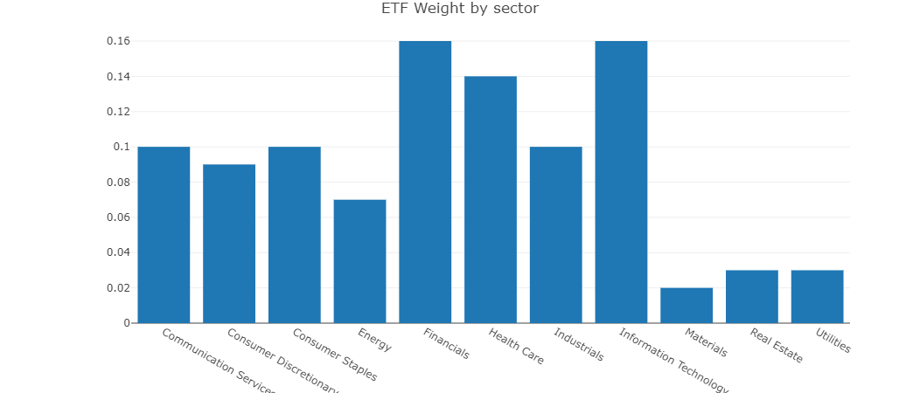

Slide 9
The key indicator here is the sudden popularity of REIT mutual holdings in 2014
One of the possible root causes of such is popularity of banking exposure in real estate
From “The Real Deal: Real Estate News” [2], in the past decade regional banks invested in real estate opportunities favorably
  “Alternative investors include debt funds, mortgage REITs, and bond investors are among the alternative funding sources, but they’re also funded by banks”

Slide 10
Mortgage 30-90 days late payments
Mortgage late payments can imply:
  Credit risk
  Loan default risk
  Interest and late fees
  Foreclosure risk

Slide 11
analysis
Across all states, the average percentage of mortgage late payments 30-90 days in a year show a downward trend in the recent decade

Slide 12
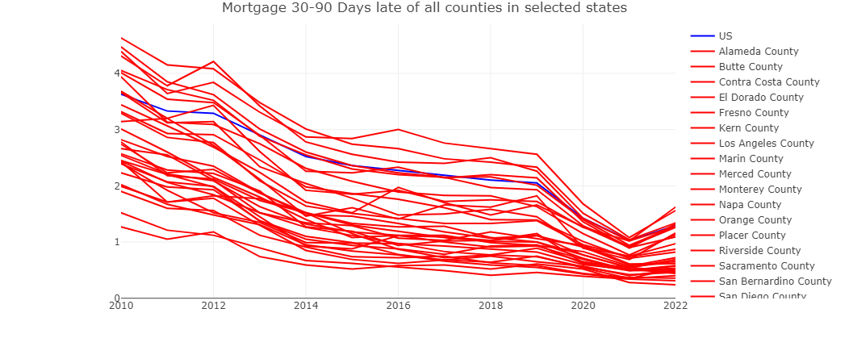

Slide 13
In turn, a buyer’s market would allow large corporations and banks to find opportunity in real estate
More lending would also ensue as growth enables more borrowers to seek opportunity
Referencing U.S. mortgage debt outstanding data [3], we see the value consolidate from the most recent housing crisis at about 13.3 trillion between 2012 and 2013
Currently our mortgage debt stands at about 19.3 trillion

Slide 14
In Summary
By analyzing REIT exposure we see that market favoritism of real estate by large investor types to create investment vehicles to serve as a factor in inducing valuation into real estate
we can also analyze market trend of consumer behavior by gauging mortgage payments day late, we can assess a possible scenario where the trend of U.S. mortgage debt outstanding may impose a risk to inflating home prices

Slide 15
Code Breakdown

Slide 16
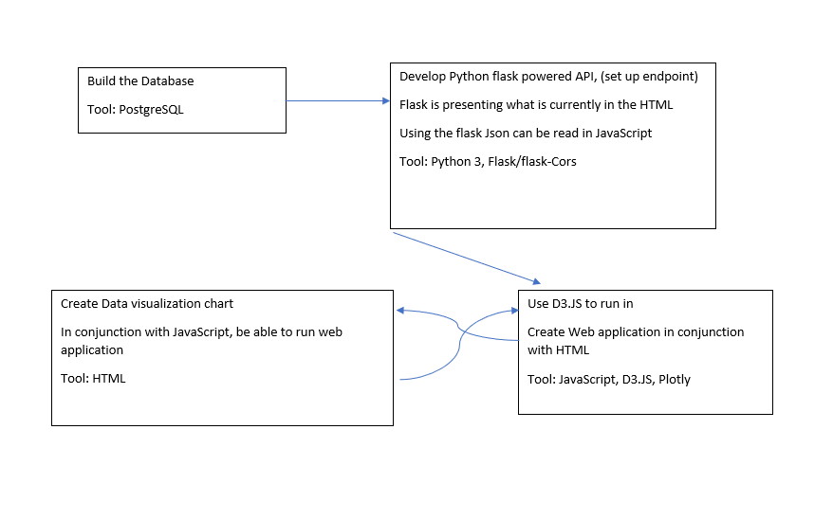

Slide 17
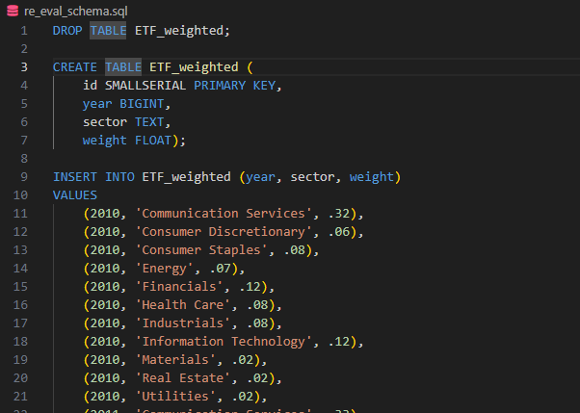

Slide 18
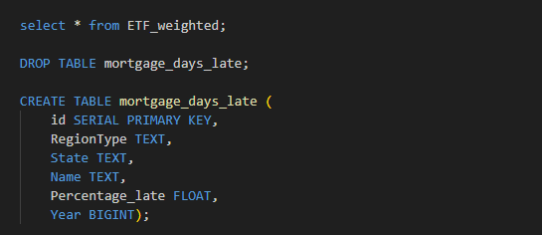

Slide 19
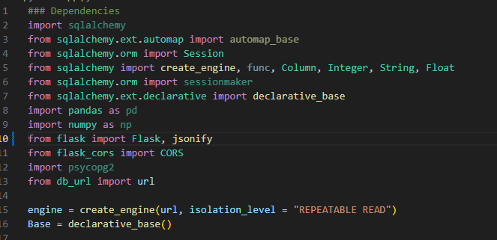

Slide 20
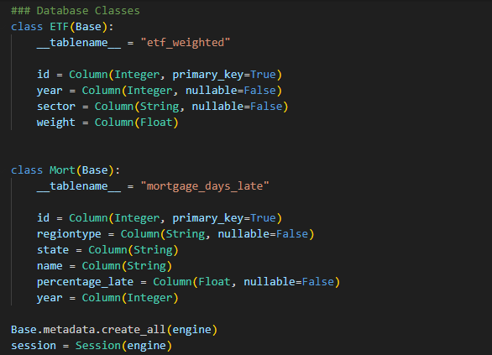

Slide 21
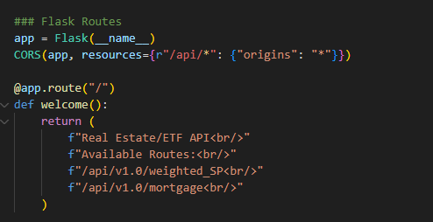

Slide 22
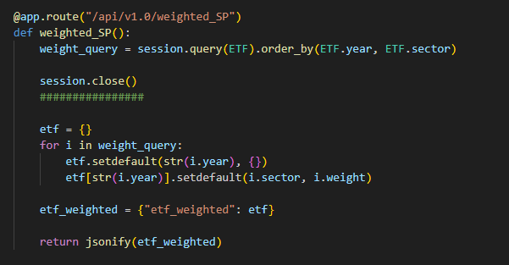

Slide 23


Slide 24
Code Demonstration

Slide 25
Resources
[1] S&P Historical Price Data retrieved from: https://www.macrotrends.net/2488/sp500-10-year-daily-chart
[2] (Holden Walter-Warner, 2023). https://therealdeal.com/national/2023/09/06/bank-exposure-to-commercial-real-estate-estimated-at-3-6-trillion/
[3] U.S. Debt Mortgage Data retrieved from: https://www.statista.com/statistics/274636/combined-sum-of-all-holders-of-mortgage-debt-outstanding-in-the-us/
https://www.investopedia.com/terms/p/pricerateofchange.asp

Slide 26
End

