Slide 1
CQRS II A5
C – Command
Q – Query
R – Responsibility
S – Segregation

Slide 2

What is CQRS about?
Separation of read (query) from write.
Normally we would have one big service like:
class ManageBikesService {
Bike getBike(int id); //query
void addBike(Bike myBike); //command
};

Slide 3
With CQRS, we are going to have two services:
class BikeReadService {
Bike getBike(int id); //query
};
class BikeWriteService {
void addBike(Bike myBike); //command
};

Slide 4
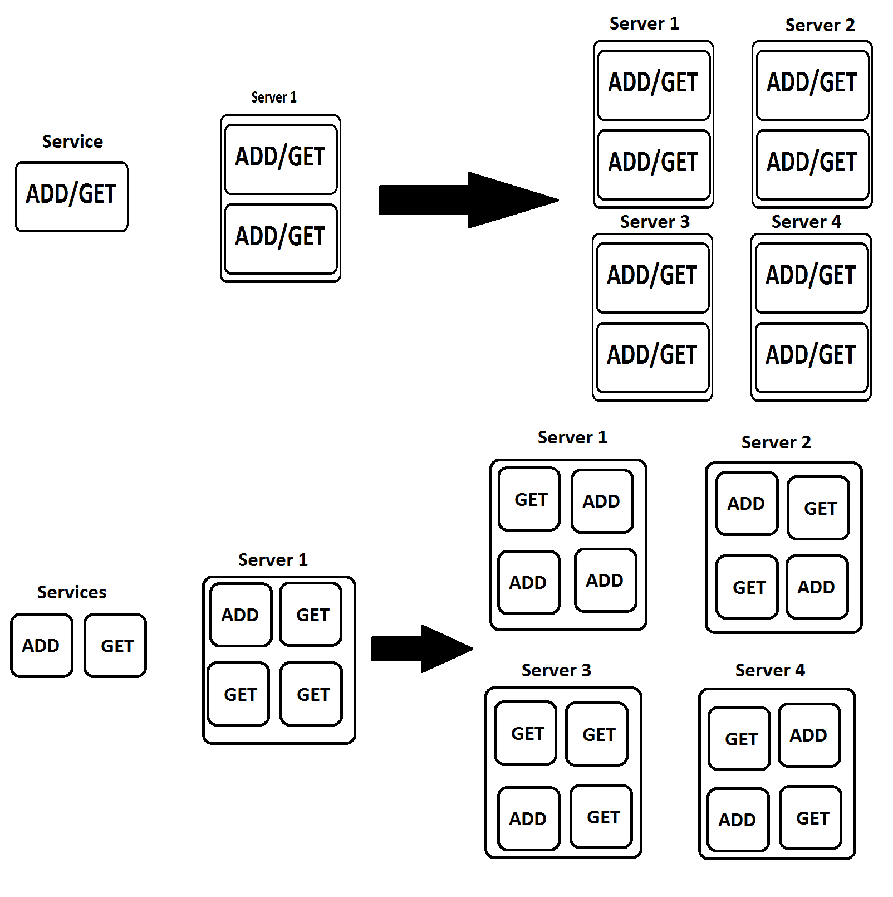
Why?
In this way we can scale the service that we need instead of scaling the entire application.

Slide 5
Services
Now each service has it’s own database, an event handler that consumes the event and a connection to the event store.

Slide 6
Event store
The event store is used to store the events that took place in order to rollback in case we need to.

Slide 7
Event processing
The event processing is transactional.
If there is a log stating that bike X was added to the database then the bike X must be in the database.

Slide 8
Rollback
Rollback operation should not only bring the database to it’s previous state but it should remove the logs too without adding a new “rollback log”.

Slide 9
Queries
Queries should have no side effects, they are only supposed to read & return data.

Slide 10
Why CQRS?
Consistency through independent systems.
Reliability in case one service is down.
Independent scaling.
}

Slide 11
What is Event Sourcing?
Wikipedia says:
An architectural pattern which warrants that your entities (as per Eric Evan’s definition) do not track their internal state by means of direct serialization or O/R mapping, but by means of reading and committing events to an event store. Where ES is combined with CQRS and DDD, aggregate roots are responsible for thoroughly validating and appl…
… … …

Slide 12
Let’s try again…
An architectural pattern
Event Sourcing ensures that all changes to application state are stored as a sequence of events.
Not just can we query these events, we can also use the event log to reconstruct past states, and as a foundation to automatically adjust the state to cope with retroactive changes.

Slide 13
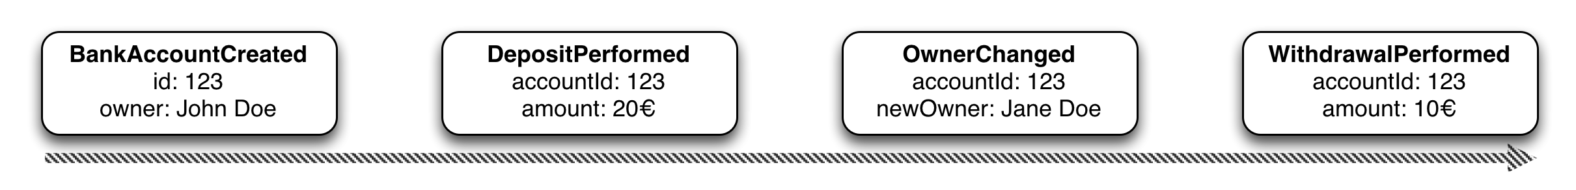
Saving objects
The order of the events is also preserved.

Slide 14
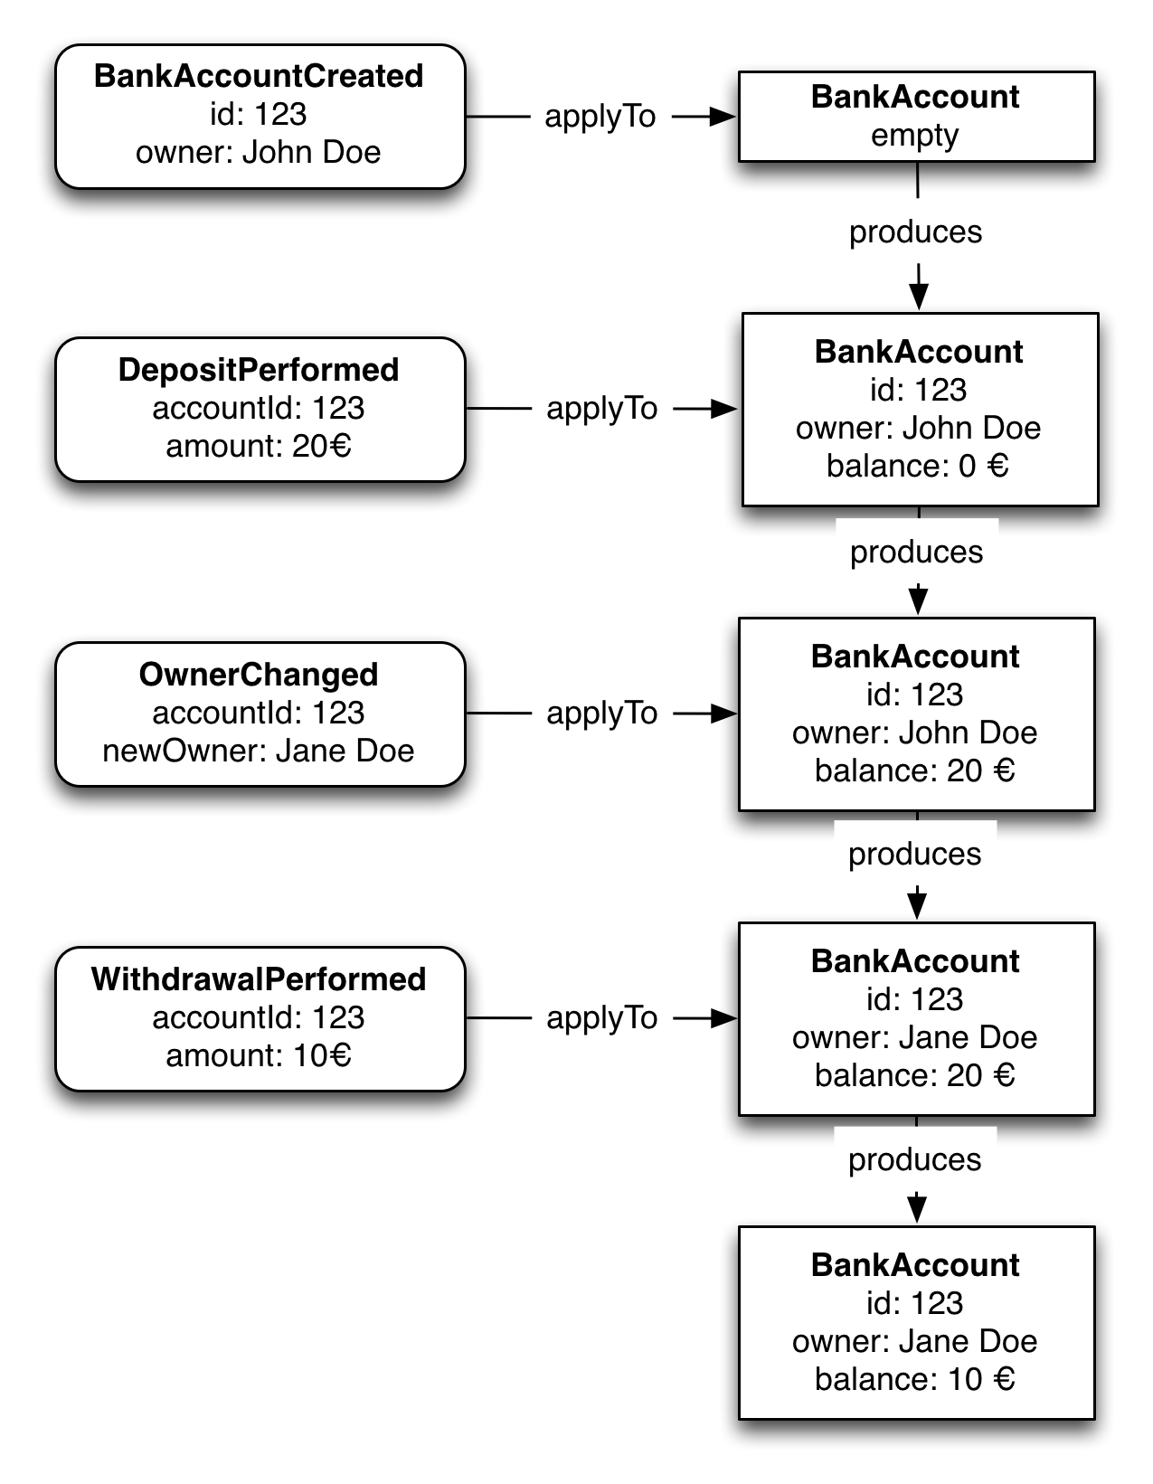
Here is a visual example of how the events are processed

Slide 15
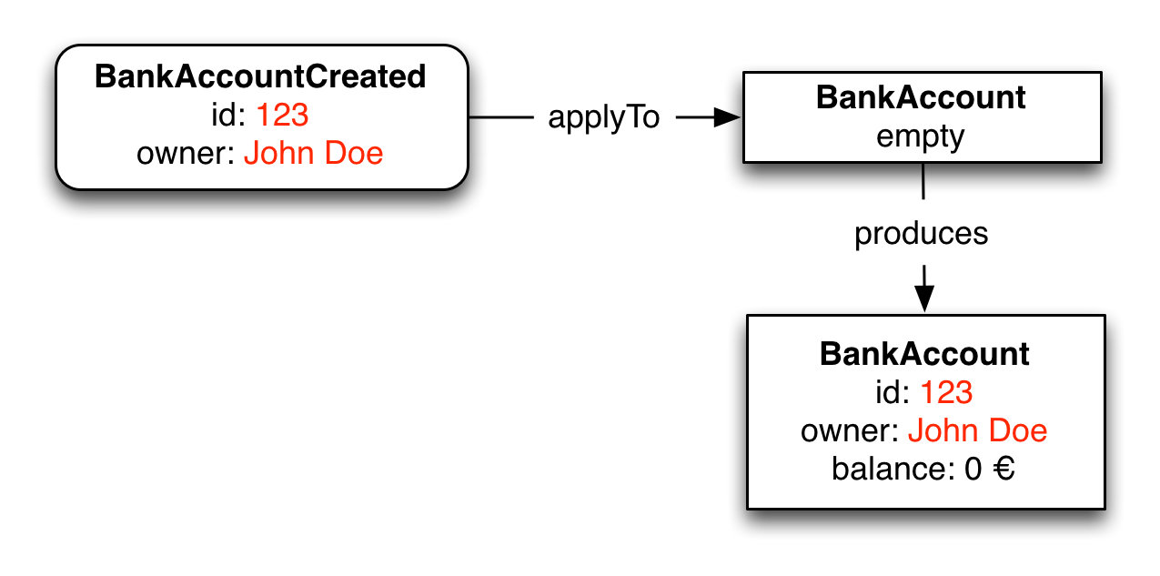
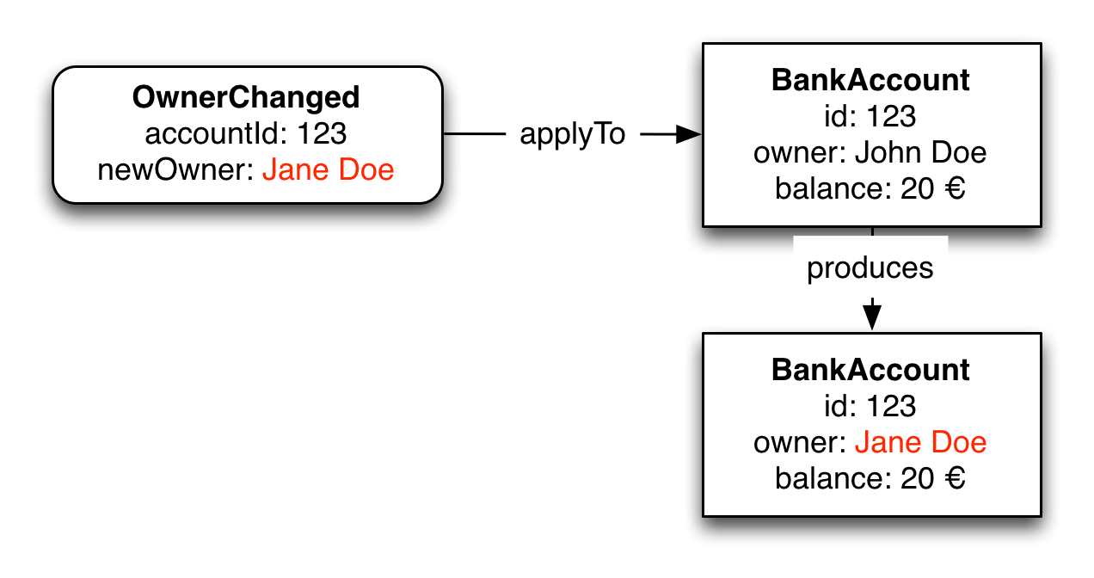
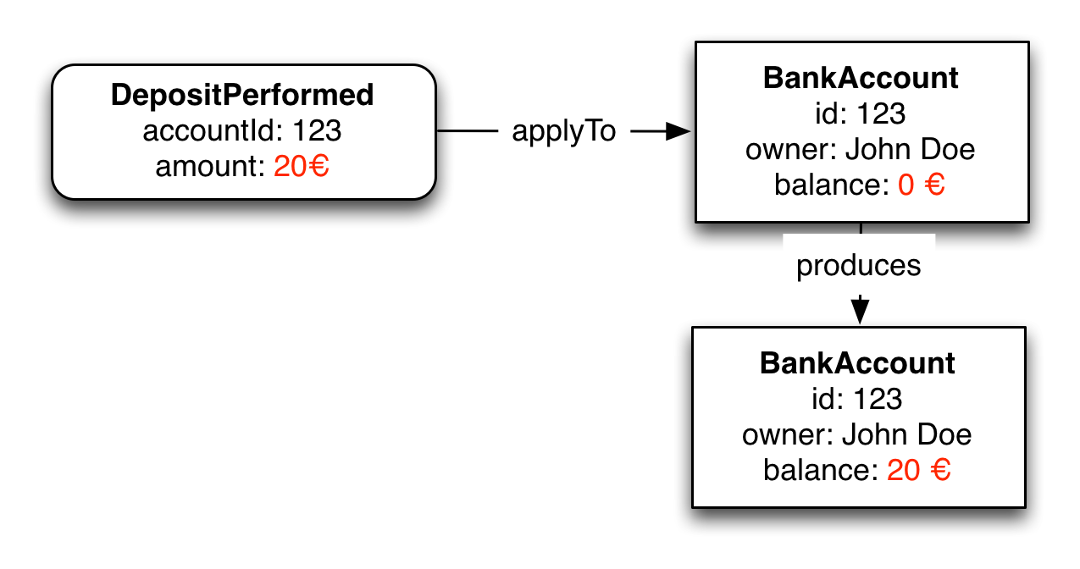
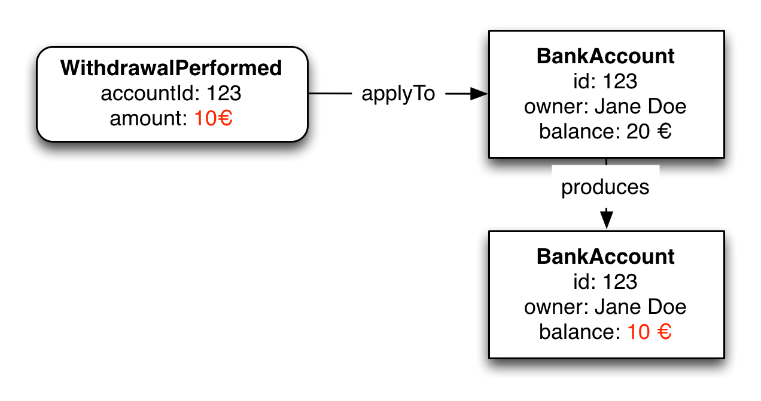

Slide 16
The most obvious thing we've gained by using Event Sourcing is that we now have a log of all the changes

Slide 17
Complete Rebuild
We can discard the application state completely and rebuild it by re-running the events from the event log on an empty application.

Slide 18
Temporal Query
We can determine the application state at any point in time. Notionally we do this by starting with a blank state and rerunning the events up to a particular time or event. We can take this further by considering multiple time-lines (analogous to branching in a version control system).

Slide 19
Event Replay
If we find a past event was incorrect, we can compute the consequences by reversing it and later events and then replaying the new event and later events. (Or indeed by throwing away the application state and replaying all events with the correct event in sequence.) The same technique can handle events received in the wrong sequence - a common problem with systems that communicate with asynchronous messaging.

Slide 20
The advantages of Event Sourcing
Complete log of every state change ever
Unmatched traceability and debugability
Very good performance characteristics
No more mapping objects to tables

Slide 21
What is the CAP Theorem?
In theoretical computer science, the CAP theorem states that it is impossible for a distributed data store to simultaneously provide more than two out of the following three guarantees:
- Consistency
- Availability
- Partition Tolerance

Slide 22
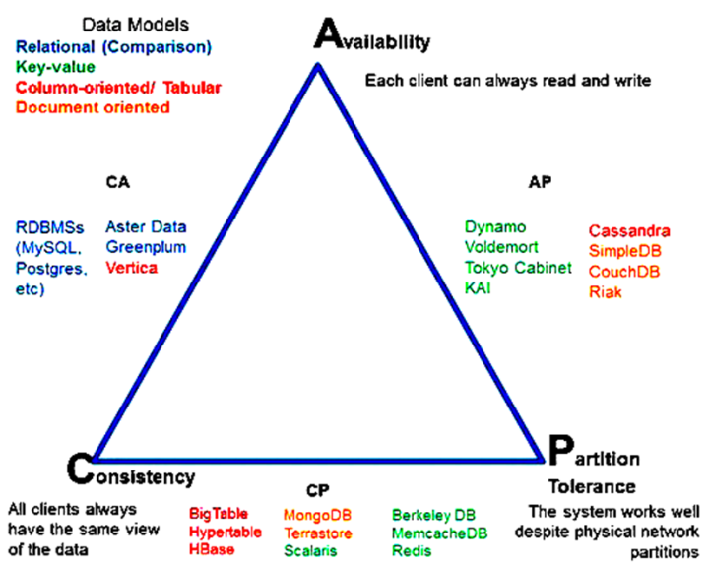

Slide 23
Consistency:
Every read receives the most recent write or an error
Availability:
Every request receives a (non-error) response – without guarantee that it contains the most recent write
Partition tolerance:
The system continues to operate despite an arbitrary number of messages being dropped (or delayed) by the network between nodes

Slide 24
In other words, the CAP theorem states that in the presence of a network partition, one has to choose between consistency and availability.
No distributed system is safe from network failures, thus network partitioning generally has to be tolerated. In the presence of a partition, one is then left with two options: consistency or availability.

Slide 25
When choosing consistency over availability, the system will return an error or a time-out if particular information cannot be guaranteed to be up to date due to network partitioning.
When choosing availability over consistency, the system will always process the query and try to return the most recent available version of the information, even if it cannot guarantee it is up to date due to network partitioning.

Slide 26
http://ksat.me/a-plain-english-introduction-to-cap-theorem/
Here’s a funny explanation of how CAP works, if you would like to know more and read about the theorem as you would about a story.

