Slide 1
CAP Theorem

Slide 2
What is the CAP Theorem?
In theoretical computer science, the CAP theorem states that it is impossible for a distributed data store to simultaneously provide more than two out of the following three guarantees:
- Consistency
- Availability
- Partition Tolerance

Slide 3
Consistency:
Every read receives the most recent write or an error
Availability:
Every request receives a (non-error) response – without guarantee that it contains the most recent write
Partition tolerance:
The system continues to operate despite an arbitrary number of messages being dropped (or delayed) by the network between nodes

Slide 4
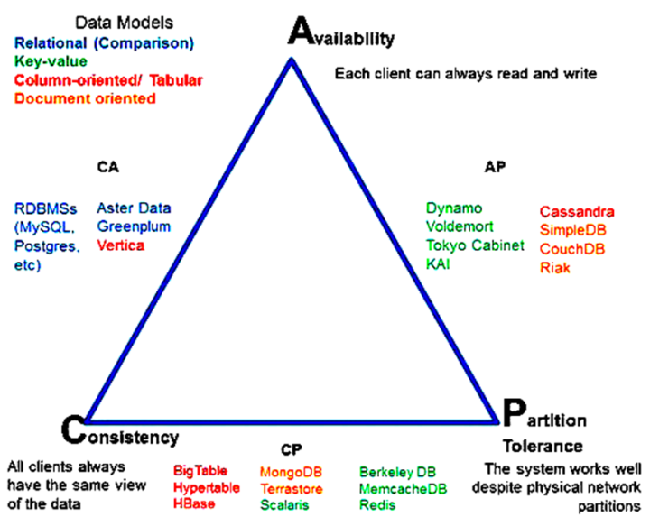

Slide 5
In other words, the CAP theorem states that in the presence of a network partition, one has to choose between consistency and availability.
No distributed system is safe from network failures, thus network partitioning generally has to be tolerated. In the presence of a partition, one is then left with two options: consistency or availability. When choosing consistency over availability, the system will return an error or a time-out if particular information cannot be guaranteed to be up to date due to network partitioning. When choosing availability over consistency, the system will always process the query and try to return the most recent available version of the information, even if it cannot guarantee it is up to date due to network partitioning.

