Slide 1
CQRS
C – Command
Q – Query
R – Responsibility
S – Segregation

Slide 2
What is it about?
Separation of read(query) from write.
Instead of having one big service like:
class ManageBikesService {
Bike getBike(int id); //querry
void addBike(Bike myBike); //command
};

Slide 3
We are going to have two services:
class BikeReadService {
Bike getBike(int id); //querry
};
class BikeWriteService {
void addBike(Bike myBike); //command
};

Slide 4
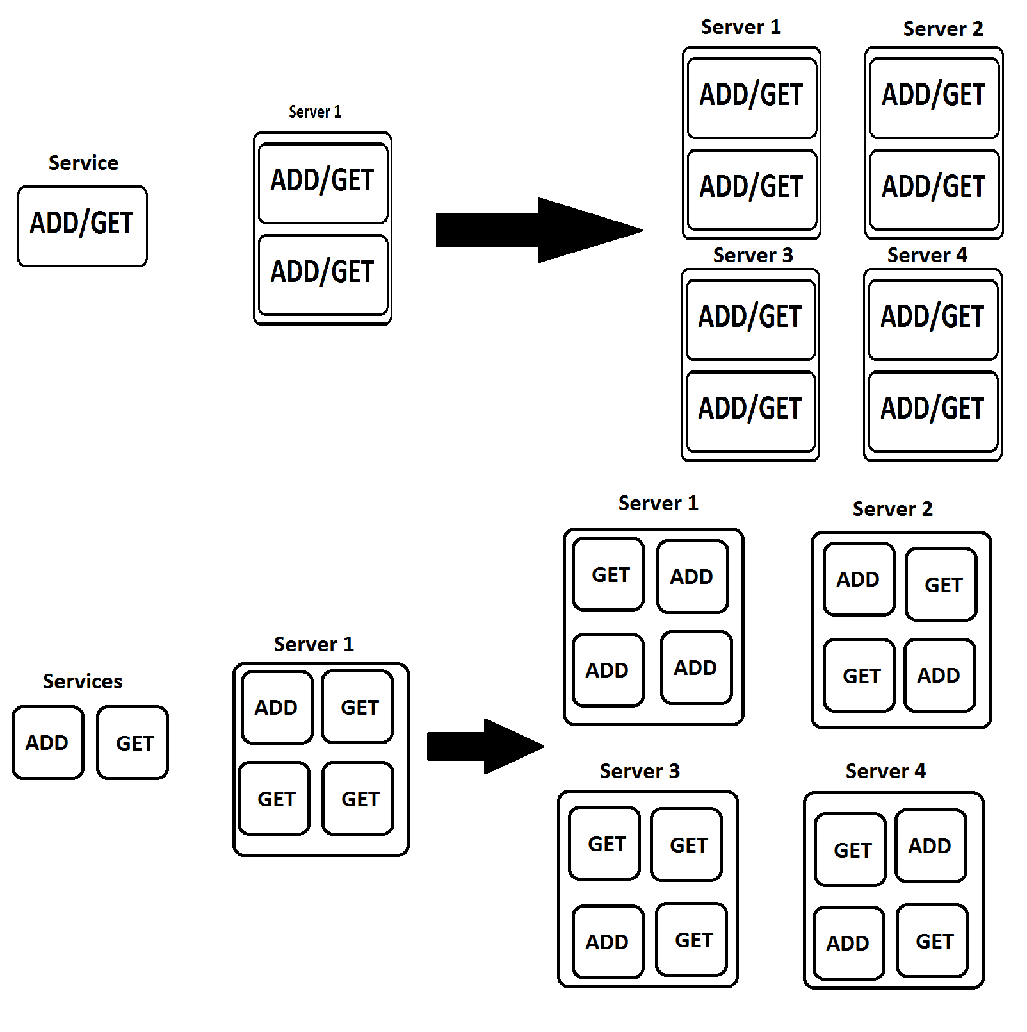
Why?
In this way we can scale the service that we need instead of scaling the entire application.

Slide 5
Services
Now each service has it’s own database, an event handler that consumes the event and a connection to the event store.

Slide 6
Event store
The event store is used to store the events that took place in order to rollback in case we need to.

Slide 7
Event processing
The event processing is transactional.
If there is a log stating that bike X was added to the database then the bike X must be in the database.

Slide 8
Rollback
Rollback operation should not only bring the database to it’s previous state but it should remove the logs too without adding a new “rollback log”.

Slide 9
Queries
Queries should have no side effects, they are only supposed to read & return data.

Slide 10
Why CQRS?
Consistency through independent systems.
Reliability in case one service is down.
Independent scaling.
}

